Slide 1
Federation and Roaming
Nishant Gupta
Delegate, Qualcomm

Slide 2
Outline
Issue
Solution Options
Deployment options
Summary

Slide 3
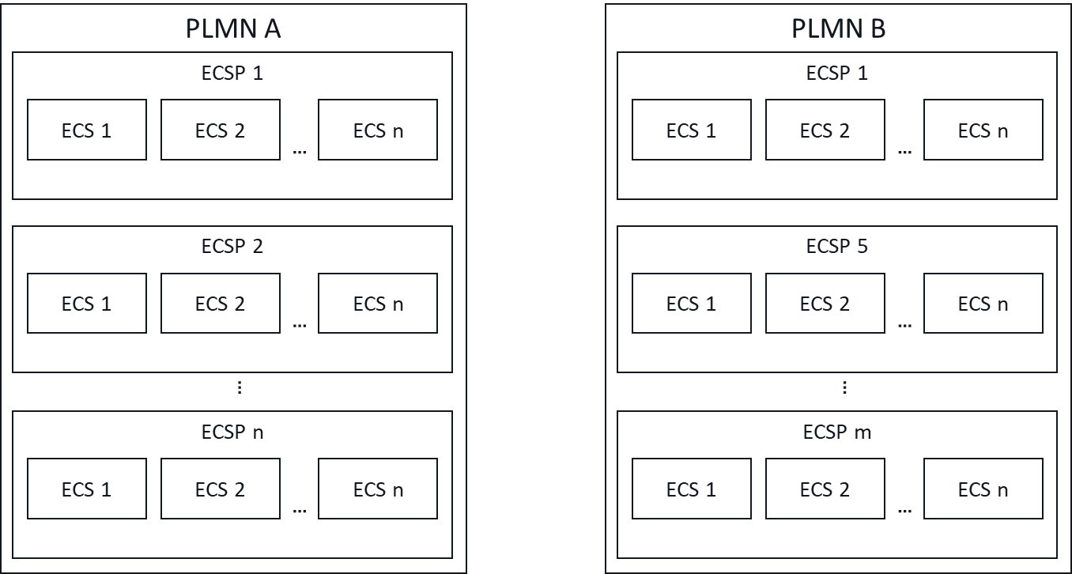

Issue
Finding the right partner ECS(P) in case of federation and roaming:
A federation comprises of two or more ECSPs
ECSPs can be associated with one or more PLMNs
PLMNs can have roaming agreement for edge computing service.
Federations can span within or across PLMNs.
When an ECS can not provide service provisioning for a required application, how should it find a partner ECS(P) that can serve the UE?
Note:
Cardinality of the ECS and ECSPs
Dynamic nature of Edge Computing resources
In the above deployment:
  PLMN A has ‘n’ ECSPs associated with it.
  PLMN B has ‘m’ ECSPs associated with it. Some can be common with PLMN A (e.g., ECSP 1)
  Each ECSP has one or more ECSs associated with it.

Slide 4
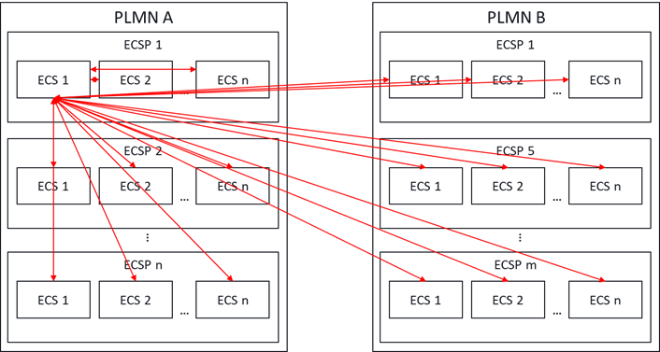
Solution option 1 – use EDGE-10
Preconfigure ECSs with endpoint information of partner ECSs
  Note that EES, EAS info can not be preconfigured as they are dynamic in nature.
Use EDGE-10 to query partner ECSs
Issues with this solution
  It’s not necessary that the required application is available with all partners. So,
    Which partner ECSs should be queried?
    And in which order?
  Wasting time in cycling through the partner ECSs will result in service continuity failure for most applications.
  Also, ECS is limited to only the preconfigured ECSs
Each red line represents an EDGE-10 interface

Slide 5
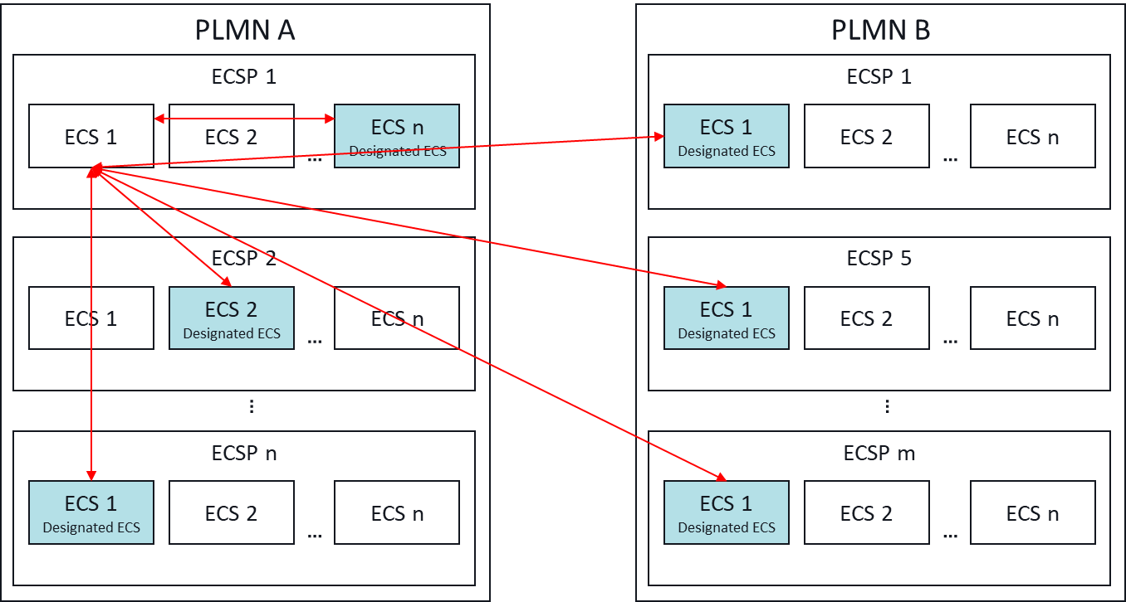
Solution option 2 – Designated ECSs
Designate one ECS of each ECSP as the ‘center of information’ or ‘repository’ of that ECSP.
Enhance EDGE-10 to register and maintain latest information on the ‘designated ECS’.
Primary ECS uses EDGE-10 to query ‘designated ECSs’.
Better than option 1, but still inefficient because:
  ECS will have to cycle through the ‘designated ECSs’. This will result in waste of resources and time (though lesser than option 1), which will still break service continuity in many ACR situations.
  Primary ECS is still limited to preconfigured information about the ‘designated ECSs’.

Slide 6
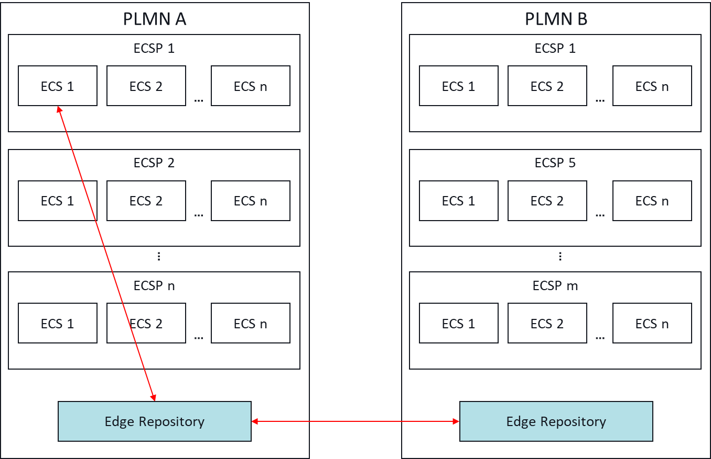
Solution option 3 – Edge Repository
Introduce a new entity - Edge Repository
ECSs register with this edge repository and store their information.
MNOs that are part of the federation have edge repositories connected via a new interface.
Highly efficient compared to option 1 and option 2, because:
  Single request to find all relevant ECSs of all partner ECSPs, both in hPLMN and vPLMN.
  Further latency improvements when information about other PLMNs is cached in the edge repository.
  Not limited to preconfigured information only.
Note:
This is like EAS’s registration with EES for EAS discovery and EES’s registration to ECS for service provisioning.

Slide 7
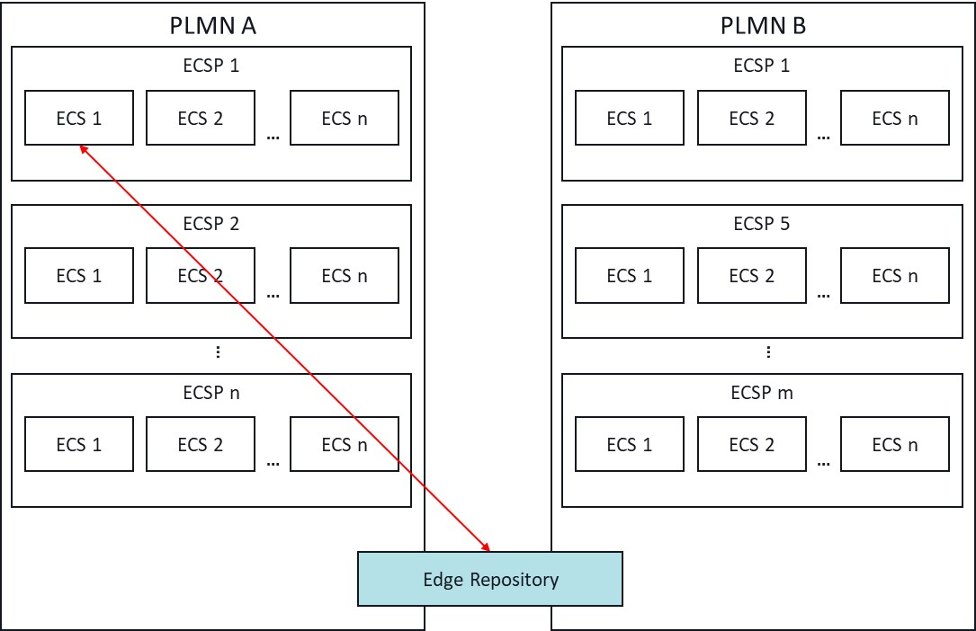
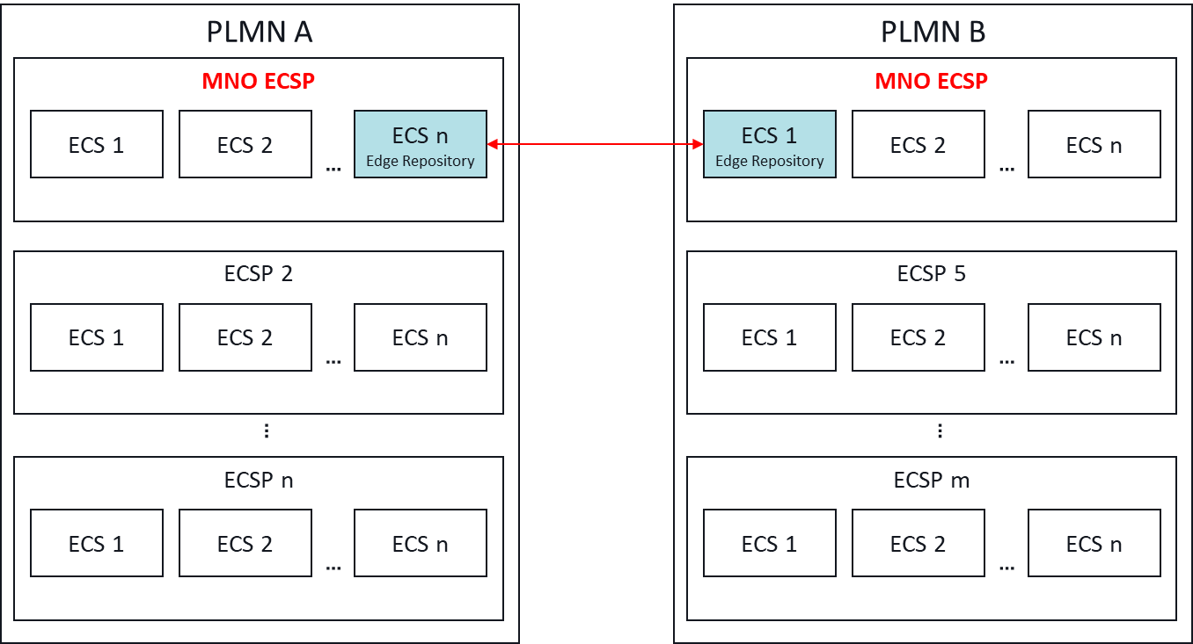
Deployment Options
Each PLMN maintains an Edge Repository for all associated ECSPs.
Edge Repository shares information based on federation information shared by ECSs
Multiple PLMNs share a common Edge Repository.
Sharing could be based on federation of PLMNs.
Variant: sharing could be based on federation of ECSPs
One of the MNO ECS acts as the Edge Repository for that MNO.
ECSs of ECSPs associated with that MNO maintain information on this designated ECS of the MNO.

Slide 8
Summary
Introducing edge repository improves discovering EASs in partner ECSPs.
Enhancements are required to enable registration of ECSs and querying the edge repository.
  EDGE-11 and EDGE-12
Deployment options:
  Dedicated per PLMN;
  Shared by the federation; or
  Deployed as part of MNO ECS

