Slide 1
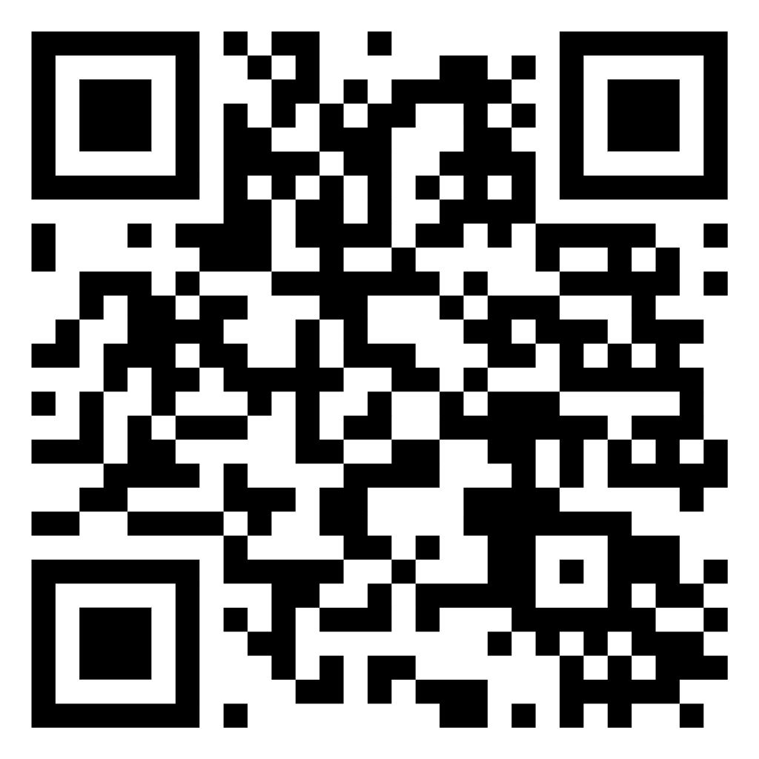
Housekeeping
3GPP SA4 (17-21/02/2025)
Security: badges are to be worn at all times
EBU opening times: 07.30 – 19.00
WiFi: 47054238
Demos & Coffee breaks: 10.30 to 11.00 and 15.30 to 16.00 in Lobby
Lunch: 12.30 to 14.00 If you have purchased lunch vouchers: Cafeteria (3rd floor), please leave trays etc on table after lunch; for non-registered lunch delegates, restaurants around the EBU are in walking distance
Meeting rooms: Montreux, Genève, Léman (Montreux + Genève), Jungfrau (ground floor), Gothard (back-up, ground floor)
Geneva info

Slide 2
RESTAURANTS NEAR EBU
Cuisine Lab, Rue Michelle Nicod 2, 1202 Genève
Tukul Restaurant, Rte de Ferney 140, 1202 Genève
Délice Ange’Vin, L'Ancienne-Route 48, 1218 Le Grand-Saconnex
Restaurant Pizzeria I SAPORI, Rte de Colovrex 22, 1218 Le Grand-Saconnex
Sandwicherie La Place, Rte de Ferney 173, 1218 Le Grand-Saconnex
Le Grand Sac’ à Pain
La Colombier, Rte de Ferney 171, 1218 Le Grand-Saconnex
Chez Nina, Rue Sonnex 17BIS, 1218 Le Grand-Saconnex
Le Pommier, Rue Sonnex 13, 1218 Le Grand-Saconnex
RESTAURANT LE GRIZZLY, Chem. Edouard-Sarasin 26, 1218 Le Grand-Saconnex

