Slide 1

SA4#126 Social
November 16, 2023

Slide 2
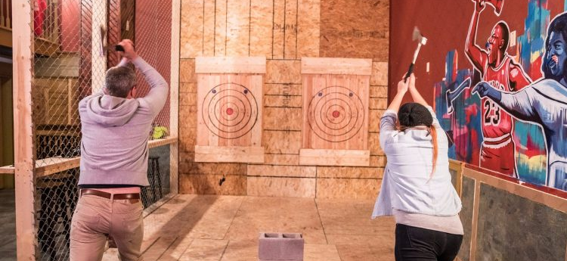
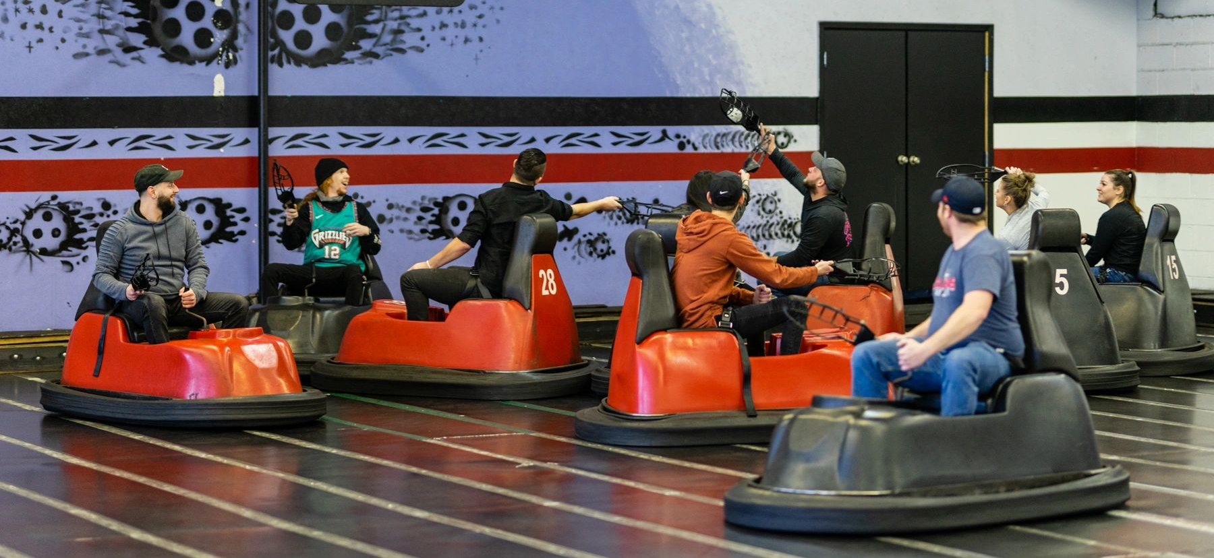
History
to continue the good spirit of social gatherings, here is a proposal for another self-funded social event at SA4#126. Everyone is invited!
This time we had three options
Thanks to Chris and the Chicago Lumberjack Association for making great suggestions – but we go safe

Slide 3
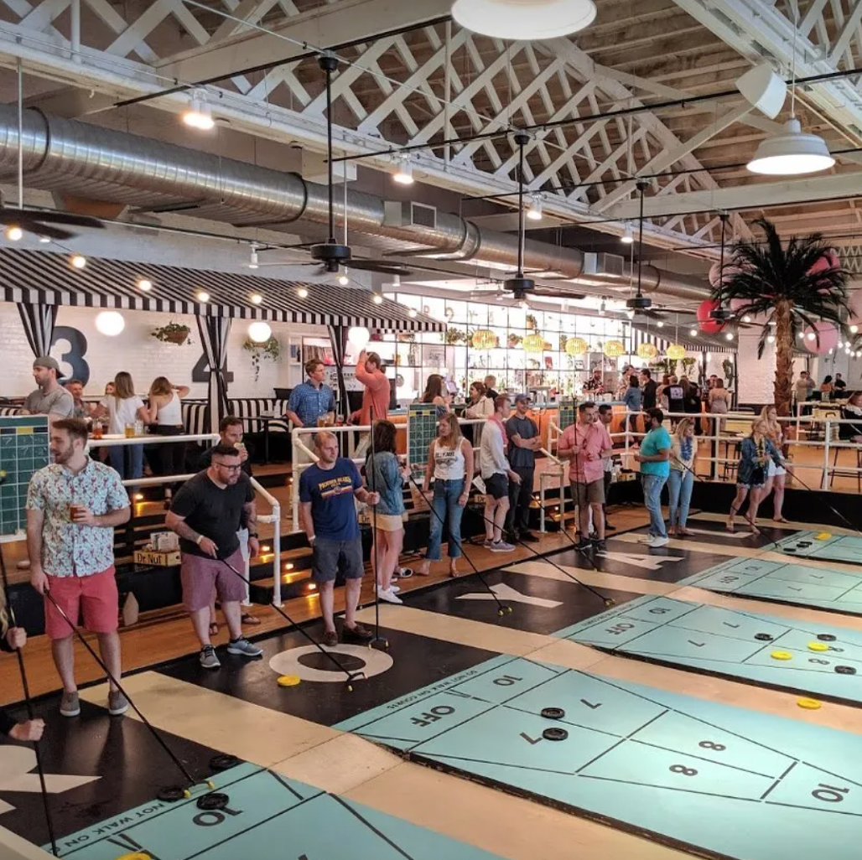
We go on a Shuffleboard
We again checked Chicago for options and found something very uniting: Cabana Party and Shuffle boarding. This place Royal Palms Chicago offers to host us.
You will get 2 hours of free drinks of beer, wine, and sodas as well as there will be playing of shuffle board.
The total cost including playing, drinks, gratuity (20%) and all kind of tax (sales 10%, amusement 10%) sums up to be 75 USD per person.
Food is NOT included, but can be picked up at food trucks.
If you're interested in placing a catering order, check out the food truck calendar and menus here! You're also welcome to order a la carte upon arrival. We recommend placing a pre-order for parties with 20+ guests.
Just a NOTE: Everyone can play Shuffleboard.

Slide 4
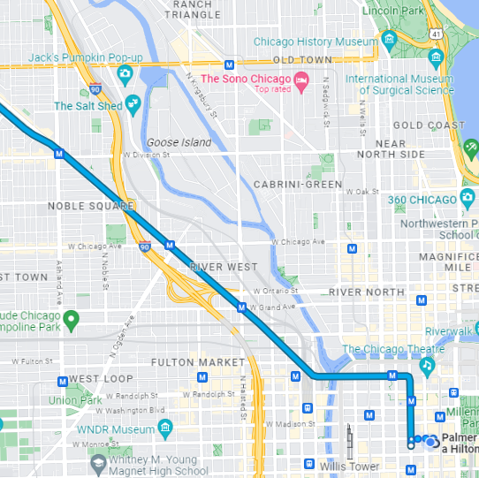
Logistics
Date and Schedule:
November 16, 2023
Party and Shuffling: 20:30 - 22:30
Directions from Meeting hotel (23min on tram)
Suggest to leave from hotel at 19:30
Costs:
Payment to be determined, I likely need to send a deposit. Will update via e-mail – likely paypal

Slide 5
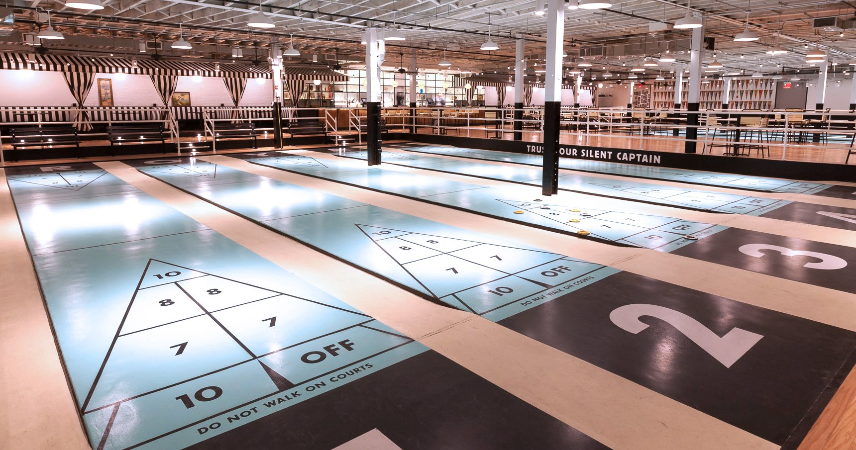
What is Shuffleboard?

Slide 6
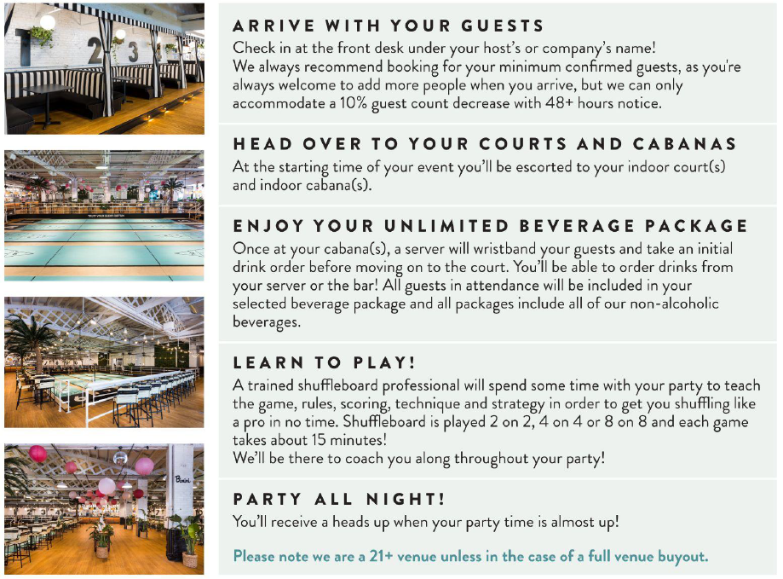
Arrangement

Slide 7

Signups (34-1)
Reservation: 28+
Mary-Luc | stephane Onno
Imed Bouazizi | Chris Steck
Elmira | Wang Bin
Jan Reimes | Jaeyeon Song
Iraj | Andre Schevciw
Emmanuel Thomas | Liangping Ma
Gilles | Gazi Illahi
Thomas Stockhammer | Serhan Gül
Stefan D | Ahmed Hamza
Gerhard Tech | Saba Ahsan
Gaëlle Martin-Cocher | Srinivas Gudumasu
Nikolai Leung | Thorsten Lohmar
Milan Jelinek | Markus Multrus
Frédéric Gabin | Antoine Burckard (ETSI)
Tomas Toftgård | Rufael Mekuria
Eleni Fotopoulou (2) | Waqar Zia
Andrei Stoica
https://forms.gle/k7WhMKx3TuK2xUqu6

Slide 8
Questions
Details on Thursday
Others?

