Slide 1

3GPP TSG SA WG4 (SA4)
meeting #126
SA4#126, Chicago, USA, 13-17 November 2023
Hosted by ATIS (Alliance for Telecommunications Industry Solutions)
Presentation to SA4 opening plenary
SA4 Chair

Slide 2


Welcome from the host

Slide 3



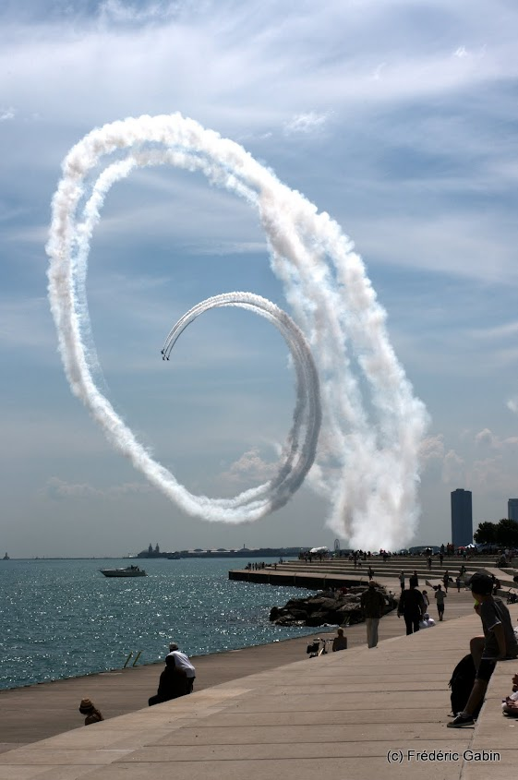


August 2012

Slide 4
A.I.3 - Call for IPRs
“I draw your attention to your obligations under the 3GPP Partner Organizations’ IPR policies. Every Individual Member organization is obliged to declare to the Partner Organization or Organizations of which it is a member any IPR owned by the Individual Member or any other organization which is or is likely to become essential to the work of 3GPP.
Delegates are asked to take note that they are thereby invited:
to investigate whether their organization or any other organization owns IPRs which were, or were likely to become Essential in respect of the work of 3GPP.
to notify their respective Organizational Partners of all potential IPRs, e.g., for ETSI, by means of the IPR Information Statement and the Licensing declaration forms"

Slide 5
A.I.3 - Statement regarding competition law
“I also draw your attention to the fact that 3GPP activities are subject to all applicable antitrust and competition laws and that compliance with said laws is therefore required of any participant of this WG meeting including the Chairman and Vice Chairmen. In case of question I recommend that you contact your legal counsel.
The leadership shall conduct the present meeting with impartiality and in the interests of 3GPP.
Furthermore, I would like to remind you that timely submission of work items in advance of WG meetings is important to allow for full and fair consideration of such matters.”

Slide 6
A.I. 6 - Issues for immediate attention
SA4 leadership and subgroups
SWG Ad Hoc Telcos
SA4 Calendar 2024/2025
TS/TR Rapporteurs
  http://www.3gpp.org/DynaReport/TSG-WG--S4.htm?Itemid=461

Slide 7
SA4 leadership and subgroups 1
SA4 officials:
  Chair: Frédéric Gabin (Dolby Laboratories Inc. , ETSI)
  Vice Chairs:
    Gilles Teniou (Tencent, CCSA)
    Jaeyeon Song (Samsung Electronics Co., Ltd, TTA)
  Secretary: Andrijana Brekalo (MCC Support)
Sub Working Groups and their Chairs
Audio SWG | Multicast-Broadcast-Streaming (MBS) SWG | Real Time Communications (RTC) SWG | Video SWG
Imre Varga (Qualcomm CDMA Technologies, ETSI) & Stéphane Ragot (Orange, ETSI) | Frédéric Gabin (Dolby Laboratories Inc. , ETSI) | Nikolai Leung (Qualcomm Incorporated, ATIS) | Gilles Teniou (Tencent, CCSA)

Slide 8
SA4 leadership and subgroups 2
Changes:
  3GPP SA4 Secretary: Andrijana Brekalo (MCC Support) is taking on new responsibilities as part of ETSI/MCC. She is now handing over to Antoine Bouskhard and will train him to support SA4. She will remain technical officer back up for SA4 and in particular will continue to support the IVAS project. Please join me in welcoming Antoine to SA4 and thank Andrijana for her continuous excellent support.
  3GPP SA4 RTC SWG Chair: As announced at SA4#124, Nikolai Leung will step down from RTC SWG Chair position at the end of SA4#127 (29 January – 2nd February 2024). A call for candidates was issued at SA4#125. Saba Ahsan (Nokia corporation, ETSI) is candidate. The SA4 Chair proposal is to nominate Saba as new RTC SWG Chair.

Slide 9
SWG Ad Hoc Telcos
To WI/SI rapporteurs, when preparing post-SA4#126 WI/SI work plans, please beware of the following guidelines:
Available weeks:
Note 1: according to a decision by 3GPP SA#90-e, meetings are not allowed during certain weeks. E.g. in this case, the week before and after SA4 meetings, Thanksgiving, Christmas and new year’s day weeks, 3GPP SA#102 week.
Note 2: as agreed in a previous SA4 meeting, Rel-19 planning discussions should start from December 2023. My proposal will be to dedicate at least a couple of SWG AH telcos in each SWG to Rel-19 planning. This proposal is to be discussed at SA4#126.
Here is the proposed list of available weeks for SA4 AH meetings:
  27 November - 1 December 2023
  4 - 8 December 2023
  18 - 22 December 2023 (Proposed to be reserved for Rel-19 discussions)
  8 - 12 January 2024 (Proposed to be reserved for Rel-19 discussions)
  15-19 January 2024 (beware of MPEG#145 22 – 26 January 2024)
Reminder on preferred day of the week per SWG:
  Monday – Audio SWG
  Tuesday – Video SWG
  Wednesday – RTC SWG
  Thursday – MBS SWG
  Friday – Audio SWG

Slide 10
SA4 calendar - 2024
Meetings in 2024 | Dates | Venue and Host
SA4#127 | F2F: 29 January - 2 February 2024 | Host: ETSI, Venue: Sophia-Antipolis, France
SA4#127bis-e | E-meeting: 8-12 April 2024 | Host: MCC, Electronic meeting
SA4#128 | F2F: 20-24 May 2024 | Host: TBD, Venue: Korea
SA4#129-e | E-meeting: 19-23 August 2024 Note: agreement to have NO SA4 meetings in August 2025 | Host: MCC, Electronic meeting
SA4#130 | F2F: 18-22 November 2024 | Host: TBD, Venue: North-America

Slide 11
SA4 calendar - 2025
Meetings in 2025 | Dates | Venue and Host
SA4#131 | F2F: 17-21 Feb. 2025 | Host: TBD, Venue: EU
SA4#131e-bis | E-meeting: 7-11 Apr. 2025 Note: dates TBC depending on MPEG#150 exact dates. | Host: MCC, Electronic meeting
SA4#132 | F2F: 19-23 May 2025 | Host: TBD, Venue: Japan
SA4#133e | E-meeting: 7-11 or 14-18 or 21-25 Jul. 2025 Note: agreement to have NO SA4 meetings in August 2025 | Host: MCC, Electronic meeting
SA4#134 | F2F: 17-21 Nov. 2025 | Host: TBD, Venue: North-America
Note: In case hosting offers are received from individual companies or other organizations, these offers would need to be worked into the overall plan. I.e., these offers would NOT entail additional F2F meetings.

