Slide 1

SA4#125 Social
August 24, 2023

Slide 2
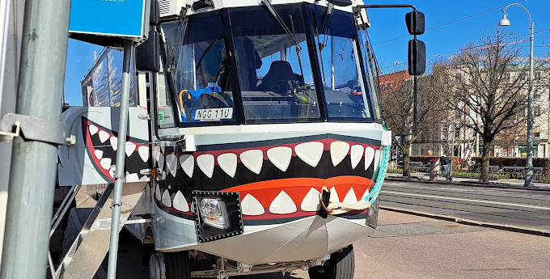
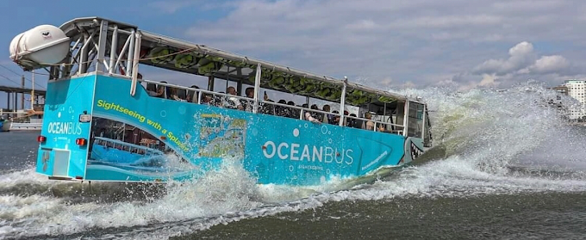
History
to continue the good spirit of social gatherings, here is a proposal for another self-funded social event at SA4#125. Everyone is invited!
History of finding a good event – bad reference
https://oceanbus.se/goteborgsturen/

Slide 3
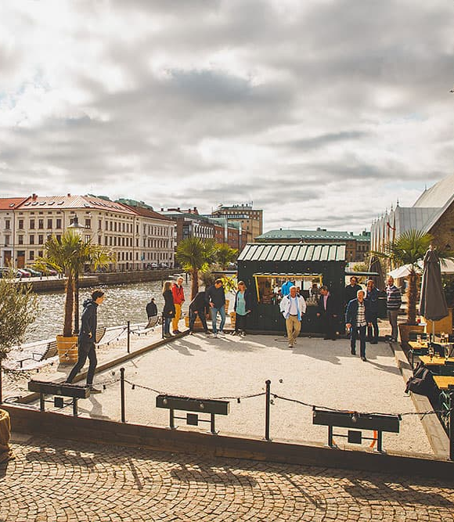
Dinner and Pétanque
The Oceanbus driver recommended something very French in Sweden: Pétanque. This place Boulebar Rosenlund offers to have dinner and then a round of plays. We will play with a guide that arranges a tournament and a prize ceremony in the end. The place is close to the meeting location (10min taxi, 30min walk).
Just a NOTE: Everyone can play Pétanque.
Date and Schedule:
August 24, 2023
Dinner: 20:15 - 21:30
Pétanque: 21:45 - 23:30
Costs:
2 course dinner SEK 390 + Tax: around 40 Euros
Pétanque with guide and tournament: SEK 290 + Tax: around 30 Euro
Total around 70 Euros + Drinks
Payment on the spot, no cash and no AMEX.
Additional responses are welcome.

Slide 4
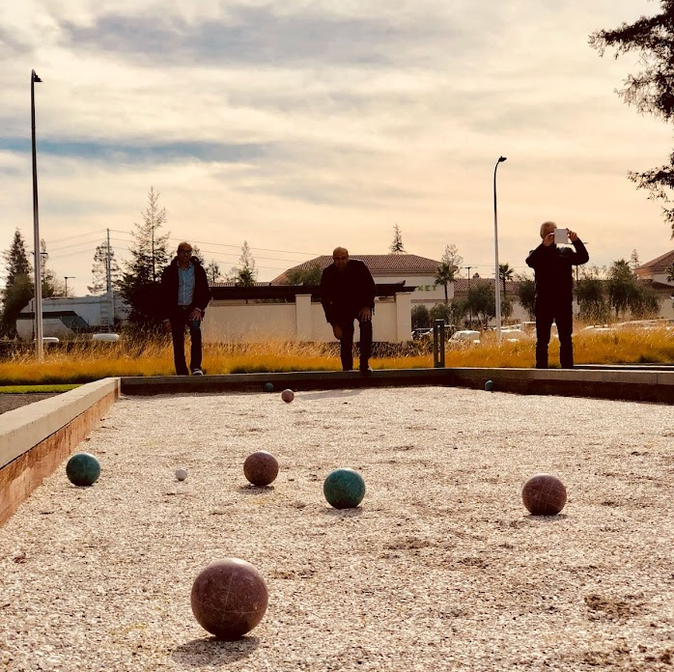
What is Pétanque?

Slide 5

Signups (40)
Simon Gunkel | Tomas Toftgård
Thomas Stockhammer | Gilles TENIOU
Jan Holub | Andrei Stoica
Julien Lemotheux | elmira ramazanirend
Nikolai Leung | Gazi Illahi
Iraj | Andre Schevciw
Chris Steck & Margaret Steck | Srinivas Gudumasu
James Hu | Qi Pan
Waqar Zia | Thorsten Lohmar
Imed Bouazizi | Mary-Luc Champel (3)
Emmanuel Thomas | Yujian Yin
Nien Wu | Brian Lee
Yuan Gao | Ahmed Hamza
Wang Bin | Harald Pobloth
Jaeyeon Song | Liangping Ma
Serhan Gül | Saba Ahsan
Frédéric GABIN | stephane Onno
Gerhard Tech | Muhammed Coban
Erik Norvell | Eric Yip
https://forms.gle/BHBiytQRX5atWS5h8

Slide 6
Questions
Details on Thursday
Others?

