Slide 1

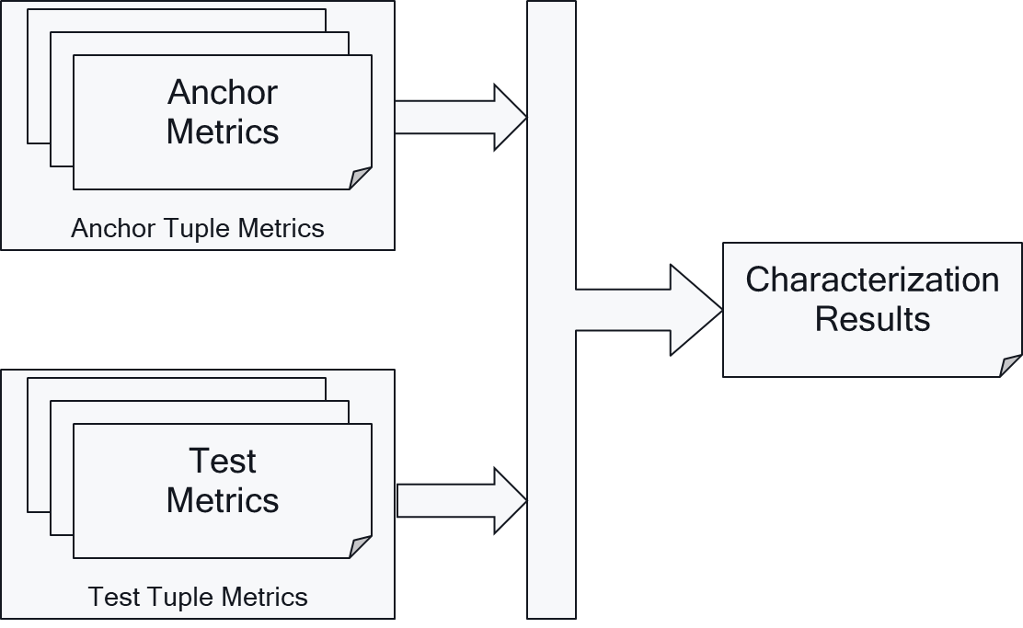




3GPP 5G Video Characterization
TR 26.955 approved at SA#96 (June 2022)
Feasibility Study in Rel-17

Slide 2
Scenarios
Scenarios are defined
  to identify how video codecs are typically used in 5G type of services
  To define reference sequences (types and formats), decoding & encoding constraints
Defined Scenarios
  Scenario 1: Full HD Streaming
  Scenario 2: 4K-TV
  Scenario 3: Screen Content Scenario
  Scenario 4: Messaging and Social Sharing
  Scenario 5: Online Gaming
Note: 8K scenario discussed, but not added

Slide 3
Anchor Generation for each Scenario
Anchor
Configuration
Reference Sequence
Reference
Software
Encoder
Anchor Bitstream
Conforming
Decoder
Anchor Sequence
Metrics Computation
Anchor
Metrics

Slide 4
Tools and Repositories
All sequences are available here https://dash-large-files.akamaized.net/WAVE/3GPP/5GVideo/ReferenceSequences/
All metrics, anchors and tests are available here: https://dash-large-files.akamaized.net/WAVE/3GPP/5GVideo/Bitstreams/
Scripts for running anchor and test generation, metrics generation as well as verification is provided here: https://github.com/haudiobe/5GVideo/

Slide 5
Reference Sequences: Example 4K-TV
Key | Name | Reference | Resolution | Frame rate | Colour Gamut | Number of Frames | Scene Cut
S2-R1 | Brest-Sedof | Annex C.3.1.3.1 | 3840 x 2160 | 60 | BT.709 | 300 | 0
S2-R2 | Rain Fruits | Annex C.3.1.3.2 | 3840 x 2160 | 50 | BT.709 | 500 | 0
S2-R3 | Park Joy | Annex C.3.1.3.3 | 3840 x 2160 | 50 | BT.709 | 500 | 0
S2-R4 | Soccer | Annex C.3.1.3.4 | 3840 x 2160 | 23.98 | BT.709 | 385 | 4
S2-R5 | Tunnel Flag | Annex C.3.1.3.5 | 4096 x 2160 | 59.94 | BT.709 | 600 | 0
S2-R6 | Boat | Annex C.3.1.3.6 | 4096 x 2160 | 59.94 | BT.709 | 300 | 0
S2-R7 | Fountain | Annex C.3.1.3.7 | 4096 x 2160 | 59.94 | BT.709 | 600 | 0
S2-R8 | Riverbank | Annex C.3.1.3.8 | 3840 x 2160 | 50 | BT.709 | 600 | 0
Key | Name | Reference | Resolution | Frame rate | Colour Gamut | Number of Frames | Scene Cut
S2-R11 | Life-Untouched | Annex C.3.2.3.1 | 4096 x 2160 | 59.94 | BT.2020 | 450 | 0
S2-R12 | Meridian | Annex C.3.2.3.2 | 3840 x 2160 | 59.94 | BT.2020 | 327 | 0
S2-R13 | Sol-Levante | Annex C.3.2.3.3 | 3840 x 2160 | 24 | BT.2020 | 145 | 0
S2-R14 | Cosmos | Annex C.3.2.3.4 | 3840 x 2160 | 24 | BT.2020 | 182 | 0
S2-R15 | Elevator | Annex C.3.2.3.5 | 4096 x 2160 | 59.94 | BT.2020 | 432 | 0
S2-R16 | Sparks | Annex C.3.2.3.6 | 4096 x 2160 | 59.94 | BT.2020 | 261 | 0
S2-R17 | Nocturne | Annex C.3.2.3.7 | 3840 x 2160 | 60 | BT.2020 | 370 | 0
All sequences are available here
https://dash-large-files.akamaized.net/WAVE/3GPP/5GVideo/ReferenceSequences/
Example annotation
https://dash-large-files.akamaized.net/WAVE/3GPP/5GVideo/ReferenceSequences/Brest-Sedof/Brest-Sedof.json

Slide 6
Metrics
SDR & HDR
Name | Type | Semantics
parameter | BIGINT | the associated variation parameter as defined for the anchor, for example the QP
bitrate | DOUBLEPRECISION | The size of the file divided by the duration of the reference sequence in bit/s as defined in clause 5.5.1 with 2 decimal digits accuracy.
y_psnr | DOUBLEPRECISION | Peak signal to noise ratio for Y planes in dB as defined in clause 5.5.2 with 2 decimal digits accuracy.
u_psnr | DOUBLEPRECISION | Peak signal to noise ratio for U planes in dB as defined in clause 5.5.2 with 2 decimal digits accuracy.
v_psnr | DOUBLEPRECISION | Peak signal to noise ratio for V planes in dB as defined in clause 5.5.2 with 2 decimal digits accuracy.
ms_ssim | DOUBLEPRECISION | structural similarity between frames as defined in clause 5.5.2 with 4 decimal digits accuracy.
vmaf | DOUBLEPRECISION | Video Multimethod Assessment Fusion (VMAF) as defined in clause 5.5.2 with 2 decimal digits accuracy.
bitrate_log | DOUBLEPRECISION | The bitrate as documented by the encoder log. If not known, it is set to 0.
encode_time | DOUBLEPRECISION | Total time spent to encode the sequence with reference encoder in seconds. If not known, it is set to 0.
decode_time | DOUBLEPRECISION | Total time spent to decode the sequence with reference decoder in seconds. If not known, it is set to 0.
Name | Type | Semantics
Parameter | BIGINT | the associated variation parameter as defined for the anchor, for example the QP
Bitrate | DOUBLEPRECISION | The size of the file divided by the duration of the reference sequence in bit/s as defined in clause 5.5.1.
y_psnr | DOUBLEPRECISION | Peak signal to noise ratio for Y planes in dB as defined in clause 5.5.2.
u_psnr | DOUBLEPRECISION | Peak signal to noise ratio for U planes in dB as defined in clause 5.5.2.
v_psnr | DOUBLEPRECISION | Peak signal to noise ratio for V planes in dB as defined in clause 5.5.2.
Wpsnr | DOUBLEPRECISION | Weighted peak signal to noise ratio for Y, U and V planes in dB as defined in clause 5.5.3.
psnrl100 | DOUBLEPRECISION | PSNRL100 as defined in clause 5.5.3
de100 | DOUBLEPRECISION | DE100 as defined in clause 5.5.3.
bitrate_log | DOUBLEPRECISION | The bitrate as documented by the encoder log. If not known, it is set to 0.
encode_time | DOUBLEPRECISION | Total time spent to encode the sequence with reference encoder in seconds. If not known, it is set to 0.

Slide 7
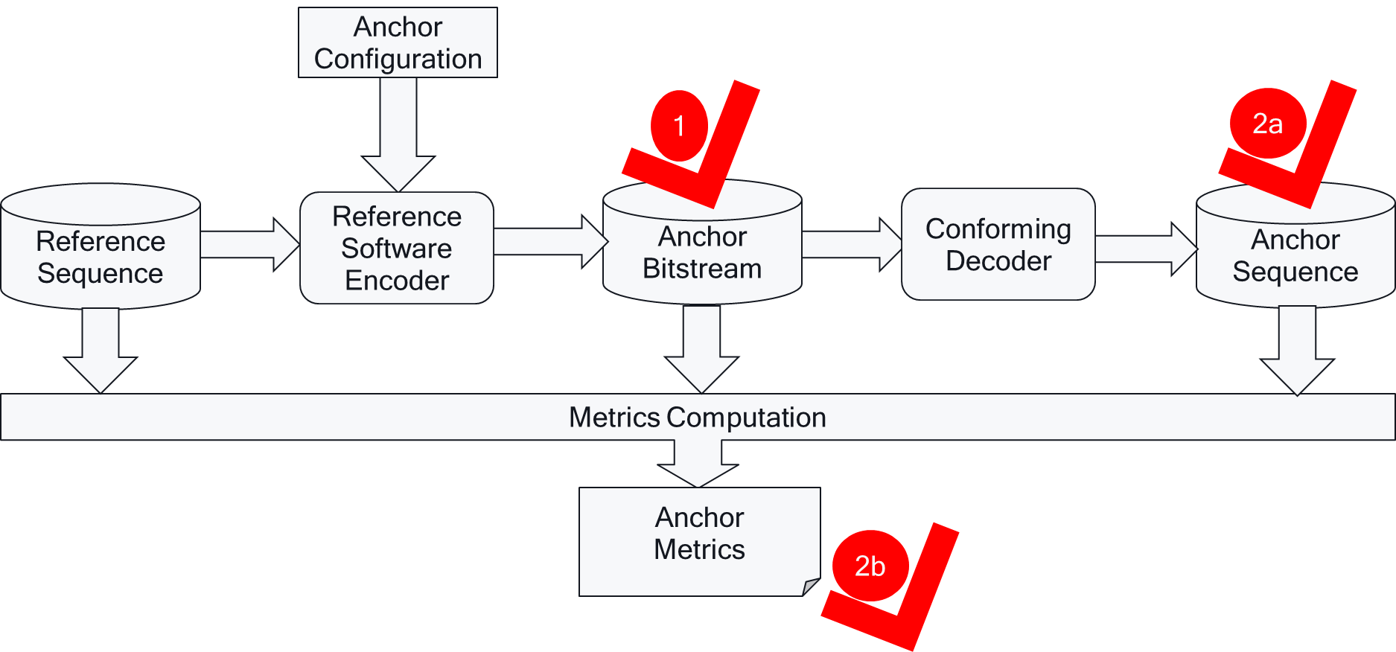
Verification
Anchor bitstream verification: Anchor bitstreams are correct. By using a defined reference sequence, an anchor configuration as well as a reference encoder, two different executions of this process results in the same anchor bitstream.
Anchor reconstruction is correct. By using a verified anchor bitstream, a reference decoder in two different implementations results
  in the same anchor sequence,
  in the same quality metrics.

Slide 8
Characterization
Characterization is the comparison of a codec under test with an anchor based on the framework introduced in this clause. Characterization in this report is based on Bjöntegard-Delta (BD)-rate.
A full characterization of a codec for a scenario against a 3GPP codec shall provide at least the following metrics
  The BD-rate gain for each defined anchor tuple and each required metric
  The average BD-rate gain across all anchors of the scenario for each required metric.

Slide 9
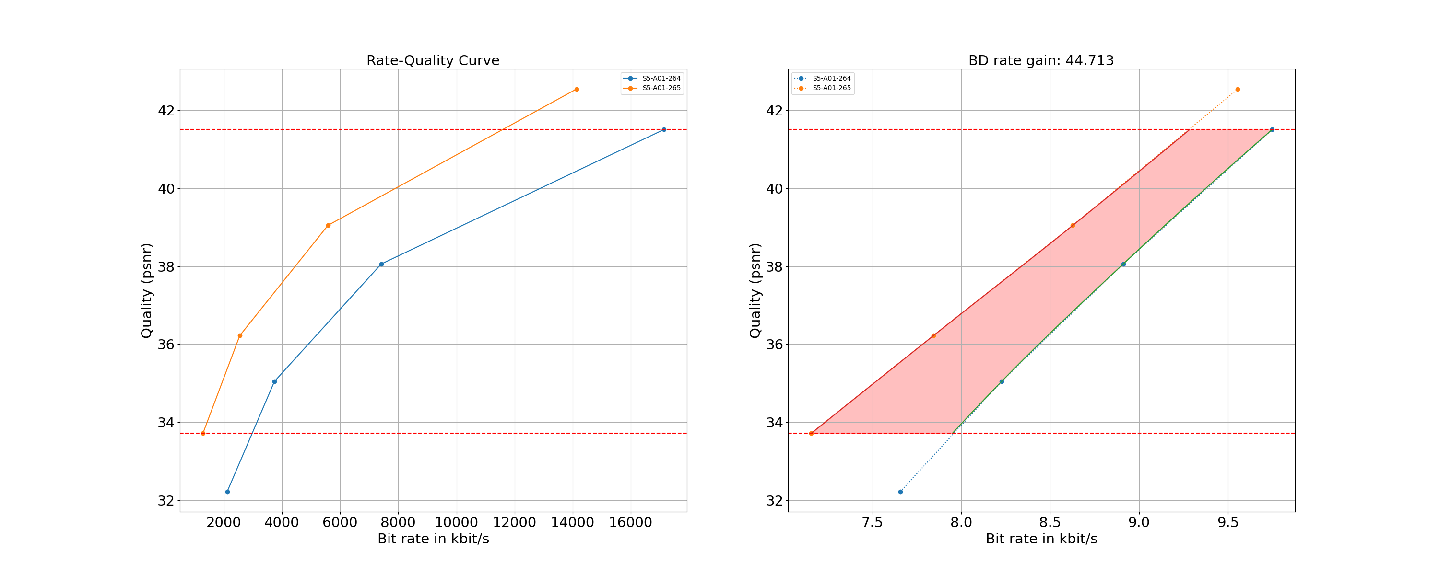
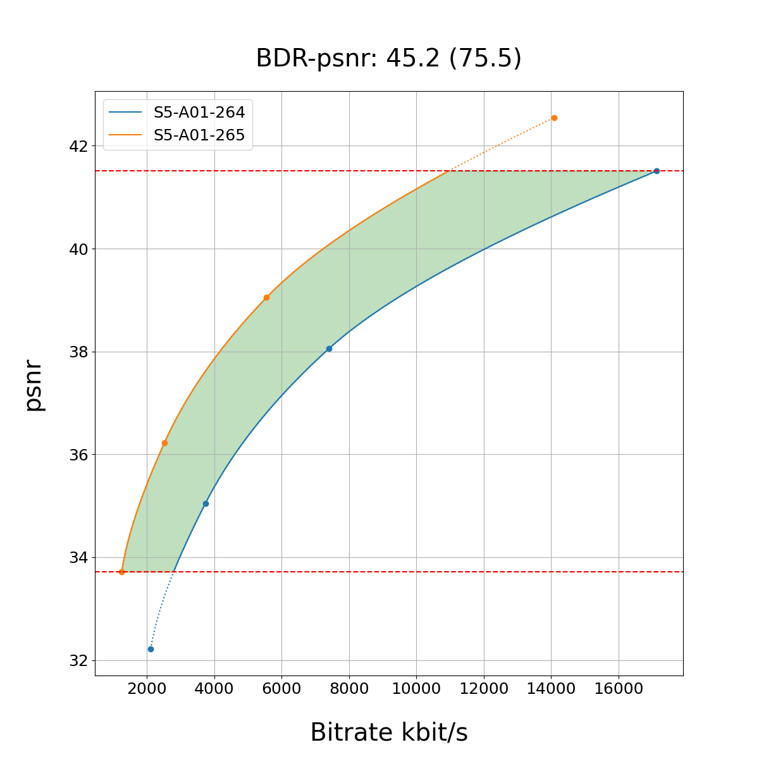
Max value
max_range
Interpolation Anchor
BD-Rate gain/loss
Interpolation Test
min_range
Min value
BD-Rate gain
Overlap
Bitrate to log scale
Interpolated Points
Quality Metric

Slide 10
HEVC against H.264/AVC – Average BD Rate Gains using PSNR
Scenario | HEVC
S1 FullHD | 41.5
S3 Screen no RA | 52.4
S3 Screen RA | 44.2
S4 Sharing no RA | 46.7
S4 Sharing RA | 36.2
S5 Gaming no RA | 41.1
S5 Gaming RA | 31.0
Minimum | 31.0
Maximum | 52.4

Slide 11
New Codecs against H.265/HEVC
Average BD Rate Gains using PSNR
Scenario | AV1 | EVC | VVC
S1 FullHD | 19.1 | 18.1 | 35.8
S1 FullHD HDR | 14.8 | 21.1 | 39.5
S2 4K | 18.2 | 20.4 | 36.7
S2 4K HDR | 16.8 | 23.2 | 38.4
S3 Screen no RA | 35.5 | 23.4 | 55.9
S3 Screen RA | 32.6 | 22.4 | 54.5
S4 Sharing no RA | 8.9 | 20.6 | 28.5
S4 Sharing RA | 16.9 | 18.2 | 24.8
S5 Gaming no RA | 21.6 | 17.6 | 33.2
S5 Gaming RA | 21.4 | 16.0 | 30.9
Minimum | 8.9 | 16.0 | 24.8
Maximum | 35.5 | 23.4 | 55.9

Slide 12
Summary – Comprehensive Framework
A comprehensive set of scenarios relevant to 3GPP services. For each scenario
  the anchors for existing 3GPP codecs (H.264/AVC and H.265/HEVC),
  the version of the reference software for the anchors, and their associated configurations are defined.
  A set of reference sequences is identified per scenario and each sequence is described in more details in Annex C.
  one or more performance metrics are defined. Each metric is described in more details in clause 5.5.
The overall characterization framework process is defined in clause 5 and in Annex B, D, E, F, and G.
New codecs, namely H.266/VVC, MPEG-5 EVC and AOMedia AV1 are identified in clause 8. For each scenario,
  a version of their respective reference software is identified and configurations as close as possible to the anchor configurations are defined.
Metrics are computed and documented as part of the Technical Report.
  The report only documents objective metrics.
  Metrics are used in order to characterize test codecs against anchor codecs using the Bjöntegard-Delta (BD)-Rate gain
The TR is supported by a huge set of data that is available here: https://dash-large-files.akamaized.net/WAVE/3GPP/5GVideo/ including raw video sequences, anchor and test bitstreams, results, png plots and annotation, etc as well as a fully functional set of scripts that allow to replicate the setup and results.
While the framework is comprehensive, it was also identified that it clearly has some limitations; for example,
  encoder configurations for each scenario may have not been stringent enough in their definition, leading to results that may not be fully comparable.
  Furthermore, the encoders used for the evaluation of the various codecs have different maturity and features.
  Results in this document should always be considered with a clear understanding of the characterization conditions and these results were derived. The framework does not include subjective evaluation; it is purely based on objective metrics.

Slide 13
Summary – HEVC
One important outcome of the work documented in this Technical Report is the characterization and evaluation of H.265/HEVC against relevant scenarios and its characterization against H.264/AVC. Also, a first understanding of H.265/HEVC performances versus new codecs was developed. From the scenarios and results in this Technical Report it is observed that:
  H.265/HEVC does not show any functional deficiencies or gaps, nor does it lack any relevant features.
  In terms of compression efficiency, H.265/HEVC, evaluated based on the HM, performs sufficiently well for all the scenarios in this technical report.
  Providing consistent HEVC-based interoperability in 3GPP services, for traditional and new scenarios, is definitely beneficial.
  It is recommended that 3GPP consider upgrading specifications to support profiles, levels, and possibly features available in HEVC. Features may include better support for screen content and computer-generated content, XR/AR type of services, as well as low and very low latency services.

Slide 14
Summary – New Codecs
The framework and the initial results for new codecs demonstrate coding performance improvements over H.265/HEVC for some codecs of up to 50%.
However, the initial results are not considered mature enough to support concrete recommendations on adding new codecs.
The potential addition of any new codec in 3GPP services and specifications requires diligent preparation, including the identification of needs and requirements for different scenarios, as well as a complete characterization against existing codecs.
The information in this TR, as well as any new developments in 3GPP with respect to codecs in latest specifications, could serve as a baseline for future work.
Such an effort may lead to conclusions on the potential addition of any new codec in 3GPP services and specifications.
However, no immediate need has been identified to initiate such follow-up work.

Slide 15
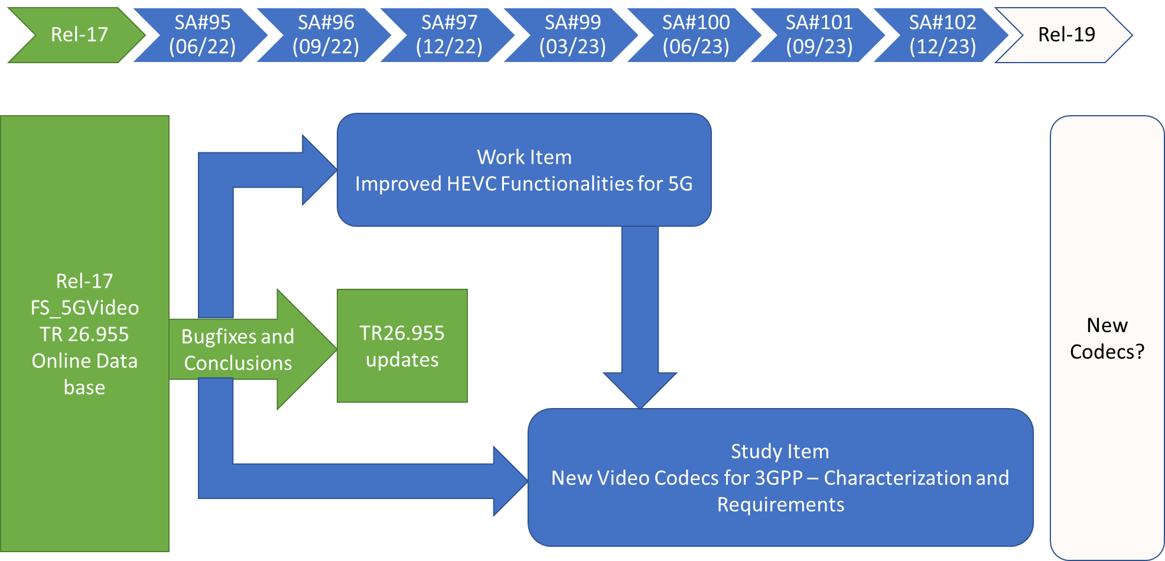
Timeline Considerations
HEVC Work Item?
New codecs preparation

