Slide 1

ETSI Software Development Groups
Collaborative Software in Support of Standardisation
SDG Support SDGsupport@etsi.org
SNS4SNS 2026

Slide 2



ETSI is adapting to a new software driven world
+ Software in Networks
ETSI SDG
Software Development Groups
+ Software in Standards
+ Software in Research

Slide 3



ETSI Software Development Groups
  New type of group in ETSI Directives since December 2022
  Tailored for collaborative software development, in support of standardisation
  Choice of software license, including open source
  Open communities, meritocracy-based governance
3
Notes:
Silvia
Tailored for collaborative software development
Tools, processes, governance, meritocracy
Free to develop their work programme, roadmap, scope
Choice of license, including open source
Open Communities
Open to ETSI members, non member organizations, individual contributors, users
Participation is free for ETSI members, SMEs, MEs, Universities, Public Research bodies, User/Trade Associations, and Individuals
Creating a new SDG only requires the support of 4 ETSI members, and motivating “Why ETSI?”

Slide 4
What is in it for ETSI
A TOOLBOX for quick prototyping, experimentation and new use-case validation allowing ETSI groups working on future network technologies to accelerate standardisation cycles and optimise their quality.
A BRIDGE between Standardisation and Research, as the code is adopted by research projects and new contributions received.
A VEHICLE to promote and facilitate adoption of ETSI standards among software development communities and open source projects.

Slide 5

Participating in an SDG
Participation is open to ETSI members, non-member organizations and individuals
  Organisations (members & non-members) sign an SDG Agreement (+CCLA)
  Non-ETSI members are subject to a yearly fee (2KEUR/organization)
    Fees waved for SME/ME, Universities, Public Research Bodies, User / Trade Associations
  Individuals create an account online and accept the ICLA (no fees apply)
Governance
  LG (Chair + Vice Chairs) are elected every 2 years – ETSI Directives
  TSC is renewed every 1-2 releases – according to SDG DWP
  MDG/TF Leaders are appointed as/when needed – according to SDG DWP

Slide 6

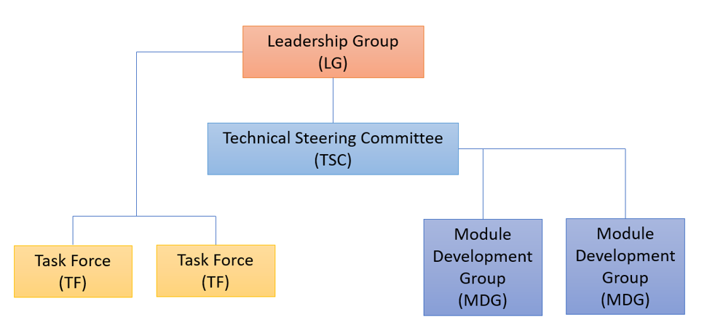



SDG Structure
Chair and
Vice-Chairs
ETSI Directives
Technical
Working Procedures
SDG Detailed Working Procedures
Top
Contributors
Meritocracy

Slide 7


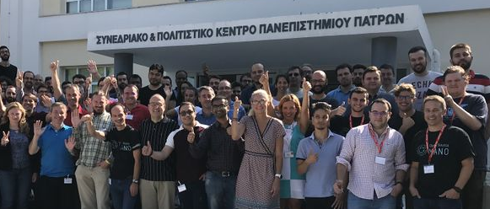
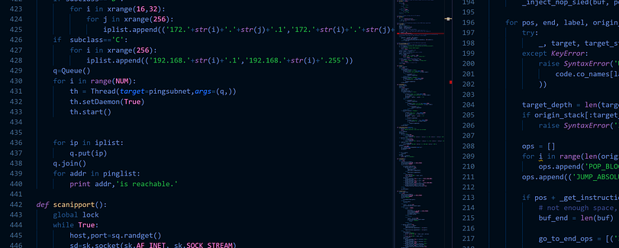
SDG Way of Working
SDGs develop code, not standards
  Regular coordination & feedback to standardisation groups
Most of the hard work (code) is done asynchronously & online (Gitab, Slack, conf calls, ..)
Major code releases twice / year
  Followed by Plenary meetings, Hackfests, Webinars, demos, presence at external events…

Slide 8








ETSI SDG Support & Assets
  Dedicated Technical Expert - project & community manager
  Gitlab Group (labs) – code, tools, websites, wikis and pipeline hosting
  ETSI VIM space – pipeline execution, test infrastructure
  ETSI Portal Page - meetings & plenary docs management
  Mailing Lists
  Slack – instant messaging
  Dedicated SDG Website
  LinkedIn page
  YouTube Chanel

Slide 9







Creating a new ETSI SDG
FM + ETSI Secretariat prepare a formal SDG Proposal
ETSI D-G discusses SDG Proposal with ETSI Board
4+ ETSI members (FM)
+ idea
Pre-evaluation by ETSI Secretariat
SDG Kick-off Meeting
SDG creation approval
SDG Announcement
T T + 1m T + 3-4 m T + 4-5m T + 6-7m

Slide 10











(Growing) SDGs Ecosystem
SDG
2016 2022 2023 2024 2025 2026
OSG OSM - Open Source MANO provides Management and Orchestration for Network Services across cloud platforms
SDG TFS - TeraFlowSDN develops an open source cloud native SDN Controller enabling smart connectivity services, automation and security for future networks
SDG OSL - OpenSlice develops an open source OSS to deliver Network as a Service (NaaS)
SDG OCF - OpenCAPIF is developing an open source Common API Framework allowing to expose and invoke APIs in a secure and consistent way
SDG OOP – OpenOP will develop an Open Operator Platform allowing for operator networks and testbed federation, along with capability exposure

Slide 11
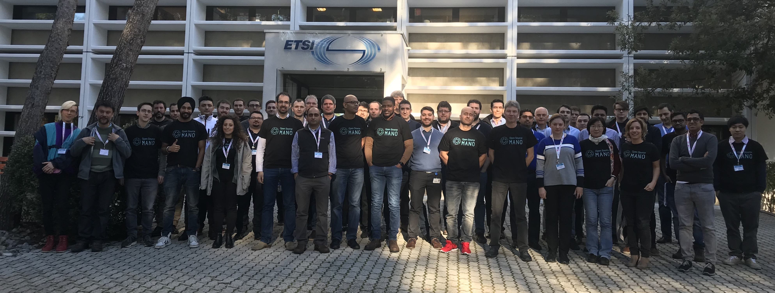
11

Slide 12

Open Source MANO (OSM) provides Management and Orchestration for Network Services across cloud platforms
  Created as (experimental) OSG in 2016
    Will become an SDG in June 2026 (SDG OSM approved at Board#154)
  Aligned with ETSI ISG NFV information model (NFV SOL004, SOL005, SOL006, SOL007)
  152 organisations members and participants
  +35 research projects involved
  Release calendar: July & December
  Latest news & upcoming events:
    ETSI OSM Release EIGHTEEN (Sept 2025)
    OSM Release EIGHTEEN Webinar (Sept 2025)
    Joint SDG Ecosystem Day (26 Nov 2025)
12

Slide 13














































  Open Source MANO links to Standardisation, Research and Open Source
NFV
Notes:
Silvia

Slide 14


  https://osm.etsi.org
  https://osm.etsi.org/gerrit/
  @OpenSourceMANO
  @OpenSourceMANO
  @OpenSourceMANO
  https://OpenSourceMANO.slack.com (invite)
  OSM_INFO@list.etsi.org
  https://portal.etsi.org/osm

Slide 15
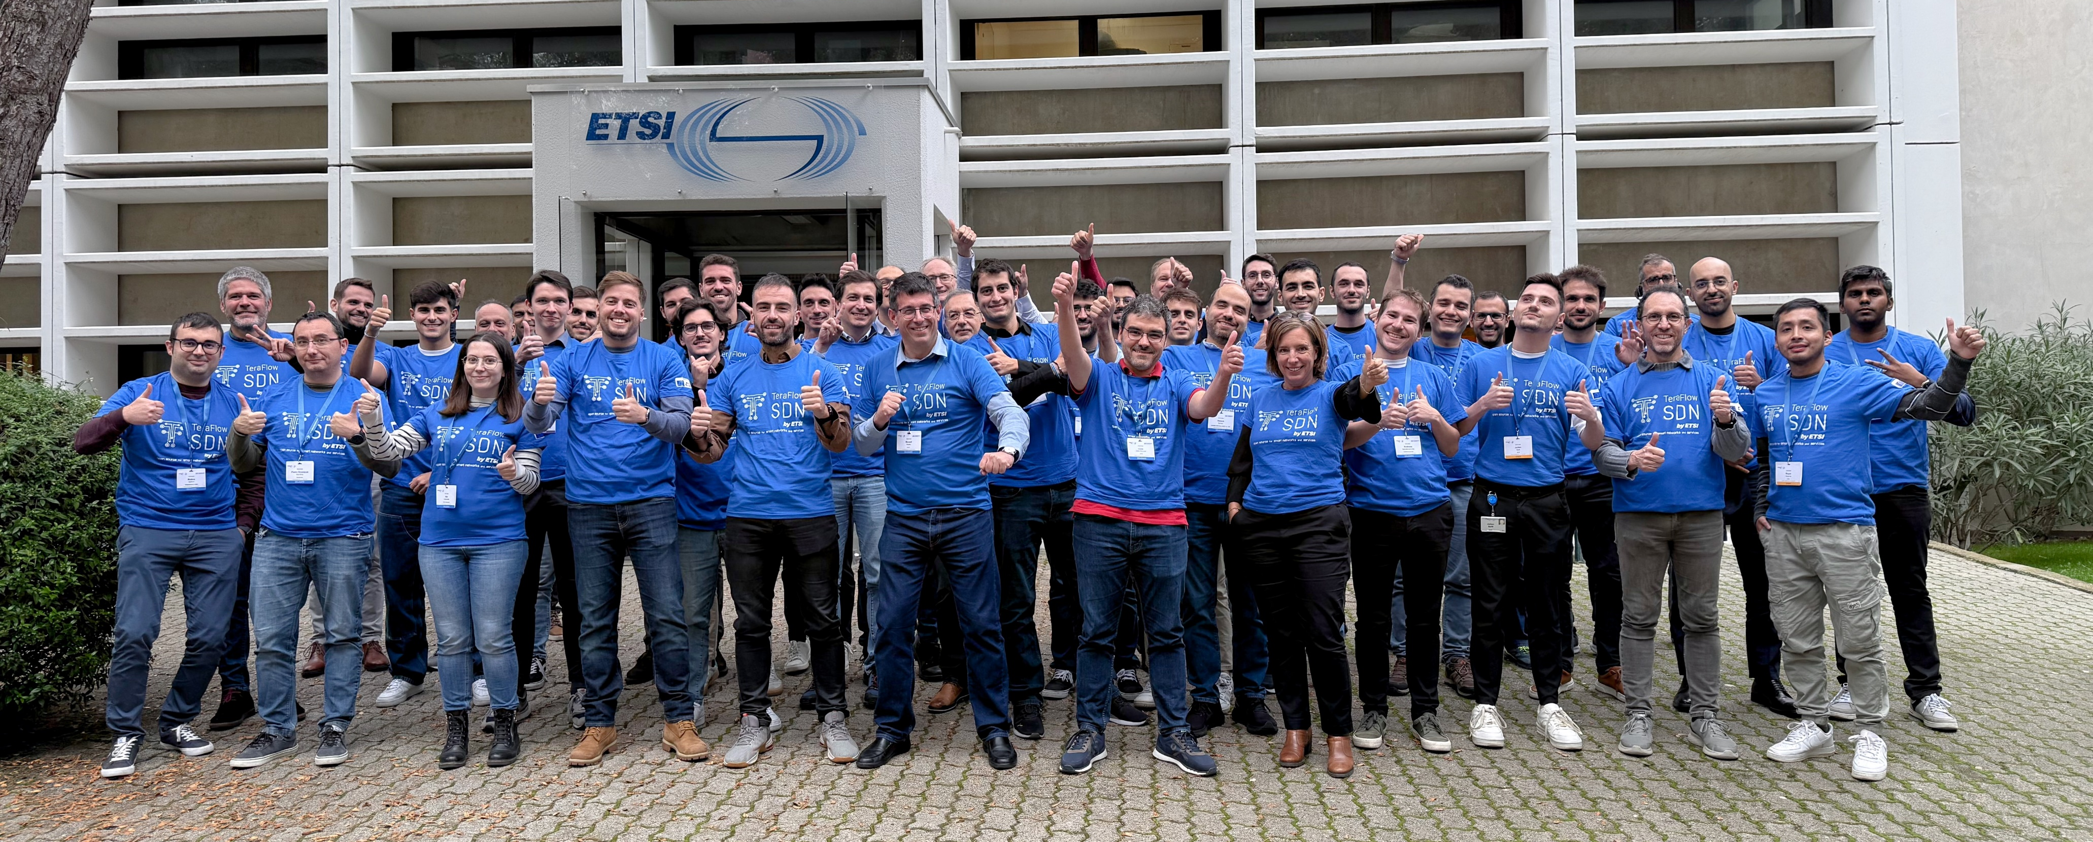
15

Slide 16
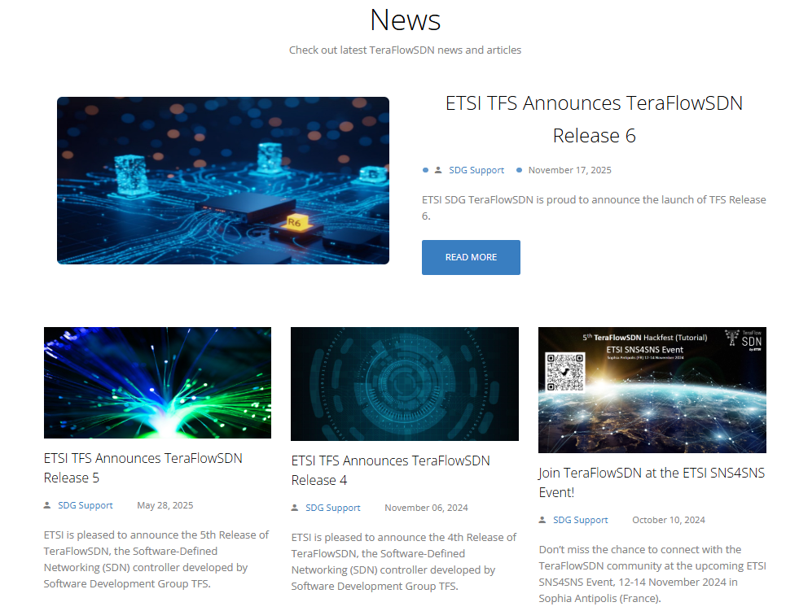
SDG TeraFlowSDN develops an open source cloud native SDN Controller enabling smart connectivity services, automation and security for future networks
  Created as (experimental) OSG in 2022
    Became an SDG in June 2024
  Aligned with IETF, ETSI ISG NFV, MEC, ZSM, F5G, QKD principles and specs
  22 organisations members and participants
  13 research projects involved
  Release calendar : April & October
  Latest news & upcoming events :
    ETSI TeraFlowSDN Release 6 (Nov 2025)
    TFS#8 Hackfest (18-21 Nov 2025)
    Joint SDG Ecosystem Day (26 Nov 2025)
    TFS Tutorial at SNS4SNS 2026 (2-5 Feb 2026)

Slide 17


















  SDG TeraFlowSDN links to Standardisation, Research and Open Source
ZSM, MEC, NFV, QKD, mWT, F5G …
17
Notes:
Ricard

Slide 18
  https://tfs.etsi.org
  https://labs.etsi.org/rep/tfs
  @TeraFlowSDN
  @TeraFlowSDN
  @TeraFlowSDN
  https://TeraFlowSDN.slack.com (invite)
  TFS_INFO@list.etsi.org
  https://portal.etsi.org/tfs

Slide 19
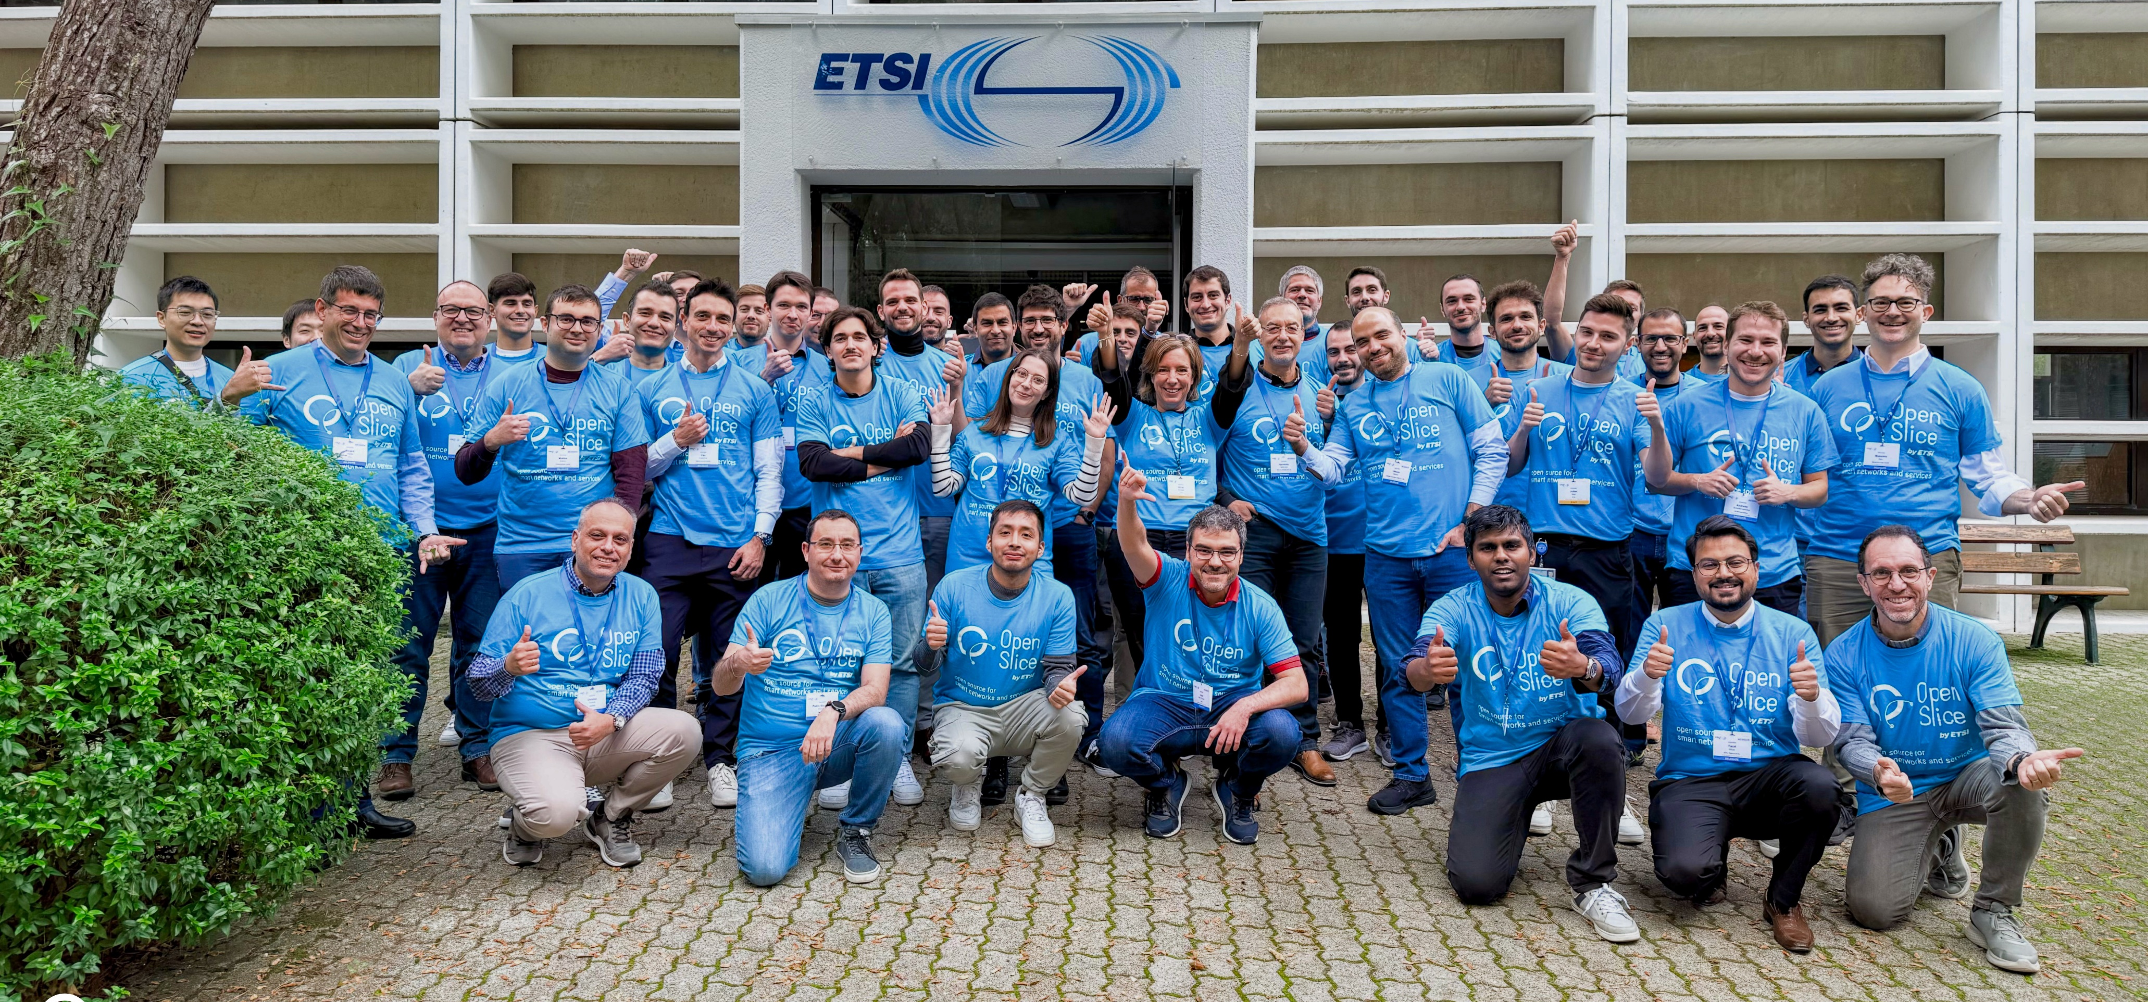

Slide 20
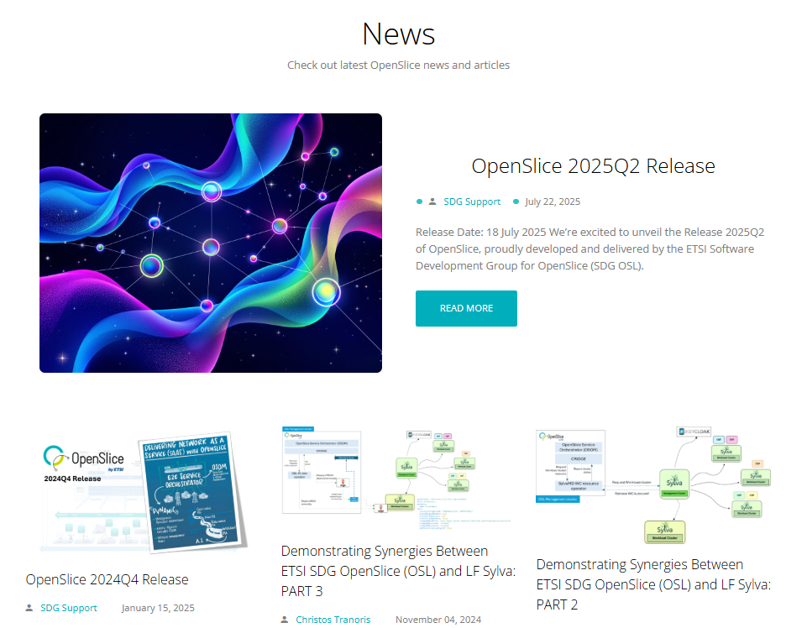
SDG OpenSlice develops an open source OSS to deliver Network as a Service (NaaS)
  Created in October 2023
  Aligned with ETSI ISG NFV, ZSM, TM Forum, GSMA and 3GPP principles and specs
    Interaction with LF Sylva, CAMARA
  17 organisations members and participants
  11 research projects involved
  Release calendar : January and July
  Latest news & upcoming events :
    ETSI OpenSlice Release 2025Q2 (July 2025)
    OSL Release 2025Q2 Webinar (Oct 2025)
    Joint SDG Ecosystem Day (26 Nov 2025)
    OSL Tutorial at SNS4SNS 2026 (2-5 Feb 2026)

Slide 21











  SDG OpenSlice links to Standardisation, Research and Open Source
Notes:
Ricard

Slide 22
  https://osl.etsi.org
  https://labs.etsi.org/rep/osl
  @OpenSlice
  @OpenSliceOSS
  @OpenSlice
  https://OpenSlice.slack.com (invite)
  OSL_INFO@list.etsi.org
  https://portal.etsi.org/osl

Slide 23
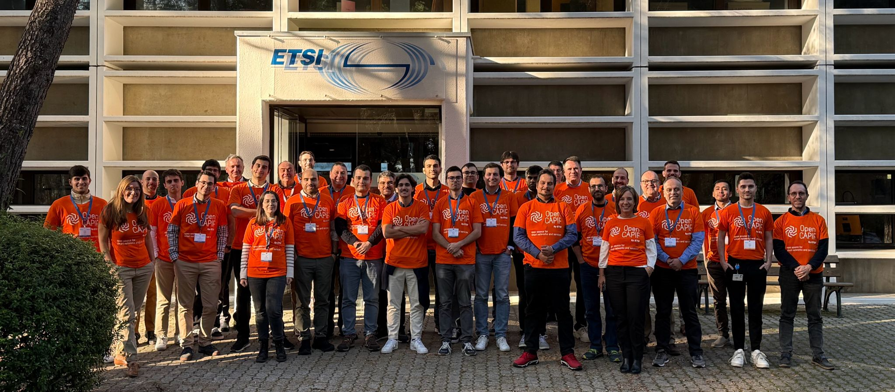
23

Slide 24
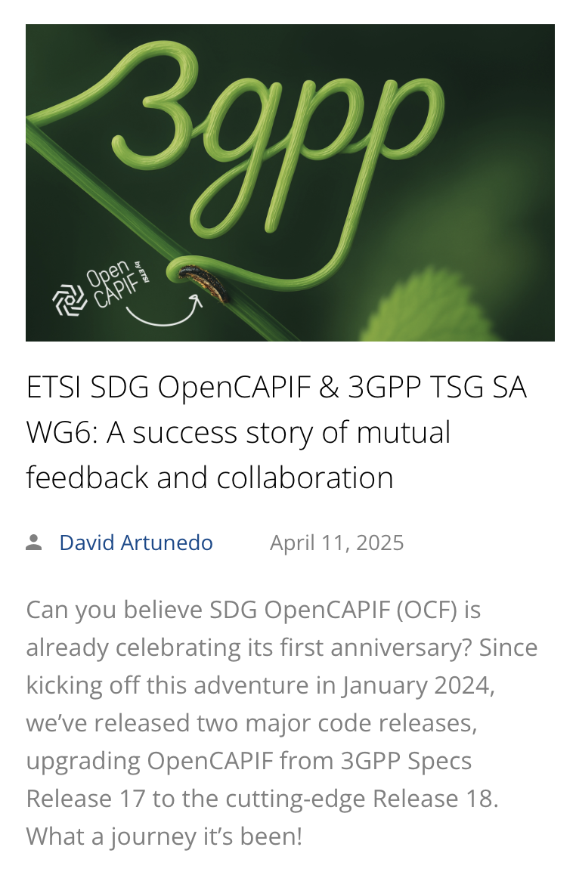
SDG OpenCAPIF is developing an open source Common API Framework allowing to expose and invoke APIs in a secure and consistent way
  Created in January 2024
  Aligned and contributing to 3GPP, ETSI ISG MEC
  15 organisations members and participants
  10 research projects involved
  Release calendar : January and July
  Latest news & upcoming events :
    ETSI OpenCAPIF Release 3 (July 2025)
    OpenCAPIF Release 3 Webinar (Sept 2025)
    Joint SDG Ecosystem Day (26 Nov 2025)
    OCF Tutorial at SNS4SNS 2026 (2-5 Feb 2026)
Notes:
Silvia

Slide 25
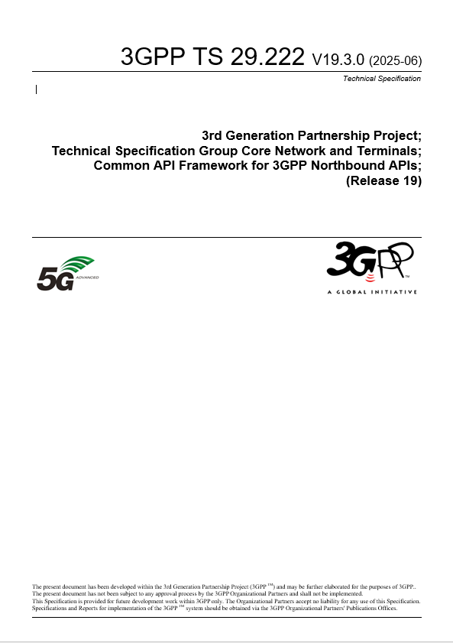

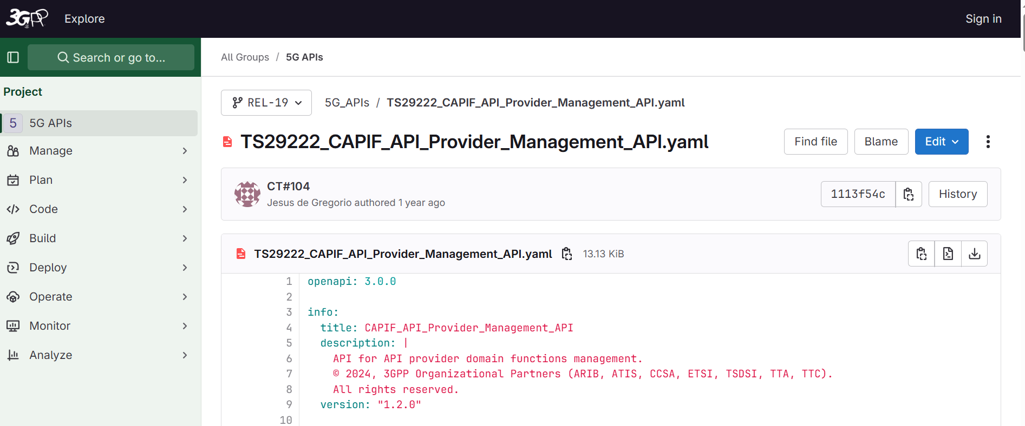


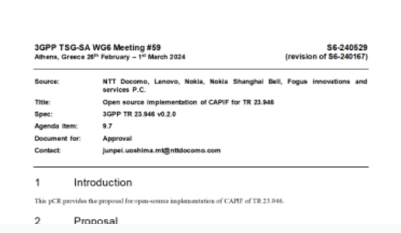
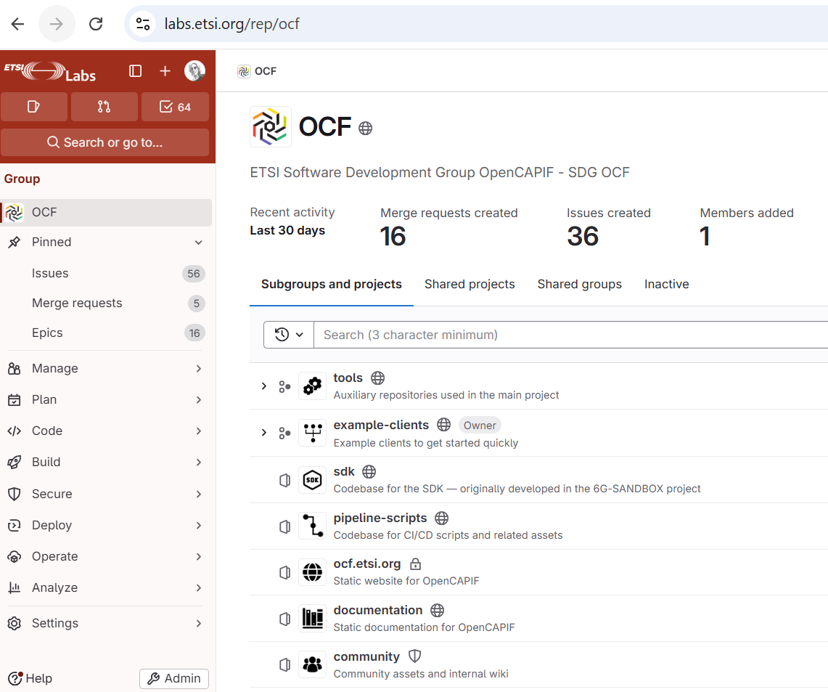
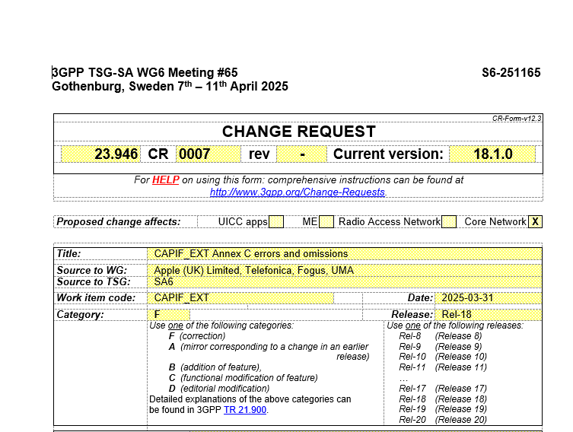
Efficient feedback loop with 3GPP
Check OCF impact

Slide 26










SDG OpenCAPIF links to Standardisation, Research and Open Source
Notes:
Silvia

Slide 27
  https://ocf.etsi.org
  https://labs.etsi.org/rep/ocf
  @OpenCAPIF
  @OpenCAPIF
  @OpenCAPIF
  https://OpenCAPIF.slack.com (invite)
  OCF_INFO@list.etsi.org
  https://portal.etsi.org/ocf

Slide 28
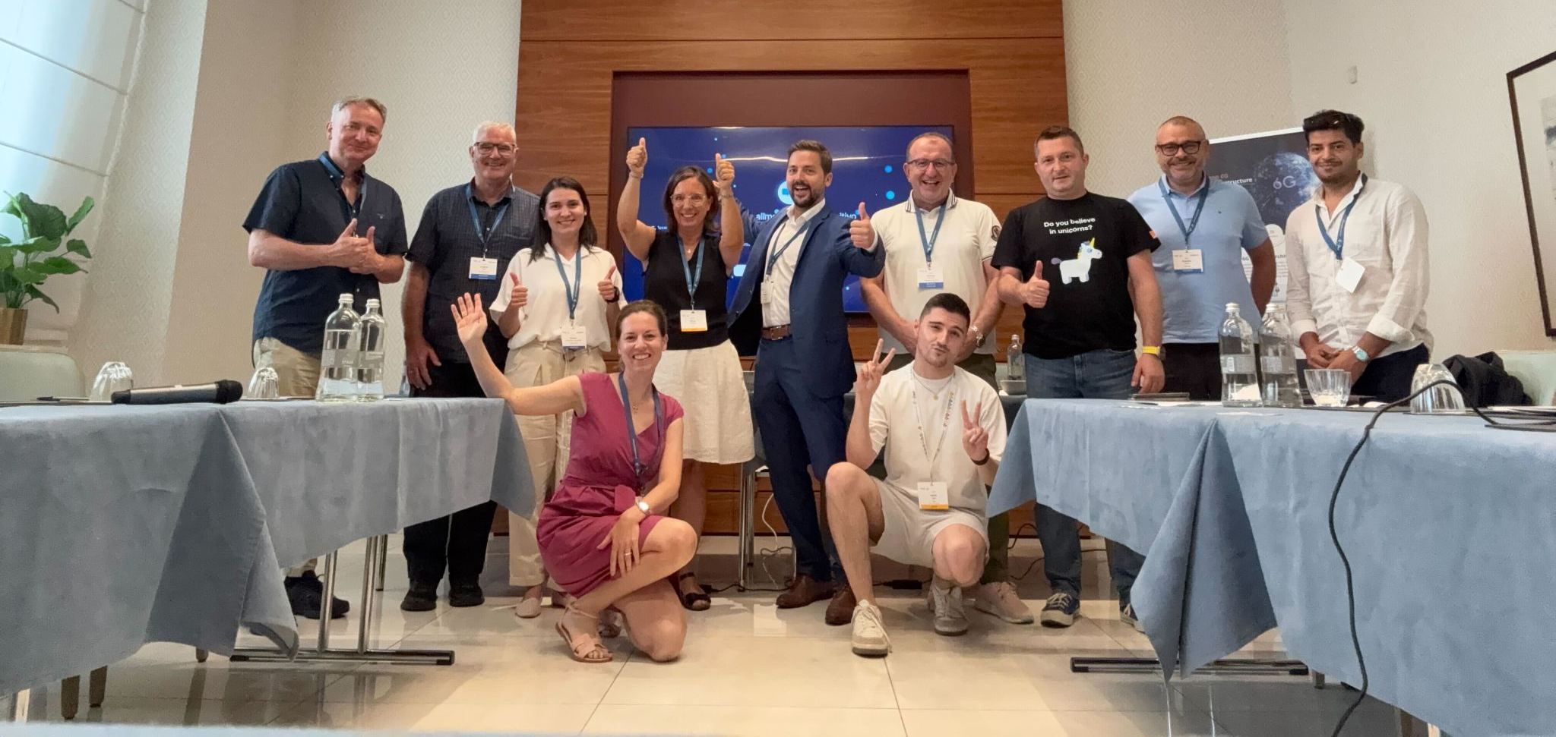
28

Slide 29

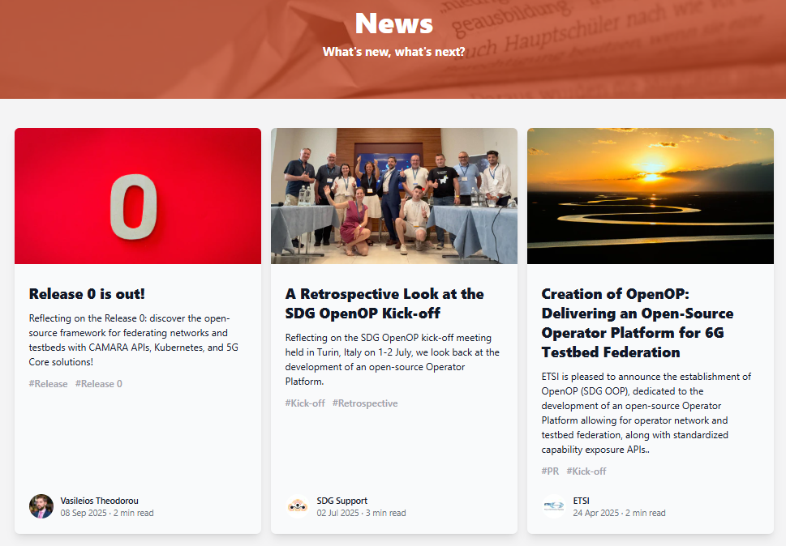
SDG OpenOP develops an Open Operator Platform allowing for 6G testbed federation and capability exposure
  Created in July 2025
    Aligned with GSMA OPG requirements
    Exposing LF CAMARA APIs
  8 Founding Members => 22 Members and Participants
  5 research projects involved
  Latest news & upcoming events :
    OpenOP Release 0 (August 2025)
    Joint SDG Ecosystem Day (26 Nov 2025)
    1st OOP Tutorial at SNS4SNS 2026 (2-5 Feb 2026)
Notes:
Silvia

Slide 30




SDG OpenOP links to Standardisation, Research and Open Source
Notes:
Silvia

Slide 31
  https://oop.etsi.org
  https://labs.etsi.org/rep/oop
  @OpenOP
  @OpenOP_
  @ETSI_OpenOP
  https://OpenOP.slack.com (invite)
  OOP_INFO@list.etsi.org
  https://portal.etsi.org/oop

Slide 32

ETSI SDGs aim for cross community collaboration
- upstream first!
Standards
ETSI Software
Development
Groups (SDG)
Open Source
Research

Slide 33
ETSI SDGs bring
Benefits for
Standardisation
Benefits
for Research
Benefits
for Open Source
Leverage Experimentation & Innovation
Receive Early Feedback
Shorten Development Cycles
Disseminate and Foster Adoption
Learn and Adopt New Ways of Working
Leverage & Impact Standardisation
Build Global Communities
Stability & Continuity
Neutral & Trusted Home
Code Reuse & Sustainability
Leverage & Impact Standardisation
Promote Reuse & Sustainability
Reduce Risk of Fragmentation
Foster Adoption
Leverage Innovation

Slide 34










ETSI SDGs in the bigger picture
Notes:
Silvia

Slide 35
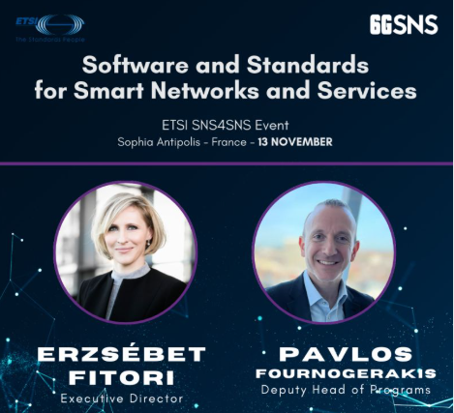
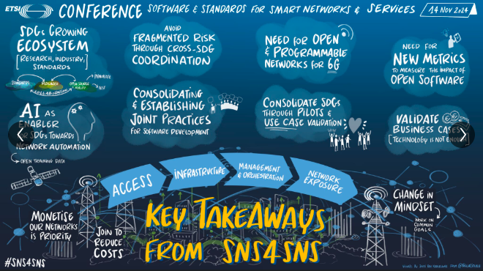
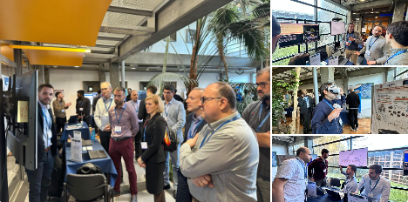
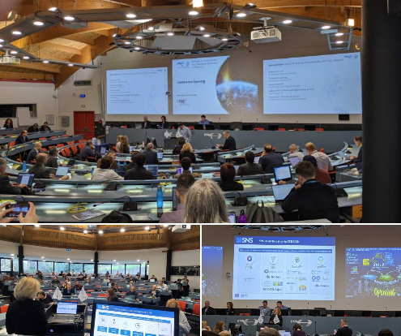
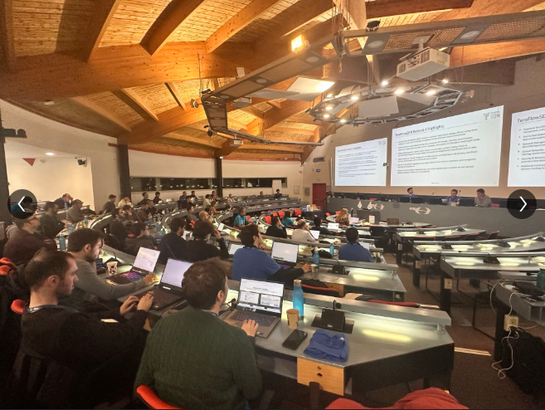
SNS4SNS Event 2024

Slide 36


Welcome to #SNS4SNS 2026!
  Conference – Demos – Tutorials – Hackathon
  2-5 February 2026
  Join us as we navigate the interplay of
  open source, standardisation, and research,
  envisioning a future where collaboration across these domains paves the way for
  sustainable, inclusive, and interoperable
  communication networks and services.

Slide 37

Thank you!
ETSI STS/SNS
SDGsupport@etsi.org

Slide 38
TC Quantum Technologies

Slide 39
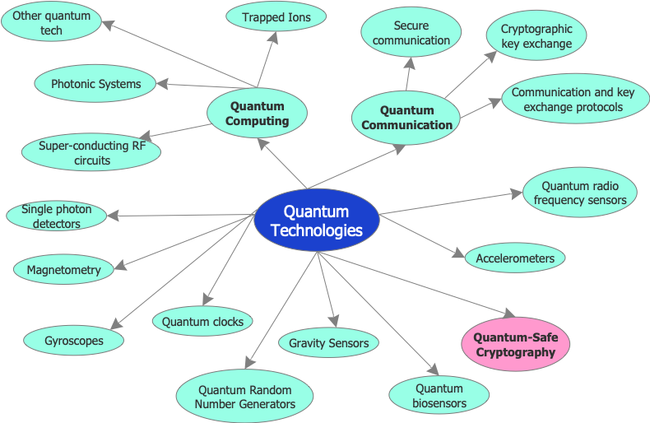
TC Quantum Technologies
This mind-map shows a high-level view of the universe of quantum technologies, including quantum-safe cryptography, which is not a true quantum technology but rather a means of avoiding attacks by quantum computers

Slide 40
TC Quantum Technologies
Quantum communications leverage the principles of Quantum mechanics to enable secure and efficient information transfer. Quantum Key Distribution (QKD), for example, uses phenomena such as quantum entanglement, promising unparalleled security and transformative advancements in how data are safeguarded in the digital age.
Quantum Networking focuses on connecting Quantum devices and systems to enable the sharing of Quantum information across distances. Quantum networking aims to support applications like distributed Quantum computing, Quantum cryptography, and advanced sensing.
Quantum Sensing aims to achieve ultra-precise measurements (timing, synchronisation, physical quantities) only for quantum communication networks.
Satellite Quantum Communications: a standardized approach to classical beacon signals—particularly in terms of wavelength specifications for uplink and downlink channels—could significantly streamline the deployment and interoperability of satellite-based QKD systems or other space-based Quantum Communication systems.
Quantum Random Number Generator (QRNG): QRNGs produce randomness derived from Quantum processes like photon detection or electron spin. This makes them ideal for applications requiring high levels of security and unpredictability, such as cryptography, simulations, and secure communications.
Quantum navigation leverages the use of quantum sensors such as gyroscopes, accelerometers and gravimeters.

Slide 41
TC Quantum Technologies ToR
Develop deliverables to support the deployment and operation of Quantum Technologies related solutions for Quantum Communications, Quantum Networks and other related fields of activity
Further differentiate the approach to standardisation depending on the maturity level of the related focus areas, and as the associated technologies mature, the TC focus more on publishing normative deliverables
Address European policy and regulatory requirements and future Standardisation Requests addressed to ETSI
Engage with specific treaty organisations such as ITU to ensure that the output supports relevant global, regional, and national requirements
Provide input on the technical aspects of ETSI responses to EU Standardisation Requests and other government requests regarding Quantum Technologies solutions
Collaborate with open-source initiatives relevant to Quantum domain standardization, starting from relevant existing and future ETSI SDGs with reference implementations and interoperability testing specifications
Cooperates with other European and international standards organizations working on Quantum standardization to avoid duplication of work and to promote harmonization, through MoUs or Collaboration Agreements
Collaborate with the research ecosystem, especially the European Horizon Framework Programmes, to attract new concepts, expertise and knowledge to standardisation activities in ETSI.

Slide 42
ISG QKD (Quantum Key Distribution)
Terms of Reference: Scope
To develop GSs (ETSI Group Specifications) describing quantum cryptography for ICT networks. Quantum Key Distribution is the essential credential in order to use quantum cryptography on a broad basis. It is the main task of the QKD ISG to specify a system for Quantum Key Distribution and its environment.
The activities of the QKD ISG will be performed in close co-operation with relevant standards activities within and outside ETSI. External relationships will be established where and when ever needed, Formal relationships will be established using the normal ETSI processes via the ETSI Secretariat.
ISG: Industry Specification Group
https://www.etsi.org/committee/qkd

Slide 43
ISG QKD (Quantum Key Distribution)
Areas of activity 1of2
Security
  Implementation security
  Evaluation activities
  Protocol security proofs
  Authentication
Optical characterization
  Optical components
  Complete QKD modules
  Penetration testing
https://www.etsi.org/committee/qkd
https://www.etsi.org/committee/qkd

Slide 44
ISG QKD (Quantum Key Distribution)
Areas of activity 2of2
Vocabulary
  Improving and aligning use of terminology
Interoperability
  Application / key delivery interfaces
  Interoperable KMS interfance
  Network architectures
  QKD in SDNs (Software Defined Networks) see next slide
https://www.etsi.org/committee/qkd
https://www.etsi.org/committee/qkd

Slide 45
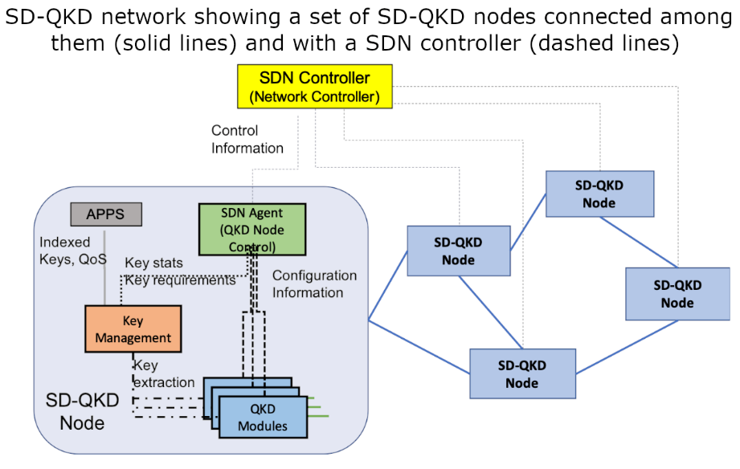
QKD SDNs (Software Defined Networks)
See GS QKD 015 and GS QKD 018
Example of an SD-QKD network showing a set of SD-QKD nodes
One of the nodes
is shown in more detail with the fundamental components which are required to build an
SD-QKD node
https://www.etsi.org/committee/qkd

Slide 46
QKD published standards
GS QKD 018 Orchestration Interface for Software Defined Networks
GS QKD 016 Common Criteria Protection Profile - Pair of Prepare and Measure Quantum Key Distribution Modules
GS QKD 015 Control Interface for Software Defined Networks
GS QKD 014 Protocol and data format of REST-based key delivery API
GS QKD 012 Device and Communication Channel Parameters for QKD Deployment
GS QKD 011 Component characterization: characterizing optical components for QKD systems
GS QKD 008 QKD Module Security Specification
GR QKD 007 Vocabulary
GS QKD 005 Security Proofs
GS QKD 004 Application Interface
GR QKD 003 Components and Internal Interfaces
GS QKD 002 Use Case
GS: Group Specification GR: Group Report
https://www.etsi.org/committee/qkd

Slide 47
QKD work in progress
RGS/QKD-004 Application Interface (revision)
RGS/QKD-005 Protocol structures and security proofs (revision)
DGS/QKD-010 Implementation security: protection against Trojan horse attacks (new)
DGS/QKD-013 Characterisation of Optical Output of QKD transmitter modules (new)
RGS/QKD-014 Protocol and data format of REST-based key delivery API (revision)
RGS/QKD-015 Control Interface of Software Defined Networks (revision)
DGR/QKD-017 Analysis of QKD Network architectures (new)
DGR/QKD-019 Design of QKD interfaces with Authentication (new)
DGS/QKD-020 Protocol and data format of REST-based Interoperable Key Management System API (new)
DGS/QKD-021 Orchestration Interface of Software Defined Networks for Interoperable key management system (new)
DGS/QKD-022 Network Architecture (new)
DGS/QKD-023 Monitoring Interface and Data Model (new)
GS: Group Specification GR: Group Report
https://www.etsi.org/committee/qkd

Slide 48

Technical Committee on Data Solutions (TC DATA)

Slide 49

TC DATA – Overview and Scope
Mission:
To support the deployment and operation of distributed data solutions for collection, integration, sharing, and management — including security and testing aspects.
Scope:
Covers data infrastructures, data products, data access services, and APIs
Addresses the 3 dimensions of distributed data processing:
  Connectivity (data in transit)
  Storage (data at rest)
  Compute (data in process)
Solutions used by both humans and machines, including their virtual representations

Slide 50

Policy, Regulation and Standardisation Focus
Aligns with European policy and regulatory requirements
Addresses standardisation needs in:
  Data interoperability
  Semantic interoperability
  Ontologies
  Data governance
Contributes to ETSI’s input on:
  EU Standardisation Requests
  European Data Act
  European AI Act
Engages with global, regional, and national regulatory bodies

Slide 51

Key Activities and collaborations
Acts as ETSI’s centre of expertise for data infrastructures, services, and applications
Develops technical standards for data and semantic interoperability
Maintains and evolves data-related specifications in collaboration with:
  TC SmartM2M, ISG CDM, ISG PDL, ISG CIM, TC ESI
Supports development and maintenance of SAREF, NGSI-LD, and oneM2M outputs
Contributes to industry-specific data standards (e.g. maritime data model)
Internal collaborations:
3GPP, oneM2M, TC Cyber, TC ESI, TC LI, TC SAI, TC SmartM2M, ISG CIM, ISG PDL, ISG ZSM
External organisations/projects:
CEN/CENELEC, DSSC, Eclipse Foundation, Gaia-X, GSMA, IDSA, IETF, ISO, ITU-T, Linux Foundation, SEMIC, W3C

Slide 52
Technical Committee on Data Solutions (TC DATA)

Slide 53





ETSI MEC: Enabling Edge through Standardisation
Foundation for Edge Computing – Fully standardised solution to enable applications in distributed cloud created by ETSI MEC + 3GPP
ETSI
ISG
MEC
The Standards People
Producing globally applicable standards for ICT-enabled systems
Industry Specification Group
Open to all of industry, regardless of ETSI membership and focused on all industry needs
Multi-access Edge Computing
Cloud Computing at the Edge of the network.
Application Life Cycle Management
NFV
MEC
RESTful based APIs for Runtime
Application Services
Now 200+
Diverse ecosystem: Operators - Technology Providers - IT players - Application developers – Startups…
Watch the video on MEC
Discover the members

Slide 54
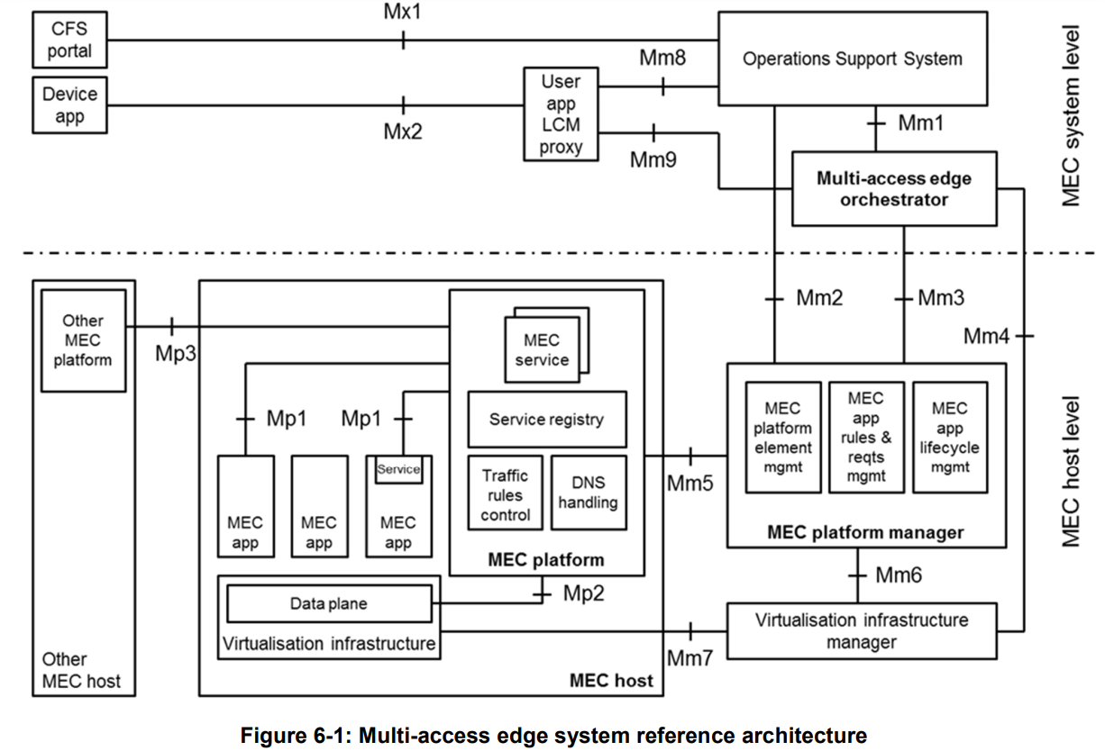
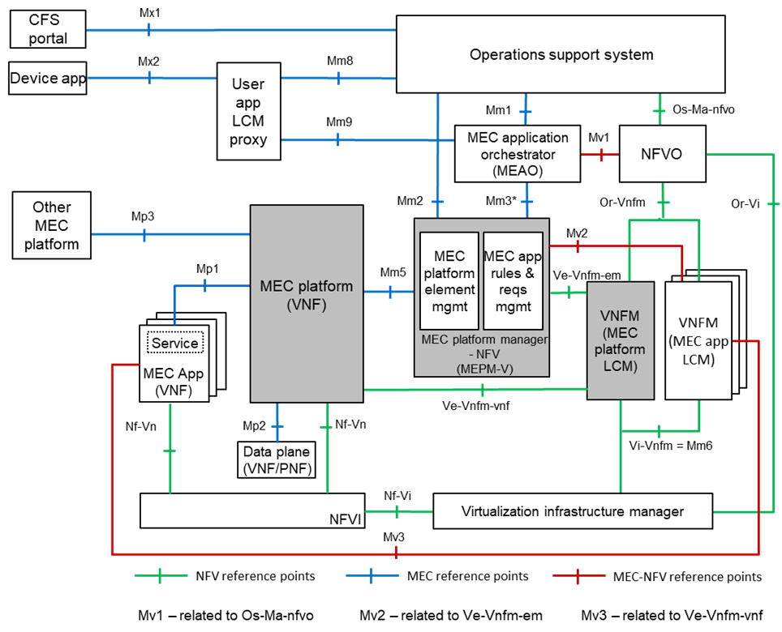
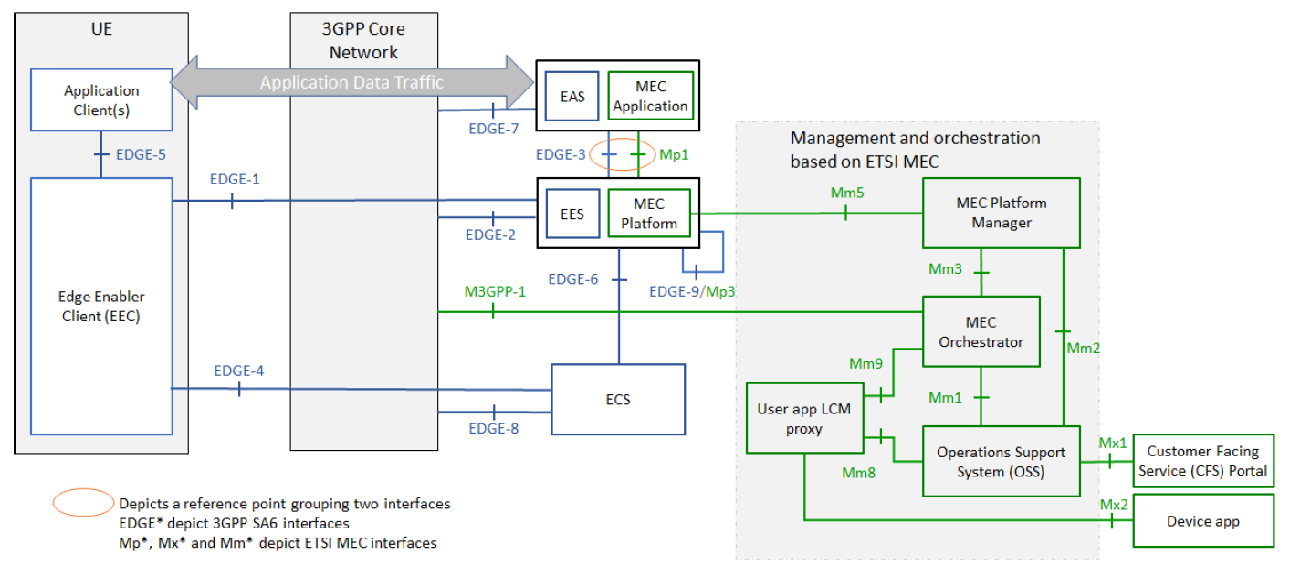
ETSI MEC: Foundation for Edge computing
MEC offers to application developers and content providers cloud-computing capabilities and an IT service environment
at the edge of the network
BASIC PRINCIPLES
Open standard → allowing multiple implementations and ensuring interoperability
MEC exploiting ETSI NFV framework and definitions → enabling MEC in NFV deployments
Alignment with 3GPP based on fruitful collab of common member companies → enabling MEC in 5G
Access-agnostic nature (as per MEC acronym - Multi-access Edge Computing) → enabling other accesses
Addressing the needs of a wide ecosystem → enable multiple verticals (e.g. automotive), federations
MEC is focused on existential questions of applications “on the edge”

Slide 55
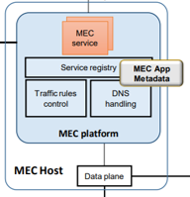

MEC Reference Architecture
API’s (Application Programming Interface )
Application Support
Service Management
Radio Network Information
Location
UE Identity
Bandwidth Management
Fixed Access Information
WLAN Information
V2X Information Service
Application Package lifecycle and operation granting
Device application interface

Slide 56


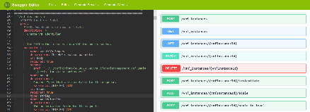


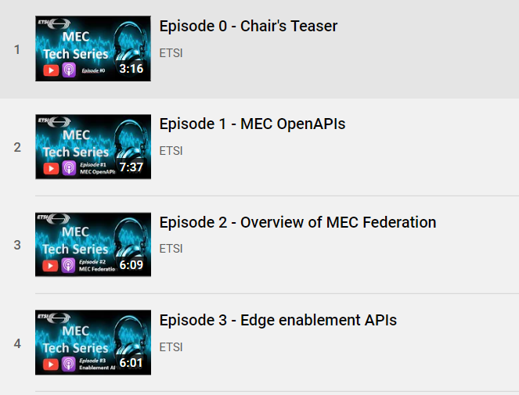
ETSI MEC DECODE Working Group
MEC Deployment and Ecosystem engagement activities
OpenAPI representations: ETSI Forge
Testing and Conformance
MEC Ecosystem wiki
PoCs (proof-of-concepts)
MDTs (MEC Deployment Trials)
MEC Sandbox
Collaborations: CAMARA, STF
Hackathons
Plugtests
MEC Tech Series
https://try-mec.etsi.org/
https://mecwiki.etsi.org/index.php?title=MEC_Ecosystem

Slide 57

Software Development in MEC :
Joint Task Force ETSI ISG MEC-ETSI SDG OCF
Joint Task Force (STF 707) ETSI ISG MEC-ETSI SDG OCF (OpenCAPIF) on enhanced Edge Native Connector.
STF 707 started on 1st January 2026 for a duration of 15 months.
More information at https://portal.etsi.org/xtfs/#/xTF/707/
The MEC Sandbox is an API playground to learn MEC APIs.
The Edge Native Connector extends the MEC Sandbox by enabling the integration of APIs from various sources.
With STF 707, ETSI MEC looks forward to a fruitful collaboration
  with ETSI SDG OCF, e.g. integrate MEC Sandbox with SDG OCF and EDGEAPP;
  with ETSI SDG OOP (OpenOP), e.g. integrate with GSMA OP/SDG OOP for developers.
MEC Sandbox Version 1.10
Includes MEC profile for CAPIF and Federation APIs
Click here to discover !

Slide 58
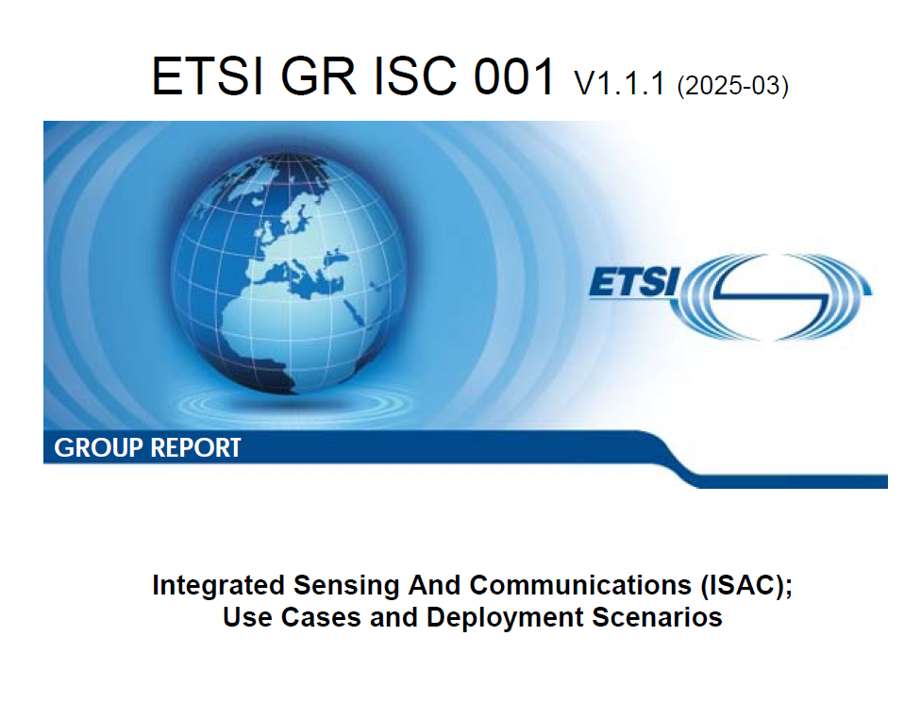
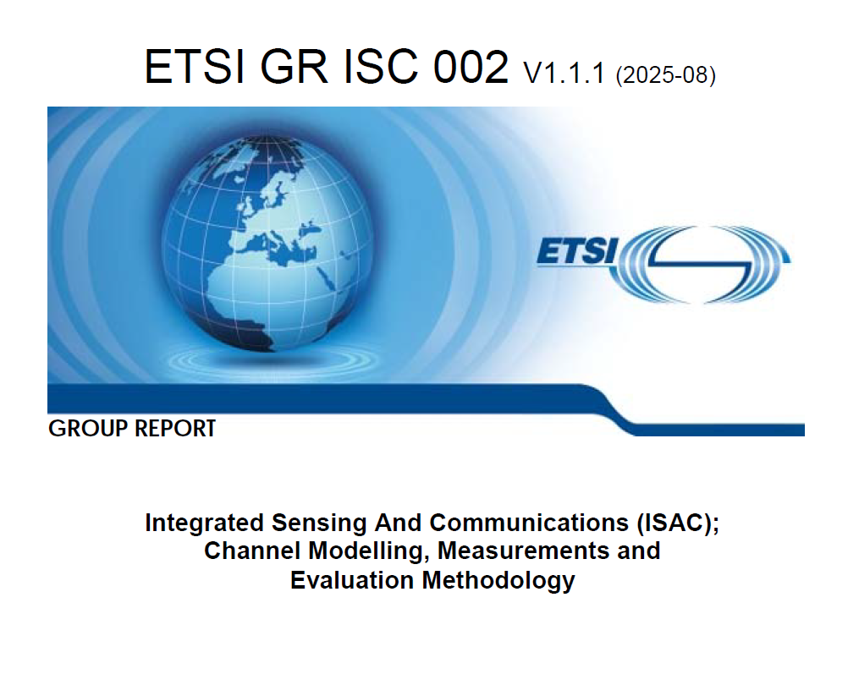
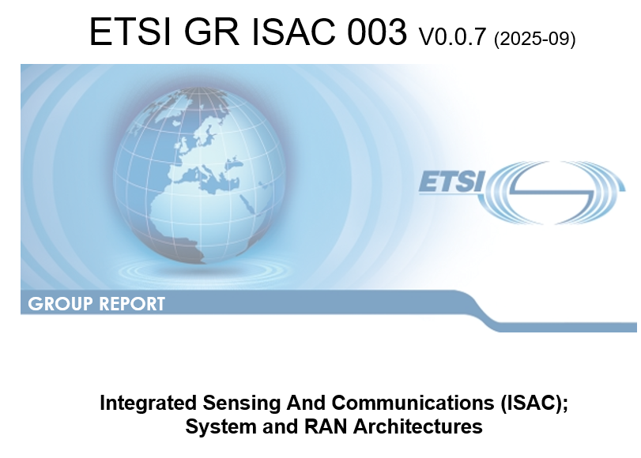
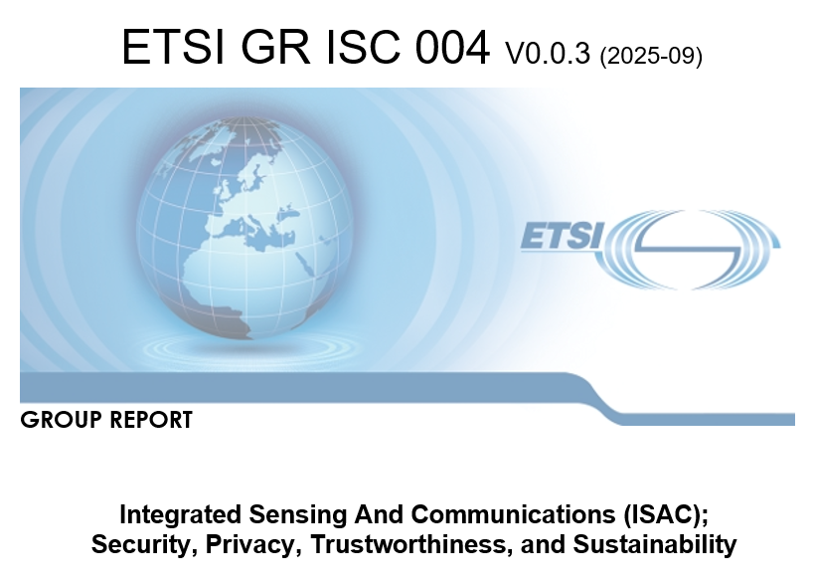
ISG Integrated Communication and Sensing (ISAC)
✓
○
○

Slide 59
ISG Integrated Communication and Sensing (ISAC)
Mission: Establish technical foundation for ISAC development and standardization in 6G
Members*: 106 ETSI members and participants, and 1 counsellor (EC)
Started 17 Nov’23 for 2Y (Completion due 16 Nov’25)
Work Programme:
  WI#1 (Use Cases and Deployment Scenarios) – Rapporteur: Mitsubishi
  WI#2 (Channel Modelling, Measurements and Evaluation Methodology) – Rapporteur: ZTE
  WI#3 (System and RAN Architecture) – Rapporteur: Huawei
  WI#4 (Security, Privacy, Trustworthiness and Sustainability) – Rapporteur: Apple
  WI#5 (Integration of Computing with ISAC) – Rapporteur: Continental
  Except of WI#5, all GRs published or due to be published in Q4’25
✓
○
○
* https://portal.etsi.org/TB-SiteMap/ISAC/List-of-ISAC-Members-and-Participants

Slide 60
ISG Integrated Communication and Sensing (ISAC) emerging themes
Architecture Framework
Cooperative Sensing
Distributed Sensing
Security, Privacy, Trustworthiness, Resilience
Signal protection
AIML and Data Frameworks
AIML for ISAC
Data governance
Demonstrability and Forward-Compatibility
Demonstration and testing
Multi-node/Multi-band/Multi-link sensing
Agent based
Computing aware
Energy Efficient
Convergence and interworking
CIANA approach
Threat detection
Security Model
Data fusion integrity
Passive sensing
ISAC for AIML
Data model
Data collection and processing
Evaluation and Validation
Forward compatibility for emerging concepts such as Near-Field, RIS, NTN, OAC
Channel modelling extensions
Frugal Sensing
Semantic Sensing

Slide 61
ISG Network Function Virtualisation
(NFV)
February 2026

Slide 62
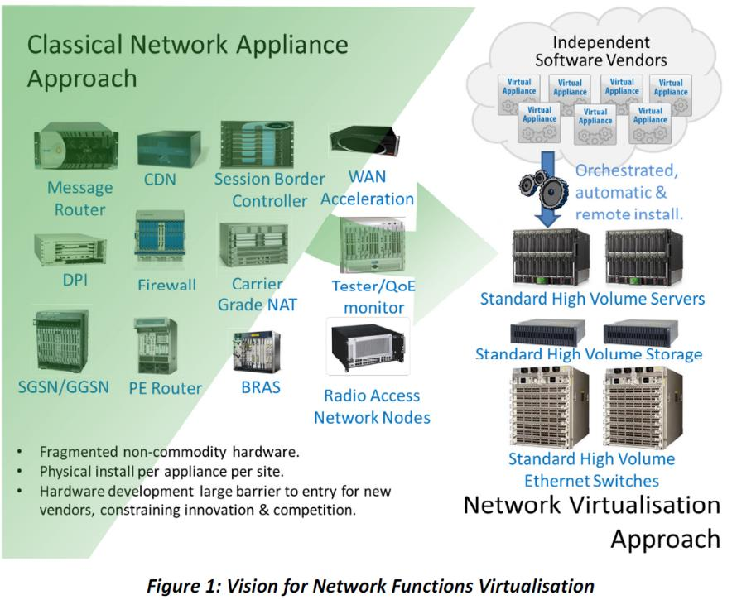
NFV concepts
Network Functions Virtualisation (NFV) is about
  Decoupling network functions functionality from infrastructure and relocating the network functions from dedicated appliances to pools of resources leveraging commodity-of-the-shelf (COTS) hardware.
  “Softwarization” of the network enabling automation of deployment and operations.
Enablers
  General purpose processor (GPP) advances enabling COTS.
  Compute, storage and network Virtualisation technologies.
  Cloud computing.
  Artificial intelligence/machine learning, policy management, etc.
  Model-driven management, etc.
Source : “Network Functions Virtualisation” white paper [Online: https://docbox.etsi.org/ISG/NFV/Open/Publications_pdf/White%20Papers/NFV_White_Paper1_2012.pdf]

Slide 63
NFV in the network transformation landscape: what can ETSI NFV offer you
A unified architectural framework enabling an open ecosystem where virtualised network functions can be
  Lifecycle-managed by independently developed management and orchestration systems
  Hosted on independently deployed and operated NFV infrastructure platforms,
    multiple virtualisation technologies
    resources distributed across various locations (e.g. centralised data centres, edge clouds, end user premises, etc.)
  Dynamically composed into network services and function chains
The transformation towards NFV is an essential piece of the overall telco network transformation towards autonomous management of network and services!

Slide 64
NFV is key to realize network transformation
Full automation /
Autonomous /
Declarative
Descriptor-based
automation
Smart
Orchestration &
Management
Cloud Native
Virtualisation
lift
LCM
Orchestration
NFV
cloud
Deployment flexilibity
on extreme distributed environment

Slide 65
Areas and work items by ETSI NFV
From a functional perspective, ETSI NFV covers different areas between services and infrastructure for telecom networks Virtualisation.
  In addition, non-functional areas of security and reliability are also covered with respect to the different functional areas.
  Maturity of the work in ETSI NFV is derived depending on the level of completeness of specification at different stages or concerning to scope of work by the ISG.
Network service orchestration
VNF/CNF Lifecycle and OAM management
Virtualized/containerized resources management
Infrastructure management
Functional areas
Packaging and descriptors
Connectivity management
Energy Management
Automation

Slide 66
ETSI NFV Releases
Release 1
Release 2
Release 3
Release 4
Release 5
Release 6
Focus: the feasibility of NFV.
Delivered the baseline studies and specifications.
Set the NFV Architecture:
  Infrastructure (NFVI),
  Virtualized network functions (VNF),
  Integration of the VNFs into Network Services (NS), and
  NFV Management and Orchestration (NFV-MANO) aspects at different layers.
  Focus: interoperability of NFV solutions.
  Details requirements and specification of interfaces and descriptors.
  Realizes the interoperability of solutions based on the NFV Architecture, detailing
    VNF Package and VNF and NS Descriptors,
    Acceleration,
    Internal and external NFV-MANO interfaces.
  Focus: feature enriching the NFV Architectural Framework, readying NFV for deployment and operation.
  Interfaces, modeling, etc. to support new features such as (not exhaustive list):
    Policy framework,
    VNF snapshot,
    NFV-MANO management,
    Multi-site,
    Cloud-native, etc.
  Focus: orchestration, cloudification and simplification of network deployment and operations.
  Interfaces, modeling, etc. to support new features such as (not exhaustive list):
    Container-based deployments,
    Further 5G support,
    Autonomous management and automation,
    Generic OAM functions, etc.
  Focus: consolidation and ecosystem.
  Interfaces, modeling, etc. to extend current features and new features such as (not exhaustive list):
    VNF configuration,
    Green NFV,
    NFV for vRAN,
    Flexible VNF deployments,
    Service-based architecture concepts,
    Cloud-native VNF reliability, etc.
  Focus: new architecture
  and infrastructure
  Interfaces, modeling, etc. to extend current features and new features such as (not exhaustive list):
    Architecture evolution and simplification
    New infrastructure
    New Virtualisation forms
    Latency aspects
Specifi cation stages state
Study work
Closed
Closed
Closed
Open
Open
Stage 1/2
Closed
Closed
Closed
Open
Open
Stage 3
Closed
Closed
Closed
Open
Not started
Notes:
Generated by Copilot
Current ETSI NFV releases are crucial for understanding the specification stages of NFV. These specifications guide the implementation and standardization of NFV technologies, ensuring that they meet industry needs and can be effectively integrated into existing systems. Staying updated on these releases is essential for stakeholders in the telecom sector.
______
Updated completion of release 3

Slide 67
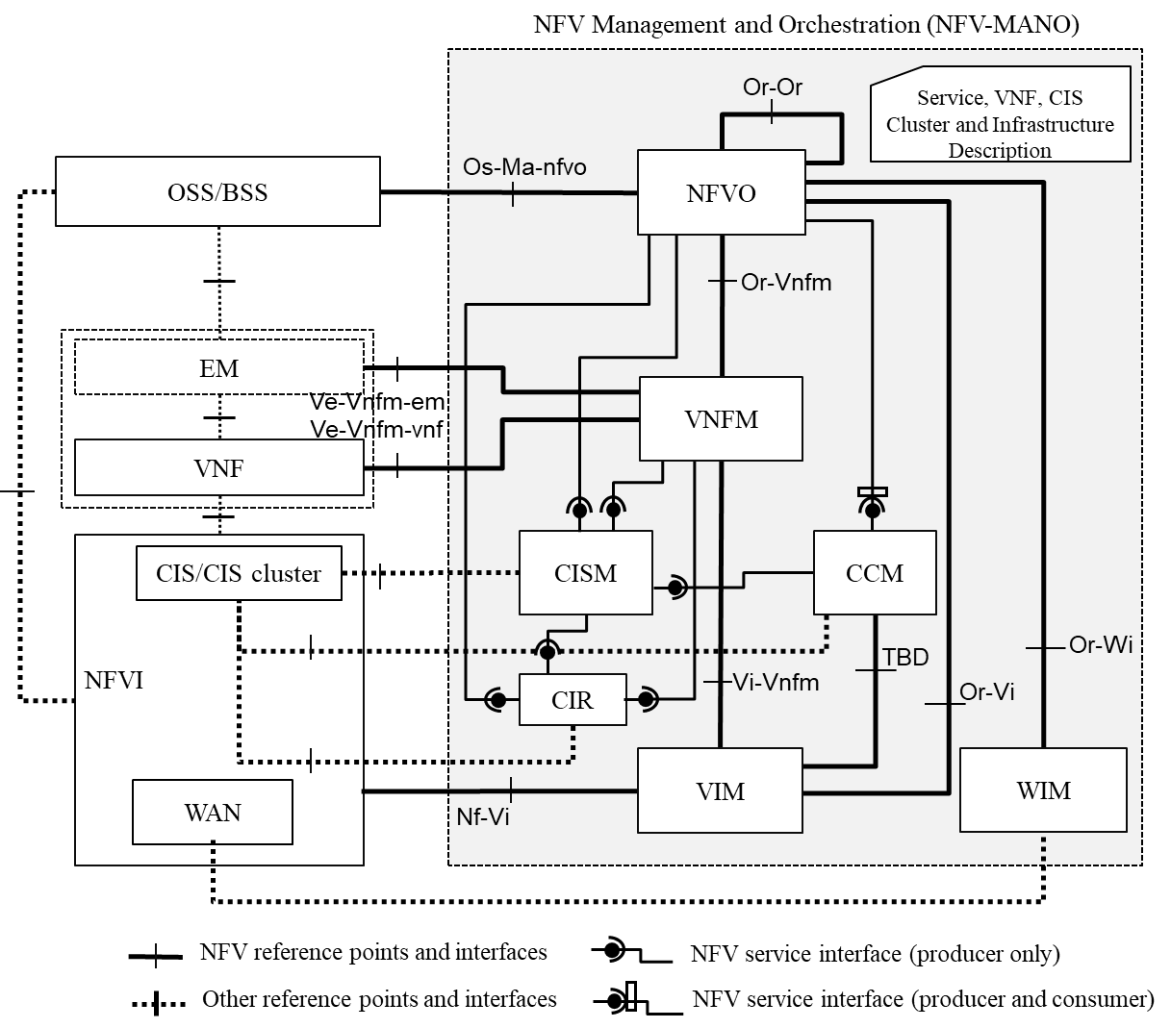
NFV-MANO architecture (Release 5)
NFV-MANO core features
  Automation and orchestration of VNFs deployed in VMs and/or containers.
  Orchestration of network services combining VM-based and container-based VNFs.
  Automation functions (MDAF, Intent Management).
  Functions for the management of container clusters and workloads LCM (CISM, CCM).
  Functions for managing virtual and physical infrastructure resources (VIM, PIM).
  Real-time monitoring and analytics.
  Scalability and flexibility.
  Security and compliance support
White paper: The Role of NFV-MANO and Its Added Value
https://www.etsi.org/images/files/ETSIWhitePapers/ETSI-WP-67-The-Role-of-NFV-MANO-and-Its-Added-Value.pdf

Slide 68
















Evolving NFV: Towards Telco Cloud Framework (Release 6)
  Enhance NFV capabilities and scope in framework for declarative management, smarter orchestration, and cloud native technology/components
  Each architectural block encapsulates the full-stack of functionality
    Telco Cloud Applications
    Telco Cloud Orchestration and Automation
    Telco Cloud Platform
    Telco Cloud Infrastructure
  Architectural components expose service interfaces
    Infrastructure services
    Platform services
    Orchestration services
  OSS/BSS communicates Telco Cloud with simplified declarative APIs design.
Telco Cloud Applications
CNF
VNF
Other apps
VNF
Other apps
CNF
VNF
Telco Cloud Services
Application Orchestration Services
Network view
NS reconciliation
Intent
Platform Services
Data
CI/CD pipeline
Packaging
Declarative
Deployment
Observability
Telco Cloud Infrastructure
Telco Cloud Infrastructure Services
Acceleration
Compute
Storage
Network

Slide 69
Technology Enablers for Future NFV
Principal | Approach
Declarative management APIs | Simplifying workflows, "infrastructure/management as code," leveraging Kubernetes Resource Model based CRDs for intent expression and reconciliation.
Generic OAM | Support in a generic way operations related to Telco cloud Applications and Telco Infrastructures OAM, connectivity management, policy and notifications management
Resource and service controller-based platforms | Achieving modularity and flexibility through dedicated controllers managing platform aspects.
Data as code and readable/versatile data models | Using textual data models as "new code" for versioning, testing, CI pipelines; simplifying descriptors.
Automation and intelligence | Integrating advanced tools and AI (big data, digital twin) for dynamic deployment, flexible configuration, optimization, decision-making, security.
Observability and security | Enhanced real-time insights (in-band monitoring), MBSS, AI-driven threat detection for robust protection.
GitOps | Applying version control best practices for integrating declarative targets, identifying configuration drifts, maintaining consistency.

Slide 70
Where to find further information
NFV Bits on YouTube:
https://www.youtube.com/user/ETSIstandards
ETSI NFV drafts and Releases documentation:
https://docbox.etsi.org/ISG/NFV/Open/
ETSI NFV published standards:
https://www.etsi.org/committee/1427-nfv
ETSI NFV blog:
https://www.etsi.org/newsroom/blogs/blog-nfv
ETSI NFV webpage:
https://www.etsi.org/technologies/nfv

