Slide 1
Working now on important topics
S2-24A3F2D
Due to the constant increase of the Number of Tdocs it has been decided to go to hexadecimal Tdoc Numbers
Justification for a release independent WID

Slide 2
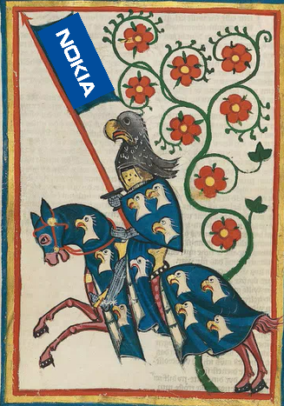

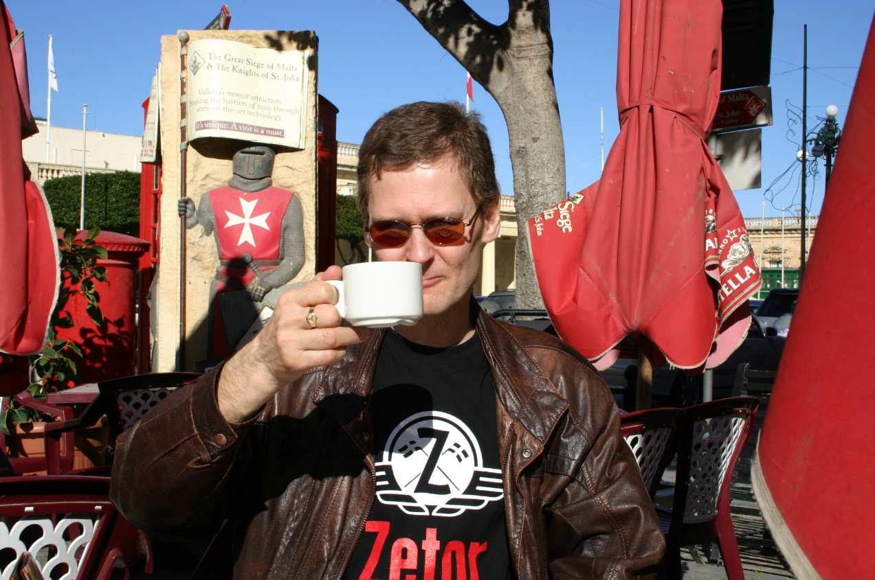
Background
This has been Hannu’s life for many years

Slide 3
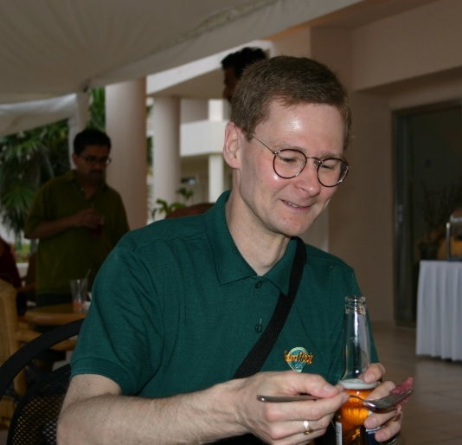
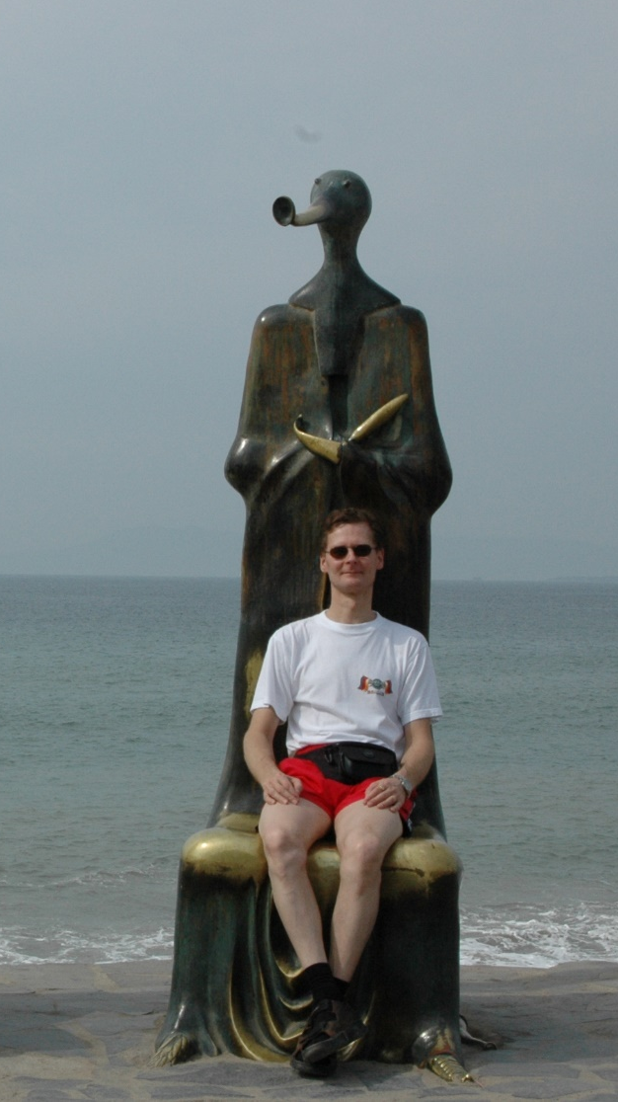
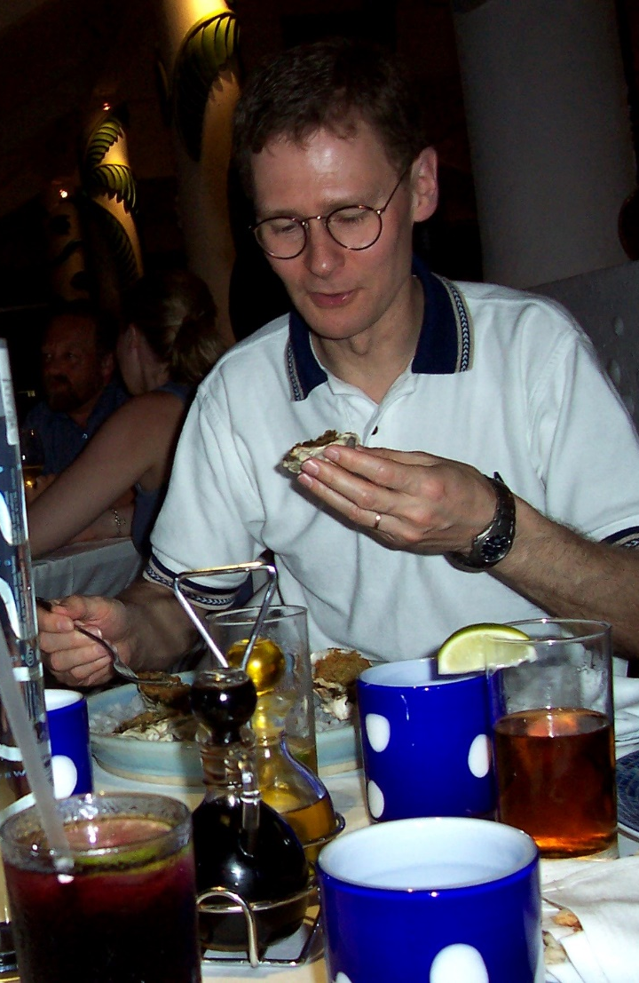
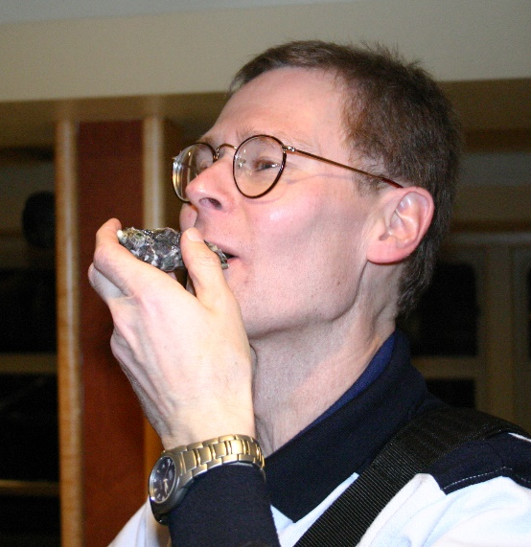
3GPP had some good aspects…

Slide 4
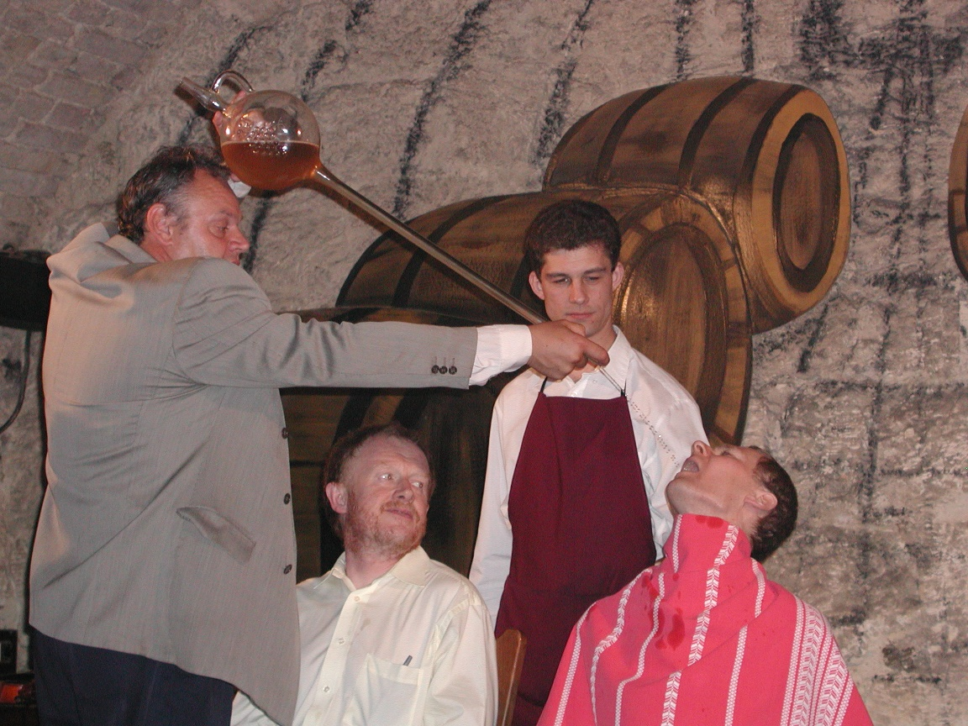
… and some more dangerous!

Slide 5
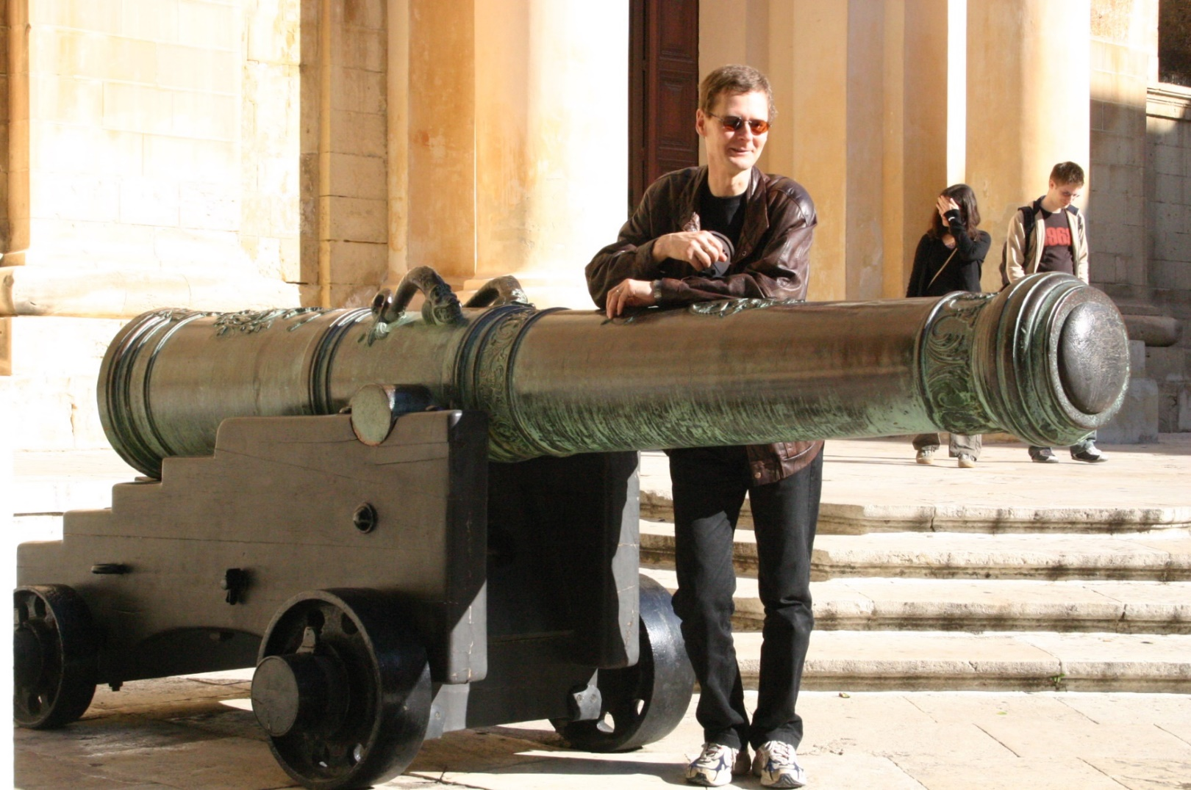
But Hannu could well defend himself
So beware !!

Slide 6
RAN impacts
none

Slide 7
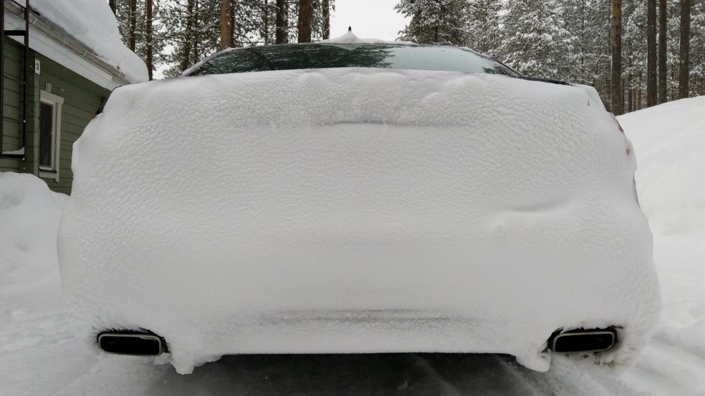
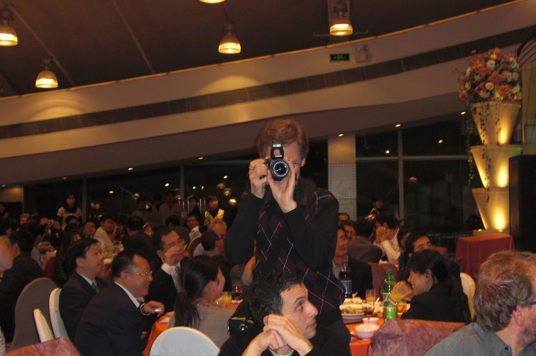
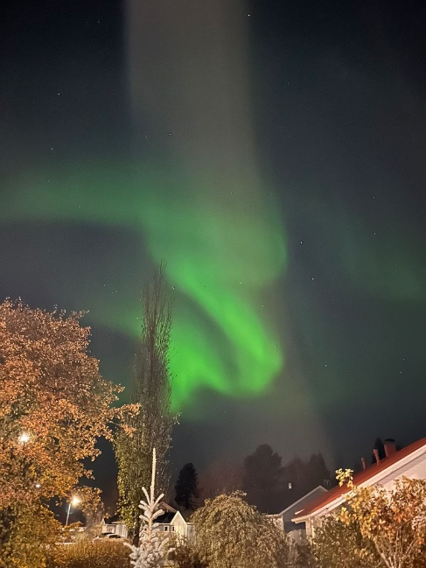
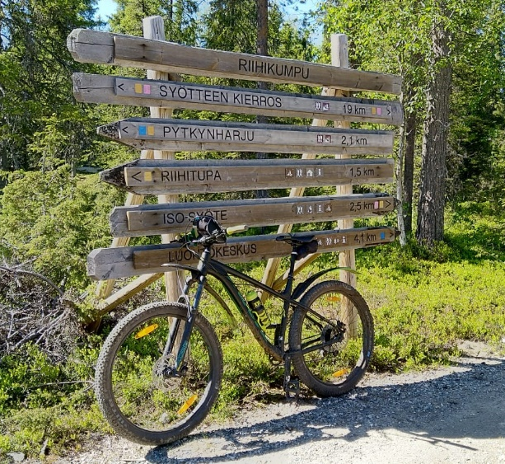
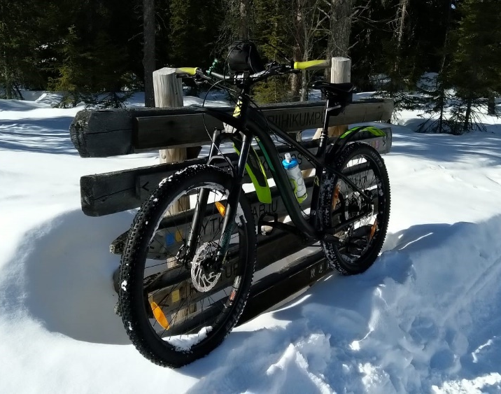

Motivation: Time to move to
More photos?
Something going faster than 3GPP: cars on ice? or more biking?

Slide 8
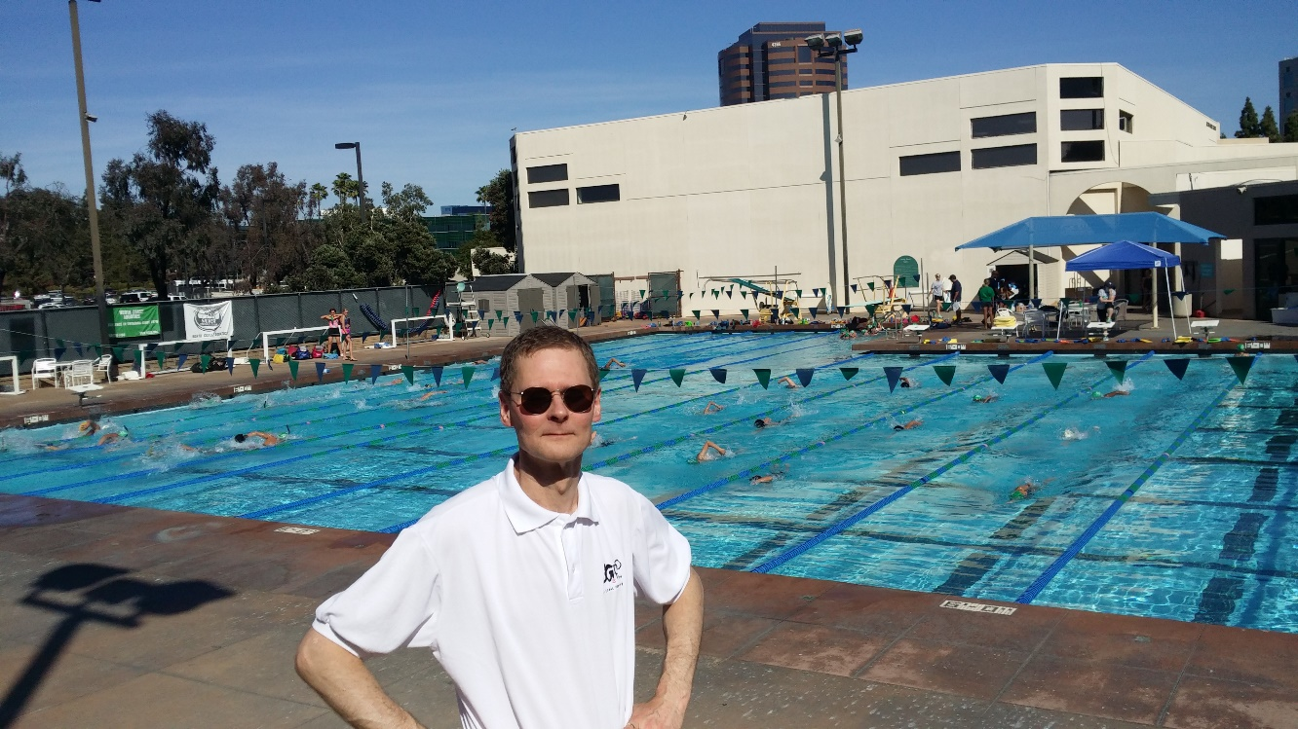
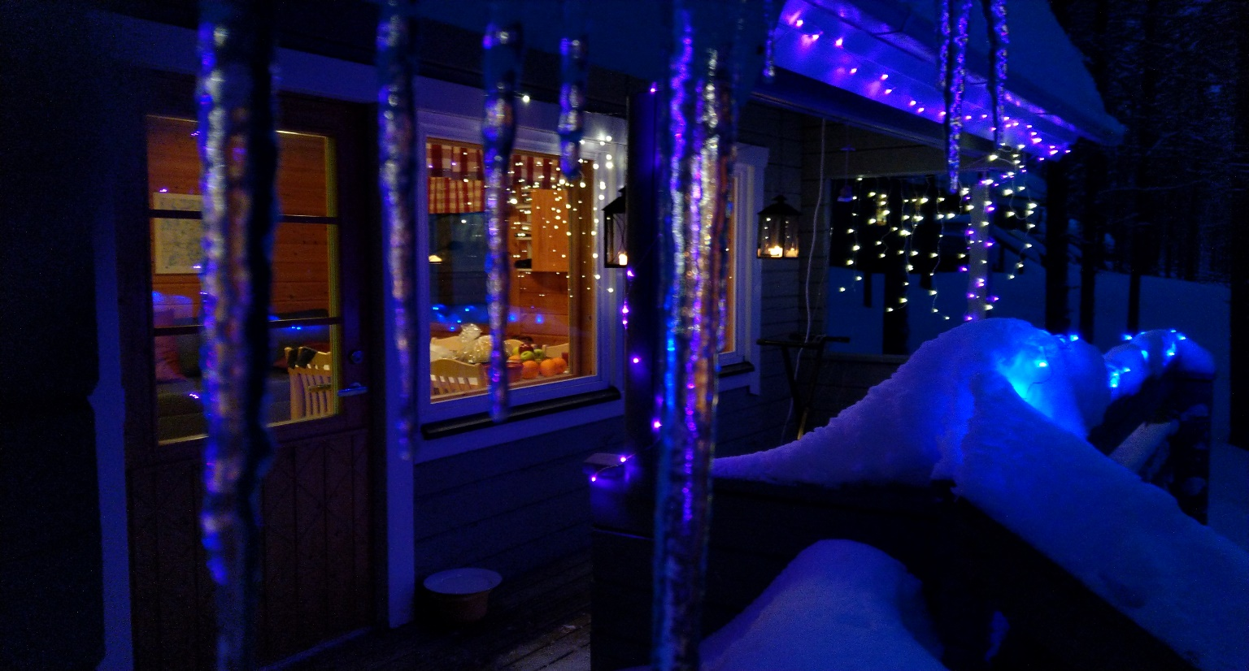
Time to move to
More fluid environment?
Santa Klaus’ house … that has connection to 3GPP specs !!

Slide 9
HAVE FUN,
HANNU !

