Slide 1
Working now on important topics
S2-24A3F2D
Due to the cnstant increase of the Number of Tdocs it has been decided to go to hexadecimal Tdoc Numbers
justification for a release independent WID

Slide 2


Background
This has been Hannu’s life for many years

Slide 3
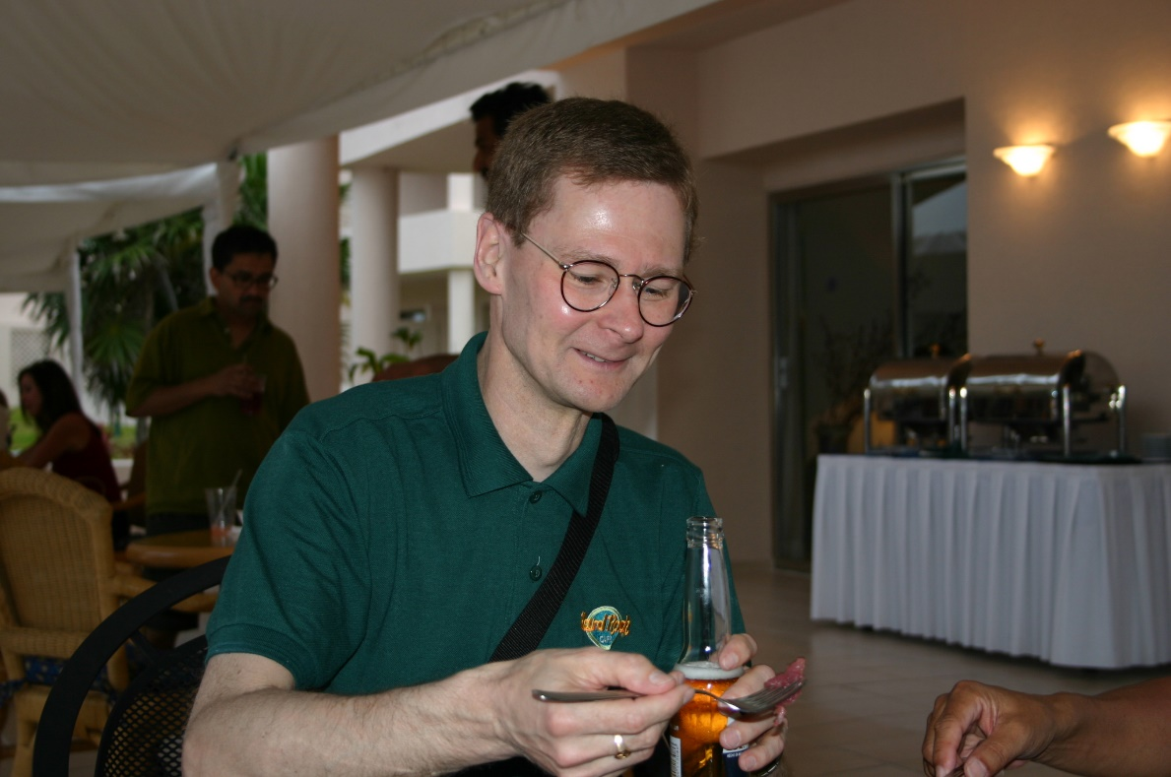
But 3gpp had some good aspects

Slide 4
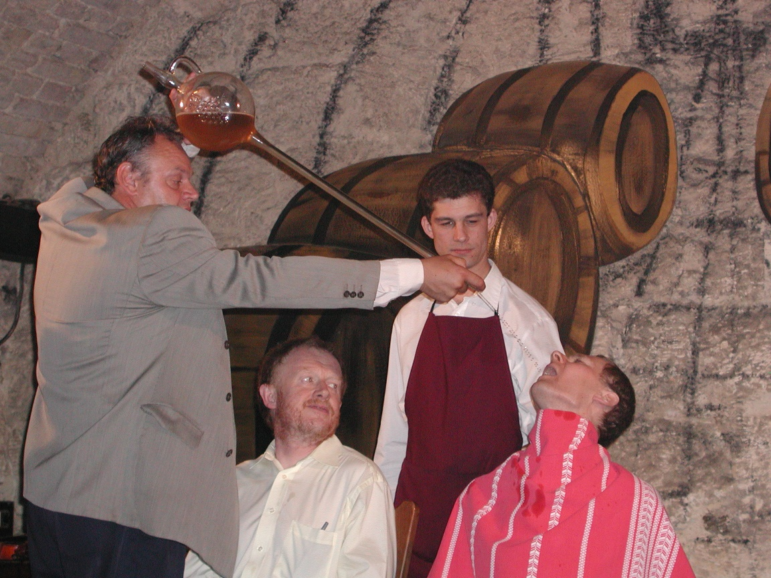
And some more dangerous

Slide 5

But Hannu could well defend himself
So beware !!

Slide 6
RAN impacts
none

Slide 7

Motivation: Time to move to
something going faster than 3GPP: cars on ice?
Something more poetic?

