Slide 1
Discussion on
Busy indication from RRC_Inactive based on LS from RAN2
by Sony

Slide 2
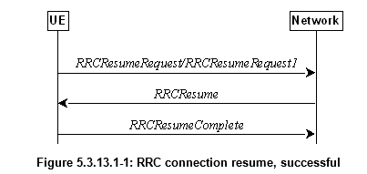
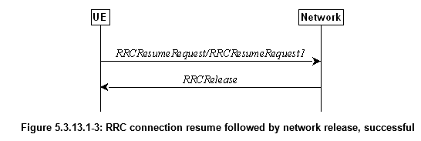
Identified Serious Issue based on the RAN decision
After receiving paging message, the UE shall select ResumeCause for the RRCResumeRequest: mt-Access or perhaps mo-Signalling in this case.
Based on the cause value the RAN shall send RRCResume msg to resume all the SRB and DRBs stored in the UE context.
After receiving the RRCResume msg, the UE enters RRC Connected state and sends RRCResumeComplete. All SRB, DRBs are configured, and UE starts monitor the control channel for DL-scheduling, channel measurements, etc…
Since the RAN has data in the buffer it will schedule the data and send it to the UE.
AMF will later ACK the Reject Paging Indication to the UE and trigger the UE Context Release (NG-AP) to RAN. (N2 and N3 released, UE moved to CM-Idle)
The solution to reject Paging using a NAS message when the UE is in RRC-Inactive results in counter productive events for the UE.
  The RRC Connection was resumed with all stored configurations
  The DL data in RAN was sent to the UE even though the UE wanted to reject the page
  The UE was then released to RRC-Idle/CM-Idle, which may be less efficient state
RAN has no tool to prevent all above to occur without specification changes!!!
To prevent this and make Reject Paging usable for RRC-Inactive a new cause value needs to be defined:
  RAN can detect that the UE is rejecting the page and stop the resume procedure
  RAN can the Release the UE to either RRC-Inactive (new I-RNTI) or RRC-Idle
  In case UE is released to RRC-Idle the RAN sends a UE Context Release Request to AMF.
…to transit a UE in RRC_INACTIVE back to RRC_INACTIVE when the UE tries to resume; or to transit a UE in RRC_INACTIVE to RRC_IDLE when the UE tries to resume...

Slide 3
Conclusion
There are fundamental issues to respond with a NAS SR including the Reject Paging Indication to RAN paging without any changes to the RRC specification.
There is no way to prevent RAN from continuing the Resume procedure which results in:
  The RRC Connection will be resumed with all the stored configurations
  The DL data that RAN has in the buffer (which triggered the page) will be sent to the UE even though the UE wanted to reject the page
  The UE will be released to RRC-Idle/CM-Idle after receiving the data and the NAS ACK.
The way forward to reuse the NAS based Reject Paging Indication proposed by RAN2 is not a viable way forward!
An alternative way forward would be to add a new cause value (mt-reject) which the RAN can detect and prevent the resumption of data radio bearers and release the UE
Proposal
SA2 should describe our concern and ask RAN2 to reconsider their decision
  Sony can volunteer to write an LS-draft for SA2#145 meeting
Only specify Reject Paging Indication for CM-Idle in SA2#145 meeting, align the specification later when RAN2 responds to the LS
Discuss the options for RRC-Inactive more in detail during the SA2#145 meeting.

Slide 4
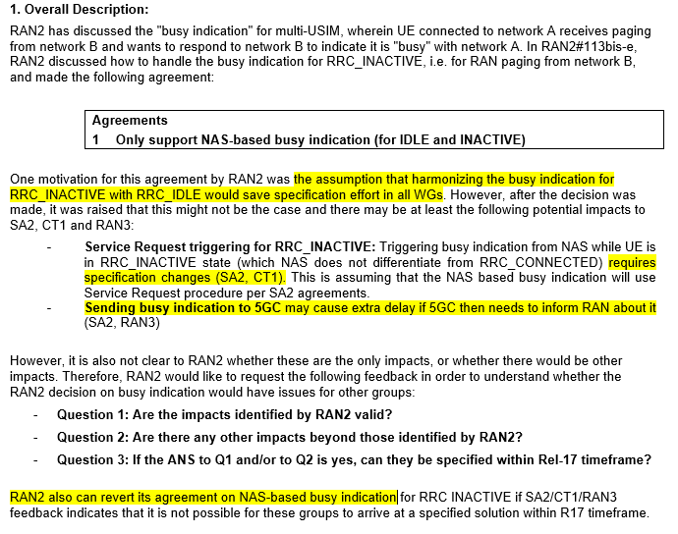
R2-2104354: LS on NAS-based busy indication
Tentative answers to RAN2 LS
Q1-answer: Yes, the impacts are valid.
Q2-answer: Yes, there are further impact and more serious issue….bla bla bla
Q3- answer: Specification impact can be handled within the rel-17 timeframe.
Ask RAN2 to reconsider the decision based on the serious issue found.

