Slide 1
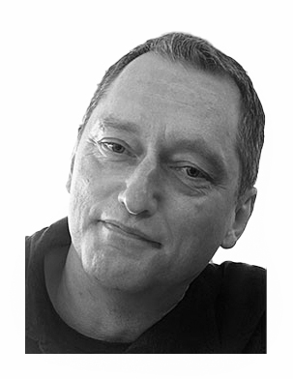
Remembering Peter

Slide 2
Peter was truly loved and appreciated by all of us
For twenty-four years, Peter was contributing to three generations of mobile systems as a champion of quality and technical excellence. It is deeply sad that he won’t be here working on 6G with us. Peter was a great colleague and a close friend to many of us, and we will never forget the moments we shared over all these years.
- Krister Sällberg
I have known Peter since the early Machine-Type-Communications days and he was more than a colleague - he was a dear friend. His kindness, integrity, and unwavering dedication to his work were inspiring. The loss of his presence will be felt by all who had the privilege of knowing him.
- Puneet Jain
____________
Working with, and knowing, Peter for more than twenty years has been truly memorable. His technical expertise was remarkable, as was his ability to help the group find compromise from conflict, always with gentleness and humour. It is hard to imagine our meetings without him there.”
- Andrew Bennett
____________
I am very sad to hear that Peter left us. He was a gentleman, great person and a role model to learn from. My deepest condolences to his family and friends. Peter will not be forgotten.
- LaeYoung Kim
____________
This is really sad and unexpected. Peter was a great delegate, and I will miss our exchanges on the floor of SA2. Convey my thoughts to his family.
- Patrice Hédé
____________
It is one of the most shocking and sad news I've got in a long time. Peter has been one of the greatest persons I've got the pleasure to meet in 3GPP always very pleasant and knowledgeable no matter what position you were on. My deepest condolences to the family and friends and the Ericsson team.
- Florin Baboescu
____________
It is a really shocking and sad news. Deepest condolences to his family and Ericsson Team.
- Jicheol Lee
____________
This is truly sad news. My sincere condolences to Peter’s family, friends and co-workers
- Mike Starsinic
____________
I was deeply saddened to hear of this terrible news. It's a unbelievable loss to SA2. My deepest condolences to Peter's family. We will miss him.
- Nihui
____________
I am deeply saddened to hear this news. Peter was a great friend and an excellent person. Please convey our deepest condolences to his family. May he rest in peace, and his spirit of kindness and respect for all continue to guide us all.
- Irfan Ali
____________
This is a shocking news and sad day for all of us. Deepest condolences to his family and Ericsson Team. Peter was a great delegate and will be always remembered in SA2.
- Mehrdad Shariat
____________
This is really shocking and sad! I still can't believe that this has happened to Peter. He was the perfect 3GPP delegate, both very professional and very friendly. I have known him for 15 years and enjoyed every occasion I had to interact with him. I would like to express my sincere condolences to his family and Ericsson team.
- Antoine Mouquet
____________
I'm really shocked to hear this sad news. He has been always a true, calm gentleman and helped a lot everyone including me. I have learned a lot from him. We will miss him a lot. My deepest condolences to his family.
- Atsushi Minokuchi
____________
Terrible news. We have lost one of the best 3GPP delegates ever: firm, yet kind; seeking compromise until the last minute, never losing his temper, often with a smiling face.
On Friday afternoon in Maastricht I had the privilege to enjoy Peter’s company on the way back from the conference centre to our hotels. We talked about his father, the summer house, future plans… then “See you in Hyderabad” with a radiant smile. Life can be so unpredictable and unfair ☹
RIP Peter. Sincere condolences to your family and Ericsson colleagues.
- Saso Stojanovski
____________
It is really shocking and sad. When I have been told that Peter has passed ways I couldn’t believe it. Please convey to his family all my (our) sympathy and tell them how much we praised his expertise and his humor. We will miss him a lot
- Laurent Thiébaut
____________
This is indeed shocking news hard to comprehend. Peter was an exceptional colleague, a real gentleman who always remained professional in his work. My deepest condolences to his family. I will miss him a lot.
- Krisztian Kiss
____________
I am deeply shocked by this news!!! Can't believe this. One week ago we are still in the meeting sessions together. I am lucky to work together with Peter in R15 on TS 23.502. I really appreciate that opportunity that I can learn quite a lot from him. He is such a kind man and professional. Please Krister and Ericsson colleagues help to convery my deep sorrow to his family and let me know if anything we can do for a remember of our SA2 buddy.
- Tao Sun
____________
What a great loss for Ericsson and this world! Peter is one of the nicest and smartest gentlemen that I have the honor to work with and to learn from in the past. I remember once that I asked him to teach me how to stay cool when interacting with people who is difficult and speaks strongly against you because this is the most difficult skill to master for working in 3GPP. It is unfortunate that I will never have the opportunity to learn this special skill from him.
Peter is always remembered as one of the most respected, nicest, smartest and kindest gentleman in 3GPP and his amazing legacy will always be the model on how we live our life.
My sincerest and deepest condolences to his family, our Ericsson colleagues and our 3GPP community. What a great loss for all of us and this world.
- Tricci So
____________
Still recalling his smile last week while walking down the hallway at the meeting.... this is unbelievable sad! My deepest condolences.
- Curt Wong
____________
So sad , I'd rather believe it's not true.
Peter is one of the most knowledgeable, courteous and constructive delegate I have worked with in 3GPP. It is a great honor for me to have such wonderful journey with him for the past 10+ years and I did learn a lot from Peter. It is a great loss of our big family. My sincerest and deepest condolences to his family, and our Ericsson colleagues.
- Wanqiang Zhang
____________
What a shocking and sad news ! I really like to work with him because he is always calm, always willing to help, always smiling and open minded. He will be missed deeply.
- Amanda Xiang
____________
A sad news indeed, I know Peter since 2000 and he was a real gentleman and always true professional. My deepest condolences to his family. Our thoughts and prayers are with them.
- Hugh Shieh
____________
I do not have enough words to express my feeling. My deepest condolences to his family.
- Marco Spini
____________
I am profoundly saddened by this terrible news. Peter was always very professional, calm, and friendly. We lost a true gentleman. My thoughts are with his family and Ericsson’s friends.
- Yannick Lair
____________
It is really shocking and unbelievable. We will miss you Peter. May his soul rest in peace. My deepest condolence to Peters family.
- Lalith Kumar
____________
This is a saddest news. Heartbreaker to all who knows him. Peter was a great man and a leader with all humanity and knowledge. My deepest condolences to Peter’s family and Ericsson Team.
- Jungshin Park
____________
Very shocking to learn the passing of Peter. Such sad news! Working with Peter was always comfortable and Peter is always kind to everyone and always willing to help and assist the colleagues with his exceptional technical skills. Please bring my sincere condolences his family and friends.
- Xiaobo Wu
____________
It is a very sad and terrible news. Peter was so friendly and knowledgeable, liked by everyone. He will be missed very much. My sincere and heartfelt condolences to Peter’s family and friends.
- Iskren Ianev
____________
And so many more…

Slide 3
Peter was truly loved and appreciated by all of us
Great Colleague
Close Friend
Gentleman
Role Model
Technical Excellence
Kindness
Calmness
Integrity
Humour

Slide 4
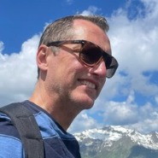
In memory of Peter Hedman
In memory of Peter Hedman
Peter is remembered with fondness as a man with integrity, exemplifying high standards, a team player, and a real Gentleman.
Peter conducted all his dealings with professionalism.
Peter was a friend and a colleague. His presence was always felt in meetings and hallways.
Peter touched us all with his beautiful personality.
Rest in peace my friend.
Syed Husain

Slide 5
Through more than 2 decades in SA2, Peter has touched many if not all of us.
Together we have made memories that shall last a lifetime.

Slide 6
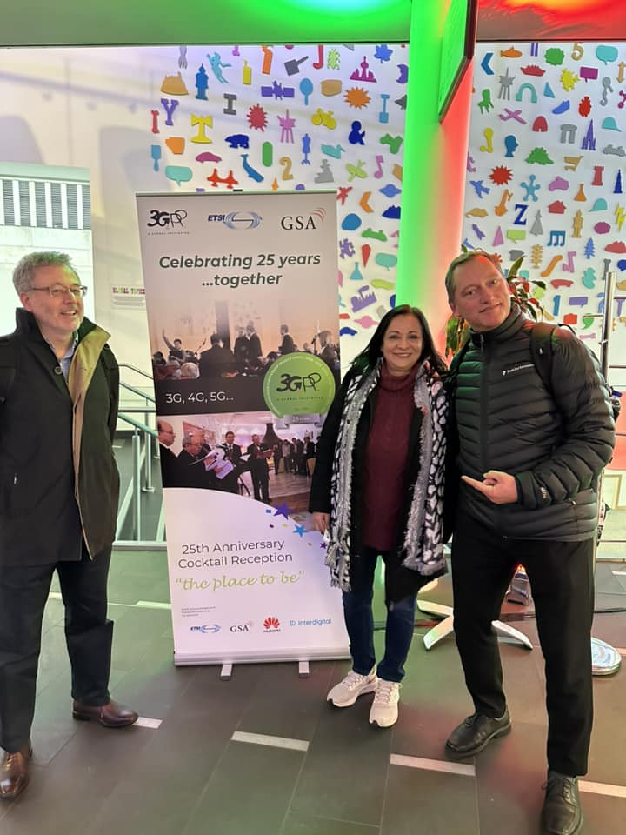
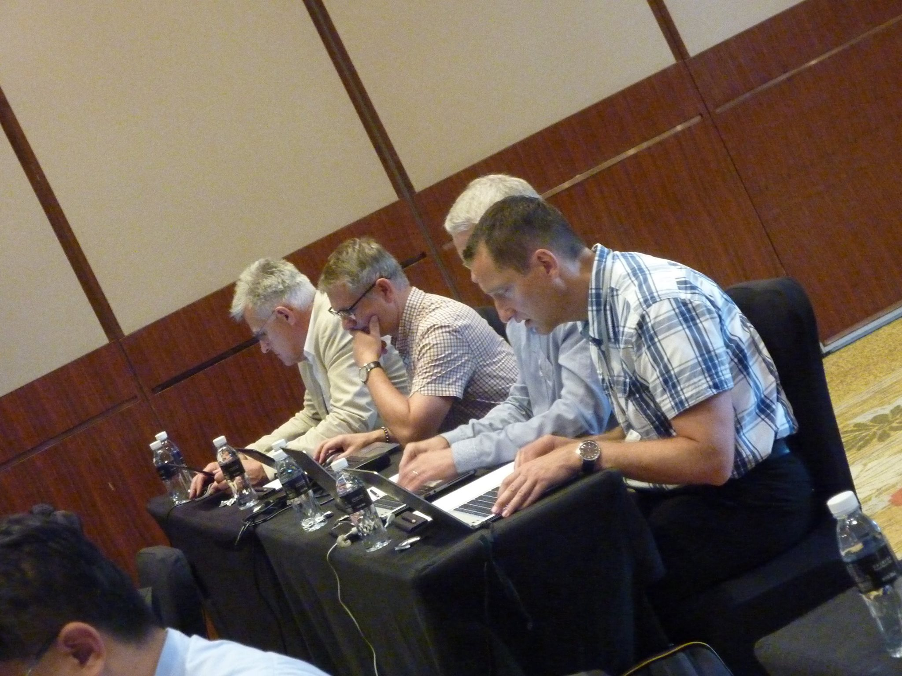
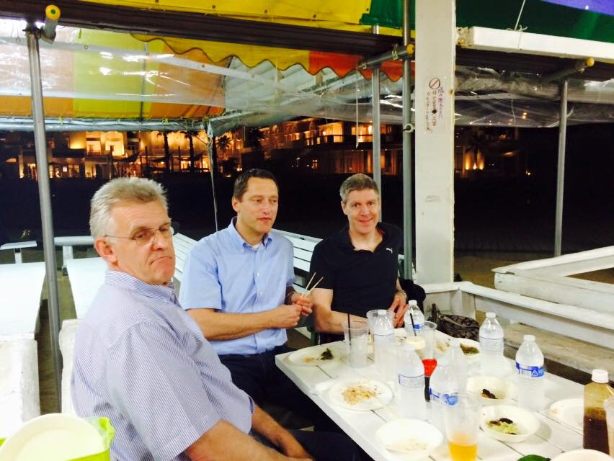

Slide 7
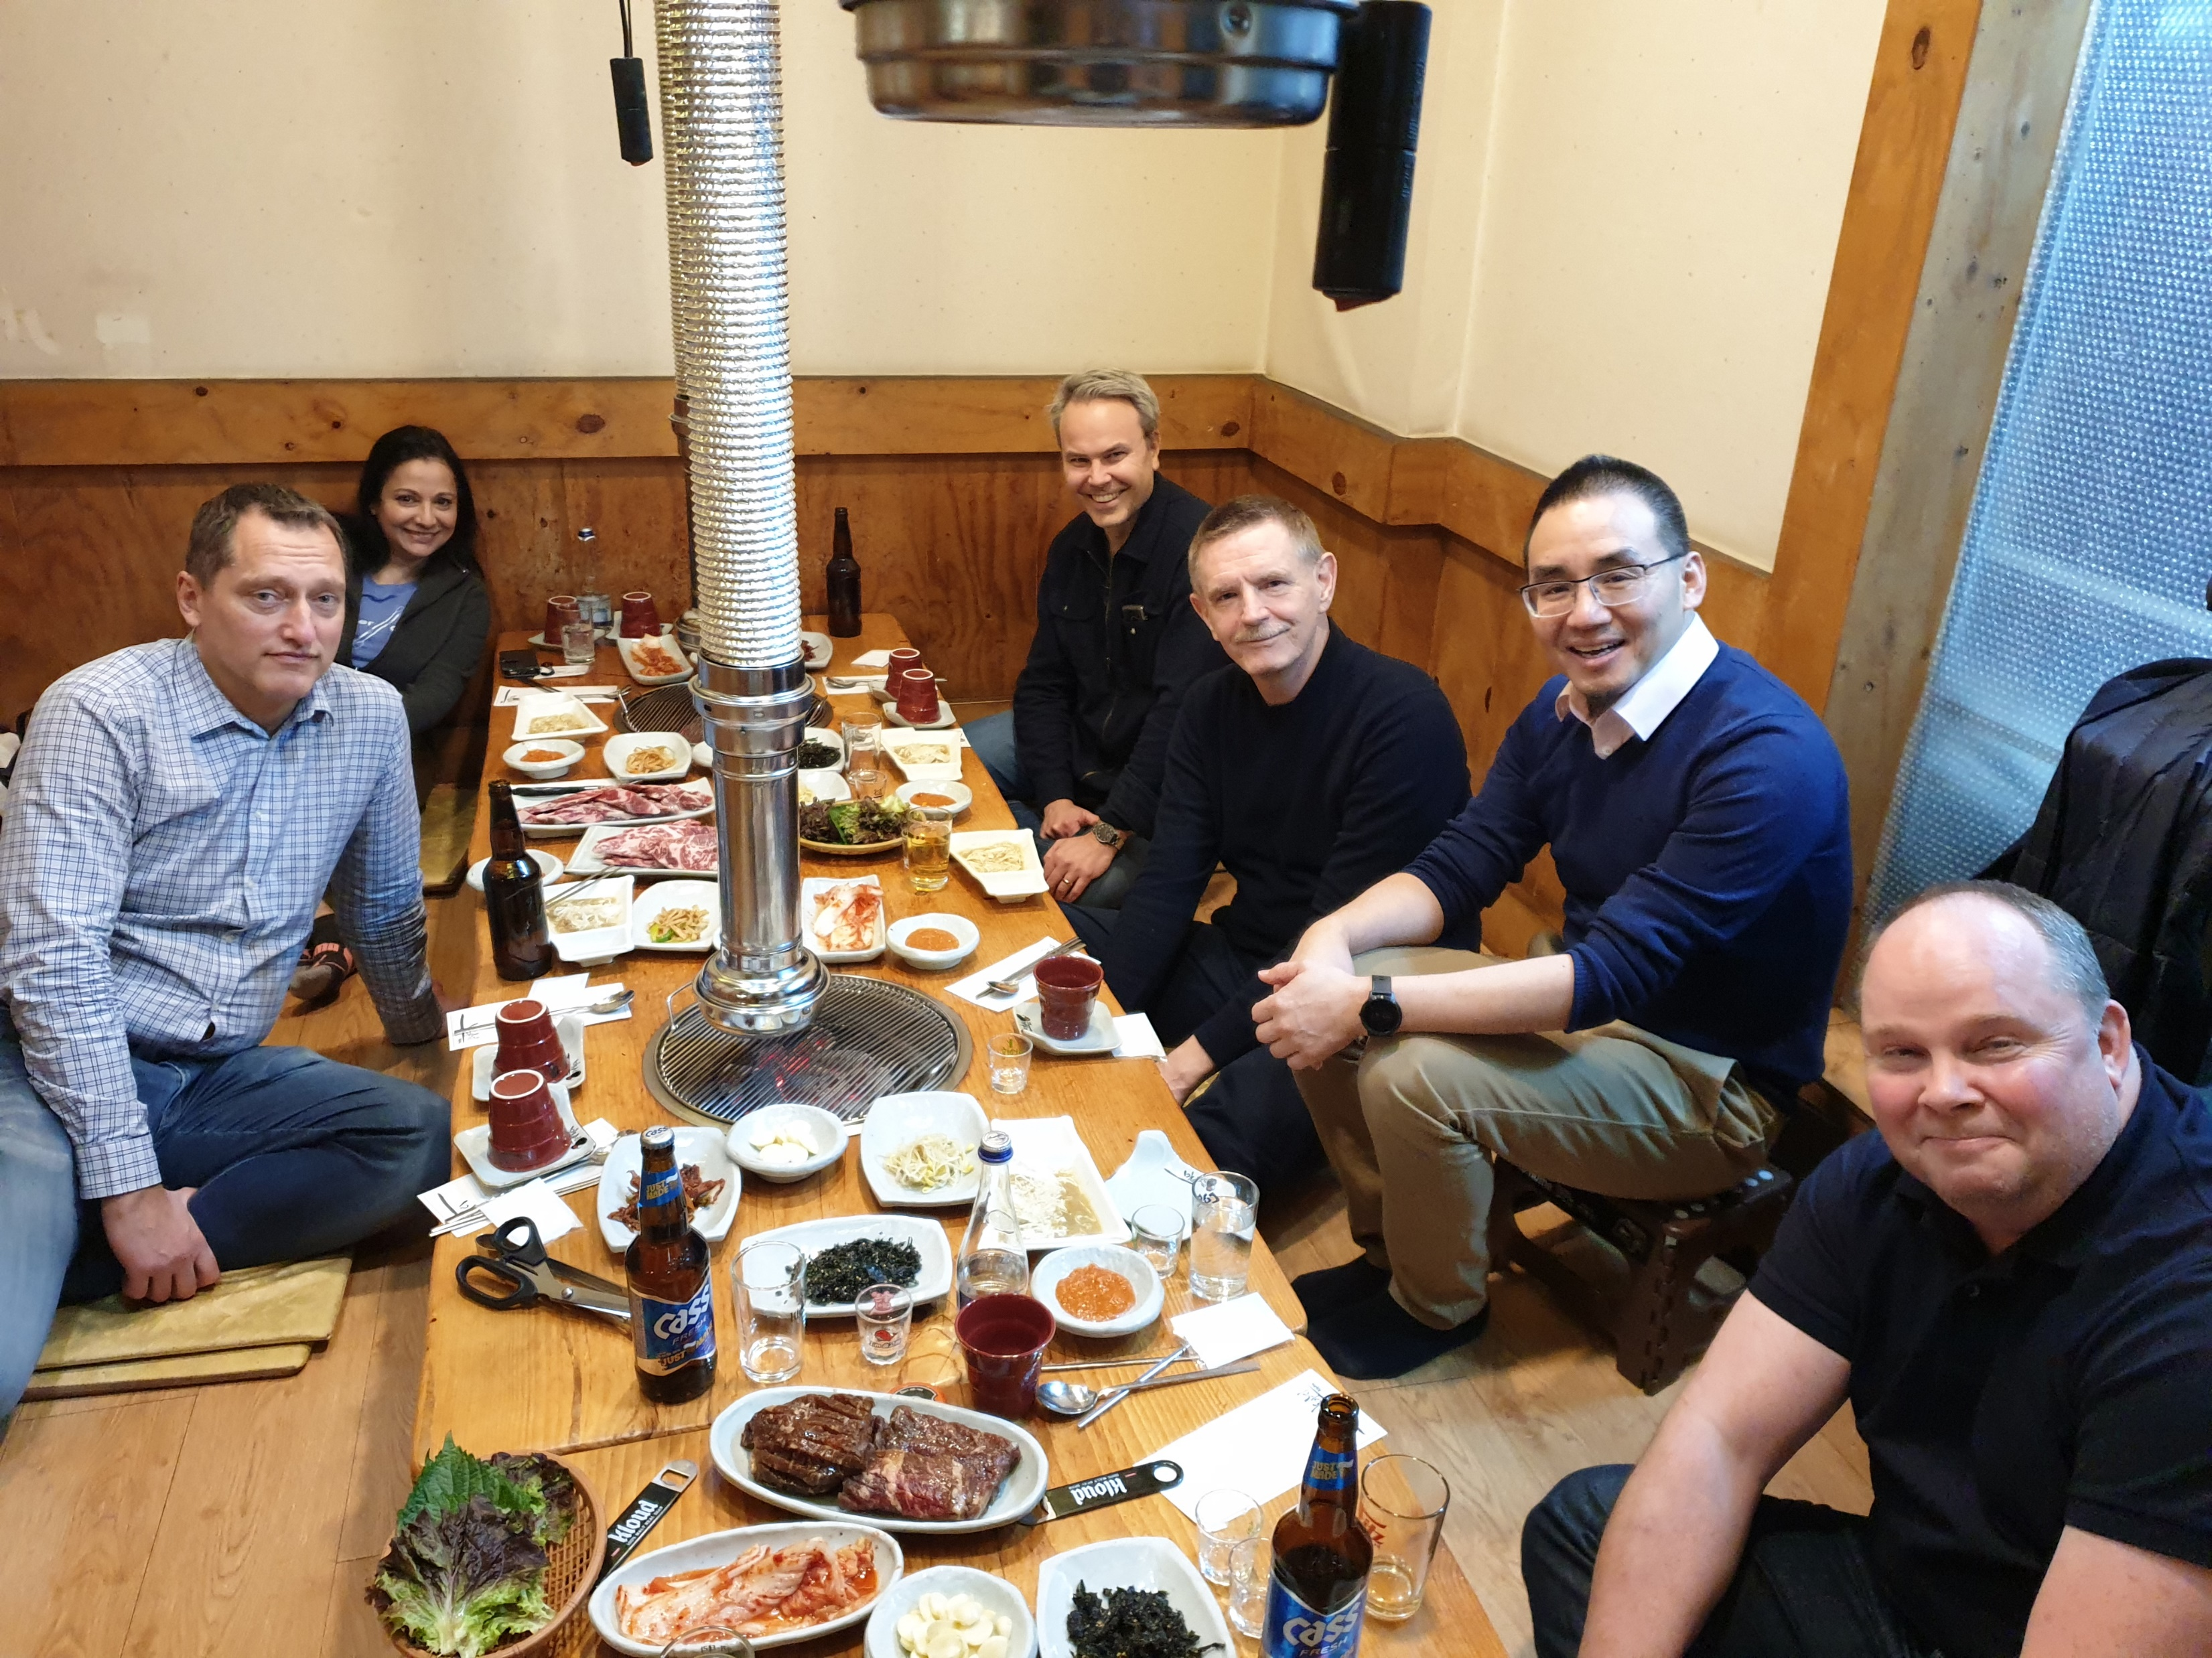
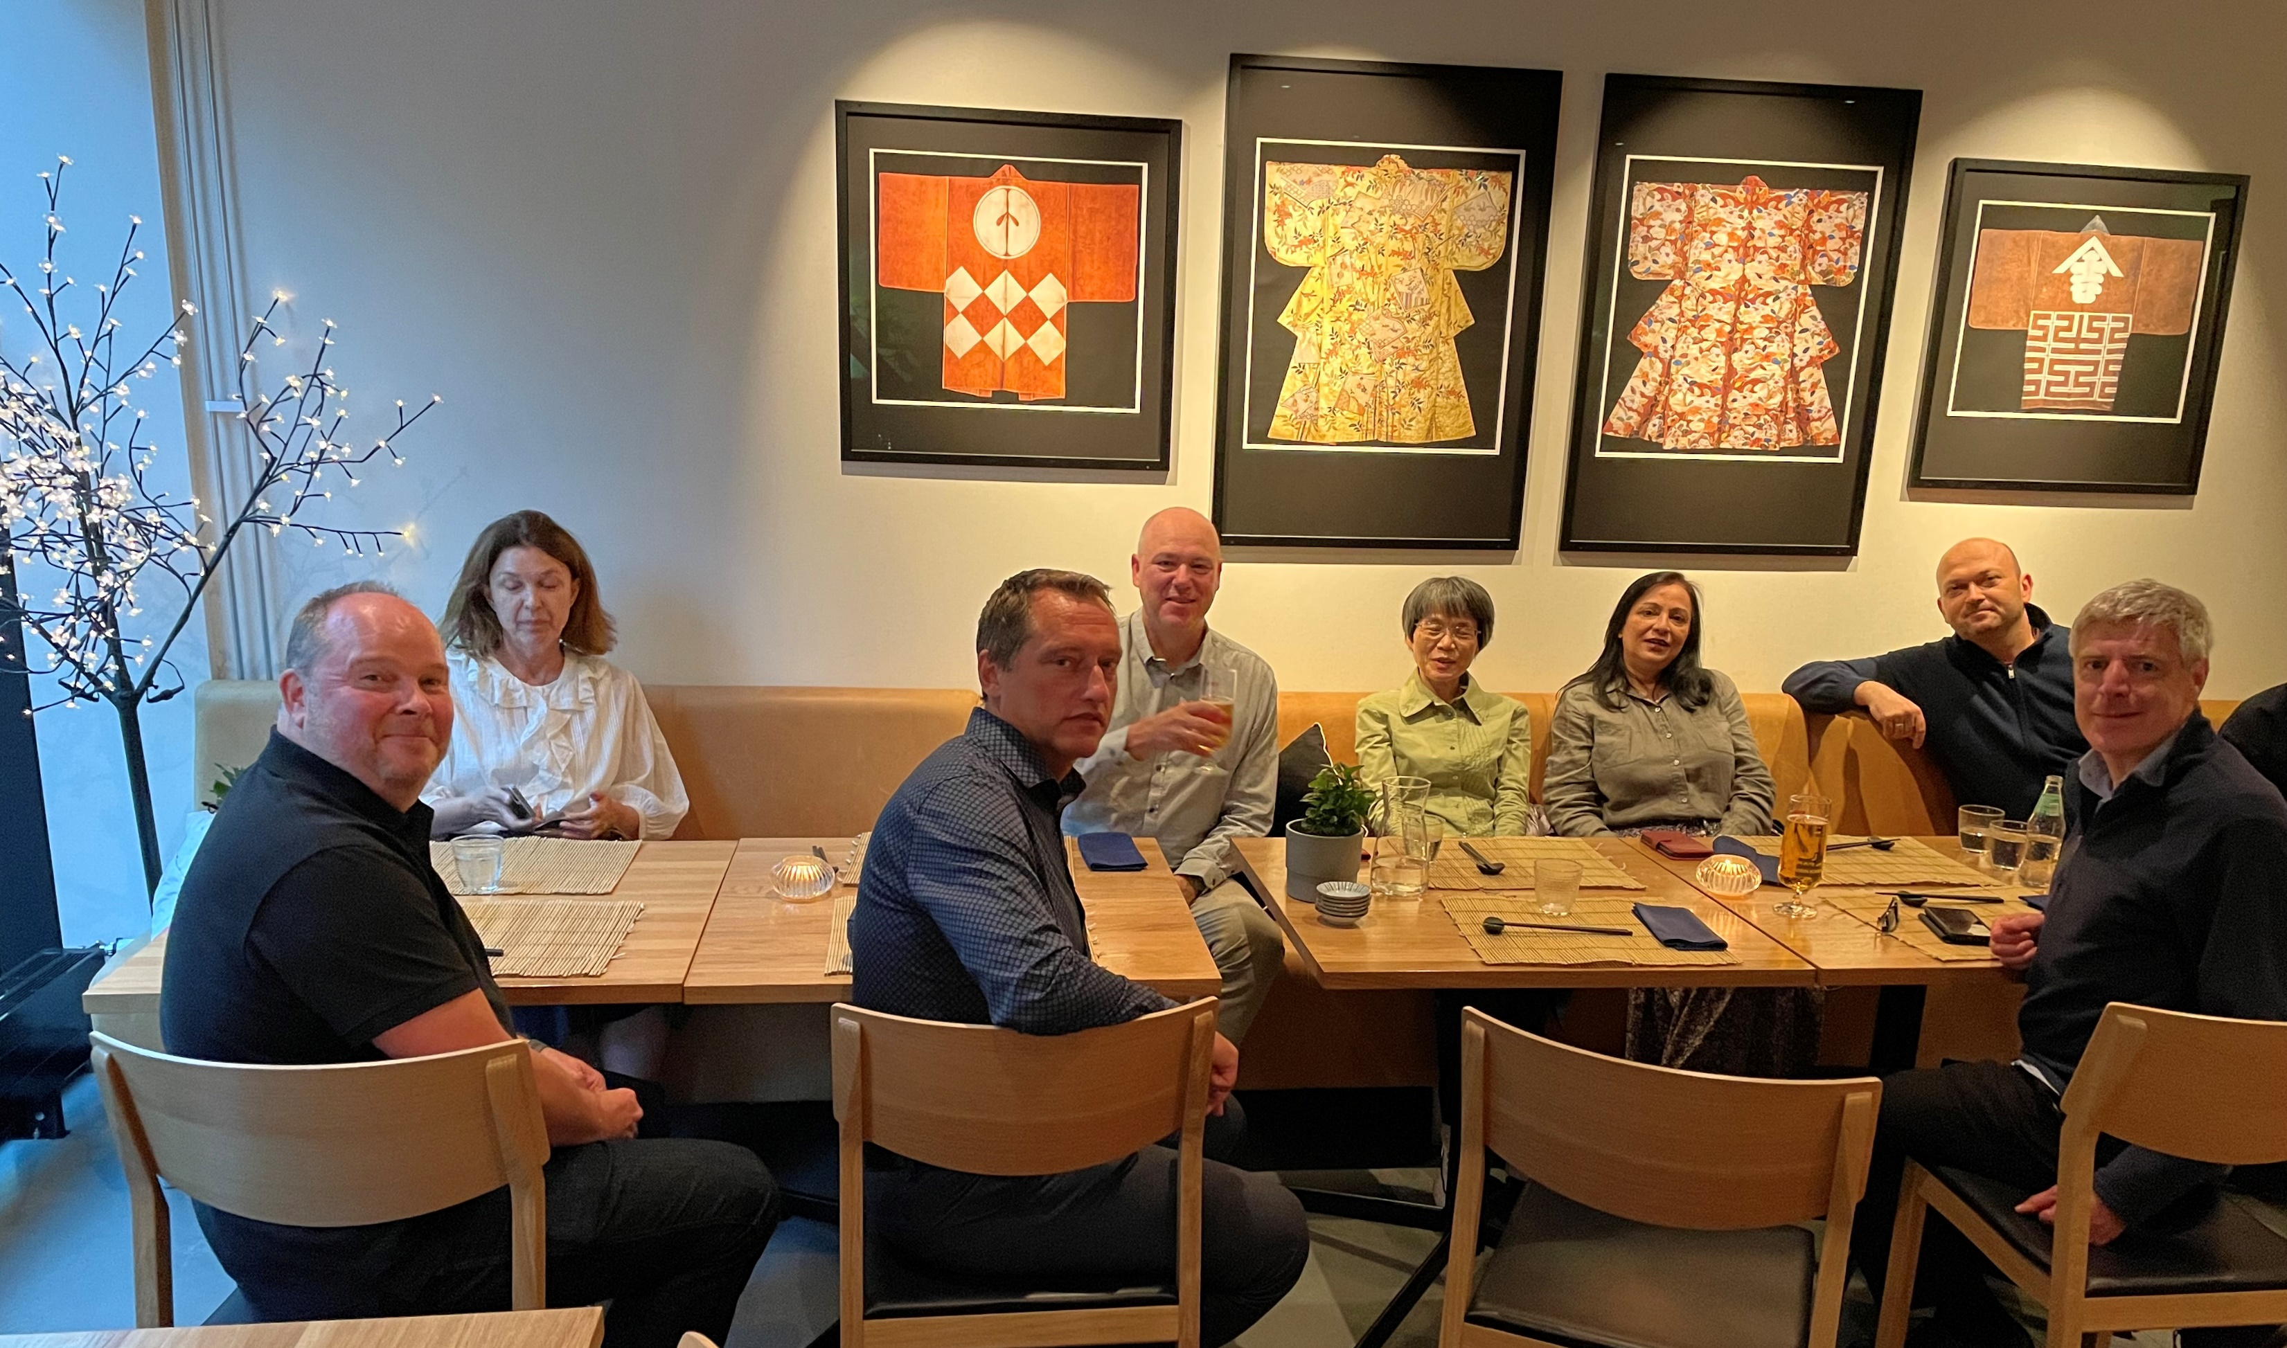
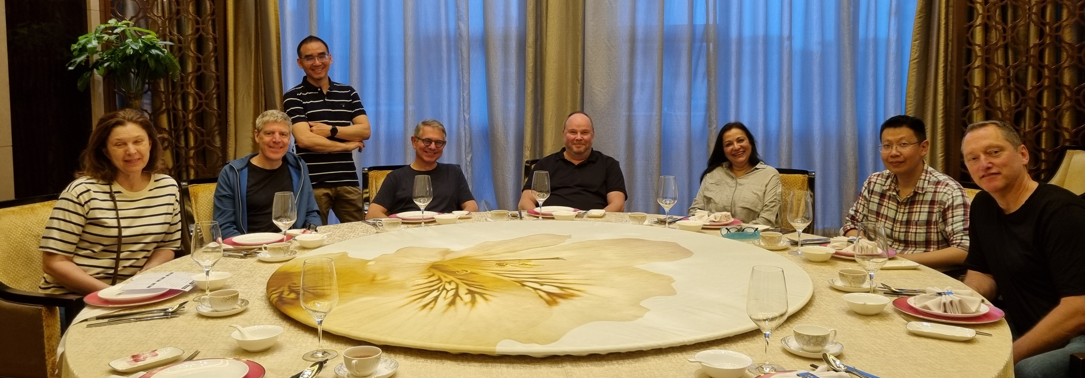
Quick with the pic! I’m STARVING!
Quick with the pic! I’m still STARVING!
Quick with the pic! You know!

Slide 8
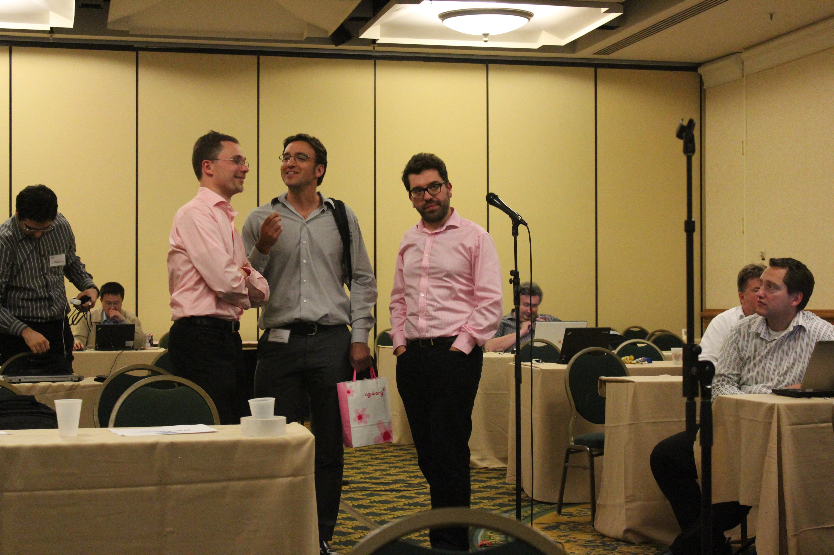
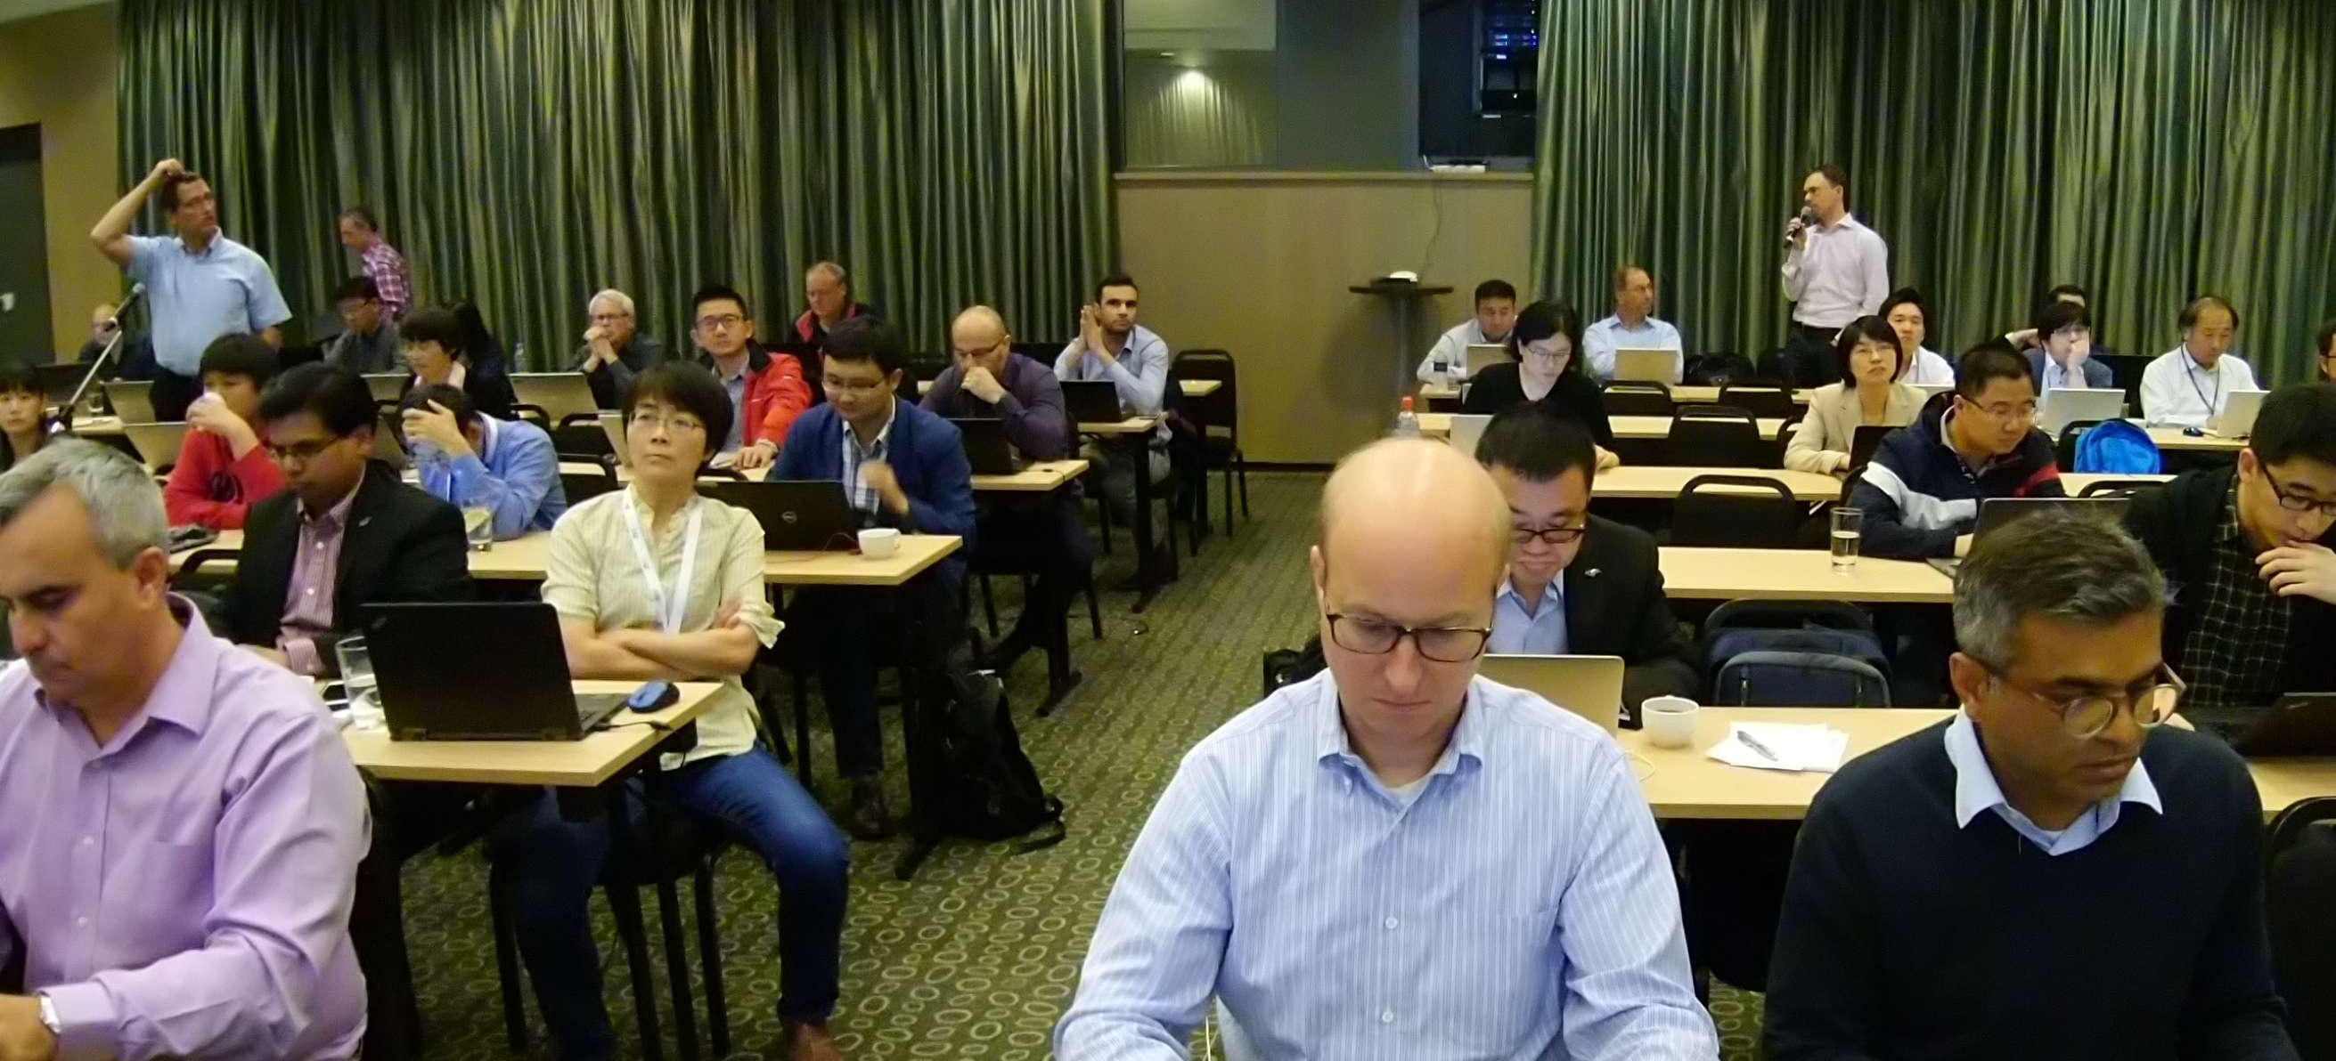
Join Qualcomm!
Join Qualcomm!
Embarrassing!
What’s going on?
This is the best solution!
I would not be so sure :)
scratch
scratch
Peter
Sebastian

Slide 9
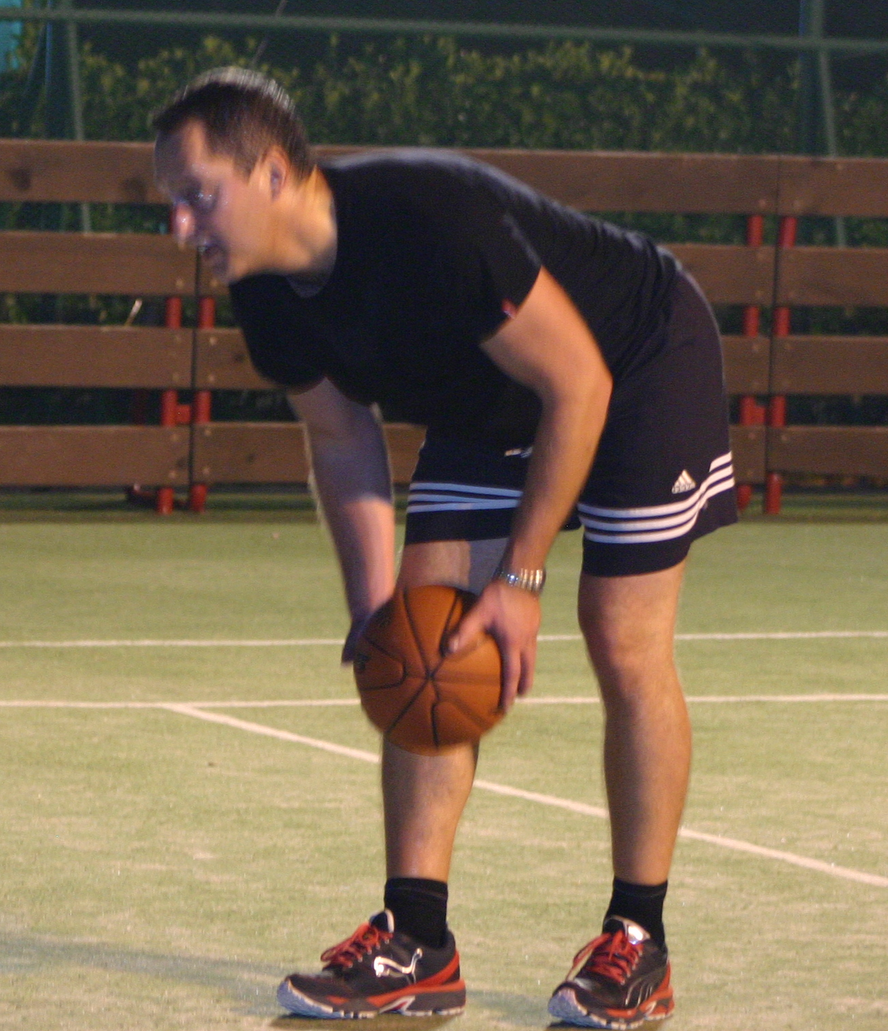
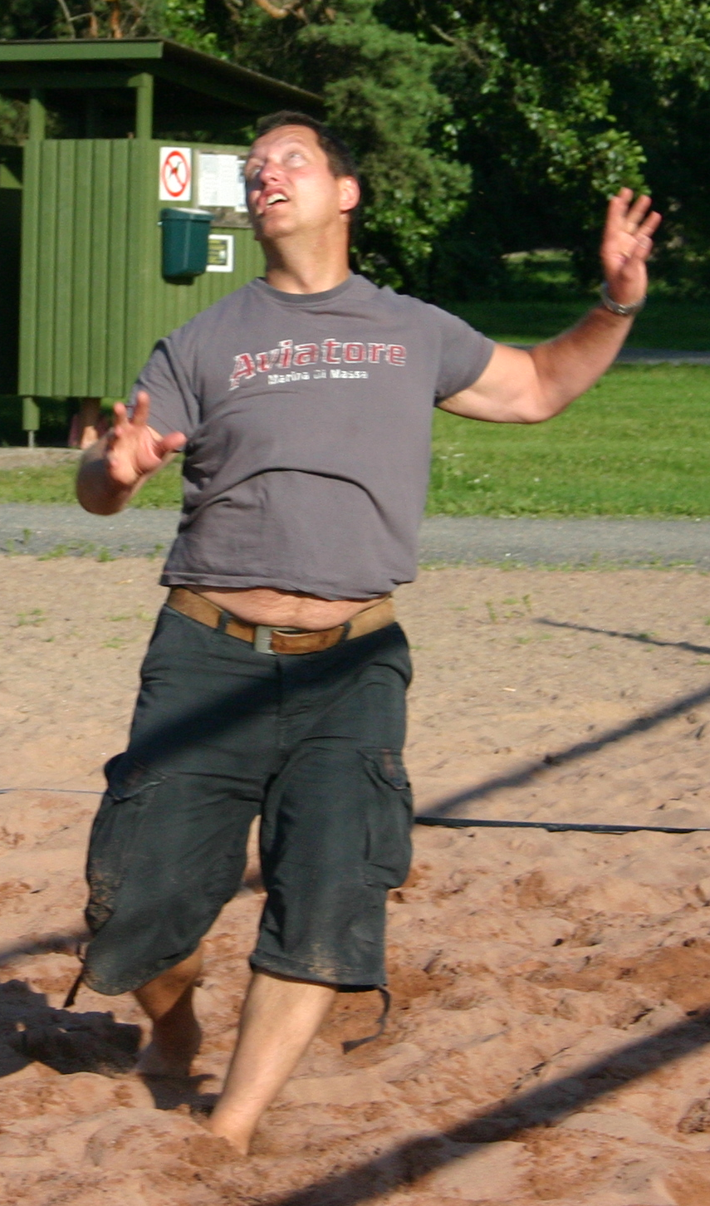
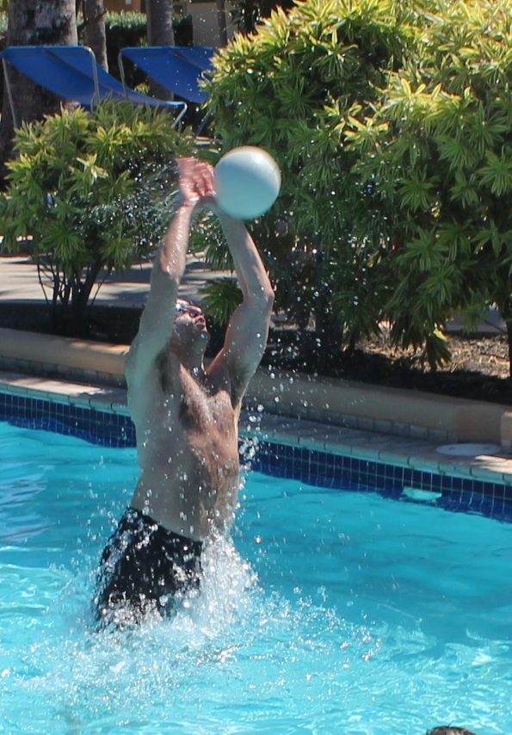
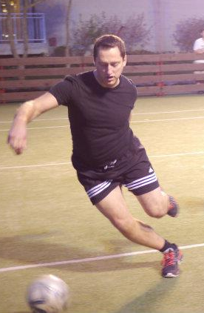
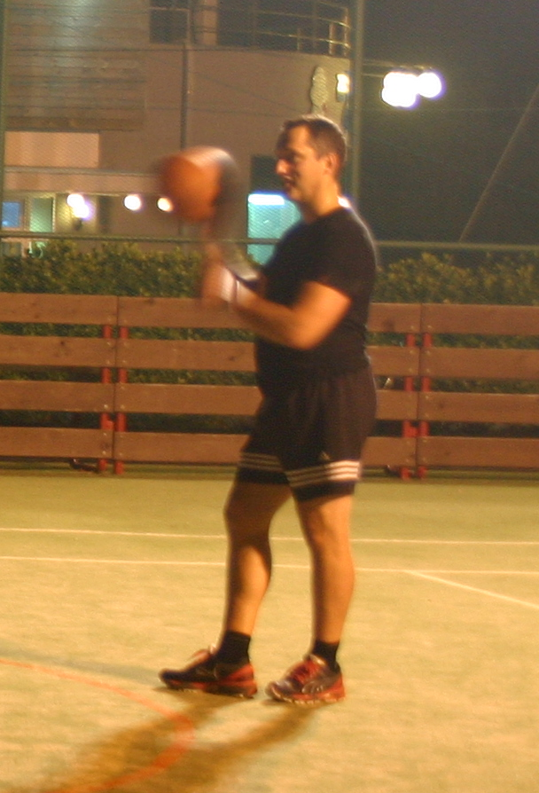
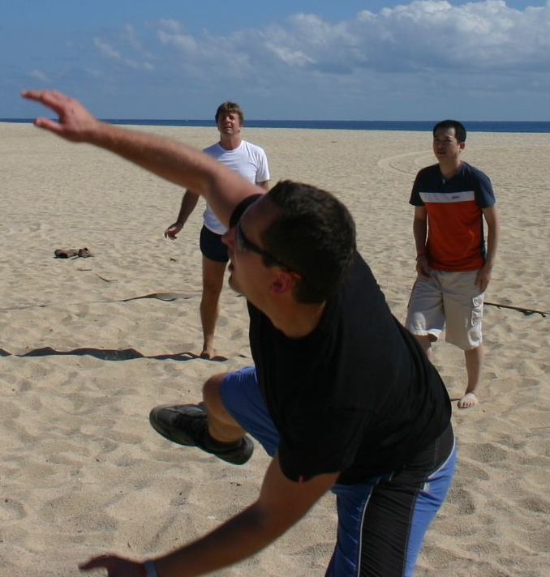
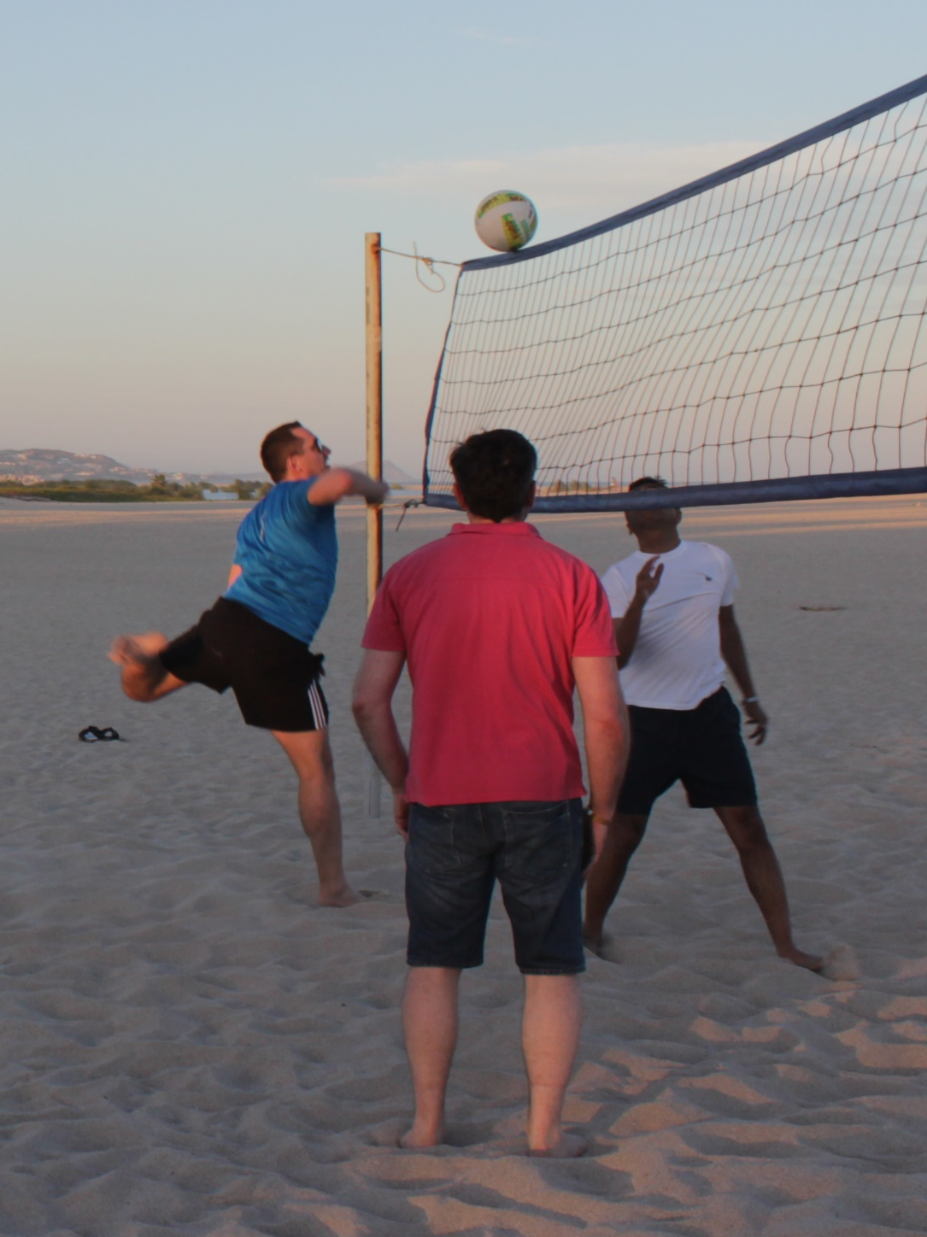
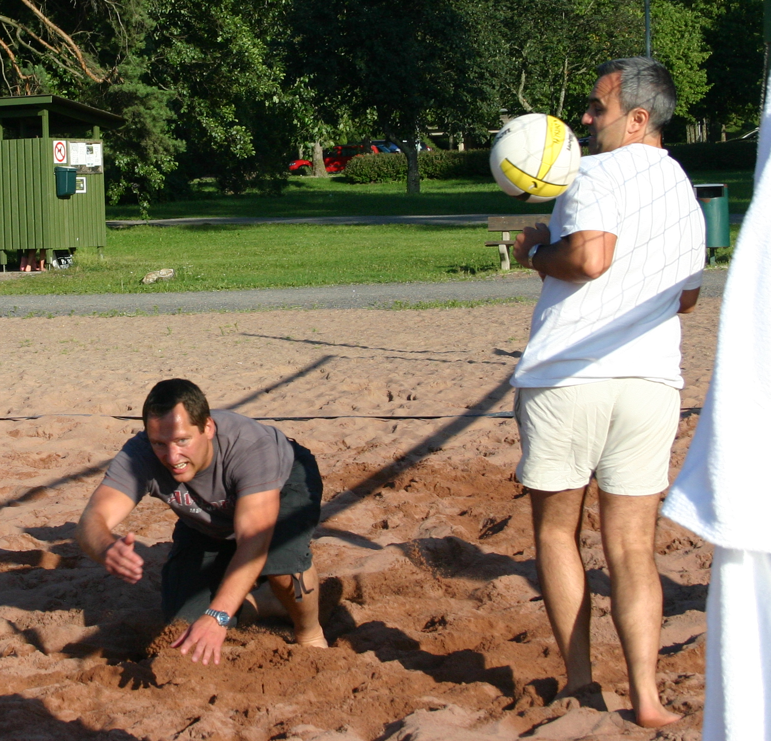
In or out of the meeting room,
Peter had many moves,
and was always playing ball.
Yes, here too
☺

Slide 10
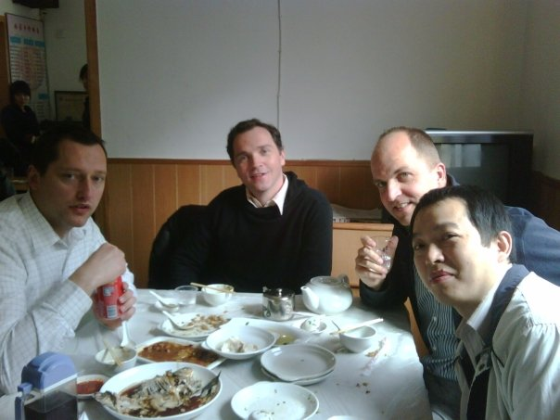
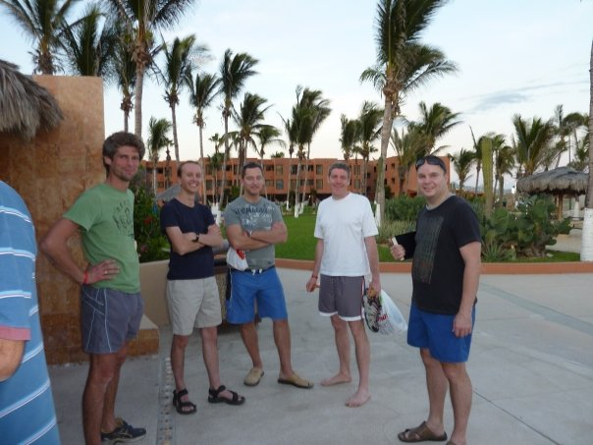
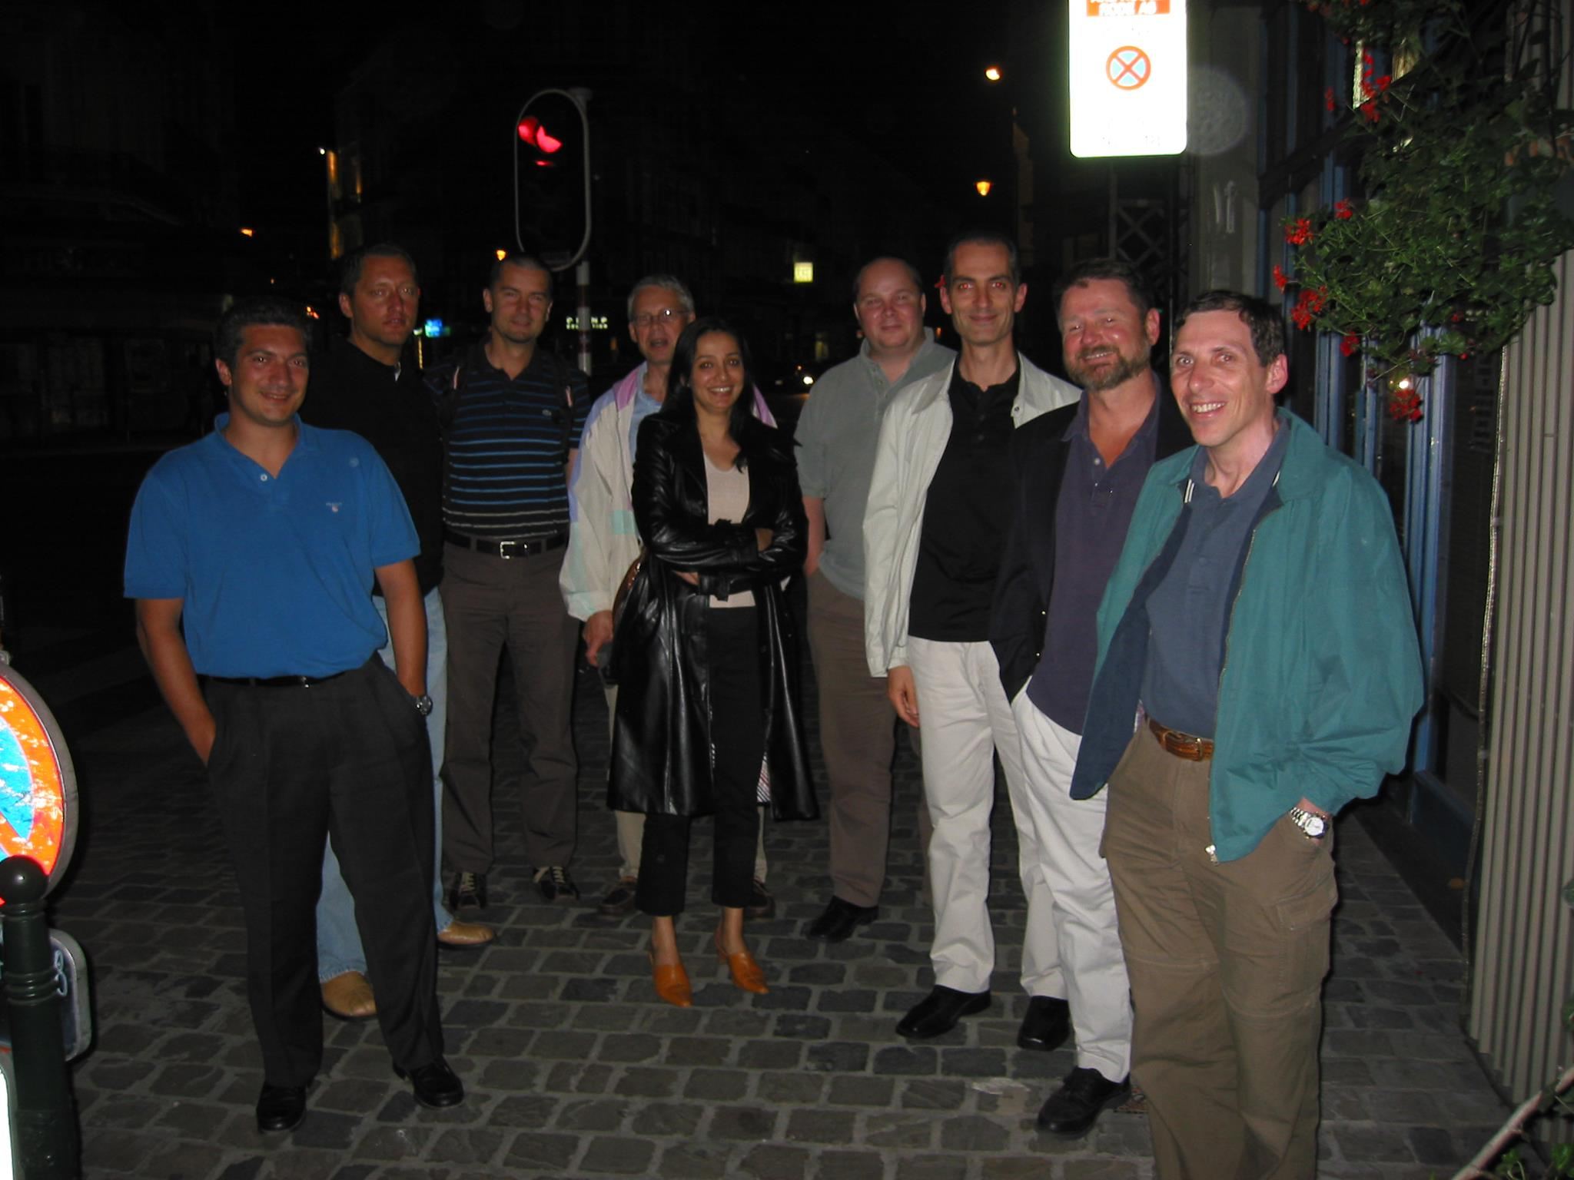
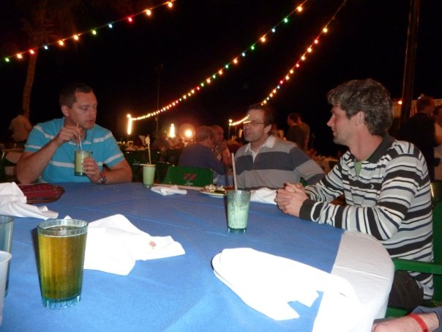
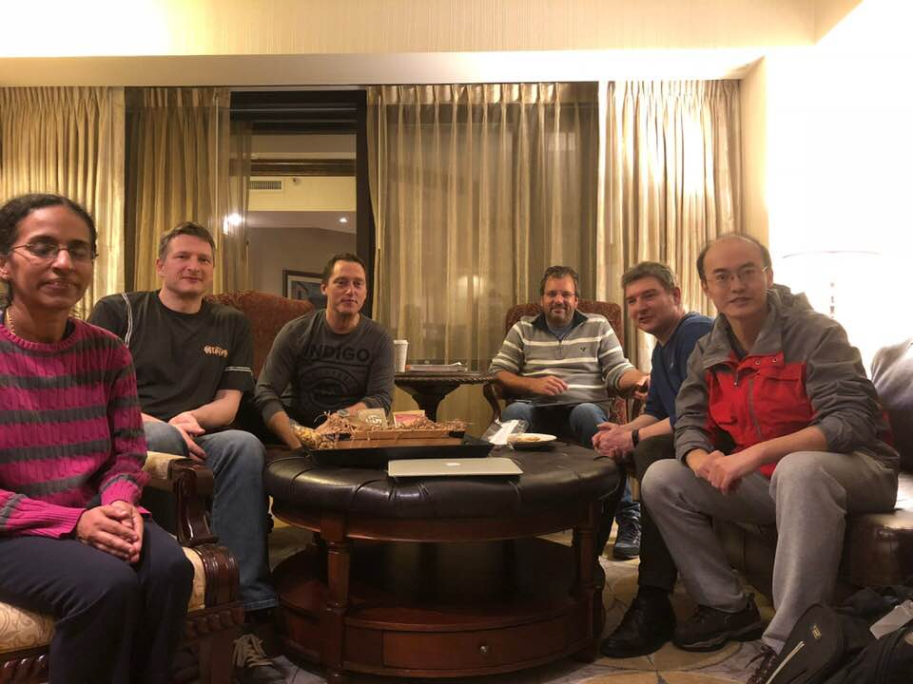
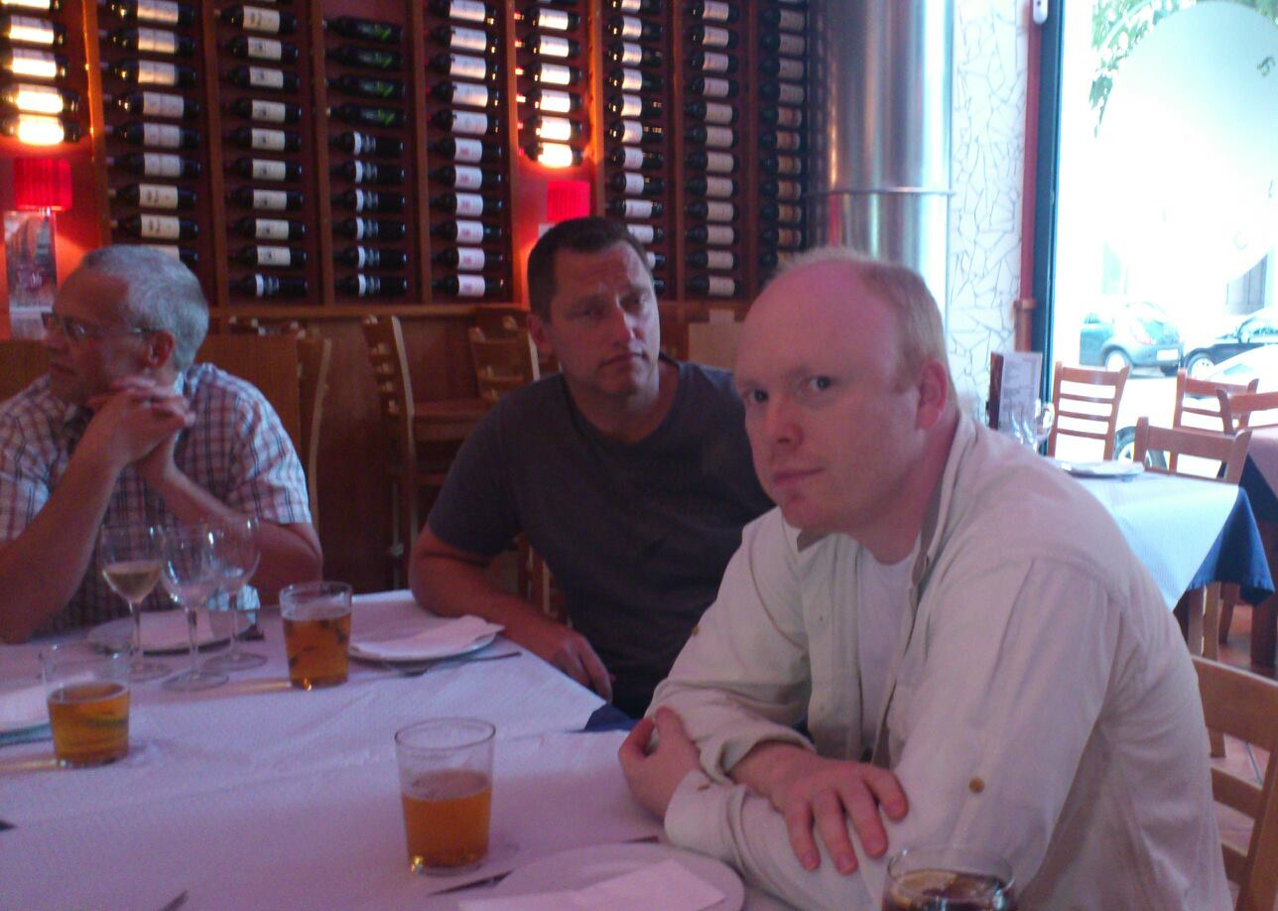

Slide 11
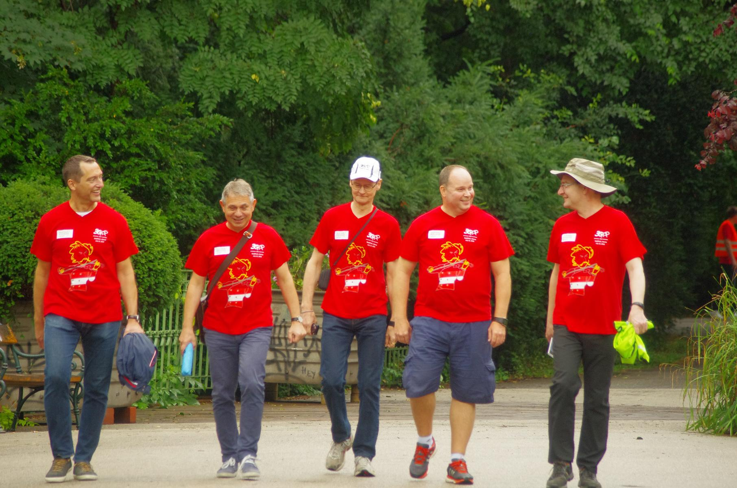

Slide 12
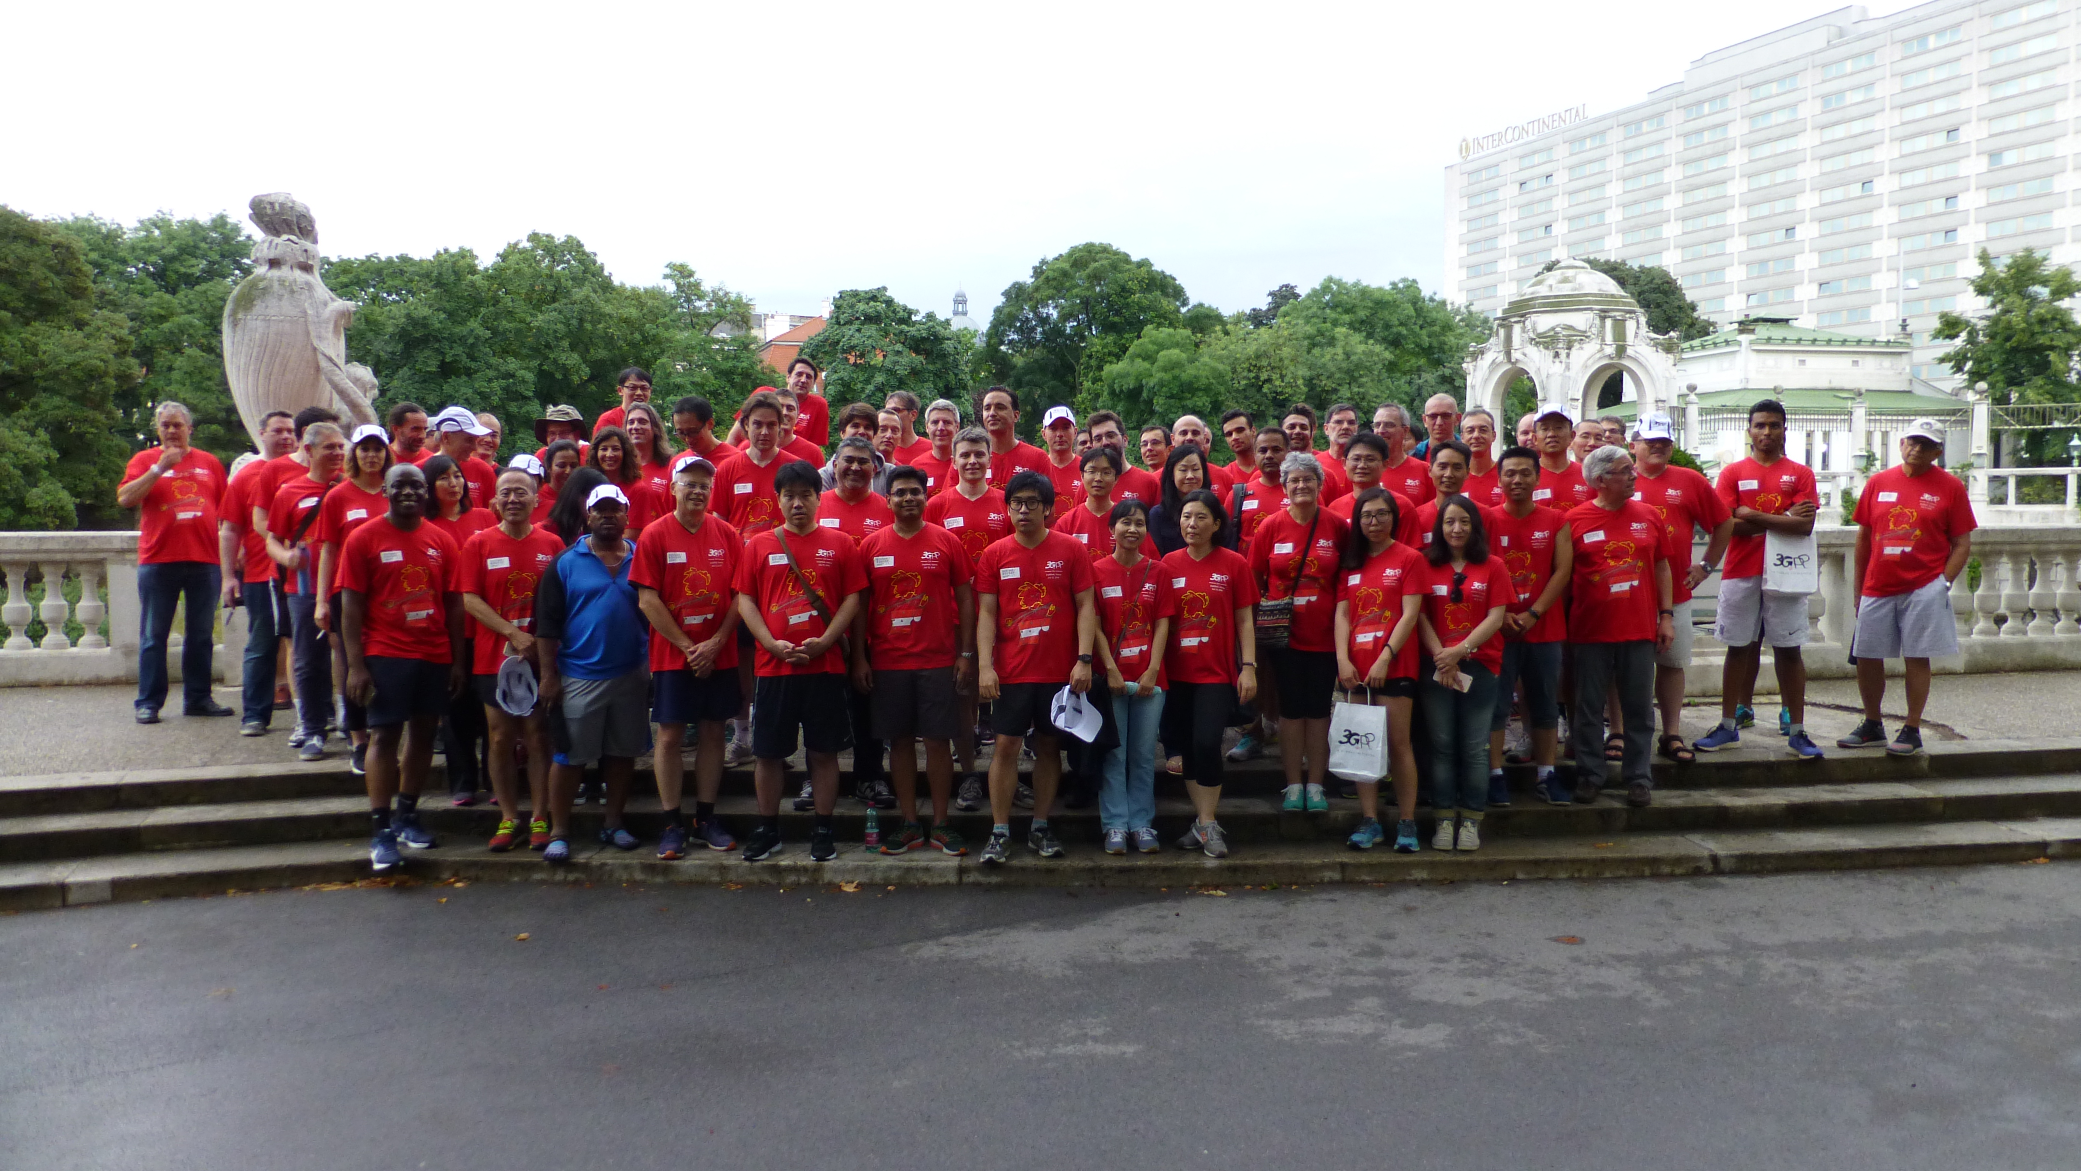

Slide 13
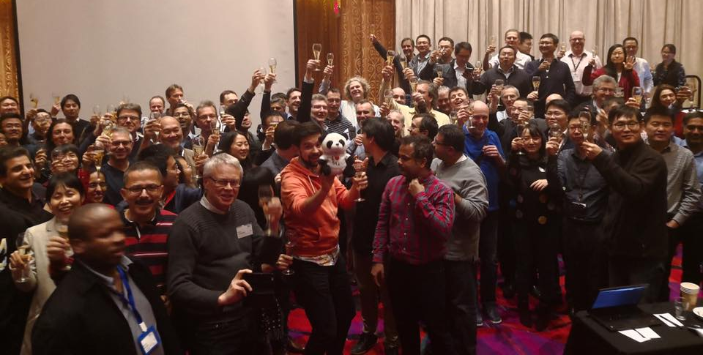
5G is done!*
*aka bring the Cat-Fs!

Slide 14
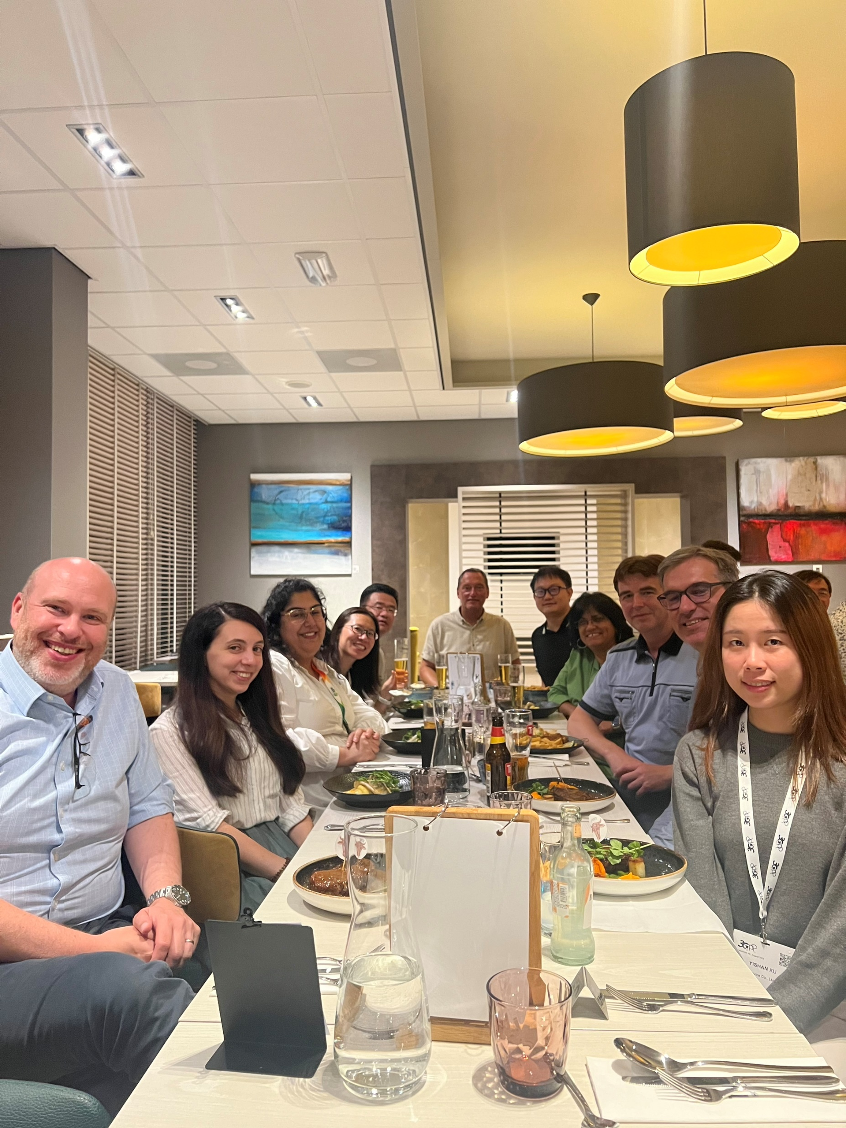
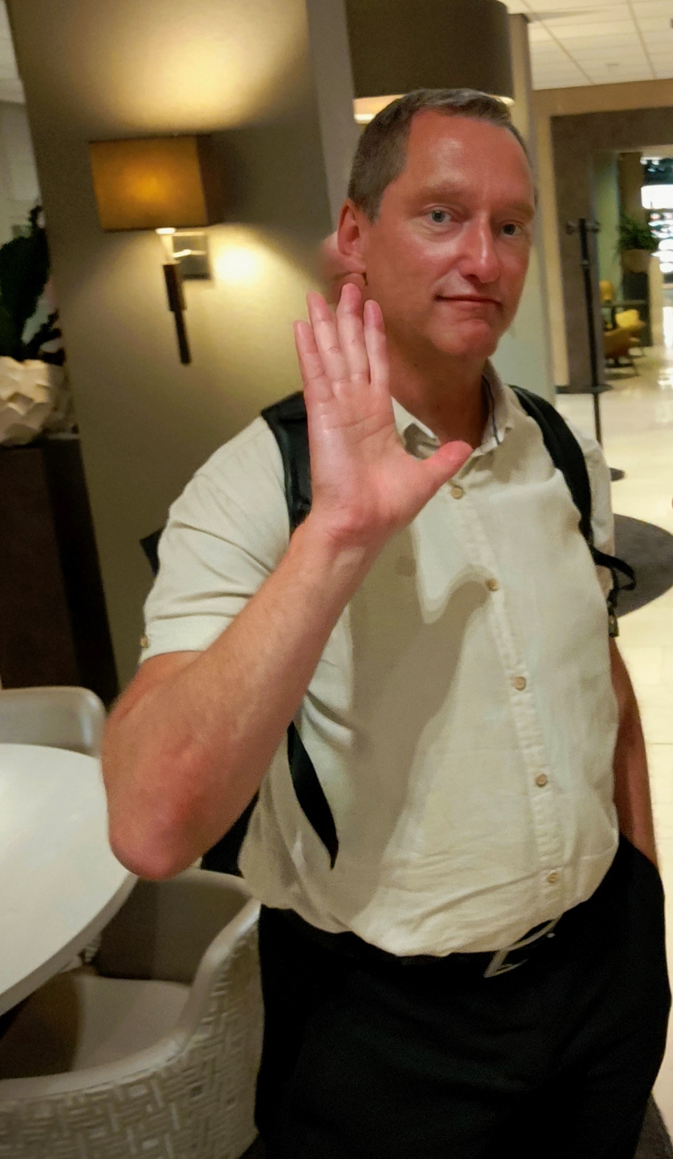
August 20th, 2024

Slide 16
For everything, thank you Peter. Rest In Peace

