Slide 1
Guidelines on WIDs names and acronyms
Source: 3GPP Work Plan coordinator
Agenda item: Working methods
Document for: Endorsement
SP-220953_CP-222213_RP-221927, 3GPP TSG #97, 12 - 19 September2022, e-meeting

Slide 2
Guidelines on WIDs names and acronyms
These guidelines are intended to help choosing names and acronyms for new WIDs - both for Studies and for Normative work.
  Note 1: Acronyms are allocated by MCC. Suggested acronyms are possible on the WID, but the final acronym is the one that will appear in the Work Plan. This process aims at maximising cross-WG and cross-TSG commonalities, by avoiding unnecessary divergences.
  Note 2: “WID name” (as per the Work plan terminology) is used in this presentation to refer to the “WID Title” (WID terminology) . This is the same concept and an alignment of terminology shall be done – but this is another problem, not addressed here.
The aims are to:
  simplify
  ensure consistency across the different 3GPP WG/TSG
  ensure consistency across the different Features
  ensure consistency across the different Releases (enhancements)
The intention is NOT to change the past items but to provide clear references for future items
The Rules (with “shall”) are shown in green, underlined font
The Guidance (with “should”, etc) are in orange/yellow font
Note on terminology: a WID defines either normative work or a Study. A WID for a study can be referred to as a “SID”

Slide 3
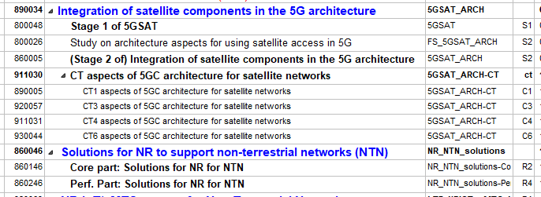
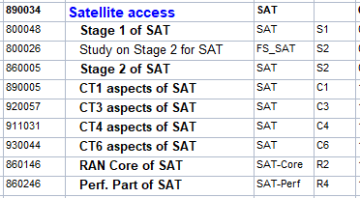

Why these guidelines – an example
Instead of this:
We would have had this:
Note: There was no issue with the SAT topic. It is a good example because it has an overall impact, on several groups.

Slide 4
Guidelines for Names/Acronyms (1/5)
Simplicity
  Generic words should be avoided, such as “System enhancements to support xxx” or “Support for additional capability for xxx”, “Added Service for xxx”, “Solution to support xxx”, etc. WI titles should be meaningful and to the point.
Generation
  Items dependent of the radio technology should mention it (e.g. NR, LTE/E-UTRA) in their Name and Acronym (in this case, avoid ”5G”, ”4G”)
  Items independent of the radio technology/generation should not mention it in the Name and in the Acronym (e.g. “MCPTT” and not “MCPTT_LTE”).
Enhancements
  For enhancements of a Feature from a previous Release:
    The Name should be the one of the original Feature (the one being enhanced) followed by “Phase n” (avoid using “Enhancement/Improvement”; “Further enhancements”, then “Even further enhancements”, etc.)
    The Acronym should be the one of the original Feature followed by “_Phn” (avoid using “e”; then “e2”, etc.)
    E.g. the first series of enhancements of NPN should be named “Non-Public Networks Phase 2”, Acronym: “NPN_Ph2”.
    (note that some delegations would prefer to use another word than “Phase” but no consolidated alternative proposal so far)

Slide 5
Guidelines for Names/Acronyms (2/5)
Acronyms: General Guidance
  Prefer an “easy to pronounce” acronym and, if possible, meaningful. It can be based on keyword(s) or part of them.
    E.g.: for “Network Sharing”, “NetShare” should be preferred to “NS”;
    Acronyms such as “PPEPO” or “MCGWUE” should be avoided.
  The length of the acronym should be limited to 8 useful characters per level. Only letters (case insensitive), numbers and underline symbol (“_”) are allowed. Hyphen “-” is not allowed, since this is a level separator.
  Note: the rules on consistency and enhancements take precedence over this one, e.g. keep using the same acronym for an already existing Feature, even if “difficult to pronounce” and/or meaningless
Acronyms: Consistency
  A group of letters commonly known for a topic shall not be used for a different meaning.
    E.g. “LCS” shall not be used be for “Local Communication Service” since it already usually refers to “Location Services”.
  Whenever possible, it is recommended to reuse some same groups of letters for related Features.
    E.g. MBMS should appear in the acronyms of all Features dealing with MBMS, e.g. “MBMSAPI_MCS” (for “MBMS APIs for MC Services”), but the acronym of “Support of Hybrid DASH/HLS over eMBMS” could have contained “MBMS”.
    This is only a “best effort” advise, not always possible to comply (e.g. because the length of the acronym is limited, or because many Features are inter-related to some degree). But when there is no specific problem, this guidance should be followed.

Slide 6
Guidelines for Names/Acronyms (3/5)
Study
  Reminder: a “study” can results only in TR(s) (or CRs on TR). It cannot create any TS nor CR on TS.
  For Studies, the Name shall begin with "Study of " and the Acronym shall begin with "FS_".
  Later, when/if some normative work is derived from this study, the same root acronym should be used. E.g. "FS_NPN" should lead to "NPN“
  Exception: this rule does not apply when the Study concluded to limit/refocus the normative work, leading to use a clearer/different title for the normative work
“New WID on”
  The WID Name shall NOT start by “New WID/SID on” nor “Updated WID/SID on”
  Note that the use of "New/Updated WID/SID on" is good practice in the tdoc title, but not in the WID title

Slide 7
Guidelines for Names/Acronyms (4/5) – “Structured Feature” (1/2)
Differentiating a new Feature from components of an existing Feature
  A key concept is to clarify whether what is proposed in a new WID is something “brand new” in this Release (a new Feature) - or if it is a specific component of an existing Feature in this Release
Feature
Components of this Feature
Reminder on 3GPP way of working: a Feature and all its components shall be within a same Release,
and all components shall be aligned at the end of the Release
(e.g. no functionality shall remain in Stage 1/2 if it is ends up not being covered in Stage 3)

Slide 8
Guidelines for Names/Acronyms (5/5) – “Structured Feature” (2/2)
When creating a new Feature:
  Its name shall be usable by other WGs*.
  E.g. do not introduce a new Feature called "Service Requirements for …" or “Architecture for …”
  Remember that, if the new Feature is an enhancement of a Feature from a previous Release, the guidance on “Phase” applies
When contributing to an existing Feature (i.e. creating a component),
  e.g. “Non-Public Network” /NPN was started in SA1, now SA2 presents the WID for the Stage 2 component.
  In this case, for the WID of the contributing group:
    The Name shall contain the name of the existing Feature, preferably also explaining which specific component is being introduced, e.g. “Stage 2 of <feature title>”, “CT3 aspects of <feature title>”, "Core part: <feature title>"”, “Perf. part: <feature title>"
    The Acronym shall be exactly the one of the existing Feature. In the above example: it shall be "NPN" (and not "NPN_St2", nor "NPN_Arc", etc).
      Indeed, the component is already specified in the name, and can be deducted by the group (SA1=service; SA2=architecture; SA3=security; etc.). Repeating this component yet again in the acronym would uselessly add complexity and waste a limited resource.
      Exception: in RAN, the use of the suffixes “-Core/-Perf/-UEConTest” in the acronyms remain allowed.
    This rule remains valid also for cross-TSG features. E.g. either RAN should have used “Sat”, or SA/CT should have used “NTN”, but ending with two different acronyms (“NTN” and “Sat”) for what are mostly different components of a same -or very similar- Feature shall be avoided.
  * Note that when a group introduces a new Feature, it actually means that it is introducing both the Feature and one of its components (e.g. “NPN”, if introduced by SA1 , actually means that the “NPN” Feature is created as well as its “Stage 1 of NPN” component). The Work Plan Manager will rectify this by creating 2 lines in the Work Plan (one for the Feature and one for the component) when needed, and will clarify the title as needed for the component part, e.g. adding “Stage 1 of”.

