Slide 1
Clarification on ACR scenarios
Yajie
Huawei, Hisilicon

Slide 2
Outline
Background & issue
Proposal

Slide 3
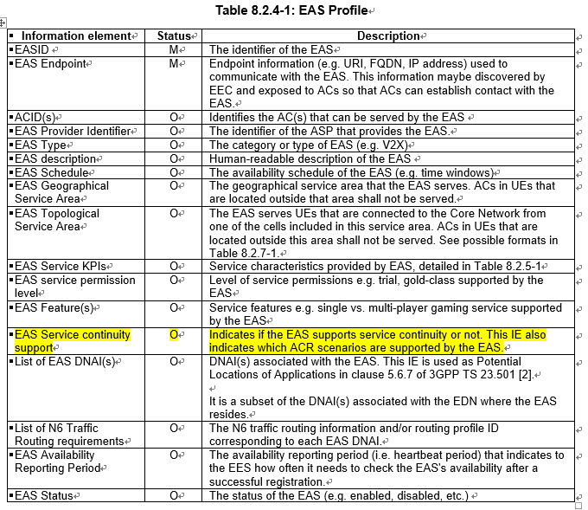
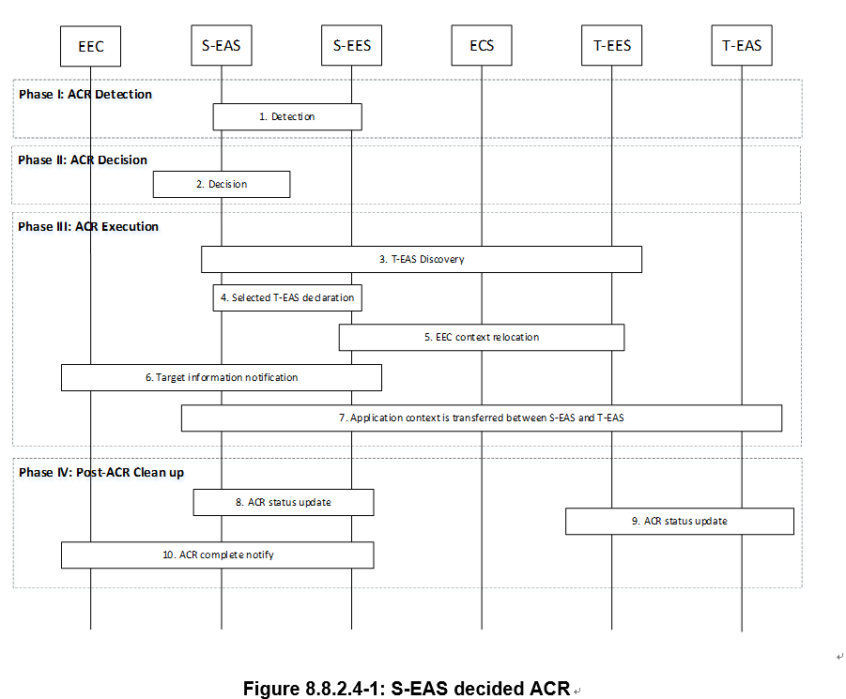

Background & issue
In current standard, ACR scenario are used to indicate the capability of certain Entity, e.g. the parameter “EAS service continuity support” in EAS profile is used to indicate the ACR capability of EAS.
However, each ACR scenario documented in clause 8.8.2 contains server sub-scenario associated with different assumption of EAS capability (also EEC, EES). For example, S-EAS decided ACR in clause 8.8.2.4 covers two sub-scenarios:
Sub-scenaio#1: EES detection , EAS determination ( EAS does not support ACR detection, but only determination)
Sub-scenaio#2: EAS detection, EAS determination (EAS should support both detection and determination)
Existing issue:
Due to above reason, if EAS profile tells EAS support S-EAS decided ACR scenario, it is unclear whether EAS support ACR detection or not. However detection capabilities are very important for ACR scenario selection.
EAS detection
EES detection
EES detection , EAS determination
S-EAS decided ACR scenario indicates:
？
EAS detection , EAS determination

Slide 4
Proposal
Further split ACR scenario into smaller granularity to indicate both detection capability information and determination capability information

