Slide 1
EAS bundles: open issues
Nishant Gupta
Qualcomm

Slide 2
Outline
Deployment consideration
Open discussions
  Can a bundle be spread across EDNs?
  Do EAS profile need to indicate EAS bundle information?
  Do EASs of a bundle interact with each other?

Slide 3
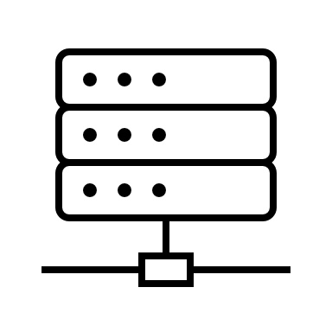
Deployment consideration
Availability zone
  “An Availability Zone is the lowest level of abstraction exposed to an Application Provider who wants to deploy an Application on Edge Cloud.” – OPG.02 Operator Platform Telco Edge Requirements
  Like “Geographical service area” defined in Rel-17.
  No standard size/shape – can be as large or as small as ECSP prefers.
One availability zone can comprise of one or more Edge Data Networks, providing same or different KPI capabilities throughout the availability zone.
Each Edge Data Network can comprise of one or more Edge Hosting Environments.
One or more Edge Enabler Servers may be located in an Edge Data Network.
~30ms latency
EDN-A1
EHE-A11
EHE-A12
EHE-A13
~40ms latency
~50ms latency
EDN-A2
EDN-A3
EHE-A21
EHE-A22
EHE-A31
Availability Zone – A

Slide 4
Bundle deployment examples
Considering a bundle of 4 EASs with the following latency tolerance:
Example deployment 1
Example deployment 2
Example deployment 3
~30ms latency
~30ms latency
~30ms latency
EDN-A1
EDN-A1
EDN-A1
EAS1 EAS2 EAS3 EAS4
EAS1 EAS2 EAS3
EAS4
EAS1
EHE-A11
EHE-A12
EHE-A13
EHE-A11
EHE-A12
EHE-A13
EHE-A11
EHE-A12
EHE-A13
EAS | Latency tolerance
EAS1 | 35ms
EAS2 | 60ms
EAS3 | 60ms
EAS4 | 45ms
~40ms latency
~50ms latency
~40ms latency
~50ms latency
~40ms latency
~50ms latency
EDN-A2
EDN-A3
EDN-A2
EDN-A3
EDN-A2
EDN-A3
EAS4
EAS2 EAS3
EHE-A21
EHE-A22
EHE-A31
EHE-A21
EHE-A22
EHE-A31
EHE-A21
EHE-A22
EHE-A31
Availability Zone – A
Availability Zone – A
Availability Zone – A

Slide 5
Can a bundle be spread across EDNs?
~30ms latency
Yes! An EAS bundle can be spread across EDNs, as long as application’s KPI requirements are met.
EDN-A1
EAS1
EHE-A11
EHE-A12
EHE-A13
~40ms latency
~50ms latency
EDN-A2
EDN-A3
EAS | Latency tolerance
EAS1 | 35ms
EAS2 | 60ms
EAS3 | 60ms
EAS4 | 45ms
EAS4
EAS2 EAS3
EHE-A21
EHE-A22
EHE-A31
Availability Zone – City A

Slide 6
  Does EAS profile need to indicate EAS bundle information?
ASPs need to indicate affinity requirements to ECSP for the EASs in the bundle.
EAS bundle information at the ECS/EES eases operations for coordinated EAS discovery and coordinated ACR -
  Discovery of one of the bundled EAS can provide information of all the EASs in the bundle.
  ACR for one of the bundled EAS can trigger ACR detection for all the EASs of the bundle.
  EAS bundle information at the EES/ECS is particularly useful for EAS initiated and EES initiated scenarios.
Conclusion: EAS bundle information needs to be included in the EAS profiles.
~30ms latency
EDN-A1
EAS1 EAS2 EAS3 EAS4
EHE-A11
EHE-A12
EHE-A13
~40ms latency
~50ms latency
EDN-A2
EDN-A3
EHE-A21
EHE-A22
EHE-A31
Availability Zone – City A

Slide 7
  Do EASs of a bundle interact with each other?
It depends on application’s requirements.
In below examples, EASs of a gaming application may require sync, while EASs of a streaming application may not; while both application would benefit from coordinated discovery and coordinated ACR.
Game Engine
Game Renderer
Video component
Audio component
Chat server
Subtext component
Gaming application
Streaming Application

Slide 8
Thank you!

