Slide 1
Mapping of EDGEAPP with GSMA OP Roles
3GPP
Samar Shailendra (Intel)

Slide 2
Operator Platform definition & notes on OP instance
In its PRD, GSMA OPG defines the Operator Platform as:
“An Operator Platform (OP) facilitates access to the Edge Cloud capability of an Operator or federation of Operators and Partners. It follows the architectural and technical principles defined in this document. NOTE: Future versions of this document may extend the capabilities of the Operator Platform.”
General note on OP instance:
  According to Figure 14 (clause 4.6) and Figure 15 (clause 4.8) of the GSMA OP PRD (v2.0), an OP instance can be seen as AF connected to NEF to access the SBI-NR.
  Also Figure 16 clarifies that the OP instance is connected to NEF via SBI-NR (for 5G Core). As a further clarification, Annex F talks about “OP in the role of AF” and “external entities in the role of an AF can initiate requests towards the 5G core network via the NEF containing parameters, […]”
  In clause 2.1.1, “For each operator supporting the OP, there shall be an OP instance that has the sole responsibility for managing the resources and services that the OP exposes in that operator's network. This instance may be operated by the Operator or be outsourced.”

Slide 3
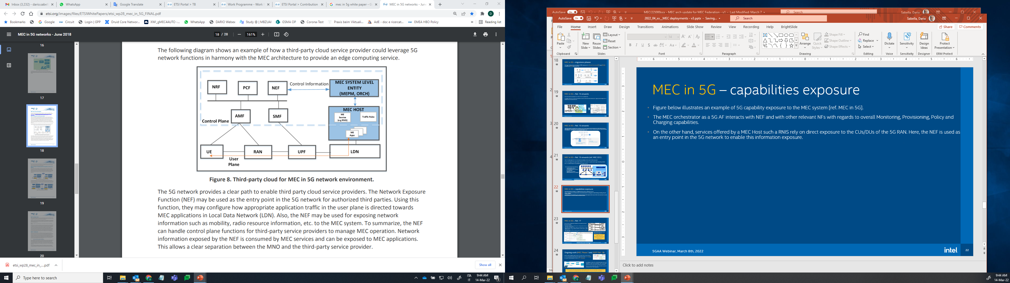
OP Domain
According to GSMA PRD, the domain of the Operator Platform is separated from the network domain.
According to 3GPP [28.814] the 5GC is in the PLMN domain, while EDGEAPP entities like EES and EAS are outside this domain.
MEC (seen by 5GS as an AF) is outside the 3GPP domain

Slide 4
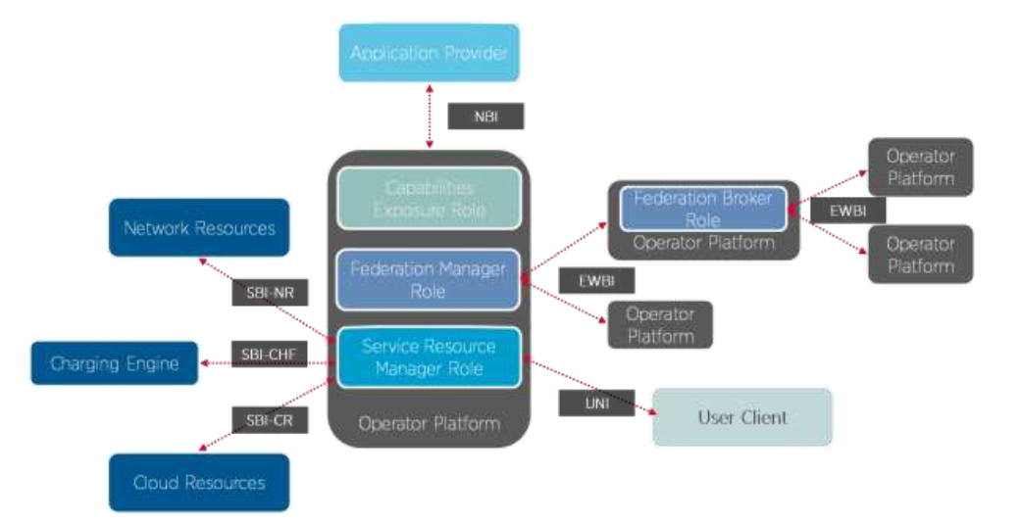
Role defined by GSMA OP
GSMA OP has defined multiple roles
  Capability Exposure Role
  Service Resource Manager Role
  Federation Manager Role
  Federation Broker Role
A single OP can implement the roles and their functionalities, or separate instances may provide different roles (by one or more AF outside the PLMN domain)
  e.g., an OP instance provides the Service Resource Manager Role, and another OP instance provides the Capability Exposure Role.

Slide 5
Capability Exposure Role
The OP role in charge of the relationship with the Application Providers.
  It unifies the use of multiple Edge Clouds, which may be operated by different Operators/OP Partners and accessed through different Operator Platforms.
OP should allow application providers to access the capabilities of different network domains including RAN, Core Network, Transport Network, and non-3GPP Access Network.
CER allows an application provider to discover the capabilities of OP (functionality and range of functionalities). Application provider accesses the CER via NBI (clause 3.2.2).

Slide 6
Service Resource Manager Role
The Service Resource Manager role in the OP is responsible for managing Cloud and Network resources from the Edge Cloud(s) via the SBI and UNI interfaces (clause 3.2.3).
The OP role in charge of orchestrating Edge Cloud Resources and Network Resources for use by Application Providers and end-users.
  This role includes managing the application load over the Edge Cloud, the configuration of network capabilities, and the relationship with the UC (EEC).

Slide 7
Federation (Manager & Broker) Role
The Federation Broker and Manager roles in the OP are responsible for interfacing with other OPs via the EWBI (clause 3.2.4).
Federation Manager Role:
  The OP role that publishes and provides access to the resources and capabilities of another OP, including its Capability Exposure Role and Service Resource Manager Role.
Federation Broker Role:
  The OP role in charge of easing the relationship between federated OPs.
  The Federation Broker Role is optional since federation can be performed directly between two Federation Managers (in a one-to-one relationship).

Slide 8
EDGEAPP and ETSI MEC - Federation
EWBI
UE
Application Data Traffic
Operator Platform
Operator Platform
Application Client(s)
EAS
MEC Application
Management & Orchestration
ECSP Management System
Edge Federator
MEC Federator
EDGE-7
Mff/
EDGE-y
3GPP Core Network
EDGE-x
Mfm
M3GPP-1
User App LCM proxy
OSS)
EDGE-5
EDGE-3
Mp1
MEC Orchestrator
Edge Enabler Client (EEC)
EDGE-1
EES
MEC Platform
EDGE-2
MEC Platform Manager
EDGE-6
EDGE-10
EDGE-9/Mp3
Edge Configuration Server (ECS)
ECS
EDGE-4
EDGE-8
UNI
Note: The edge configuration server (ECS) may reside in PLMN operator or ECSP
Virtualization Infrastructure Manager
PLMN domain
OP domain

Slide 9
Conclusion
These roles need to be further mapped to EDGEAPP.
Further Gap Analysis is required w.r.t. to existing block/interfaces mapping to GSMA OP roles and interfaces.
  May require to redefine/remap existing mappings.
  May require to enhance or define new functional entities and/or interfaces.

