Slide 1
SA6 Rel-19: Discussion on Network enabler for XR services
May, 2023
Shaowen Zheng (CMCC)

Slide 2
Outline
Background and motivation
Potential use case
Potential Objective

Slide 3
Background and motivation
SA1
SA2
SA4
R17: tactile and multi-modal communication service
R18: XRM
R16: FS_5GXR
provide policy(ies) for flows associated with an application
apply 3rd party provided policy(ies).
AF information provisioning: common ID, PDU Set related assistance information including PDU Set QoS parameters, Burst periodicity, Description of Service Protocol.
Network information exposure: congestion level information, Data rate, delay difference and round trip delay of QoS flow, Estimated bandwidth.
R17: FS_ 5GSTAR
R18: FS_SmarTAR
R18: FS_Metaverse
R18: SR_MSE
precise location triggered information provisioning,
management of the spatial anchor
management of the digital assets
...
R18: MeCAR
XRM in SA2 studies the key issues, solutions on how to support XR and advanced media services from 3gpp architecture perspective. SA4 focus more on the application layer interaction between the UE and video/audio media service. However, to enable a variety of XR services not limited to video/audio communications , specific support by network enabler layer based on the 3GPP system may be required.
Notes:
SA4 的关系；
对比

Slide 4
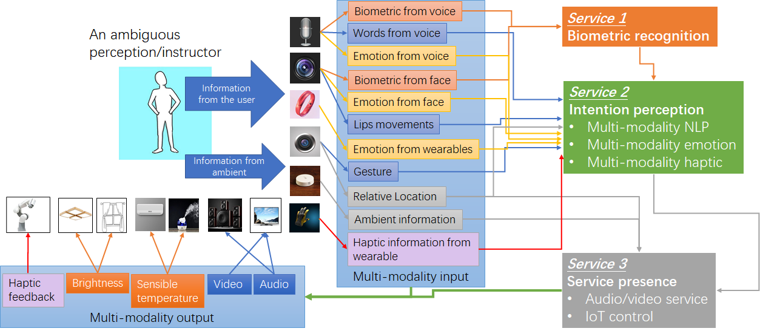
The tactile and multi-modal communication service
The tactile and multi-modal communication service may include multiple types of flows from multiple type of dervices, e.g. video/audio stream, and haptic or sensor data for more immersive experience
Requirement from 22.261 for tactile and multi-modal communication service:
The 5G system shall enable an authorized 3rd party to provide policy(ies) for flows associated with an application. The policy may contain e.g. the set of UEs and data flows, the expected QoS handling and associated triggering events, other coordination information.
The 5G system shall support a means to apply 3rd party provided policy(ies) for flows associated with an application.
Possible objective:
Support for 3rd party policy provisioning and management to provide policy(ies) to the 5GC for flows associated with the XR services for information extraction and provisioning to the 5GC. (such as Multi-modal Service ID provisioning)
Utilization of 3rd party provided policy(ies) for control of flows associated with an application (e.g., PDU/flows coordination, delay difference handling, QoS scheduling, buffering, transmission quality guarantee etc..)
Support seamless XR streaming over 3GPP or non-3GPP devices (e.g., non-3GPP device connecting to the 5G network and non-3GPP device connecting to a UE with 5G network access), and including aspects of data pre-processing, or triggering user plane management like MA-PDU session etc;
Notes:
extract the PDU Set related information in the RTP header)
•Provisioning of associated XR Services information in the 5GC with the help of an enabler, such as Multi-modal Service ID provisioning;
•Utilization of 3rd party provided policy(ies) for control of flows associated with an application (e.g., PDU/flows coordination, delay difference handling) (可以基于SEALDD已有的服务，比如是redundant transmission， bandwidth control， data transmission quality guarantee，或者SA2的 redundant transmission, PDU set identifier based, ECN/congestion information based solutions 或者自己的QoS scheduler. Based on the, something more could be done.

Slide 5
Immersive Live concert
Large amount of computing resouces is needed to perform real-time processing for audio, video, and interactive data, etc. Considering different customers will use terminals e.g. XR glasess with different brands and different processing capabilities, some of the glasses will not have enough computing resources to perform the real-time rendering. Through split rendering, most of the computing work task can offload to the network, the high speed and low latency transmission provided by 5G system can cooperate with the edge cloud side for real-time rendering, and combine with the local optimized rendering of the XR terminal side to provide the immersive and unbounded XR experience.
Requirement from SA1:
Table 7.6.1-1 KPI Table for additional high data rate and low latency service
Use Cases | Characteristic parameter (KPI) |  |  | Influence quantity
 | Max allowed end-to-end latency | Service bit rate: user-experienced data rate | Reliability | UE Speed | Service Area(note2)
Cloud/Edge/Split Rendering(note 1) | 5ms(i.e. UL+DLbetween UE and the interface to data network) (note 4) | 0,1 to [1] Gbit/s supportingvisualcontent(e.g. VR based or high definition video)with 4K, 8K resolution and up to120 frames per second content. | 99,99 % in uplink and 99,9 % in downlink (note 4) | Stationary or Pedestrian | Countrywide
Requirement for SA6:
Whether and how the enabler could help to meet the high data rate and low latency requirement of XR service via spliting the computing and/or rendering task based on the collected location and network status
Possible objective:
Split computing, principle of computing task/content splitting, steering to enable split rendering, split modeling etc. (maybe based on the EDGEAPP architecture)
KPI guarantee, and XR services related information measurement and exposure based on the enhancement of SEALDD (e.g. traffic periodicity, Packet Delay Variation among the associated flows etc.);

Slide 6
Potential objectives
signaling
data flow
a.Identify architecture requirements and solutions for architecture enhancement of SEAL/SEALDD to support the XR services;
b.Identify key issues, and solution recommendations to enable capabilities for support of XR services including:
enabler for XR service
VAL 2
UE
CAPIF
5GC
PCF/NEF
UPF
Support for 3rd party policy provisioning and management to provide policy(ies) to the 5GC for flows associated with the XR services for information extraction and provisioning to the 5GC. (such as Multi-modal Service ID provisioning)
Utilization of 3rd party provided policy(ies) for control of flows associated with an application (e.g., PDU/flows coordination, delay difference handling, QoS scheduling, buffering, transmission quality guarantee, etc..)
Support seamless XR streaming over 3GPP or non-3GPP devices (e.g., non-3GPP device connecting to the 5G network and non-3GPP device connecting to a UE with 5G network access), and including aspects of data pre-processing, or triggering user plane management like MA-PDU session etc;
Split computing, principle of computing task/content splitting, steering to enable split rendering, split modeling etc. (maybe based on the EDGEAPP architecture)
KPI guarantee, and XR services related information measurement and exposure based on the enhancement of SEALDD(e.g. traffic periodicity, Packet Delay Variation among the associated flows etc.);
NOTE 1: Potential enhancement to transport layer may need to coordination with CT groups.
NOTE 2: Enhancements to existing SA6 defined enablers (e.g. SEAL, CAPIF, EDGEAPP) may be required.
Notes:
XR service 打卡看看
分一分哪些是XR specific
动态的分离渲染可行性；实现上

Slide 7
Thanks

