Slide 1
FS_MetaApp: application enablement for Localized Mobile Metaverse Services
20 July, 2023
Sapan Shah (Samsung)

Slide 2
FS_MetaApp: Application enablement for Localized Mobile Metaverse Services 1/2
Rel-19 SID/WID Proposal Slide Template
Continuation or New Item: New Item
Study Item/Work Item/Both: Both
Source of requirements: SA1 (TR 22.856) and possibly requirements from other SDOs too can be considered
Expected Output: For Study: New TR, For Work item: possible new TS or update to existing TSs (23.434, 23.222, 23.558)
Anticipated start date/meeting: SA6#57/Oct-23 (start of study), SA6#60/Apr-24 (Start of Work)
Target Completion: SA6#61/May-24 (End of study) , SA6#64/Nov-24 (End of Work)
Estimated TUs: 10 TUs (SID) + 9 TUs (WID)
Rapporteurship: Sapan Shah (Samsung)
Supporting IMs: Samsung, AT&T, CATT, CEWiT, CMCC, Convida Wireless, Dish Network, Deutsche Telekom, ETRI, InterDigital, Lenovo, NTT, NTT Docomo, Orange, Vivo, ZTE

Slide 3
FS_MetaApp: Application enablement for Localized Mobile Metaverse Services 2/2
Rel-19 SID/WID Proposal Slide Template
Description:
In Rel-19, SA1 studied in FS_Metaverse (TR 22.856) specific use cases and service requirements for localized mobile metaverse services to offer shared and interactive user experience of local content and services, accessed either by users in the proximity or remotely.
Many of the requirements captured in stage 1 are well-suited for application enabler layer. Some example list of use cases are - Localized Mobile metaverse Service, Spatial Anchor Enabler, Spatial Mapping and Localization Service, etc.
Goals:
Study requirements for overall application framework/enabling layer platform architecture to support localized mobile metaverse services in 3GPP specified networks, including the interactions between UE and application enablement layer (See SID or discussion paper for more details)
Identify key issues based on above, develop corresponding functional model and potential solutions
Dependency on other working groups:
SA2 for system aspects, SA3 for security aspects, SA4 for media aspects and SA5 for management aspects
Impacts to 3GPP/Industry work if this is not accepted into Rel-19:
Multiple companies are looking into metaverse domain as a way to provide different user experience and also opportunity for new business. Examples of business opportunities the metaverse domain include entertainment, interior design, and e-government.
While services in these areas will emerge continuously, it is worthwhile to consider how to best anticipate and support the technical challenges of shared localized experiences received by users of devices that communicate by means of mobile telecommunications standards.

Slide 4
Estimated TU Calculation
Meeting | FS_MetaApp (SID) | MetaApp (WID) | Comment
SA6#55 (May-23) | SID Proposal
SA6#56 (Aug-23) | SID Proposal
SA6#57 (Oct-23) | 2 TU
SA6#58 (Nov-23) | 2 TU
SA6#59 (Feb-24) | 2 TU
SA6#60 (Apr-24) | 2 TU | Work item Proposal | Overlap with Study and work item
SA6#61 (May-24) | 2 TU (Study completes) | 1 TU
SA6#62 (Aug-24) |  | 2 TU
SA6#63 (Oct-24) |  | 3 TU
SA6#64 (Nov24) |  | 3 TU
Total | 10 TUs | 9 TUs

Slide 5
Discussion on - application enablement for Localized Mobile Metaverse Services

Slide 6
Motivation
The Metaverse applications need (very) low-latency, low Power, high capacity and high processing
Application enablement will play important role to satisfy Metaverse applications requirements
To take maximum benefits of the 5G/6G connectivity and to enable Metaverse applications to easily integrate with core network and access the network capabilities
Metaverse is also being studied in other SDOs - W3C Open Metaverse Interoperability Group , OneM2M (Metaverse IoT), Metaverse Standard Forum
3GPP SA1 is already studying Localized Mobile Metaverse Services (in TR 23.856).
Some of the use cases and requirements are related to application enablement.

Slide 7
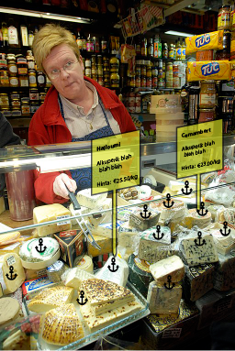
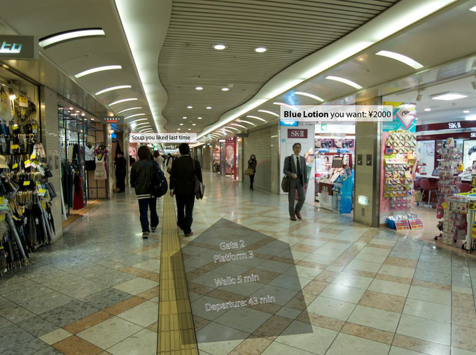
Example Use cases (From TR 22.856)
Other use cases
4. (Clause 5.13) Digital asset container information access and certification
5. (Clause 5.14) Interconnection of mobile metaverse services
6. (Clause 5.15) Access to avatars
7. (Clause 5.16) Use case of virtual store in a mobile metaverse marketplace
8. (Clause 5.26) IMS-based 3D Avatar Call Support for Accessibility Use Case
9. (Clause 5.27) Use case of Localized Mobile Metaverse Overload
1. (Clause 5.5) Spatial Mapping and Localization Service
Spatial mapping is constructing or updating a map of an unknown location
localization is tracking an object to identify its location and orientation over time
3. (Clause 5.4) Spatial Anchor Enabler
2. (Clause 5.1) Localized Mobile Metaverse Service
The 'spatial anchor producer' determines what to share and its location, and any constraints
The 'spatial anchor consumer' is able to recognize anchors associated with locations, and obtain the associated information
It will provide the user with information services integrated into their ordinary experience

Slide 8
Potential Objectives
Application enablement and management of avatars
Mobile metaverse services often involve the use of digital representation (e.g. avatars)
Multiple use cases defined in SA1 requires users to register and use avatars.
Further, clause 5.15 also specifies that:
“The advantage of having a central storage of the information related to avatars is that the same avatar could potentially be used in different mobile metaverse services. ”
It is appropriate for SA6 to provide enabling framework for users and metaverse services to manage avatars.
Some of the requirements from SA1 are as follows:
[PR 5.16.6.2-1] Subject to user’s consent, the 5G system shall support mechanisms to securely register, store and update the digital assets for a user.
[PR 5.24.6-4] Subject to regulatory requirements, user’s consent and operator’s policy, the 5G system shall be able to support mechanisms to register and update the information of an avatar including the information about the subscriber who is the owner of this avatar and the subscriber who is authorized to use this avatar.
Possible gaps:
How (or which procedure) to register, store and update the Avatar related information?
Consolidated Potential Requirement: CPR 5.1, CPR 5.2

Slide 9
Potential Objectives
Application enablement and management of spatial anchors
Spatial anchor is an association between space and service information
The 'spatial anchor producer' determines what to share and its location, and any constraints
The 'spatial anchor consumer' is able to recognize anchors associated with locations, and obtain the associated information
It is appropriate for SA6 to provide enabling framework for users and metaverse services to manage spatial anchors and associated information.
Some of the requirements from SA1 are as follows:
[PR-5.4.6-5] Subject to operator policy, the 5G system shall provide an authorized third party a means to manage the spatial anchor(s), e.g. add, remove or modify spatial anchors, determine privacy and security aspects, and specifically to enable the third party to define which spatial anchors they manage have restricted access conditions.
[PR-5.4.6-1] Subject to operator policy, the 5G system shall enable an authorized third party to establish an association between a physical location (in three dimensional space, an orientation, etc.) and service information, where the service information is provided to the 5G system and the spatial anchor is either provided or determined by the 5G system.
Possible Gaps: How to enhance SEAL to enable producer and consumer to perform required OPs?
Consolidated Potential Requirement: CPR 1.1, CPR 1.2, CPR 1.3

Slide 10
Potential Objectives
Support for Spatial mapping and localization service
Spatial mapping is constructing or updating a map of an unknown location and localization is tracking an object to identify its location and orientation over time.
SA6 can provide/enhance framework to provide Spatial mapping and localization service.
Some of the requirements from SA1 are as follows:
[PR5.5.6.1-3] Subject to operator policy and relevant regional and national regulation, the 5GS shall support mechanisms to expose a spatial map or derived localization information from that map to authorized third parties.
Possible Gaps: SA6 needs to enhance SEAL LM enabler to expose APIs for the authorized third parties to access spatial maps.
Consolidated Potential Requirements: CPR 1.4

Slide 11
Potential Objectives
Enhancements to application discovery for metaverse applications
Mobile metaverse services offer shared and interactive user experience of local content and services, accessed either by users in the proximity or remotely.
It is required for user to discover appropriate metaverse service based on requirement and also location and direction.
SA6 has defined Edge application server discovery procedure. Enhancement to this procedure may be required to meet metaverse service requirements (e.g. persistent search, pose of the user, etc)
Some of the requirements from SA1 are as follows:
[P.R.-5.1.6-2] The 5G system shall provide suitable exposure mechanisms for application services (i.e. provided by Application Servers) associated with a precise location available in the user's proximity (e.g. within line of sight), such that the mobile metaverse services can conform to specific service constraints.
NOTE: The term 'service constraints' implies that certain targets of service discovery are supported, e.g. to find 'restaurants.‘
Possible Gaps: To consider Metaverse application requirements and KPIs in EDGEAPP enabler procedures.
Consolidated Potential Requirement: CPR 1.1

Slide 12
Potential Objectives
Enhancements to service continuity for metaverse application
Clause 5.14: interconnection of mobile metaverse services
“A user is able to transition between immersive mobile metaverse services using the similar digital representation seamlessly and taking into account the constraints of the mobile metaverse services accessed. The transfer of information via the operator's network ensures the semantic compatibility – possibly through abstraction - between the origin and the destination. This also ensures, if necessary, the confidentiality of the origin and the destination.”
Possible Gaps: Enhancement to service continuity procedures to consider when UE moves from one application to other application.
Support for communication for users with disabilities
In clause 5.26, SA1 discussed use case to support users with disabilities (blind, deaf, mute, semi-blind).
Possible study: SA6 enablers has not yet considered scenarios where end user is disabled. SA6 need to study possible enhancements for different enablers.
Do we need to enhance user profile and UE configuration for disabled user?
How to support enabler for transcoding facial expression or sign language to normal language for all apps?

Slide 13
Proposal
Samsung has proposed SID to study application enablement for Localized Mobile Metaverse Services.
It is proposed to agree to SID and start the study from next meeting.

