Slide 1
SA6 work on MCover5GMBS
Huawei

Slide 2
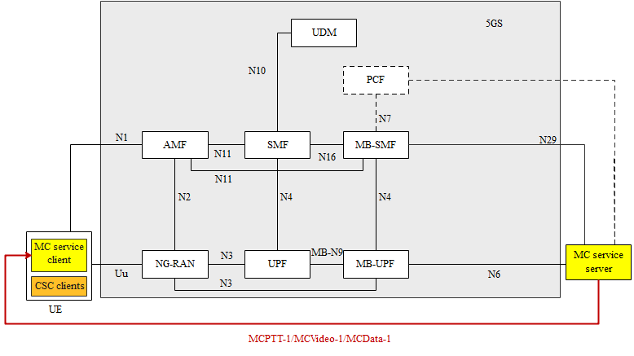
MC over 5G MBS in SA6
Working assumption and principle
In R17, only support the minimum/basic set of features to enable the MC services.
The roadmap for MC over 5G MBS should be:
R17 – support Transport Only mode for all the MC services (MCPTT, MCVideo, MCData) without using MBSF and MBSTF capabilities, Full Service mode is not a necessity.
R18 – support Full Service mode for MCData by utilizing the MBSF and MBSTF capabilities.
The reasons are as follows:
1) The MC service server already supports the service layer functionalities (e.g., service authorization, membership, security, service announcement, unicast/multicast switching), ;
2) The MBSF and MBSTF are defined by SA4, and the progress is a bit of slow that fails to enable SA6 to use those MBSF/MBSTF service in R17.
MC over 5G MBS application layer architecture in R17
Essential aspects needs to be addressed in SA6 R17
Essential aspects | Potential Feature Category | Potential detailed features in SA6 | Dependency on SA2 features/procedures
① Prepare network resource | 5G MBS service (multicast/broadcast) activation | MC service server to request 5G MBS service from the 5GC for the group communication delivery | N33/Npcf/Nmbsmf - TS 23.247 Allow the AF to activate the 5G MBS service; get the MBS session ID(i.e., TMGI or source IP multicast address) and service description e.g., radio frequency; get the N6 tunneling address.
② Notify the user | Service announcement | MBMS bearer announcement MapGroupToBearer
③ Data delivery over multicast/broadcast | Deliver data over 5GMBS flows | Use of 5G MBS flows for DL data delivery FEC/RoHC handling ( at MC service server)

Slide 3
Use of 5G multicast service
Procedures of using multicast service
SA6 works of using multicast service (Term changes are no specially )
Essential aspects | Related procedures in SA6 | Key changes/enhancements
Service announcement | 10.7.3.5 MBMS bearer announcement over MBMS bearer in TS 23.280 | Enhance the “MBMS bearer announcement” message to include source IP multicast address for 5G MBS multicast session
Session Establishment | 10.7.3.1 Use of pre-established MBMS bearers 10.7.3.2 Use of dynamic MBMS bearer establishment in TS 23.280 | Modify step 1 to align with 5G MBS session configuration mechanism. Modify step 3 to align with multicast session join at the UE. Remove step 4 which is not applicable for multicast
Data Transfer
> DL Media over multicast | 10.7.3.1 Use of pre-established MBMS bearers 10.7.3.2 Use of dynamic MBMS bearer establishment in TS 23.280 | Refer to the session establishment part
> floor control over multicast | 10.7.3.4 Use of MBMS bearer for application level control signaling | Modify step 1 to align with 5G MBS session configuration mechanism. Modify step 3 to align with multicast session join at the UE. Remove step 4 which is not applicable for multicast
> group status over multicast | 10.7.3.13 Use of MBMS bearer for group status | Reused with term, reference update
> FEC and ROHC | 10.7.3.11.2 Header compression by the MC service server 10.7.3.12.2 Header compression by the MC service server | Reused with term, reference update
Fig 4.2.1 in TS 23.247

Slide 4
Use of 5G broadcast service
Procedures of using multicast service
SA6 works of using broadcast service (Term changes are no list here)
Essential aspects | Related procedures in SA6 / TS 23.280 | Key changes/enhancements
Service announcement | 10.7.3.5 MBMS bearer announcement over MBMS bearer | Reuse with term and reference update
Session Establishment | 10.7.3.1 Use of pre-established MBMS bearers 10.7.3.2 Use of dynamic MBMS bearer establishment in TS 23.280 | Add the configuration mechanism for 5G Reuse with term and reference update
Data Transfer
> DL Media over multicast | 10.7.3.1 Use of pre-established MBMS bearers 10.7.3.2 Use of dynamic MBMS bearer establishment | Refer to the session establishment part
> floor control over multicast | 10.7.3.4 Use of MBMS bearer for application level control signalling | Reused with term, reference update
> group status over multicast | 10.7.3.13 Use of MBMS bearer for group status | Reused with term, reference update
> unicast/broadcast switching | 10.7.3.3 Switching from MBMS bearer to unicast bearer 10.7.3.6 MBMS bearer quality detection | Reused with term, reference update Remove MBSFN related description
> FEC and ROHC | 10.7.3.11.2 Header compression by the MC service server 10.7.3.12.2 Header compression by the MC service server | Reused with term, reference update
Fig 4.2.2 in TS 23.247

Slide 5
Other aspects
How to select multicast/broadcast ?
Principle
For a specific group call, the selection can be determined at the begin of the call setup by the MC service operator’s policy or configuration, e.g., based on group side, service type.
The selected multicast/broadcast will NOT change during a ongoing group call session.
Potential impacts to standard
Add some general description about the selection,
introduce new parameter(s) in the profiles if required.

Slide 6
Summary
As per the analysis, we think that the MCOver5GS normative work can be completed in Rel.17 in 2 meetings (SA6#42BIS-e and SA6#43e).
During SA#91e, the guidance was provided to further discuss in SA6 and agreements can be made for further approval in SA#92e.
Hence, the suggested way forward for this work is:
During SA6#42BIS-e agree to the revised WID for MCOver5GS and further also progress both study and normative work to include the 5MBS related changes (SA6#43e is also available to progress this topic).
Submit the revised WID for MCOver5GS for approval to SA#92e along with the TS 23.289 for approval.
It is proposed to endorse this suggested way forward.

