Slide 1

3GPP Mission Critical Standards – Past, Present and the Future
Jukka Vialén
3GPP SA6 Vice Chair

Slide 2
Content
Past
    The 3GPP MCX working groups and workflow
    11 years of MCX standardization in 3GPP
Present
    MCX Rel-19 and Rel-20 - new features and enhancements
The future
    Potential MC topics for Rel-21
    6G
Summary

Slide 3
MCX working groups in 3GPP
PCG – Project Coordination Group
TSG RAN – Radio Access Network
TSG SA – Service and System Aspects
TSG CT – Core Network and Terminals
RAN1 – Radio Layer 1 (Physical Layer)
SA WG1
Services
CT WG1 - User Equipment - Core Network Protocols
RAN2 – Radio Layer 2 and Radio Layer 3 RRC
SA WG2 - System Architecture and Services
CT WG3 - Interworking with External Networks & Policy and Charging Control
RAN3 – (E-)UTRAN/NG-RAN Architecture and Related Network Interfaces
SA WG3
Security and Privacy
CT WG4 - Core Network Protocols
RAN4 – Radio Performance and Protocol Aspects
SA WG4 - Multimedia Codecs, Systems and Services
CT WG6 - Smart Card Application Aspects
RAN 5 - Mobile Terminal Conformance Testing
SA WG5 - Management, Orchestration and Charging
SA WG6 - Application Enablement and Critical Communication Applications
RAN AH1 – TSG RAN ITU-R Ad Hoc

Slide 4
MCX standardization workflow
SA1
User requirements
N
SA2
System architecture
N-1
SA6
MC applications
Implementations
3GPP Release
SA3 Security
N-2
CT1 Protocols
ETSI MCX plugtests
RAN5
Protocol test specifications
N-3
GCF
ETSI STF T028
ETSI MCC TF160
12+ months
12-18 months
9 months
STAGE 1
STAGE 2
STAGE 3
”STAGE 4”

Slide 5



11 years of Mission Critical application layer standardization in 3GPP
Rel-16
Rel-18
WG SA6 Established
Dec 2014
Rel-17
Rel-19
Rel-15
MCPTT 4.0
MCData 3.0
MC IWF 2.0
MC MBMS API
MC Location (study)
MC log&DL (study)
FRMCS_Ph2
MCX 6.0
MCOver5MBS
MCOver5GProSe
MCShAC(study)
MCAHGC
MCGWUE
FRMCS_Ph4
Rel-20_5GA
MCX 7.0
MCShAC
Recording
MCS over NTN
Generic IOPS
FRMCS_Ph5
Rel-14
MCPTT 3.0
MCVideo 2.0
MCData 2.0
MC Interworking
FRMCS_Ph1
MCPTT 5.0
MCData 4.0
MCIOPS
MCOver5GSFRMCS_Ph3
MCX 8.0
Recording 2.0
Discreet listen.
Multi-hop relay
FRMCS_Ph6
Rel-13
MCPTT 2.0
MCVideo
MCData
MCPTT
Mar 2016
June 2017
June 2019
June 2020
June 2022
June 2024
Dec 2025
June 2027
3GPP Release ‘end’ date (Stage3 stable)

Slide 6
Rel-19 new and enhanced MCX features
Rel-19 schedule
  Stage 2 completed 12/2024
  Stage 3 freeze 09/2025
  Release end 12/2025
New MC features
  MCShAC
  MCS over NTN
  Recording
Enhancements
  Location protocol (stage 3)
  Location reporting (stage 2)
  FRMCS_Ph5
  Generic IOPS
  Other

Slide 7


Rel-19 new MCX features - MCShAC
MCShAC – Sharing administrative configuration between interconnected MC systems
  Information required to enable migration of users and usage of interconnected groups
    Configuration parameters for user profiles and group profiles
  Standardized procedures and messages instead of informal communication methods (e.g. email, MCPTT,…)
  Optional feature – “…not essential to enable MC services…”

Slide 8
Rel-19 new MCX features – MCS over NTN
MCS over NTN
  No new MC functional elements or reference points (interfaces) needed
  From TS 23.289 – MCX over 5G system: “The MC service UE should utilize satellite access to obtain MC services as specified in 3GPP TS 23.501, 3GPP TS 23.502 and 3GPP TS 23.503. “
  “Satellite service provider” added into “business relationships” (TS 23.289).
  One open question from the Rel-19 study: “How to inform MC group participants of one or more users being connected via NTN?”
  Further work expected in future releases.

Slide 9
Rel-19 new MCX features - Recording
Recording and replay
  SA1 requirements already in Rel-13, first SA6 study in Rel-16
  New functional elements:
    Recording server, Recording admin client, Replay client
  Only part of the functionality completed in Rel-19:
    Authentication/authorization of the new client types
    Configurations (target users/groups)
    Utilizing SIPREC between MCX server – Recording server for MCPTT and MCVideo realtime communications
  To be completed in Rel-20. The missing parts are e.g.:
    MCData and any non-realtime MCVideo service
    Non-call related metadata (emergency alert, affiliation change, …)
    Migrated users and interconnection/interworking scenarios
    Details of recording e2ee media
    Off-network recording

Slide 10

Rel-19 MCX enhancements – Location protocol
MC Location protocol Rel-18 (stage 3)
  In Rel-18 and earlier, stage 3 location procedures are per service (MCPTT, MCData, MCVideo).
  This is not aligned with stage 2 architecture.
MC Location protocol Rel-19 (stage 3)
  LMS and LMC introduced. Location procedures common for all services
  Now aligned with stage 2 architecture.

Slide 11
Rel-19 MCX enhancements – Location reporting
Enhancements to location reporting (stage 2)
  Groups as target for location request i.e. location report requested from all currently affiliated group members.
  Aggregation in LMS for location triggers towards the same client.
  Location info from PLMN operator (optional Le interface between LMS and 3GPP LCS).
  Default configuration for location reporting (in the user profile).

Slide 12
Rel-19 MCX enhancements – FRMCS Ph5
FRMCS Ph5
  MC gateway UE enhancements
    MCGWUE was introduced in Rel-18, enables MC service access from non-3GPP device.
    Several enhancements in Rel-19.
  Ad-hoc Group Communication
    Introduced in Rel-18. Enables group creation “ad-hoc” with participants list or criteria. AH group is deleted when the communication terminates.
    Several enhancements in Rel-19.
  CP/UP separation
    Allow different IP address for MCX server, Floor control (MCPTT) / Transmission control (MCVideo) server and media distribution function.
  Interworking with GSM-R

Slide 13
Rel-19 MCX enhancements – IOPS
IOPS
  Isolated Operation for Public Safety
    Introduced for LTE in Rel-13. TS 23.401 (LTE system architecture).
    MC application layer functionality in Rel-17. TS 23.180 (MCX services in IOPS mode of operation).
  From TS 23.401:
    “Isolated Operation for Public Safety (IOPS) provides the ability to maintain a level of communications for public safety users, via an IOPS-capable eNodeB (or set of connected IOPS-capable eNodeBs), following the loss of backhaul communications”.
  Rel-19 enhancements:
    Making the application layer MC IOPS (TS 23.180) agnostic to the 3GPP network (LTE / 5GS).
  5G-IOPS has a pending update to TS 23.501 (5GS System architecture).

Slide 14
Rel-19 MCX enhancements - other
Other MCX enhancements
  5G capability enhancement for MCVideo
    L4S: “Low Latency, Low Loss and Scalable Throughput” - service for MCVideo
  Remote floor request in emergency communication
  5G Prose UE-to-UE relay

Slide 15
Rel-20 5G-Advanced - new and enhanced MCX features
Rel-20 5GA schedule
  Stage 2 complete 09/2026
  Stage 3 freeze 03/2027
  Release end 06/2027
New MC features
  Discreet listening
  (Lawful interception)
Enhancements
  Recording
  FRMCS_Ph6
  Multi-hop relay
  Other

Slide 16
Rel-20 5GA new MCX features – Discreet listening
Discreet listening
  User requirement (TS 22.280): “The MCX Service shall provide discreet listening capabilities without noticeable impact on or knowledge of the target MCX User, or the members of the target MCX Service Group….”.
  SA1 user requirements in Rel-13 → First SA6 study in Rel-16 → SA6 work item in Rel-19 → postponed to Rel-20.
  SA6 Rel-20 new study item approved 03/2025.
  No architecture yet, but potentially can reuse some of the Recording functionality (FFS).
  NOTE: This is not Ambient listening.

Slide 17
Rel-20 5GA new MCX features - LI
Lawful interception of MCS
  NOTE: not in SA6 Rel-20 work plan
  Discussions with SA3-LI group started
TS 33.126/127/128

Slide 18
Rel-20 5GA MCX enhancements
Recording
  A major update to Rel-19 version.
  SA6 Rel-20 new study item approved 03/2025
FRMCS Ph6
  Ad-hoc group communication enhancements – e.g. call forwarding, merging multiple ad-hoc group calls, multi-talker control.
  MCGWUE enhancements – migration, location, interconnection, multiple GWUEs per service.
  Enhancements to GSM-R interworking.
5G Prose multihop relay
  UE-to-UE and UE-to-network
Other enhancements, e.g.
  Temporary vs permanent UE disable
  Pause and resume for ambient listening

Slide 19
The future - Release-21
Rel-21 will be the first 3GPP 6G release
  In Rel-20 only 6G studies, no normative 6G work.
Rel-21 timeline to be decided latest in June 2026.
No 6G specific MCX use cases or requirements have been identified (yet).
  TR 22.870 Study on Use Cases and Service Requirements, Stage 1 (target: 03/2026)
Possible “G-agnostic” SA6 MCX topics for Rel-21:
  Enhancements to Rel-20 big features (Recording/Discreet listening)
  Lawful Interception?
  FRMCS-Ph7?
  Feedback from end users and MCX operators
  MCX stage 2 – stage 3 alignments
  Review of all SA1 MC requirements – what have been missed?

Slide 20
Summary
Past
  The 8th MCX release - 3GPP Rel-20 – ongoing.
  All releases have introduced at least one new feature in addition to enhancements and corrections.
Present (Rel-19 + Rel-20)
  Several big and small features and essential enhancements/corrections under work.
  Stage 2 Release 19 completed 12/2024. Release 20 target 09/2026.
Future (Rel-21)
  No 6G MCX requirements/use cases identified so far.
  Possible “G-agnostic” topics: e.g. enhancements to Rel-20 features and more real end user feedback.

Slide 21
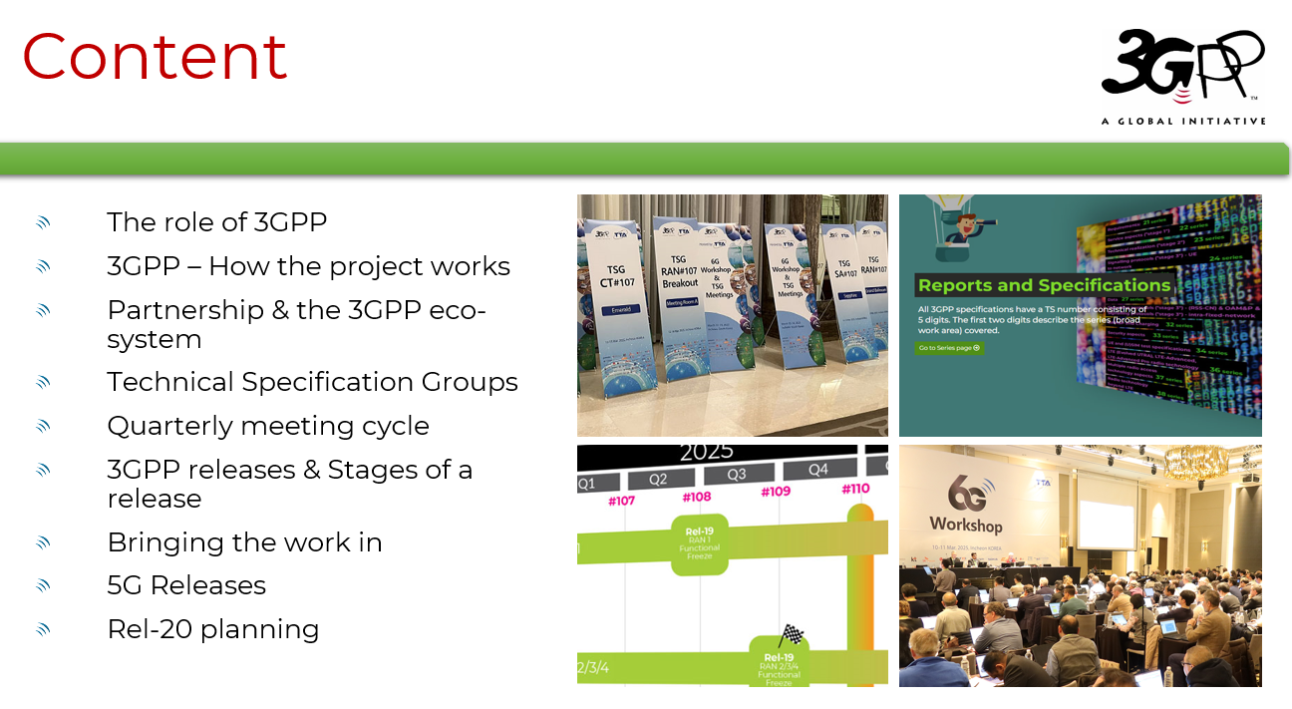
If you want to learn more about 3GPP
A general 3GPP presentation (updated every 3 months) is available:
  https://www.3gpp.org/ftp/Information/presentations/3GPP_PowerPoint_template/2025_06_general_external.pptx

Slide 22


For more info on 3GPP…
Specifications, working documents, news, portal, technology articles:
  Online; www.3gpp.org
Consider attending a WG or TSG meeting (listing):
  https://portal.3gpp.org/
Subscribe to our regular newsletter:
  www.3gpp.org/highlights
Keep in touch:
  www.3gpp.org/contact
www.3gpp.org/highlights
www.3gpp.org
www.3gpp.org

Slide 23
Thank You !

