Slide 1
DP on Cancelling solutions
(SA5 #148)
Chen Shan Huawei

Slide 2
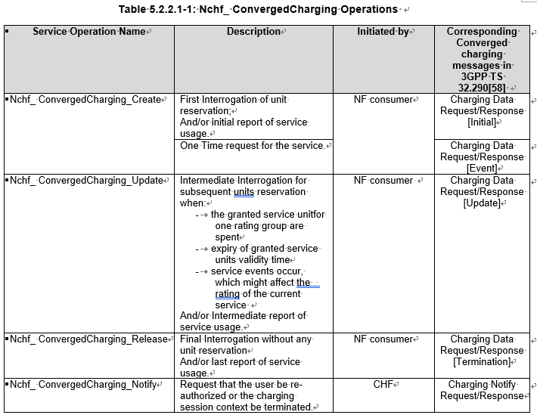
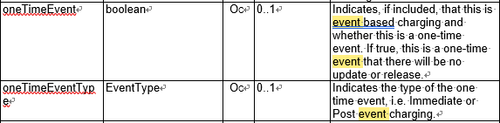


Service Operation and Event Type
Service Operation (Nchf_ ConvergedCharging )
  Nchf_ConvergedCharging_Create Operation
  Nchf_ConvergedCharging_Update Operation
  Nchf_ConvergedCharging_Release Operation
  Nchf_ConvergedCharging_Notify Operation Notify
Service Operation and Event Type
2a. At successful operation, "201 Created" response is returned. In the "201 Created" response, the CHF includes a Location header field and the allocated quota in the body. The Location header field shall contain the URI of the created resource. The NF (CTF) shall use the URI received in the Location header in subsequent requests to the CHF for the same PDU session.
1. NF (CTF) sends a Nchf_ConvergedCharging_Update request to the CHF. The {ChargingDataRef } in the URI identifies the "Charging Data" to be updated. ….
Source: TS 32.291

Slide 3

Cancelling Solutions
(1) Reuse Service Operation (Nchf_ ConvergedCharging )
  Nchf_ConvergedCharging_Release Operation + New Event Type (Cancel)
(2) Reuse Service Operation (Nchf_ ConvergedCharging )
  Nchf_ConvergedCharging_Release Operation + Refundinformation
Event Charging Procedure: In the Nchf_ConvergedCharging_Create operation, the Location header field shall contain the URI(ChargingDataRef) of the created resource.
Cancel Procedure: The NF (CTF) use the URI (chargingDataRef) received in the Location header and sent Nchf_ConvergedCharging_Release operation to the CHF with the new Event Type (Cancel).
Event Charging Procedure: In the Nchf_ConvergedCharging_Create operation, the Location header field shall contain the URI (ChargingDataRef) of the created resource.
Cancel Procedure: The NF (CTF) use the URI (chargingdataRef)received in the Location header and sent Nchf_ConvergedCharging_Release operation to the CHF with the Refundinformation in the previous Charging Data Response.
Enumeration value | Description
IEC | This value is used to indicate immediate event charging.
PEC | This value is used to indicate post event charging.
Cancel | This value is used to indicate Cancel event charging.
[Event]
[Event]

Slide 4
Cancelling Solutions
(3) New Service Operation (Nchf_ ConvergedCharging )
(4) Reuse Service Operation (Nchf_ ConvergedCharging )
  Nchf_ConvergedCharging_Cancel Operation + ChargingDataRef
  Nchf_ConvergedCharging_Create Operation + New Event Type + New paramenter (ChargingDataRef)
Event Charging Procedure: In the Nchf_ConvergedCharging_Create operation, the Location header field shall contain the URI (chargingDataRef) of the created resource.
Cancel Procedure: The NF (CTF) use the URI (chargingDataRef) received and send the Nchf_ConvergedCharging_Create operation to the CHF with the new Event Type (Cancel) and ChargingDataRef in the new parameter. The CHF will generate the chargingdataRef 1.
Event Charging Procedure: the Nchf_ConvergedCharging_Create operation, the Location header field shall contain the URI(ChargingDataRef) of the created resource.
Cancel Procedure: The NF (CTF) use the URI (ChargingDataRef) received in the Location header and send the Nchf_ConvergedCharging_Cancel operation to the CHF.
Enumeration value | Description
IEC | This value is used to indicate immediate event charging.
PEC | This value is used to indicate post event charging.
Cancel | This value is used to indicate Cancel event charging.

Slide 5
Solution Analysis
Solutions | Analysis |  | Preference
(1) Nchf_ConvergedCharging_Release Operation + New EventType (Cancel) | Add the New Event Type (Cancel) Add supported message (Event) in the Nchf_ConvergedCharging_Release Operation | CHF and NF(CTF) should negotiate the supported feature (Cancel). There are 3 results: Cancel not supported Cancel is failed Cancel is successful. | 2
(2) Nchf_ConvergedCharging_Release Operation + Refundinformation | Add the New parameter(Refundinformation) Add supported message (Event) in the Nchf_ConvergedCharging_Release Operation --PEC | CHF can indicate whether support the cancel. If refundinformation is covered in the ChargingDataResponse, that means CHF support the cancel. There are 2 results: Cancel is failed Cancel is successful. | 1: Highest
(3) Nchf_ConvergedCharging_Cancel Operation + ChargingDataRef | Add the New Operations about Nchf_ConvergedCharging_Cancel Operation | More description for the new operation. | 3
(4) Nchf_ConvergedCharging_Create Operation + New Event Type(Cancel) + New parameter(ChargingDataRef) | Add the New Event Type (Cancel) Add the New parameter (ChargingDataRef: indicated the cancelled resource) The create operation will take more chargingdataRef 1. | More resource consumption | 4: Lowest

Slide 6
Thank you!

