Slide 1
SA5 OAM&P Exec Report SA5#144e, 27 June – 1 July, 2022 e-meeting
Zou Lan, SA5 Vice-Chair, HUAWEI
Thomas Tovinger, SA5 Chair, ERICSSON
Mirko Cano Soveri, MCC

Slide 2
Incoming LSs (SA5 level)
Tdoc | Title | Source | Decision | Reply In
S5-224316 | Reply LS ccSA5 on Logical relationship between query parameters | C1-223711 | Noted
S5-224319 | Reply LS ccSA5 on Logical relationship between query parameters | C3-223457 | Noted
S5-224323 | RE: LS on Inclusive language updates related to BBF TR-196 | BBF | Noted
S5-224329 | Reply LSccSA5 on Issues Network Slice information delivery to a 3rd party | S1-221224 | Noted
S5-224332 | Reply LS ccSA5 on Logical relationship between query parameters | S4-220796 | Noted
S5-224334 | Reply LS to the clarification of Dynamic EAS instantiation triggering | S6-221486 | Noted
S5-224336 | LS ccSA5 on potential IPR issues | SP-220712 | Noted
S5-224337 | Publication of GS ZSM009-2 and information about related ETSI ISG ZSM work | ETSI ISG ZSM | Postponed

Slide 3
Incoming LSs (OAM WG level)
Tdoc | Title | Source | Decision | Reply In
S5-224317 | Reply LS ccSA5 on NR QoE | C1-224182 | Noted
S5-224321 | Answer to liaison IN EEPS(22)061016 | ETSI TC EE | Noted
S5-224322 | Liaison Response to 3GPP TSG-SA5 for Network Slice Ordering, Provisioning & Assurance | MEF Forum | Postponed
S5-224324 | LS on RAN3 agreements for NR QoE | R3-222890 | Postponed
S5-224325 | Reply LS on User Consent Updating | R3-224076 | Postponed
S5-224326 | LS on M6 Delay Threshold | R3-224079 | Postponed
S5-224327 | Response LS on changes over E1AP due to RACH NSA Measurements | R3-224080 | Replied | S5-244341
S5-224328 | Reply LS on Report Amount for M4, M5, M6 and M7 measurements | R3-224084 | Postponed
S5-224330 | LS on O-RAN – UML models and tools to be used by 3GPP SA5 | O-RAN | Postponed
S5-224331 | LS on O-RAN – Transport Network Slicing Enhancement IM/DM TS28.541 | O-RAN | Postponed
S5-224333 | LS on DN energy efficiency data analytics | S6-221347 | Replied | S4-224342
S5-224335 | LS/r on study on KQIs for 5G service experience (reply to 3GPP TSG SA5-LS35) | ITU-T SG12 | Noted
S5-224338 | Resubmitted LS on FS_eEDGEAPP, Solution for Dynamic EAS instantiation | S6-220848 | Replied | S5-224387
S5-224339 | LS/r on methodology harmonization update | ITU-T SG2 | Postponed

Slide 4
Outgoing LSs
Tdoc | Title | To | Cc | ReplyTo
S5-224100 | LS to NGMN GFN and GSMA NG on Customer acceptation of QoS degradation to save energy | NGMN GFN, GSMA NG | SA
S5-224341 | Reply LS on changes over E1AP due to RACH NSA Measurements (R3-224080) | RAN3 |  | S5-244327
S5-224342 | Reply LS to SA6 on DN energy efficiency data analytics | SA6 | SA1, SA | S5-224333
S5-224343 | LS on 3GPP SA5 work on intent driven management | TM Forum, ETSI ZSM, ETSI NFV IFA
S5-224387 | Reply LS on FS_eEDGEAPP, Solution for Dynamic EAS instantiation | SA6 |  | S5-224338

Slide 5
New Rel-18 Work Items / Study Items
Tdoc | Type | Release | Title | Source | Potential related groups
S5-224384 | WID new | Rel-18 | New Rel-18 WID Enhancement of Management Data Analytics phase 2 | Intel, NEC | SA2,RAN2,RAN3

Slide 6
Documents endorsed by OA&M
TDoc | Title | Source | Potential related topics and related groups
S5-224347 | DP on new specification for TS 28.622 in the context of SBMA with new structure proposal | Huawei
S5-224382 | Discussion paper on relationship between the EE of NWDAF and the performance measurements of NWDAF | China Telecom

Slide 7
Overview of Rel-18 SA5 OAM ongoing WIs/SIs
Altogether 35 WIs/Sis, including 23 ongoing Sis and 9 ongoing Wis, 1 WI are waiting for SA approval, 2 studies are finished.
Rel-18 OAM&P Studies
Intelligence and Automation
1 | Study on enhancement of autonomous network levels | China Mobile, Huawei | FS_eANL | SP-211446
2 | Study on evaluation of autonomous network levels | China Mobile, Huawei | FS_ANLEVA | SP-211445
3 | Study on enhanced intent driven management services for mobile networks | Huawei, Ericsson | FS_eIDMS_MN | SP-211450
4 | Study on intent-driven management for network slicing | Ericsson, Huawei | FS_NETSLICE_IDMS | SP-220278
5 | Study on AI/ ML management | Intel, NEC | FS_AIML_MGMT | SP-211443
6 | Study on Enhancement of the management aspects related to NWDAF | China Telecom | FS_MANWDAF | SP-211435
new | Enhancement of Management Data Analytics phase 2 (wait for SA approval) | Intel, NEC | eMDAS_Ph2 | S5-224384
7 | Study on Fault Supervision Evolution | China Mobile, Huawei | FS_FSEV | SP-220153
8 | Study on measurement data collection to support RAN intelligence | Intel, China Mobile | FS_MEDACO_RAN | SP-220488
Management Architecture and Mechanisms
9 | Study on Enhancement of service based management architecture | Huawei, Ericsson | FS_eSBMA | SP-211451
10 | Study on Basic SBMA enabler enhancements | Nokia | FS_eSBMAe | S5-221506
11 | Study on Management Aspects of URLLC | China Unicom | FS_URLLC_Mgt | SP-220146
12 | Study on Management Aspects of 5GLAN | China Mobile | FS_5GLAN_Mgt | SP-220324
13 | Study on Management of Cloud Native Virtualized Network Function | China Mobile | FS_MCVNF | SP-220150
14 | Study on Management Aspects of 5G MOCN Network Sharing Phase2 | China Unicom | FS_MANS_ph2 | SP-220151
15 | (finished) Study on continuous integration continuous delivery support for 3GPP NFs | Lenovo | FS_CICDNS | SP-211427
16 | Study on Management of Trace/MDT phase 2 | Nokia | FS_5GMDT_Ph2 | SP-220152
17 | Study on YANG PUSH (stopped at SA5#144e) | Ericsson | FS_YANG | SP-200765
18 | Study on Management Aspects of IoT NTN Enhancements | China Unicom | FS_IOT_NTN | SP-220490
Rel-18 OAM&P Studies
Support of New Services
19 | Study on enhancement of management of non-public networks | Huawei | FS_OAM_eNPN | SP-211436
20 | Study on new aspects of EE for 5G networks Phase 2 | Orange | FS_EE5G_Ph2 | SP-211440
21 | Study on Network and Service Operations for Energy Utilities | Samsung | FS_NSOEU | SP-211622
22 | Study on Key Quality Indicators(KQIs)for 5G service experience | Huawei | FS_KQI_5G | SP-211433
23 | Study on Deterministic Communication Service Assurance | Huawei | FS_DCSA | SP-211442
24 | Study on management aspects of network slice management capability exposure | Alibaba | FS_NSCE | SP-220142
25 | Study on alignment with ETSI MEC for Edge computing management | Huawei | FS_MEC_ECM | SP-220147
Rel-18 Operations, Administration, Maintenance and Provisioning (OAM&P)
Intelligence and Automation
26 | Self-Configuration of RAN NEs | China Mobile, Huawei | RANSC | SP-211431
Management Architecture and Mechanisms
27 | Network slicing provisioning rules | Ericsson | NSRULE | SP-211449
28 | Additional NRM features Phase 2 | Nokia | AdNRM_ph2 | SP-220351
29 | enhanced Edge Computing Management | Samsung, Intel | eECM | SP-220154
30 | 5G performance measurements and KPIs phase 3 | China Telecom, Intel | PM_KPI_5G_Ph3 | SP-220489
31 | Enhancement of QoE Measurement Collection | Ericsson | eQoE | SP-200193
32 | Access control on management service | Nokia | MSAC | SP-210859
33 | Network slice provisioning enhancement | Samsung | eNETSLICE_PRO | SP-211434
Support of New Services
34 | Enhancements of EE for 5G Phase 2 | Orange | EE5GPLUS_Ph2 | SP-211441

Slide 8
CRs
No CRs at this meeting.

Slide 9
Rel-18 WI - Intelligence and Automation
WI code | WI/SI information | Rapporteur | TS | Target date | Completion rate | Related groups | Related topic
RANSC | Self-Configuration of RAN NEs (RANSC) (SP-211431) | China Mobile,Huawei | 28.317 28.313 | SA#100 (June 2023) | 0->5->5%
Working Progress
RANSC: The following aspects were discussed:
- Concept and background
- Updated Use case and requirement for ARCF data handling
- Use case and requirement for Self-configuration Management
All above pCRs were noted due to Nokia's and Ericssion's objections. More offline discussions or rapporteur call may be needed for reaching some agreement.

Slide 10
Rel-18 WI - Management Architecture and Mechanisms
WI code | WI/SI information | Rapporteur | TS | Target date | Completion rate | Related groups | Related topic
NSRULE | Network slicing provisioning rules (NSRULE) (SP-211449) | Ericsson | 28.531, 28.541 | SA#97(Sep 2022) | 0->15->35->45%
AdNRM_ph2 | Additional NRM features Phase 2 (AdNRM_ph2) (SP-220351) | Nokia, Nokia Shanghai Bell | 28.540, 28.541, 28.622, 28.623 | SA#99(Mar 2023) | 0->5->7->10%
eECM | Enhanced Edge Computing Management (eECM) (SP-220154) | Samsung, Intel | 28.531, 28.532, 28.538, 28.541, 28.552, 28.554 | SA#100 (Jun 2023) | 0->5->10->20%
PM_KPI_5G_Ph3 | 5G performance measurements and KPIs phase 3 | China Telecom | 28.550,28.552,28.554,32.425 | SA#102 (Dec. 2023) | 0 -> 5% | SA2,RAN2,RAN3
eQoE | Enhancement of QoE Measurement Collection (SP-220708) | Ericsson | 28.307/28.308/28.309/28.404/28.405/28.406/28.622/28.623/28.533 | SA#98 (Dec. 2022) | 0->0% | RAN2/RAN3/SA4/CT1/CT4
MSAC | Access control for management service (SP-220692) | Nokia | 28.533/28.622/28.623/28.532 | SA#98 (Dec. 2022) | 67->67% | SA3
eNETSLICE_PRO | Network slice provisioning enhancement | Samsung | 28.531,28.541 | SA#97 (Sept. 2022) | 85->85%
Working Progress
NSRULE
The group discussed network slice provisioning rules requirements to support provisioning rules for network slicing and impacts on network slicing resource model. Parts of the proposals were agreed, more work is needed to come to complete solution for solving the use case.
AdNRM_ph2
5GC NRM enhancement for NF profile and UPFFunction, input to draftCR regarding Add Scheduler IOC stage 2/3, Add BWP set support to NRM discussed and accepted
Enhancing PerfMetricJob by service execution condition stage2/3, add missing definitions of common data type, Enhanced QoS model for RLC and PDCP and Add missing pLMNInfoList attribute for OperatorDU and GNBDUFunction discussed but not agreed, hence noted;
eECM: The asynchronous support contributions could not be agreed as they have dependencies on the related discussion happening on eNETSLICE_PRO.
eQoE: There were four contributions in this meeting: S5-224241 (adding QMCJob (Stage 2)), S5-224249 (add QMCJob (Stage 3)), S5-224244 (Handling of QoE measurement collection at handover in NR), S5-224246 (adding Signalling Based Activation for NR (stage 2)).
Unfortunately, none of the contributions were agreed. Thus we did not have any progress.
MSAC
No major progress
The AccessRight NRM design is open for further discussion
PM_KPI_5G_Ph3: 3 Rel-18 draftCRs approved for TS 28.552:
S5-224057 Add the per SSB RSRQ and SINR measurements
S5-224166 28.552 Add beam specific inter-system handover counters related to MRO
S5-224034 TS 28.552 Add remote interference related performance measurement
1 Rel-18 draft CR for TS 28.313:
S5-224168 Add beam specific inter-system handover counters related to MRO
eNETNLICE_PRO: The asynchronous support contributions could not be agreed. The group is divided into two a) use of additional states b) XXXJob wrapper. The discussion will continue in one of the rapporteur calls.

Slide 11
Rel-18 WI - Support of New Services
WI code | WI/SI information | Rapporteur | TS | Target date | Completion rate | Related groups | Related topic
EE5GPLUS_Ph2 | Enhancements of EE for 5G Phase 2 ( EE5GPLUS_Ph2) (SP-211441) | Orange | 28.310, 28.541, 28.552, 28.554 | /June 2023(SA#100) | 0->0->0%
Working Progress
EE5GPLUS_Ph2
No contribution at this meeting.

Slide 12
Rel-18 SI - Intelligence and Automation (1/2)
WI code | WI/SI information | Rapporteur | TR | Target date | Completion rate | Related groups | Related topic
FS_eANL | Study on enhancement of autonomous network levels (FS_eANL) (SP-211446) | China Mobile, Huawei | 28.910 | SA#97(Sep. 2022) -> SA#98(Dec. 2022) | 0->10->25->25% | SA2, RAN3 and ETSI ZSM
FS_ANLEVA | Study on evaluation of autonomous network levels(FS_ANLEVA) (SP-211445) | China Mobile, Huawei | 28.909 | SA#99(Mar 2023) | 0->10->10->10% | SA2, RAN3 and ETSI ZSM
FS_eIDMS_MN | Study on enhanced intent driven management services for mobile networks (FS_eIDMS_MN) (SP-211450) | Huawei, Ericsson | 28.912 | SA#97(Sep. 2022) -> SA#98(Dec. 2022) | 0->15->40->65% | SA2, RAN3, ETSI ZSM, TM Forum
FS_NETSLICE_IDMS | Study on intent-driven management for network slicing (FS_NETSLICE_IDMS) (SP-220278) | Huawei, Ericsson | 28.836 | SA#97(Sep 2022) | 0->10->20->35%
Working Progress
FS_eANL: The following aspects were discussed but no agreement was achieved:
Introduction on relevant SI/WI in 3GPP
WoP#1: ANL enhancement of network optimization, RAN NE deployment and fault management defined in Rel-17
WoP#3: ANL of network slice provisioning, service experience optimization and 5GC network disaster recovery
FS_ANLEVA: The following aspects were discussed but no agreement was achieved:
WoP#1: Process, dimension and generic methodology of evaluating the autonomous network level
WoP#2: KEI of autonomous network levels evaluation for radio network optimization
FS_eIDMS_MN:
Regarding the Wop#1 and Wop#3, issues are concluded and finished, including issue for intent driven approach for RAN energy saving, issue for Enhancement of radio network intent expectation, issue for 5GC related intent expectation and issue for solution for radio service intent expectation.
Regarding the Wop#2, following three issues are discussed and agreed: issue for intent Report, issues for intent driven closed loop control and issue for intent confliction.
Regarding the Wop#4, following one issue is discussed and agreed: issue for mapping intent operations between 3GPP and TM Forum
FS_NETSLICE_IDMS
The group has been discussing various proposals for network slice use cases and intent driven management solutions including discussion paper on gaps, progress has been made in the discussion however no new content for the report has been agreed at this meeting.

Slide 13
Rel-18 SI - Intelligence and Automation (2/2)
WI code | WI/SI information | Rapporteur | TR | Target date | Completion rate | Related groups | Related topic
FS_AIML_MGMT | Study on AI/ ML management (FS_AIML_MGMT) (SP-211443) | Intel, NEC | 28.908 | SA#97(Sep 2022) | 0->5->10->30% | SA1, SA2, RAN3 and RAN2
FS_MANWDAF | Study on Enhancement of the management aspects related to NWDAF (FS_MANWDAF) (SP-211435) | China Telecom | 28.864 | SA5#146/SA#98(Dec 2022) | 0->5->30->60% | SA2
FS_FSEV | Study on Fault Supervision Evolution (FS_FSEV) (SP-220153) | China Mobile, Huawei | 28.830 | SA#99(Mar 2023) | 0->10->10->15%
FS_MEDACO_RAN | Study on measurement data collection to support RAN intelligence | Intel | 28.838 | SA#98(Dec. 2022) | 0->10% | RAN2,RAN3
Working Progress
FS_AIML_MGMT
The study has made a relatively good progress this time. Several pCRs were discussed and repeatedly reviewed leading to the approval of 8 use cases, as listed below, covering various aspects of AI/ML management aspects: AIML context, AIML Inference History, AI-ML entity validation, AIML Testing, AIMLEntity Capability Discovery, Pre-processed event data for ML training, AI-ML model update, AI-ML model deployment.
The discussion on the workflow has also reached initial agreements leading to the approval of one pCR which adds description of main task elements of the workflow. One pCR has also been approved adding clarifications into the overview and terminologies.
FS_FSEV: The following aspects were discussed and noted:
background, concepts and relation, management framework, 4 key issues description and solutions.
The following aspects were discussed and sent for email approval: key issue description for definitions
Change of the main rapp. from Chen Wang to Lingli Deng
FS_MANWDAF: 5 pCRs were agreed and 1 DP was endorsed. pCR agreed for TR 28.864:
S5-224373 Update KI#1 and KI#2 (enhancement of NWDAF IOC)
S5-224374 Add potential solution#1 for KI#1 (enhancement of NWDAF IOC)
S5-224375 Add potential solution#1 for KI#2 (enhancement of NWDAF IOC)
S5-224377 Add potential solution#1 for KI#5 (performance measurement on data collection aspect of NWDAF)
S5-224265 Update potential solution#2 for KI#3 (performance measurement on interaction aspect of NWDAF)
DP endorsed:
S5-224382 Discussion on the relationship between EE KPI for NWDAF and the scope of FS_MANWDAF
FS_MEDACO_RAN: The group agreed the skeleton, scope, and overview for the measurement data collection to support RAN intelligence

Slide 14
Rel-18 SI - Management Architecture and Mechanisms (1/2)
WI code | WI/SI information | Rapporteur | TR | Target date | Completion rate | Related groups | Related topic
FS_eSBMA | Study on Enhancement of service based management architecture (FS_eSBMA) (SP-211451) | Huawei, Ericsson | 28.925 | SA#99(Mar 2023) | 45->50->60->65%
FS_eSBMAe | Study on Basic SBMA enabler enhancements (FS_eSBMAe) (SP-220145) | Nokia | 28.831 | SA#98(Dec 2022) | 0->5->10->15 %
FS_URLLC_Mgt | Study on Management Aspects of URLLC (FS_URLLC_Mgt) (SP-220146) | ChinaUnicom | 28.832 | SA#99(Mar. 2023) | 0->10->15->15%
FS_5GLAN_Mgt | Study on Management Aspects of 5GLAN (FS_5GLAN_Mgt) (SP-220324) | China Mobile | 28.833 | SA#98(Dec 2022) | 0->10->25->45% | SA2
Working Progress
FS_eSBMA:
A proposal for providing a usage guide for SBMA specifications was approved.
Further understanding was acheieved for MnFs to be managed and a contribution on multiple MnS discovery service was discussed.
FS_eSBMAe:
The work on targeted notification subscriptions progressed. A set of potential requirements and potential solutions was agreed. Analysis of potential solutions started. First contributions on enhancing stage 2 definitions of the ProvMnS were submitted. In addition, the work on advertising which NRM features are supported by a MnS producer started.
FS_URLLC_Mgt: no contribution at this meeting.
FS_5GLAN_Mgt: This SI studies the use cases, requirements, and enhancement of the management system (e.g. performance measurement and related new KPIs in VN group level) to support 5G-LAN capabilities. CMCC changes the rapporteur from Xiaowen Sun to Yushuang Hu.

Slide 15
Rel-18 SI - Management Architecture and Mechanisms (2/2)
WI code | WI/SI information | Rapporteur | TR | Target date | Completion rate | Related groups | Related topic
FS_MCVNF | Study on Management of Cloud Native Virtualized Network Functions (FS_MCVNF) (SP-220150) | China Mobile | 28.834 | SA#99(Mar 2023) | 0->0->5->15%
FS_MANS_ph2 | Study on Management Aspects of 5G MOCN Network Sharing Phase2 (FS_MANS_ph2) SP-220151) | China Unicom | 28.835 | SA#99(Mar. 2023) | 0->10->30->40%
FS_5GMDT_Ph2 | Study on Management of Trace/MDT phase 2 (FS_5GMDT_Ph2) (SP-220152) | Nokia | 28.837 | SA#98(Dec 2022) | 0->10->15->20%
FS_YANG | Study on YANG PUSH(FS_YANG) ( SP-200765) | Ericsson | 28.818 | SA#98(Dec 2022) | 10->10->10->10%
FS_IOT_NTN | Study on Management Aspects of IoT NTN Enhancements | China Unicom | 28.841 | SA#98(Dec 2022) | 0->20%
Working Progress
FS_MCVNF：Several contributions have been approved:
S5-224428 Add use case for VNFC failover.
S5-224429 Add Use Case on Traffic management of the cloud-native VNF using generic OAM functions.
S5-224430 Add Use Case on Configuration of the cloud-native VNF using generic OAM functions.
S5-224431 Add use case for VNF scaling
FS_MANS_ph2: several contributions approved:
S5-224162 Add key issue remote access requirement of MOP-SR-DM for each POP
S5-224165 Add potential solution for remote access requirement of MOP-SR-DM for each POP
S5-224432 Add potential solution for management requirement between MOP-NM and MOP-SR-DM
FS_5GMDT_Ph2: The following aspects have been approved:
Description and Problem Statement of Key Issue ‘Alignment of “Report Amount” parameter for Immediate MDT measurements’
Solution to Key Issue ‘Gaps in Signalling Trace Activation’
Problem statement of Key Issue ‘Reporting of Collected Management Data’
FS_YANG: It has been decided to close the study at this meeting.
FS_IOT_NTN: skeleton, TR structure, scope, introduction, concept and background are agreed.

Slide 16
Rel-18 SI - Support of New Services
WI code | WI/SI information | Rapporteur | TR | Target date | Completion rate | Related groups | Related topic
FS_OAM_eNPN | Study on enhancement of management of non-public networks (FS_OAM_eNPN) (SP-211436) | Huawei | 28.907 | SA#98(Dec 2022) | 0->10->40->60%
FS_EE5G_Ph2 | Study on new aspects of EE for 5G networks Phase 2 (FS_EE5G_Ph2) (SP-211440) | Orange | 28.913 | SA#100(June 2023) | 0->10->10->15% | RAN WGs
FS_NSOEU | Study on Network and Service Operations for Energy Utilities ( FS_NSOEU) (SP-211622) | Samsung | 28.829 | SA#98(Dec 2022) | 0->10->25->35% |  | SEI
FS_KQI_5G | New Study on Key Quality Indicators (KQIs) for 5G service experience (FS_KQI_5G) ( SP-211433) | Huawei | 28.863 | SA#98(Dec 2022) | 0->5->10->10% | SA4,RAN2,RAN3
FS_DCSA | Study on Deterministic Communication Service Assurance (FS_DCSA) (SP-211442) | Huawei | 28.865 | SA#98(Dec 2022) | 0->5->30>32% | SA2, SA6, RAN2, SA4
FS_NSCE | Study on Network Slice Management Capability Exposure (FS_NSCE ) (SP-220142) | Alibaba | 28.824 | SA#99(Mar 2023) | 70->75->80->82% | SA3, SA, RAN
FS_MEC_ECM | Study on alignment with ETSI MEC for Edge computing management (FS_MEC_ECM) (SP-220147) | Huawei | 28.903 | SA#97(Sep 2022) | 0->5->15->40% | SA6, ETSI MEC
Working Progress
FS_OAM_eNPN: The group agreed on:
Update performance data collection procedure;
Add potential solution for SLA monitoring and evaluation.
FS_EE5G_Ph2: The following pCRs were agreed:
Add new Key Issue - EE KPI for V2X network slice
Correcting vocabulary for CNF
New Key Issue – Customer accepts QoS degradation to save energy
One LS has been sent to NGMN and GSMA.
FS_NSOEU: The following pCRs were agreed:
Business use case - MNO exposes Network Performance Monitoring
Business use case - Business use case - MNO exposes Network Service Alarm
FS_KQI_5G: We discussed the relationship between KPI/KQI/QoE, and the scenarios of video uploading and remote controlling. But we have got no agreement.
FS_DCSA: The following contribution has been approved:
Correct the inconsistence information in concept (S5-224055).
Other contributions were discussed and noted.
FS_NSCE: Several contributions have been approved:
S5-224121 Add solution based on CAPIF ServiceAPIDescription
S5-224436 Updating use case for Network slice management capability exposure
S5-224443 Update of solution 7.9
S5-224442 evaluation of solution 7.9
S5-224437 Requirements related to authorized external customers
S5-224120 Editorial improvements
S5-224288 Rephrase or replace eMnS with exposed MnS
S5-224289 Update Introduction to procedures 4.1.4.1
FS_MEC_ECM

Slide 17
List of latest DraftCRs
Tdoc# | Title | Source Company | Rapporteur | Agenda
S5-224354 -> S5-224385 (draftCR email approval) | DraftCR for eECM – TS 28.538 | Samsung | Deepanshu
S5-224170 | DraftCR for adNRM_ph2 - 28.623 | Nokia | Christiane
S5-224350 | DraftCR for adNRM_ph2 - 28.622 | Nokia | Christiane

Slide 18
New action items from this meeting
Item | Description | Rel. | Owner | Status | Target

Slide 19
TRs / TSs to be sent to Edithelp
Tdoc | Title | Source

Slide 20
Rapporteur calls (draft plan after SA5#144e)
Rapporteur calls | Date | Time | Potential Topics
#144e.1 | July 21st | 15:00 CEST~17:00 CEST
#144e.2 | July 28th | 15:00 CEST~17:00 CEST | Asynchronous operations
Potential topics:
FS_NSCE (Yu Xiaobo)
Asynchronous operations (Joey Chou)
FS_FSEV
FS_ANL, FS_ANLEVA
FS_MANWDAF
Latest update on the rapporteur call agenda in : https://www.3gpp.org/ftp/Email_Discussions/SA5/OAM%20rapporteur%20calls/Rapporteur%20call%20%23144e

Slide 21
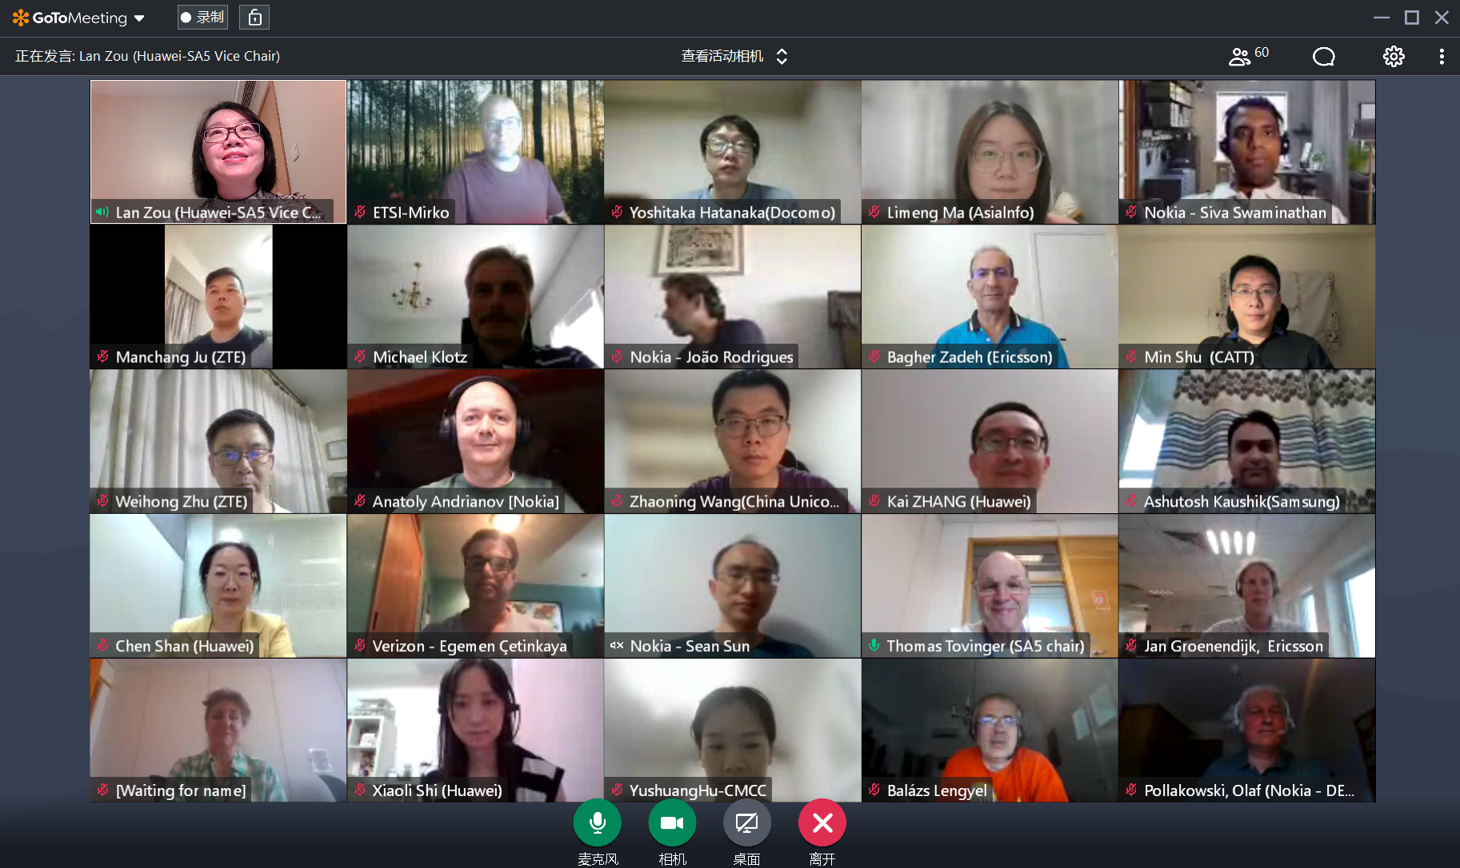
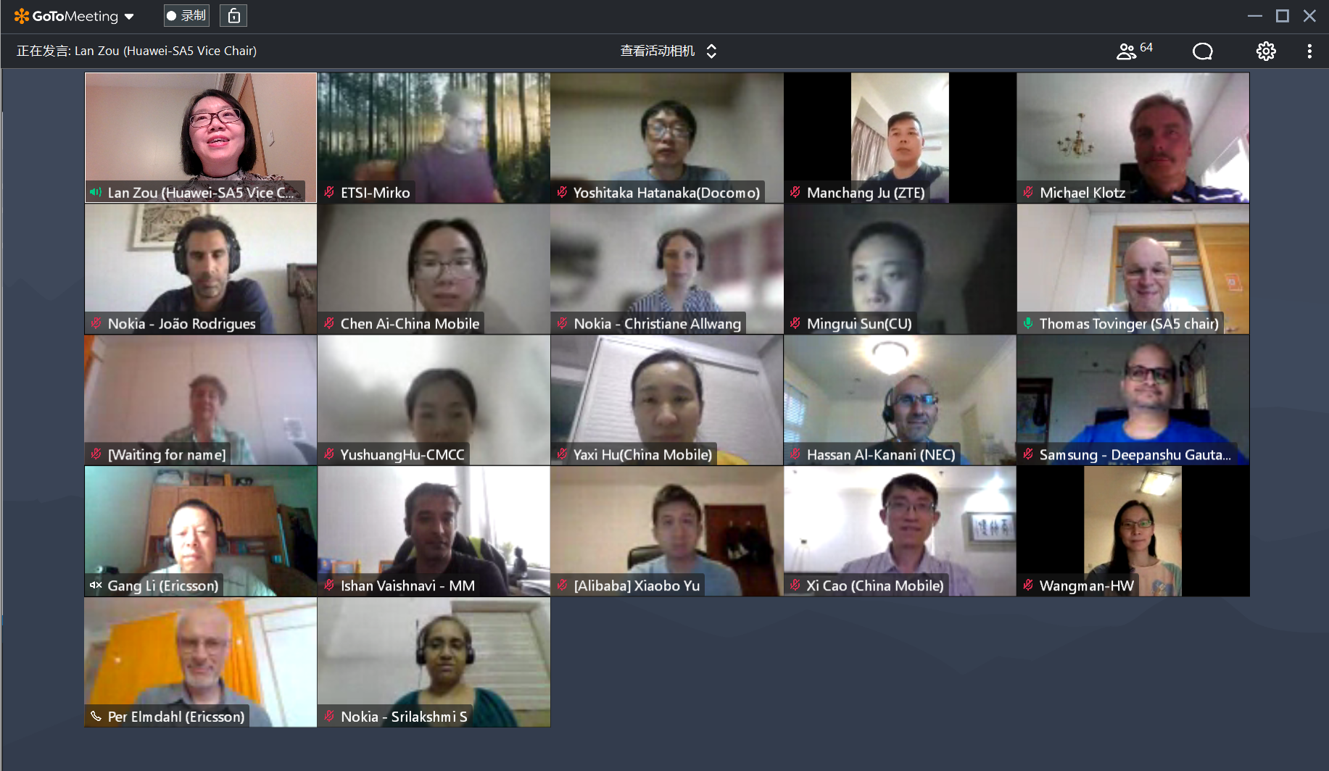
Thank you!

Slide 22

3GPP SA5 Time plan
SA5 time plan:
S5-221173 Rel-18 time plan proposal for OAM (Endorsed)
SA5 OAM Release 18 planning：
Mar 2022 (TSG#95): SA5 SIDs/WIDs specified
Sept 2022 (#97) and Dec 2022 (#98): SA5 SID concluded and Rel-18 WID started if needed
Mar 2023 (TSG#99): Stage 1 work freeze
Sep 2023 (TSG#101): Stage 2 Functional work Freeze and stage 3(OAM/CN related), provide inputs to CT
Dec 2023 (TSG#102): Stage 2 Functional work Freeze and stage 3 (RAN related)
SA5 OAM Release 19 planning：
After Jun 2023 (TSG#100): start of Rel-19 planning
Sep 2023 (TSG#101): Start of Rel-19

Slide 23
Release 18 timeline – figure with SA5 OAM
2021
Now
2022
2023
2024
TSG#
91
92
93
94
95
96
97
98
99
100
101
102
103
104
Stage 1 (SA1)
Rel-18 Content def.
Content def. RAN4
Prio
Stage 2 (SA2, SA6,…)
RAN1
RAN Completion (RAN2, RAN3, RAN4 core)
Stage 3 (CT & SA)
ASN.1 & Open APIs
RAN4 performance
Studies (SA5 OAM)
Stage 1 (SA5 OAM)
Stage 2 Functional and stage 3 work (OAM/CN related),
provide inputs to CT
SA5 OAM Rel-18 Timeline
Stage 2 Functional and stage 3 work (RAN related)
SA5 OAM Rel-19 Timeline
Rel-19 planning
Start of Rel-19
Note: starting dates are indicative

Slide 24
OAM General Topics (Rel-18 prioritization and Work Package)
Info about WoP:
We need to start the Rel-18 work at SA5#142e – all SA-approved Rel-18 WI/SIs should be on the agenda.
Definition of the complete set of WoPs for each Rel-18 WID/SID should be proposed by the work item rapporteurs as input contributions to SA5#142e and agreed there, which means that the WoPs can and should then be used as basis for selection of subsets of the WoPs on the agenda for SA5#143e.
Therefore we need some other less formal way of reducing the agenda for SA5#142e, if we want that – like a leaders recommendation of what to focus on, e.g. initial skeleton proposals and/or DPs. Maybe this will come natural anyway for a first Rel-18 meeting, so we did not decide on any such leaders recommendation yet (but I still ask everyone to consider that, to avoid a huge overload of Rel-18 contributions at the same time as we need to finish the Rel-17 work items with approved exceptions as well as the earlier Rel-17 studies that continue into Rel-18).
The WoPs shall in no way modify the content or meaning of the objectives in the approved WID/SIDs – they are only allowed to identify clearly defined subsets of the objectives, typically one WoP per “main bullet” in the WID/SID Objectives, or in some cases subsets of a bullet if it’s clearly separable.
The SA5#142e-agreed complete set of WoPs for each Rel-18 WID/SID should be documented as an “SA5-local WID/SID update with WoPs” (no need to send them to SA for approval).
Then we ask the rapporteurs to propose a subset of all agreed WoPs to be recommended to the leaders to be put on the agenda for next meeting, which means that contributions to the next meeting (143e) are only allowed to address the selected WoPs. We don’t spend time on this selection during the meeting, as the agreed WoPs are not known until the end of the meeting but also to save time for the tdoc discussions and conclusions in the meeting.
We will add the selection of subsets of WoPs to the real meeting agenda as “level 4 (or 5)” agenda item (e.g. 6.3.4.1 for WoP no. 1 in agenda 6.4.3) so that this has to be used for tdoc agenda allocation in 3GU. This is possible in 3GU according to Mirko. The next meeting’s draft agenda shall be sent out for email review asap after the meeting, and then it will be decided by the leaders after any comments have been considered. Thus the WoP selection for SA5#143e should be known soon after SA5#142e finished, for everyone to be able to plan and prepare contributions for SA5#143e as early as possible.
This also means that the leaders have “full control” to decide about the WoP selection in the agenda for next meeting (like we always have for the agenda), and it is not possible to contribute to any other WoPs than the selected ones.
This also has the big advantage that we can follow the “statistics of number of tdocs for every WoP” at every meeting to see an indication of the progress for each WoP and at the end of the release check if all objectives (WoPs) have been addressed with some contributions (and how many were agreed).
Latest version of WoP is captured in S5-224345 Collection of Rel-18 3GPP SA5 OAM WoPs
We ask every rapporteur to provide proposal to update the WoP if needed.

Slide 25
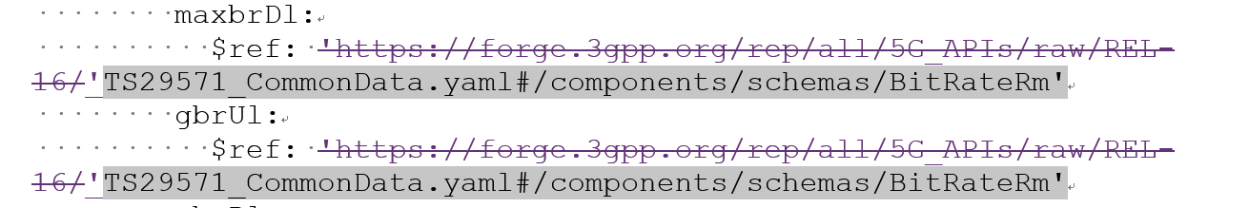
OAM General Topics (Forge collaboration with CT) (1/2)
Forge collaboration background information:
SA approved forge structure: SP-220341 Proposed recommendations on Storage of 3GPP OpenAPI specification files in 3GPP Forge
Request from CT Chair and CT expect:
A. Update the file names to start with TS number, Correct internal references to common defs (and other SA5 spec) to take into account the file name update
B. Use relative URIs to refer to external specifications (e.g. TS29571)
C: “comDefs.yaml" and “"coslaNrm.yaml"
Summary of the update in SA5#142e&#143e: All requests related to A-B-C from CT Chair and CT expert are completed.
A. SA5 OpenAPI file name is fully aligned with the naming convention as CT, see the following examples how it look like.
TS28541_5GcNrm.yaml TS28541_NrNrm.yaml
TS28532_FaultMnS.yaml TS28541_SliceNrm.yaml
TS28532_FileDataReportingMnS.yaml TS28550_PerfMeasJobCtrlMnS.yaml
TS28532_HeartbeatNtf.yaml TS28623_ComDefs.yaml
TS28532_PerfMnS.yaml TS28623_GenericNrm.yaml
TS28532_ProvMnS.yaml TS29512_Npcf_SMPolicyControl.yaml
TS28532_StreamingDataMnS.yaml TS29514_Npcf_PolicyAuthorization.yaml
TS28536_CoslaNrm.yaml TS29571_CommonData.yaml
(Also the reference inside will also be updated)
B. Relative URIs are used to external specifications, see the following example in S5-223048.
C. YAML syntax issues in “comDefs.yaml" and "coslaNrm.yaml“ are corrected.

Slide 26
OAM General Topics (Forge collaboration with CT) (2/2)
Progress in SA5#142e:
1. List of SA5#142e agreed tdocs:
Collaboration with CT on Forge (TS 32.312&28.532&28.536&28.538&28.541&28.550&28.622&28.623):
[SA5#142e], 6.3-MAINT, S5-222384 Rel-17 CR TS 28.312 OpenAPI file name and dependence change-intentNrm
[SA5#142e], 6.3-MAINT, GROUP#1 (S5-222580/S5-222502) Draft CR 28.532 OpenAPI file name and dependence change
[SA5#142e], 6.3-MAINT, S5-222382 Rel-16 CR TS 28.536 OpenAPI file name and dependence change-coslaNrm
[SA5#142e], 6.3-MAINT, S5-222385 Rel-17 CR TS 28.538 OpenAPI file name and dependence change-edgeNrm
[SA5#142e], 6.3-MAINT, GROUP#2 (S5-222581/S5-222582/S5-222583) TS 28.541 OpenAPI file name and dependence change-5gcNrm-nrNRM-SliceNrm.yaml
[SA5#142e], 6.3-MAINT, S5-222518 CT OpenAPI file relative-path URI references and dependence change for 5gcNrm.yaml
[SA5#142e], 6.3-MAINT,S5-222503 Rel-16 Draft CR 28.550 OpenAPI file name and dependence change
[SA5#142e], 6.3-MAINT, GROUP#3 (S5-222584/S5-222585) TS 28.623 OpenAPI file name and dependence change-comDefs-genericNRM.yaml
2. Issues have been addressed in SA5#142e (corresponding to the requests A-B-C above from CT Chair and CT expect):
A. Filename alignment:
a) Add TS number: Rel-16 related draftCRs have been updated and agreed.
B. Absolute/relative URI: Rel-16 related draftCRs have been updated and agreed.
Progress in SA5#143e :
1. List of SA5#143e agreed tdocs:
[SA5#143e], 6.3-MAINT, GROUP#1 (S5-223527/S5-223528/S5-223529/S5-223530/S5-223531/S5-223532) CR TS 28.541 OpenAPI file name and dependence change-5gcNrm-nrNRM-SliceNrm
[SA5#143e], 6.3-MAINT, GROUP#2 (S5-223533/S5-223534/S5-223535/S5-223536) CR TS 28.623 OpenAPI file name and dependence change-comDefs- genericNrm
[SA5#143e], 6.3-MAINT, GROUP#3 (S5-223068/S5-223069) CR TS 28.536 OpenAPI file name and dependence change- coslaNrm
[SA5#143e], 6.3-MAINT, S5-223537 Rel-17 CR TS 28.538 OpenAPI file name and dependence change-edgeNrm
[SA5#143e], 6.3-MAINT, GROUP#4 (S5-223314/ S5-223317) CR 28.550 OpenAPI file name and dependence change
[SA5#143e], 6.3-MAINT, GROUP#5 (S5-223312/ S5-223313/ S5-223315/ S5-223316) CR 28.532 OpenAPI file name and dependence change- part1/part2
[SA5#143e], 6.3-MAINT, GROUP#6 (S5-223538/ S5-223126) CR 28.623 yaml indentation correction for comDefs.yaml
[SA5#143e], 6.6.3-IDMS_MN, GROUP#1 (S5-223628) pCR TS 28.312 OpenAPI file name and dependence change-intentNrm
[SA5#143e], 6.7 S5-223048 Rel-16 TS 28.541 CT OpenAPI file relative-path URI references and dependence change for 5gcNrm.yaml
[SA5#143e], 6.7 S5-223049 Rel-17 TS 28.541 CT OpenAPI file relative-path URI references and dependence change for 5gcNrm.yaml
2. Issues have been addressed in SA5#143e (corresponding to the requests A-B-C above from CT Chair and CT expect):
A. Filename alignment:
a) Add TS number: Block approve of Rel-16 CRs and Rel-17 mirror CRs based on agreed draftCRs.
b) Lowercase/Uppercase: Rel-16 and Rel-17 contributions to address this issue.
B. Absolute/relative URI: Block approve of Rel-16 CRs and Rel-17 CRs agreed draftCRs.
C. issues “comDefs.yaml" and “"coslaNrm.yaml“
Collaboration plan with CT after SA5#143e:
After 3GPPSA5#143-e, we will have to copy the SA5 OpenAPI files into the draft release branches right before TSG#96.
As the draft versions of the specifications sent to TSG#96 for approval should be available at the end of the week 21, I would propose to use May 27 as the targeted date for copying the SA5 files in the draft branches of 5G-APIs.
Of course, they can also be made available in week 22 but the sooner will be the better for having all the files available, to have more time to generate CRs if needed after error detection during the final sanity check.

Slide 27
TRs / TSs to be sent to SA#97-e
Tdoc | Title | Source | Sent for

