Slide 1
Discussion Paper on exposure via OSS
Source: AsiaInfo, Alibaba

Slide 2

Background
  SA5 has discussed and agreed use cases and related solution regarding exposure via OSS. However, there is an LS relay from GSMA that suggest to only consider exposure via BSS. There is an need for further justify exposure via OSS from the business and technical perspective.
  This discussion paper propose to address such issue.

Slide 3
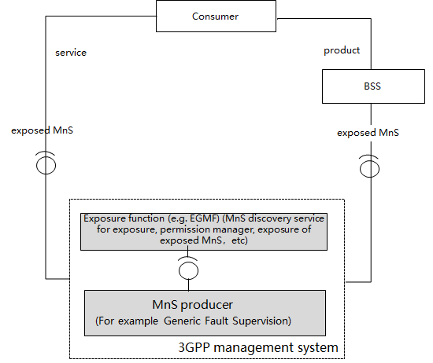

The type of Exposure
  exposure via OSS
  Exposed MnS can be exposed via a dedicated exposure function (e.g.EGMF) or directly via the MnS producer for exposed MnS (e.g. NSSMF, etc)，the consumer can consume the exposed MnS via the dedicated exposure function.
  exposure via BSS
  Exposed MnS is exposed directly via MnS producer for exposed MnS or via the dedicated exposure function, for example NSMF, NSSMF, etc. exposed MnS is exposed via BSS, the consumer can consume the exposed MnS via BSS.

Slide 4

Issues on Exposure via BSS
  Frequency and Large volume of data exchange for exposure via BSS
  Vertical may have the requirement to consume the MnS regarding KPI monitoring (e.g. QoS) from the OSS. For example, the service provider for certain kind of application (e.g. cloud gaming) may require frequent consumption of exposed MnS so that based on the performance, the service provider can decide whether to allow its customer to get access to the network slice. The interval for obtaining such MnS may be less than 1 minute. Such kind of frequent interaction for expsoure may cause poor service performance and overload for BSS.
  Non-public network cases where BSS may not needed
  Vertical customer, such as electricity, may set up its own NPN. In order to manage such network, the vertical customer can purchase network management system from a vender. The vertical can directly interact with the OSS for the management of the NPN without the support of BSS.

Slide 5
Non public network cases
Vertical customer
Vertical customer
Product-level interaction
Product-level interaction
NOP BSS
Exposed MnS interaction
NOP BSS
Exposed MnS interaction
NOP OSS
Dedicated OSS
NOP OSS
Dedicated OSS
NOP Network
PNI-NPN
(dedicated resources)
NOP Network
SNPN
  PNI-NPN as dedicated resources to vertical
  the MnS exposure may still go through Operator's management system if the network resources of the PNI-NPN is shared resources. However, there may have another case where the network resource of PNI-NPN is delicately allocated to the Vertical customer. In this case, the customer may have its own management system to manage the network resources and the MnS exposure can comes from OSS directly.
  SNPN with dedicated OSS provided by Operator
  The vertical has its own SNPN. The dedicated OSS can a part of the hard isolation of NOP OSS（e.g. the performance monitoring of network equipment still belongs to NOP OSS，network slice management belongs to dedicated OSS）. In this case , the customer have its contract with the Operator. After that, the MnS exposure comes from OSS.

Slide 6
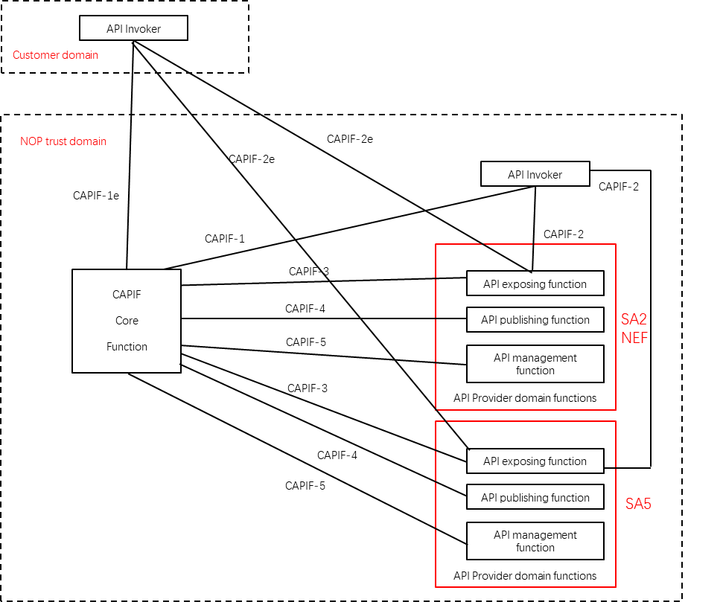
Issues on Exposure via BSS
  exposure trust gateway/middleware(e.g. CAPIF)
  CAPIF core function, as the trust gateway/middleware (e.g. CAPIF), can interact directly with the exposure interface from NEF defined in SA2 and get exposure service directly via NEF. Therefore, it is expected that the CAPIF core function can have the similar interaction with the exposure interface from OSS so that it can consume the exposed MnS.
  It may cause complication for the CAPIF core function to have service level interaction from NEF while having product level interaction from BSS.

Slide 7
NS management service exposure classification
category | NS management service exposure | For example | Reference
Query | Network Slice Performance measurements | Performance measurements for NSSF | TS28.552
 | Network Slice Key Performance Indicators (KPI) | one-single-network-slice-related KPI | TS28.554
 | Network Slice fault supervision | fault supervision of NS instance | TS28.545
Control | Network Slice lifecycle management | Network slice feasibility check, Network slice resource capacity planning | TS28.531
 | network slice SLS assurance SLS control | adjustment of attributes Of ServiceProfile | TS28.535、TS28.541
 | Network slice recourse control | modification of Network slice instance virtualized part | TS28.531

Slide 8
Proposal
  Based the discussion, it is suggest to send LS to GSMA to explain the use case and requirement for the exposure directly via OSS.

