Slide 1
On the relationship of CAMARA and SA work on capability exposure
Source: AT&T, Deutsche Telekom, Ericsson, Huawei, Intel, Orange, Telefónica, Verizon

Slide 2
Capability Exposure - Motivation
Network-as-a-Service (NaaS) represents a paradigm shift whereby a network operator can make network capabilities available for external consumption, including monitoring and configuration related capabilities, through Application Programming Interfaces (APIs).
The controllable and on-demand exposure of these capabilities will pave the way for transforming telco networks into service enablement platforms, facilitating the application-to-network integration. This exposure is a win-win for both CSPs and 3rd parties:
  3rd parties -> it will be key to deliver enhanced and service-tailored customer experience in the 5G (and beyond) era.
  CSPs -> it may be a relevant business oportunity for operators (new revenue streams) and one of the ways to monetize investment in fiber, edge computing and 5G (CAPEX amortization)
To ensure wide market adoption and an attractive economy of scale for all stakeholders in the value chain, it is essential to push the industrialization of APIs adhered to the following principles:
  Open: APIs need to be designed following open process and be publicly available, using Apache2.0 license code.
  Global: APIs shall allow every 3rd party to have an uniform and consistent service experience across different operators, with the effortless portability of applications across their platforms (design-once-run-everywhere approach) and easy service replicability
  User-friendly: APIs made available for 3rd party consumption need to be abstracted out of operator internal APIs, to hide telco complexity and make them easy to use to 3rd parties with no telco expertise/background (e.g. hyperscalers, app developer, OTT SPs, ..).
  Robust, stable, reliable and well-documented, following good IT practices.

Slide 3
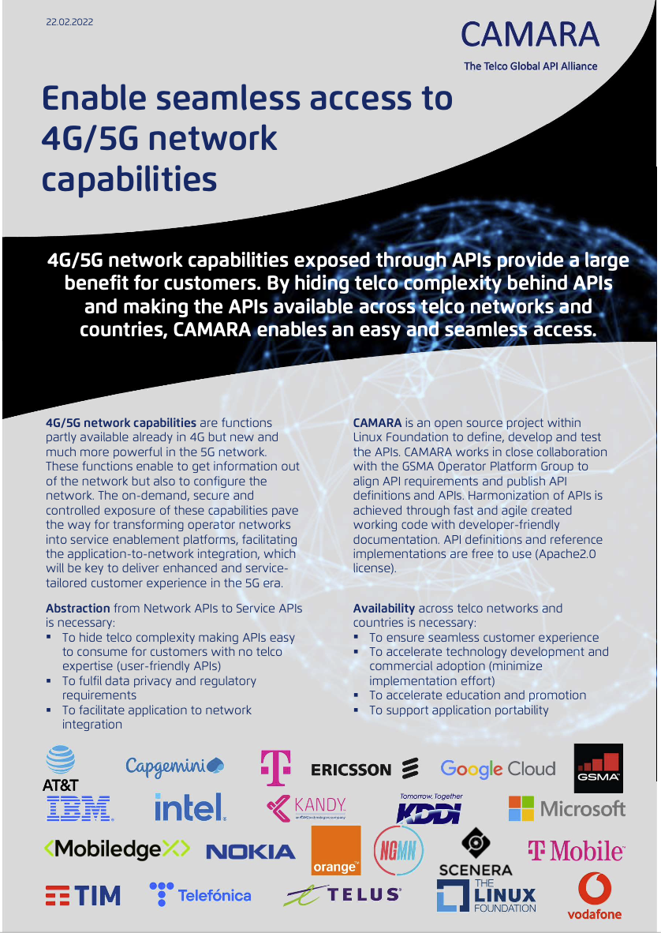
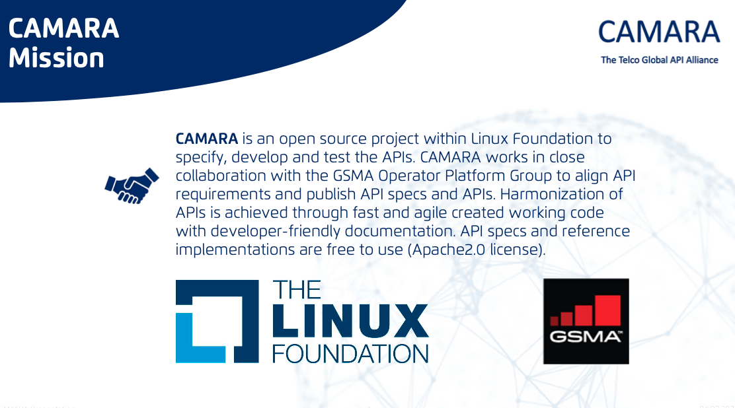



CAMARA Initiative
To push the industrialization of open, global and user-friendly APIs, CAMARA initiative has emerged.
  Joint initiative between the GSMA (OPAG) and Linux Foundation (CNCF) to foster the definition, development and validation of APIs for 3rd party consumption.
  Consortium partners include operators, vendors, solution integrators and hyperscalers (first-class 3rd party consumers).
  Official announcement made at MWC’22
  Press release: https://www.linuxfoundation.org/press-release/linux-foundation-announces-new-project-camara-the-telco-global-api-alliance-with-global-industry-ecosystem/

Slide 4
CAMARA Architecture
Internal APIs: these are the APIs which are implemented in telco assets, including network resources (e.g., core, access, transport functions), cloud resources (e.g., virtualized and cloud-native workload hosting infrastructures) and OAM resources (e.g., OSS and NOC tools).
  These APIs are typically defined in SDOs or industry fora, and quiet tied to the underlying technology.
Service APIs: these are the APIs that are made available for consumption to 3rd parties. These APIs shall be open, global, user-friendly and designed following IT guidelines (robust, stable, reliable, well-documented)
  Service APIs typically (but not always) result of abstraction of internal APIs, to hide telco complexity. This abstraction is done and maintened by transformation function.
Transformation function: it keeps the information on correspondences (mappings) between service APIs and internal APIs, and executes the workflows to enforce these mappings. The transformation function is typically deployed as a microservice provisioned with a workflow engine.
  For some internal APIs, there might not be need for abstraction, i.e. the service API is a mirror of the internal API.
Exposure Gateway: it provides all the capabilities that are needed to provide a controllable capability exposure to 3rd parties.
NOTE: E/WBI stands for East/Westbound Interface, and calls for federation capabilities across telco operators. This is transparent to 3rd parties, and therefore out of scope of CAMARA project

Slide 5
CAMARA – deployment models
Model #1
Model #2
NOTE: This is a non-exhaustive list of deploymet models
Model #3

Slide 6
Transformation Function (1/2)
Transformation function: it keeps the information on correspondences (mappings) between service APIs and internal APIs, and executes the workflows to enforce these mappings.
  NW category internal APIs -> SA2, IETF,…
  Cloud category internal APIs -> NFV, CNCF,…
  OAM category internal APIs -> SA5, TMF, ….
The transformation function is typically provisioned with a workflow engine
  Because the invocation of one service API can trigger the invocation of more than one network API, hence the need for coordination.

Slide 7
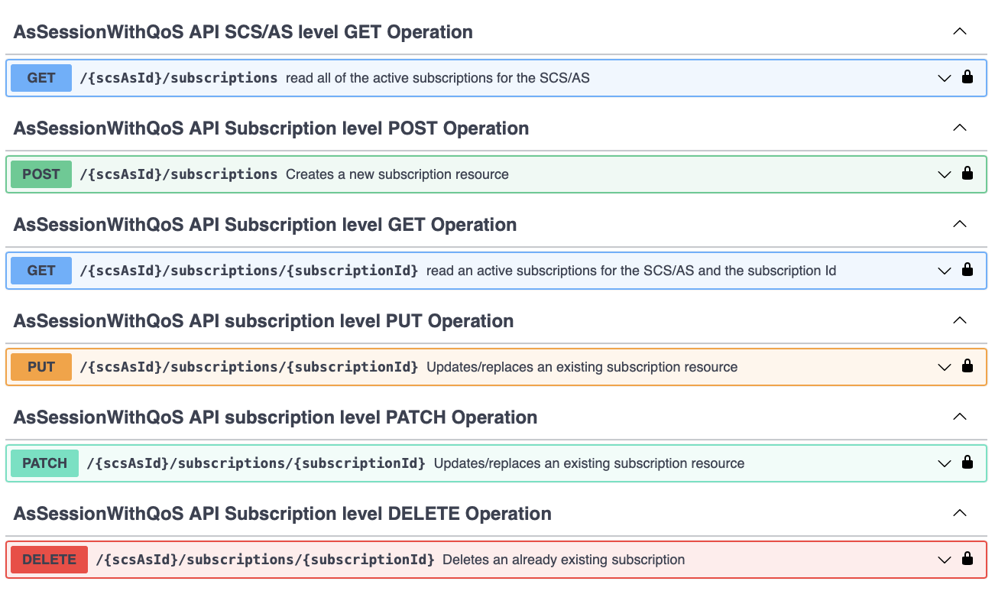
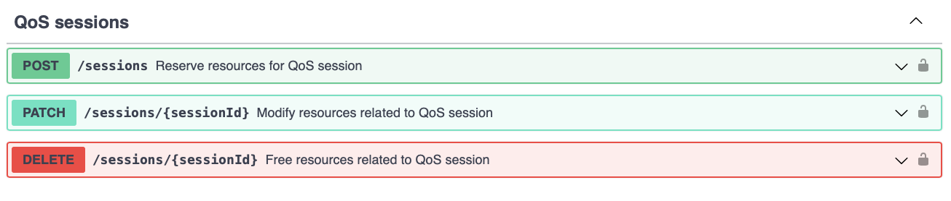
Transformation Function (2/2)
Example: AsSessionWithQoS API (network category internal API, 3GPP 29.122) vs Quality on Demand (service API, CAMARA)
Resource structure
Data model (schemas)
AsSessionWithQoSSubscription
AsSessionWithQoSSubscriptionPatch
QosMonitoringInformation
QosMonitoringInformationRm
QoSMonitoringReport
UserPlaneNotificationData
UserPlaneEventReport
TscQosRequirement
TscQosRequirementRm
UserPlaneEvetn
3GPP
Resource structure
Data model (schemas)
SessionId
SessionInfo
SessionUpdate
AddrInfo
QosChanged
ThroughputProfile^{1,2}
LatencyProfile^{1,2}
ErrorInfo
CAMARA
7
NOTE1: Camara’s Quality on Demand (QoD) API includes qos-throughput.yaml and qos-stable-latency.yaml.
NOTE2: ThroughputProfile==TRUE iff qos-throughput.yaml; LatencyProfile==TRUE iff qos-stable.latency

Slide 8
Exposure GW (1/2)
Exposure GW: provides a set of capabilities to policy the interaction between the API provider and consumer, when they both belong to different admin domains. Non-exhaustive list of capabilities presumed for exposure GW.
  Onboarding (registration)
  Discovery
  Access control (authN/Z)
  Auditing
  Accounting
  Logging
  ….
It is important to look for a reference solution. In this regard, a reference solution can be CAPIF. Three reasons:
  Implementing GW capabilities
  Standard solution, with wide acceptance at industry
  It is not tied to 3GPP APIs; CAPIF can be used as exposure GW solution for any API, regardless of API semantics.

Slide 9
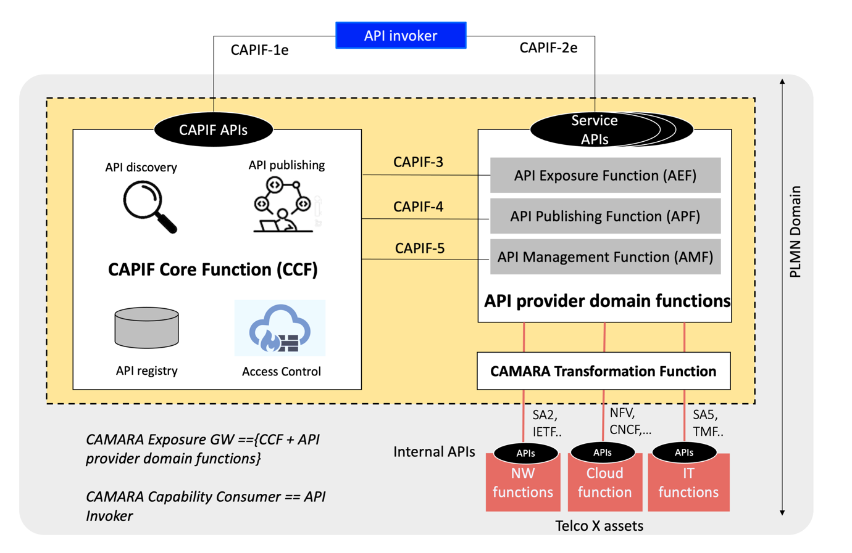
Exposure GW (2/2)
Reference document: https://github.com/camaraproject/WorkingGroups/raw/main/Commonalities/documentation/Deliverables/API-exposure-reference-solution.docx
Service APIs

Slide 10
Conclusions
Specification, development and testing of service APIs is an activity to be carried out in CAMARA
  Some attempts were made in the past to have these service APIs specified in SDOs, and the experience was bad.
  There is a need to involve 3rd party consumers from the very beginning, to make sure we meet their expectations, and these consumers are already in CAMARA.
  There exists coordination between CAMARA initiative and GSMA OPAG (OP API Group), to work together in this endeavor.
  Service APIs build on network APIs that are beyond 3GPP SA scope (CNCF APIs, ETSI APIs, TMF APIs….), so not appropriate for 3GPP SA to lead this activity.
3GPP SA work should focus on solutions enabling the exposure of APIs.
  CAMARA focus: service API definition (scope: transformation function)
  3GPP SA focus: mechanisms to allow on-demand, secure and auditable exposure of APIs (scope: exposure GW).
  Collaborative work potentially involving different WGs, including (though not limited to) SA5 and SA6.
3GPP SA5 work shall be articulated on how to link SBMA concepts (MnS producer, consumer, discovery) with ”exposure GW”.
  3GPP SA5 work should avoid the definition of artificial concepts that put at risk the stability of SBMA principles.
  Talking about eMnS producer/consumer, eMnS discovery, … does not help at all, and deviate attention/focus.

Slide 11
Proposal
Point #1: 3GPP SA5 work on charging may have an impact on service APIs, hence it shall be in scope of CAMARA.
Point #2: 3GPP SA work shall focus on solutions enabling on-demand, secure and auditable exposure of APIs
  3GPP SA scope shall be limited to “Exposure GW”.
Point #3: 3GPP SA work/study items related to ‘capability exposure’ may include analysis with CAMARA, as appropriate.
Point #4: 3GPP SA WG should decide how to communicate with CAMARA
  Including decision on which WG should as contact point
  Including decision on the need for a workshop with CAMARA (similar to the one organized with OPAG), to fully understand scope and objectives of CAMARA.
Point #5: 3GPP SA5 work shall be articulated on how to link SBMA concepts (MnS producer, consumer, discovery) with ”Exposure GW”.
The WG is asked to endorse the following:
Action #1: Agree on Points #1, #2 and #3 and #4
Action #2: Send a LS to 3GPP SA, with proposals captured in points {#2, #3, #4}, asking for feedback.
Action #3: Scope the work in FS_NSCE according to Point #5.

