Slide 1
SA5 OAM&P Exec Report SA5#136e, 1 – 9 Mar,2021 e-meeting
Zou Lan, SA5 Vice-Chair, HUAWEI
Thomas Tovinger, SA5 Chair, ERICSSON
Mirko Cano Soveri, MCC

Slide 2
Incoming LSs
Tdoc | Title | Source | Decision | Reply In
S5-212014 | Resubmitted LS reply to 3GPP SA5 on the relation between EDGEAPP and ETSI MEC architectures | ETSI ISG MEC | noted
S5-212015 | Resubmitted LS New Whitepaper: “Operator Platform Telco Edge proposal" | GSMA | replied to | S5-212319
S5-212016 | Resubmitted LS to SA5 on Relation between 3GPP EDGEAPP and ETSI MEC architectures | S6-202355 | noted
S5-212017 | Resubmitted LS on O-RAN – 3GPP Cooperation on Management Services | O-RAN | replied to | S5-212328
S5-212018 | Resubmitted LS/r on methodology harmonization and REST-based network management framework (reply to 3GPP TSG SA5-S5-204647) | ITU-T SG2 | postponed
S5-212019 | Resubmitted LS/r on work progress on M.resm-AI "Requirements for energy saving management of 5G RAN system with AI" (reply to 3GPP SA5-LS1225) | ITU-T SG2 | postponed
S5-212020 | Liaison reply to 3GPP SA5/SA2 on relation between ENI and MDAF/NWDAF | ETSI ISG ENI | noted
S5-212021 | Reply LS ccSA5 on SA WG2 assumptions from conclusion of study on architecture aspects for using satellite access in 5G | R2-2102498 | noted
S5-212022 | LS reply to SA5 on QoE Measurement Collection | R2-2102500 | noted
S5-212023 | Reply LS to SA5 on MDT Stage 2 and Stage 3 alignment | R3-211140 | noted
S5-212024 | LS to SA5 on the details of logging forms reported by the gNB-CU-CP, gNB-CU-UP and gNB-DU under measurement pollution conditions | R3-211334 | postponed
S5-212025 | Reply LS to SA5 on limitation of Propagation of immediate MDT configuration in case of Xn inter-RAT HO | R3-211335 | noted
S5-212026 | Progressing the Multi SDO Autonomous Network coordination | TM Forum | replied to | S5-212310
S5-212029 | LS on NG.116 support of service categories | GSMA 5G Joint-Activity (5GJA) | replied to | S5-212320

Slide 3
Outgoing LSs
Tdoc | Title | To | Cc | Reply To
S5-212319 | Reply LS on New Whitepaper: “Operator Platform Telco Edge proposal" from GSMA | GSMA | 3GPP TSG SA WG2, TSG SA WG6 | S5-212015
S5-212328 | Reply LS on O-RAN – 3GPP Cooperation on Management Services | O-RAN WG1 |  | S5-212017
S5-212310 | Reply LS on Progressing the Multi SDO Autonomous Network coordination | TM Forum | 3GPP SA, ETSI (AN initiative, ZSM, NFV, ENI, F5G), GSMA, NGMN, CCSA TC7,ITU-T, IETF, IEEE | S5-212026
S5-212320 | Reply LS to GSMA on NG.116 support of service categories | GSMA 5G Joint-Activity (5GJA) | 3GPP SA2 | S5-212029
S5-212403 | LS from SA5 to RAN2,RAN3 on network sharing with multiple SSB | RAN2, RAN3 |  | New
S5-212390 | LS to TM Forum on introduction of 3GPP Autonomous Network Levels | TM Forum | 3GPP SA,ITU-T (FG-AN), ETSI (AN initiative, ZSM, NFV, ENI, F5G), IETF | new

Slide 4
New or Revised Work Items / Study Items
Tdoc | Type | Release | Title | Source | Potential related groups
S5-212368(email approval) | New SID | Rel-17 | New SID on management aspects of network slice management capability exposure | Alibaba Group
S5-212369 | New WID | Rel-17 | New WID Enhancements of Management Data Analytics Service | Intel, NEC | SA2
S5-212331 | New WID | Rel-17 | New WID on File Management | Nokia, Nokia Shanghai Bell
S5-212332 | New SID | Rel-17 | New WID on enhancement of service based management architecture | Huawei, China Telecom, China Unicom, China Mobile, Ericsson
S5-212399 | Revised WID | Rel-17 | Revised WID on Discovery of management services in 5G | Huawei
S5-212373 | Revised WID | Rel-17 | Updated WID Enhancement on Management Aspects of 5G Service-Level Agreement | Ericsson

Slide 5
Documents endorsed by OA&M
TDoc | Title | Source | Potential related topics and related groups
S5-212330 | Rel-17 time plan proposal for OAM | SA5 Vice chair (Huawei), SA5 chair
S5-212347 | Discussion on issues with NSI and NSSI state management | Huawei, Orange
S5-212272 | Input to DraftCR 28.541 Discussion including perfRec mapping to domain specific attributes | Ericsson LM
S5-212055 | Proposal to stop using draftCR for WI ePM_KPI_5G | Intel
S5-212382 | Simplified Request for Data Collection | Nokia, Nokia Shanghai Bell
S5-212234 | Discussion on support RRC connection number measurements per PLMN in MOCN network sharing | China Telecom Corporation Ltd.

Slide 6
Overview of SA5 OAM ongoing WIs/SIs
Rel-17: 24 ongoing WIs/SIs, 1 finished SI, 3 WI and 3 SI for SA approval
17 ongoing WIs, 3 WI wait for SA approval
7 ongoing SIs, 1 finished SI, 3 SI wait for SA approval
 | Rel-17 Operations, Administration, Maintenance and Provisioning (OAM&P)
1 | Additional NRM features | adNRM | 870026
2 | Enhancements of 5G performance measurements and KPIs | ePM_KPI_5G | 880025
3 | Management of MDT enhancement in 5G | e_5GMDT | 870025
4 | Enhancement of QoE Measurement Collection | eQoE | 870027
5 | Management data collection control and discovery | MADCOL | 880028
6 | Management Aspects of 5G Network Sharing | MANS | 900021
New | Generic Plug and connect | RUNT | Wait for SA approval
New | New WID on File Management | FIMA | Wait for SA approval
7 | Autonomous network levels | ANL | 880027
8 | Intent driven management service for mobile networks | IDMS_MN | 810027
9 | Network policy management for 5G mobile networks | NPM | 860024
10 | Enhanced Closed loop SLS Assurance | eCOSLA | 870030
11 | Enhancements of Self-Organizing Networks (SON) for 5G networks | eSON_5G | 870028
12 | Enhancement of Handover Optimization | E_HOO | 880029
13 | Enhancements on EE for 5G networks | EE5GPLUS | 870022
14 | Discovery of management services in 5G | 5GDMS | 820035
New | New WID Enhancements of Management Data Analytics Service (email approval) | eMDAS | Wait for SA approval
15 | Management of non-public networks | OAM_NPN | 870023
16 | Enhancement on Management Aspects of 5G Service-Level Agreement | EMA5SLA | 870024
17 | Management of the enhanced tenant concept | eMEMTANE | 880026
 | Rel-17 OAM&P Studies
1 | Study on management and orchestration aspects with integrated satellite components in a 5G network | FS_5GSAT_MO | 830025
2 | Study on enhancement of Management Data Analytics Service | FS_eMDAS | 850028
3 | Study on new aspects of EE for 5G networks | FS_EE5G | 870021
4 | Study on network slice management enhancements | FS_NSMEN | 860022
5 | Study on enhancements of edge computing management | FS_eEDGE_Mgt | 870029
6 | Study on YANG PUSH | FS_YANG | 890017
7 | Study on access control for management service | FS_MNSAC | 890016
New | New SID on continuous integration continuous delivery support for 3GPP NFs | FS_CICDNS | Wait for SA approval
New | New WID on enhancement of service based management architecture | FS_eSBMA | Wait for SA approval
New | New SID on management aspects of network slice management capability exposure (email approval) | FS_NSCE | Wait for SA approval
8 | Study on autonomous network levels (finished) | FS_ANL | 850032

Slide 7
OAM General Topics
Working Progress
The following topics are discussed in the meeting:
Collection of useful endorsed document and external communication documents
List of Approved DraftCR
Rel-17 Use case template and requirement template discussion
Need more discussion, especially for the requirement to align with the recent SA discussion.
Rel-17 time plan proposal for OAM
SA5 try to align with overall 3GPP time plan, especially for the stage3 freeze time.

Slide 8
Rel-11/Rel-12/Rel-13/Rel-14/Rel-15/Rel-16/Rel-17 CRs
Working Progress
The following topics are discussed and agreed related CRs in the meeting.
Rel-11/Rel-12/Rel-13/Rel-14/Rel-15 CR:
TS 32.422:
Correct MDT collection period in LTE
Rel-15 CR:
TS 28.541:
CR 28.541 Correction to NSI and NSSI state management
Rel-16 CR:
TS 28.532:
CR 28.532 Correct definitions for the File MnS stag2, REST SS, OpenAPI definitions.
CR 28.532 Correct some minor errors in the Fault MnS definition (REST SS)
CR 28.532 Correct some minor errors in the Prov MnS definition (REST SS)
CR TS 28.532 Correct the misalignment information for stage 2 Fault Supervision MnS
TS 28.535:
Update use cases and requirements to replace communication service
CR 28.535 Clean up the concepts and background
TS 28.536:
CR TS 28.536 Correct the misalignment information for COSLA
CR TS 28.536 add explanation for Entities in loop
CR 28.536 Correct OpenAPI definition of the COSLA NRM
TS 28.541:
Update of the PCI and DESManagementFunction
CR TS 28.541 Correction on misalignment issues on EP_Transport IOC
CR TS 28.541 Correct multiplicity issue for several attributes of NR NRM
CR TS 28.541 Correct the NF name in definition of EP_NgU
CR 28.541 Correction to NSI and NSSI state management(mirror)
CR 28.541 Correction of ServiceProfile attributes
fix containment relationship for EP_Transport IOC
“Mega CR”: Rel-16 28.541 OpenAPI CR
“Mega CR”: Rel-16 28.541 YANG CR
TS 28.545:
Add missing Alarm Requirements and Use Cases
TS 28.552:
CR 28.552 Update measurements to consider abnormal releases in RRC connected state
CR 28.552 Message names correction
TS 28.554：
CR 28.554 Update retainability KPIs to consider abnormal releases in RRC connected state
TS 28.622：
CR 28.622 Correct notification support table for ManagedElement and ManagementNode
CR TS 28.622 Some minor correction
TS 28.623:
“Mega CR”: Rel-16 28.623 YANG CR
Rel-17 CRs:
TS 28.537:
Rel-17 Input to DraftCR 28.537 Add requirements for File Management (input to draftCR)
TS 28.541:
Remove the XML Solution set
Update of the PCI and DESManagementFunction (mirror)
CR TS 28.541 Correction on misalignment issues on EP_Transport IOC (mirror)
CR TS 28.541 Correct multiplicity issue for several attributes of NR NRM (mirror)
CR TS 28.541 Correct the NF name in definition of EP_NgU (mirror)
CR 28.541 Correction to NSI and NSSI state management(mirror)
CR 28.541 Correction of ServiceProfile attributes(mirror)
fix containment relationship for EP_Transport IOC (mirror)
“Mega CR”: Rel-17 28.541 OpenAPI CR
“Mega CR”: Rel-17 28.541 YANG CR
TS 28.552:
CR 28.552 Update measurements to consider abnormal releases in RRC connected state (mirror)
CR 28.552 Message names correction (mirror)
TS 28.554：
CR 28.554 Update retainability KPIs to consider abnormal releases in RRC connected state (mirror)

Slide 9
Rel-17 WI MADCOL/ePM_KPI_5G/e_5GMDT/eQoE
WI code | WI Title | Completion rate | TS/TR | Tdoc reference | Target date | Rapporteur | Related groups | Related topic
MADCOL | Management data collection control and discovery | 5%->10%->25% | TS28.533/28.532/28.622/ 28.623 | SP-200465 | SA#93 (Sep. 2021) | Nokia | SA2/RAN2/RAN3
ePM_KPI_5G | Enhancements of 5G performance measurements and KPIs | 20%->30%->40% | TS28.552/32.425/28.554/32.426/32.450/32.451/32.455 | SP-200462 | SA#93 (Sep. 2021) | Intel | SA2/RAN2/RAN3
e_5GMDT | Management of MDT enhancement in 5G | 50%->60%->70% | TS32.421/32.422/32.423/28.622/28.623/28.523 | SP-200191 | SA#90 (Dec. 2020) | Ericsson | SA2/RAN2/RAN3
eQoE | Enhancement of QoE Measurement Collection | 5%->10%->15% | TS28.307/28.308/28.309/28.404/28.405/28.406/28.622/28.623/28.533 | SP-200193 | SA#93 (Sep. 2021) | Ericsson | RAN2/RAN3/SA4
Working Progress
MADCOL: The following topics are discussed and endorsed.
Simplified Request for Data Collection
The following topics are agreed as input into draftCR
Rel-17 Input to DraftCR 28.537 Add management data management requirements
e_5GMDT: The following topics are discussed and agreed
Add new clauses and clarification for MDT collection peroid in NR
Add new MR-DC related requirements
eQoE: The following topics are discussed and agreed
Adding Signalling Based Activation for UTRAN and LTE
ePM_KPI_5G: The following topics are discussed and agreed.
CR Rel-17 28.552 CR for WI ePM_KPI_5G converted from draftCR S5-211355
CR Rel-17 28.552 Add measurements related data management for UDR
CR Rel-17 28.552 Add measurements related to background data transfer policy control for PCF
Rel-17 CR 28.552 Add measurements to cover all accessibility types
The following topics are discussed and endorsed
Proposal to stop using draftCR for WI ePM_KPI_5G

Slide 10
Rel-17 WI adNRM/MANS
WI code | WI Title | Completion rate | TS/TR | Tdoc reference | Target date | Rapporteur | Related groups | Related topic
adNRM | Additional NRM features | 5%->10%->15% | TS28.540/28.541/28.622/ 28.623 | SP-200192 | SA#92 (Jun. 2021) | Nokia | SA2/RAN3
MANS | Management Aspects of 5G Network Sharing | 0%->15%->20% | TS 28.541/28.552/32.130 | SP-201080 | Sep 2021 (SA#93) | China Unicom | RAN2/RAN3
Working Progress
adNRM: The following topics are discussed and agreed
Correct NR endpoint classes containment in YANG
Code begin end markers and longer prefix length
The following topics need more discussion.
Modeling managed management entities
MANS: The following topics are discussed and agreed
CR TS 28.552 Add PLMN granularity for RRC connection number measurements
CR TS 28.552 Add PLMN granularity for packet delay measurements in split gNB scenario
CR 28.552 Add Filter and Filter naming description
CR TS 32.130 Update role definition and business requirements for network sharing
LS from SA5 to RAN2,RAN3 on network sharing with multiple SSB
The following topics are discussed and endorsed.
Discussion on support RRC connection number measurements per PLMN in MOCN network sharing
The following topics need more discussion.
Discussion on NRM enhancement to support NG-RAN network sharing

Slide 11
Rel-17 WI ANL/IDMS_MN/NPM/eCOSLA
WI code | WI Title | Completion rate | TS/TR | Tdoc reference | Target date | Rapporteur | Related groups | Related topic
ANL | Autonomous network levels | 30%->40%->50% | TS 28.100 | SP-200464 | SA#92 (Jun. 2021) | CMCC | SA2/RAN3/ZSM | Autonomous network
IDMS_MN | Intent driven management service for mobile networks | 65%->65%->70% | TR28.812/TS 28.312 | SP-180899 | SA#93 (Sep. 2021) | Huawei | SA2/RAN3/ZSM | Intent
NPM | Network policy management for 5G mobile networks based on NFV scenarios | 60%->60%->65% | TS 28.555/28.556 | SP-191211 | SA#92 (Jun. 2021) | CMCC | SA2/RAN2/RAN3 | Policy
eCOSLA | Enhanced Closed loop SLS Assurance | 10%->20%->30% | TS28.535/28.536/28.533/28.541/28.546/28.552/28.553 | SP-200196 | SA#93 (Sep. 2021) | Ericsson | ZSM/SA2/RAN3 | Close loop interaction
Working Progress
ANL: The following topics for normative phase are discussed and agreed in the meeting.
Add autonomous network level for RAN NE deployment
Add autonomous network level for RAN UE throughput optimization
Update Clause 4.1 Autonomous network concept
Add generic classification of autonomous network level for network optimization
LS to TM Forum on introduction of 3GPP Autonomous Network Levels
The following topics needs more discussion.
Add definition of network and service planning
IDMS_MN: The following topics for normative work are discussed and agreed in the meeting.
Add conceptual description for intent MnS
Add concept for intent lifecycle management
Add stage 2 information model definition for intent
Add stage 2 procedure for intent lifecycle management
Add stage 2 management operation for intent
Requirement of Intent for service at edge
The following topics needs more discussion.
Add capabilities of an intent Driven MnS
NPM: The following CR topics are discussed and agreed.
add specification level use cases-policy deletion
add specification level use cases-policy update
add specification level use cases-policy activation
add specification level use cases-policy deactivation
add specification level use cases-policy query
add specification level use cases-policy conflicts notification
The following topics needs more discussion
pCR 28.555 add specification level requirement
eCOSLA: The following CR topics are discussed and agreed as input to draftCR.
Input to eCOSLA draft CR S5-211358
The following topics needs more discussion.
Add requirements of closed loop SLS assurance
Rel 17 CR TS28.535 Add Use Case on ACCL Goal translation
Add lifecycle of closed control loop and clarify relationship between CSA and intent
Rel-17 Input to draftCR TS 28.535 Configure policies for closed control loop
DP on assurance policy for closed control loop
Rel-17 Input to draftCR TS 28.536 Add assurance policy for closed control loop
DP on assurance report for closed control loop
Rel-17 Input to draftCR TS 28.536 Add assurance report for closed control loop
Rel 17 CR TS28.536 Solution for configuring conditions for ACCL state change
Rel 17 draft CR TS28.536 Solution for pausing a closed loop

Slide 12
Rel-17 WI eSON_5G/E_HOO/EE5GPLUS/5GDMS
WI code | WI Title | Completion rate | TS/TR | Tdoc reference | Target date | Rapporteur | Related groups | Related topic
eSON_5G | Enhancements of Self-Organizing Networks (SON) for 5G networks | 5%->15%->15% | TS28.313/28.552/28.541/28.545 | SP-200194 | SA#92 (Jun. 2021) | Intel | RAN3 | SON
E_HOO | Enhancement of Handover Optimization | 5%->10%->10% | TS28.552/28.313/28.541 | SP-200466 | SA#92 (Jun. 2021) | Ericsson | RAN3 | SON
EE5GPLUS | Enhancements on EE for 5G networks | 10%->20%->30% | TS28.310/28.552/28.554/28.541 | SP-200188 | SA#93 (Sep. 2021) | Orange | SA2/RAN2/RAN3/ETSI EE/ITU-T/GSMA | Energy saving
5GDMS | Discovery of management services in 5G | 50% ->60%->70% | TS 28.533/28.532/531 | SP-181072 | SA#93 (Sep-2021) | Huawei |  | Service based discovery
Working Progress
eSON_5G: The following topics need more discussion.
Update of PCI configuration for D-SON and C-SON
Requirements, use cases and services for C-PCI
EE5GPLUS: The following topics are discussed and agreed in this meeting
Rel-17 CR TS 28.310 Add use case and requirements for switching off edge UPFs
E_HOO: The following topics need more discussion.
CHO measurements
5GDMS: The following topics are discussed and agreed
Revised WID on Discovery of management services in 5G
The following topics need more discussion.
TS 28.533 Add Management Service Type
Discussion on AddMnSType
Rel-17 CR 28.533 Add operations for discovery of management services
Rel-17 CR 28.532 Add operations for discovery of management services

Slide 13
Rel-17 WI OAM_NPN/EMA5SLA/eMEMTANE
WI code | WI Title | Completion rate | TS/TR | Tdoc reference | Target date | Rapporteur | Related groups | Related topic
OAM_NPN | Management of non-public networks | 5%->15%->25% | TS28.557/28.541/28.531/28.533/28.552/28.554 | SP-200189 | SA#92 (Jun. 2021) | Huawei | SA2/RAN3 | NPN
EMA5SLA | Enhancement on Management Aspects of 5G Service-Level Agreement | 5%->40%->50% | TS28.531/28.541 | SP-200190 | SA#91 (Mar. 2021) | China Mobile | SA2/RAN3 | SLA
eMEMTANE | Management of the enhanced tenant concept | 0%->5%->5% | TS28.531/28.532/28.533/28.541 | SP-200463 | SA#94 (Dec. 2021) | Huawei | SA2 | Tenant
Working Progress
OAM_NPN: The following topics are discussed and agreed
28.557 Add 5GLAN group management in UE related management aspects
28.557 Applicability of management modes considering the deployment options of individual NPN functions.
28.557 Add requirements for management of PNI-NPN
28.557 Add requirements for management of SNPN
The following topics need more discussion.
pCR 28.557 Exposure of management capabilities
eMEMTANE: No contribution submitted to this meeting.
EMA5SLA: The following topics are discussed and agreed.
Updated WID Enhancement on Management Aspects of 5G Service-Level Agreement
Handling of slice input data
Input to DraftCR 28.541 Discussion including perfRec mapping to domain specific attributes
Update the information model definitions for network slice NRM
The following topics need more discussion.
Rel-17 Input to draftCR 28.541 Define performance requirements in different domains and update the related slice profile
Rel-17 Input to draftCR 28.541 Delete the PerfReq and add some attributes of original perfReq to RANSliceSubnetProfile
Rel-17 Input to DraftCR 28.541 Define perfRec domain specific attributes

Slide 14
Rel-17 SI FS_eMDAS/FS_EE5G
WI code | WI Title | Completion rate | TS/TR | Tdoc reference | Target date | Rapporteur | Related groups | Related topic
FS_eMDAS | Study on enhancement of Management Data Analytics Service | 90%->95%->100% | TR 28.809 | SP-190930 | SA#91 (Mar.2021) | Intel | SA2/RAN3 | Data analytics
FS_EE5G | Study on new aspects of EE for 5G networks | 45%->50%->70% | TR 28.813 | SP-200188 | SA#93 (Sep. 2021) | Orange | SA2/EE | Energy saving
Working Progress
FS_eMDAS: The following topics are discussed and agreed.
re-arranging paging UC
re-arranging traffic projection UC
Report Validation
Enahancing analytics request and reporting use case
Add evaluation for cross-slice resource optimization
Add evaluation for RAN user plane congestion analysis
Add evaluation for UE throughput in network slice analysis
Update and evaluate the solution for jitter analysis
Update and evaluate the mobility performance analysis
Presentation of TR 28.809 for approval
Add general conclusions and recommendations
Summary of discussion on MDAS use cases
Update on MDA assisted energy saving
The group agreed to claim completion of the study.
FS_EE5G: The following topics are discussed and agreed in this meeting:
28.813: Update Resource Consumption Estimation Methods
TR 28.813 EE KPI definition for RAN-only eMBB network slice
TR 28.813 Potential solution for KI#5 (5GC NF Energy Consumption)
28.813 Update on EE KPI for URLLC type of network slice
The following topics need more discussion.
TR 28.813 New Key Issue: SLS assurance for EE

Slide 15
Rel-17 SI FS_5GSAT_MO/FS_eEDGE_Mgt
WI code | WI Title | Completion rate | TS/TR | Tdoc reference | Target date | Rapporteur | Related groups | Related topic
FS_5GSAT_MO | Study on management and orchestration aspects with integrated satellite components in a 5G network | 90%->95%->100% | TR 28.808 | SP-190138 | SA#90 (Dec.2020) | TNO | SA2/RAN3 | NPN
FS_eEDGE_Mgt | Study on management aspects of edge computing | 25%->50%->75% | TR 28.814 | SP-200195 | SA#90 (Dec. 2020) | Intel | SA6 | edge
Working Progress
FS_5GSAT_MO: The following topics are discussed and agreed
Reference architecture for the management of integrated satellite transport network for backhaul
Two architecture scenarios for 5G networks with an integrated satellite transport network for backhaul
Presentation sheet for approval of TR28.808
FS_eEDGE_Mgt: The following topics are discussed and agreed.
28.814 UC of UPF selection to support EAS deployment
28.814 add solutions for UPF selection to assist EAS deployment
28.814 5GC NF performance assurance use case
28.814 5GC NF performance assurance solution
28.814 5GC NF fault supervision use case
28.814 5GC NF fault supervision solution
28.814 correct EAS deployment UC
28.814 clarification of 3GPP management system
28.814 correct EES and ECS deployment requirement
The following topics need more discussion.
28.814 correct EAS deployment solution

Slide 16
Rel-17 SI FS_NSMEN/FS_YANG/FS_MNSAC
WI code | WI Title | Completion rate | TS/TR | Tdoc reference | Target date | Rapporteur | Related groups | Related topic
FS_NSMEN | Study on network slice management enhancements | 20%->30%->40% | TR 28.811 | SP-191192 | SA#92 (Jun. 2021) | Huawei | SA2/RAN3 | SLA
FS_YANG | Study on YANG PUSH | 5%->5%->10% | TR 28.818 | SP-200765 | SA#91 (Mar.2021) | Ericsson | ONAP | YANG
FS_MNSAC | Study on access control for management service | 5%->30%->35% | TR 28.817 | SP-200853 | SA#91 (Mar.2021) | Nokia | SA3 | security
Working Progress
FS_NSMEN: The following topics are discussed and agreed
28.811 Addition of national roaming scenario
The following topics need more discussion.
28.811 Enhancement of operations for network slice management
FS_YANG: The following topics need more discussion
Functionality of YANG-Push
Using YANG-Push
YANG-Push Impact on Specifications
FS_MNSAC: The following topics are discussed and agreed.
28.817 use case - trust relationship between MnS producer and consumer
The following topics need more discussion.
28.817 use case - granular access control by operator
28.817 use case - integrate with existing AAA system of operator

Slide 17
List of latest DraftCRs
List of approved DraftCRs to be used as baseline (S5-212062):
Title | DraftCR Tdoc# | Source Company | Rapporteur | Included “input to draftCR” | Description
DraftCR for EMA5SLA - TS 28.540 | S5-205277 -> S5-211356 | China Mobile | Xiaowen Sun | 5320 | #135e: Updated to latest draftCR S5-211356 (updated for latest TS baseline).
DraftCR for EMA5SLA - TS 28.541 | S5-205278 -> S5-211357 | China Mobile | Xiaowen Sun | - S5-205292,- S5-205283,- S5-205293,- S5-205294;- S5-205295,- S5-211359;- S5-211446;- S5-211504;- S5-211505 | #135e: Updated to latest draftCR S5-211357: 1357rev1 updated for latest TS baseline, continue with SA5#135e email approval in rev2(d2) to include all approved “input to DraftCR”
DraftCR for e_5GMDT - TS 32.441 | S5-205279 | Ericsson | Zhulia Ayani | 5302 | #135e: Confirmed no need to update.
DraftCR for eQoE - TS 28.404 | S5-205281 | Ericsson | Robert Petersen | 5305 | #135e: Confirmed no need to update.
DraftCR for ePM_KPI_5G - TS 28.552 | S5-205282 ->S5-211355 | Intel | Yizhi Yao | 5310, 5311, 5306, 5307, 5308, S5-211102, S5-211103, S5-211104 | #135e: Confirmed no update on the content, the baseline version needs to be updated on the cover page – done in d1. Continue with SA5#135e email approval in d2 to include all approved “input to DraftCR”.
DraftCR for eCOSLA - TS 28.535 | S5-206345->S5-211358 -> S5-212439 | Ericsson | Jan Groenendijk | 6326, 6366, 2397 | #135e: Confirmed no update on the content, the baseline version needs to be updated. Updated to latest draftCR S5-211358.
DraftCR for 5GDMS - TS 28.533 | S5-206348 -> S5-211069 | Huawei | Brendan | 6374 | #135e: DraftCR needs to make synchronization update with latest TS 28.533. Updated to latest draftCR S5-211069.
DraftCR for eSON_5G – TS 28.313 | S5-211487 | Intel | Joey | 1431
DraftCR for eQoE - TS 28.405 | S5-211510 -> S5-212440 | Ericsson LM | Robert Petersen | 1232, 2273
DraftCR for TS 28.537 | S5-212441 | Nokia | Olaf | 2080, 2081,2085,2086

Slide 18
Rapporteur calls (draft plan after SA5#136e)
Rapporteur calls | Date Time | Potential Topics
#136e.1 | Mar.25th 14:00 CET~16:00 CET | 1. Clarification of MnS component typeA and type B in TS 28.532 2. Model management functions (e.g. MDAF, NWDAF, data collection function etc.) (2088/2089)
#136e.2 | Apr.8th 14:00 CET~16:00 CET | 1. 5GDMS, Discussion on IOC for 5GDMS (GROUP#2 (S5-212223/S5-212224) Add operations for discovery of management services) (Confirmed) 2. S5-212129 Discussion paper on Use Case template/S5-212131 Rel-17 CR TS 32.160 Update on template for requirement specifications
#136e.3 | Apr.15th 14:00 CET~16:00 CET | TBD
#136e.4 | Apr.22nd 14:00 CET~16:00 CET | TBD

Slide 19
TRs / TSs to be sent to SA#91e
Tdoc | Title | Source | Sent for
S5-212232 | Presentation sheet for approval of TR28.808 | TNO | Approval
S5-212054 | Presentation of TR 28.809 for approval | Intel Sweden AB | Approval

Slide 20
Exception to be sent to SA#91e
Tdoc | Title | Source

Slide 21
TRs / TSs to be sent to Edithelp
Title | Source

Slide 22
New action items from this meeting
Item | Description | Rel. | Owner | Status | Target
136e.1 | Improve the use case and requirements in 5.1.3 and 5.1.4 of TS 28.535 | Rel-17 | Ericsson LM, Deutsche Telekom AG, Huawei | Open | SA5#137e

Slide 23
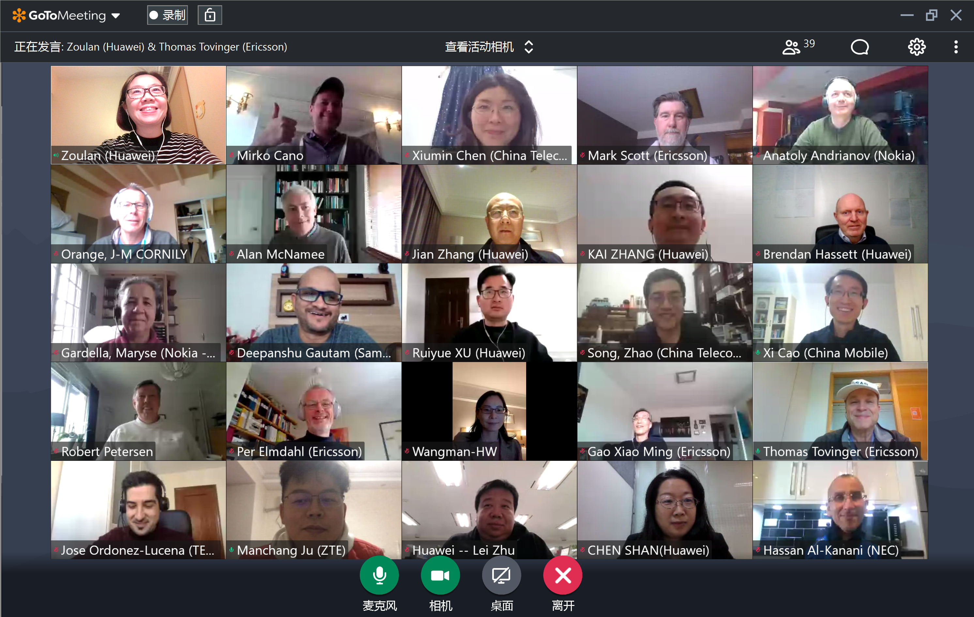
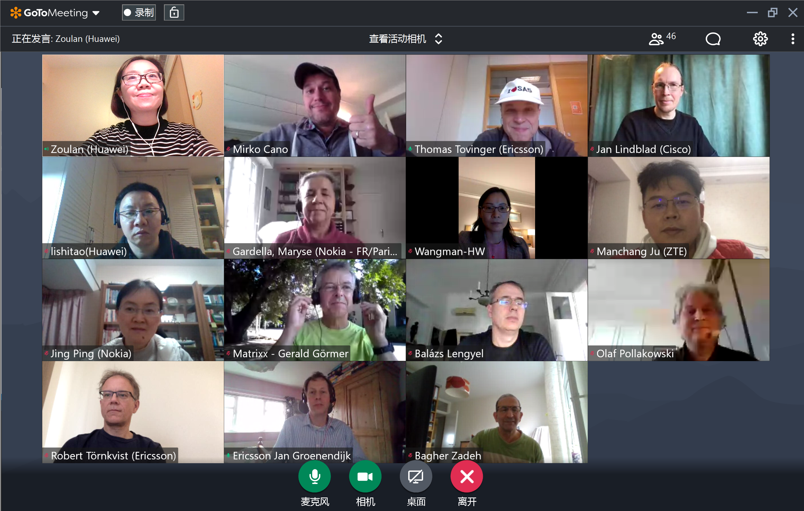
Thank you!

