Slide 1
SA5 OAM&P Exec Report SA5#134e, 16 November – 25 November,2020 e-meeting
Zou Lan, SA5 Vice-Chair, HUAWEI
Thomas Tovinger, SA5 Chair, ERICSSON
Mirko Cano Soveri, MCC

Slide 2
Incoming LSs
Tdoc | Title | Source | Decision | Reply In
S5-206014 | Resubmitted LS on O-RAN – 3GPP Cooperation on Management Services | O-RAN | Postponed
S5-206015 | Resubmitted LS on Counter of UEs Registering Network Slice | C4-204421 | Replied in | S5-206298
S5-206016 | LS ccSA5 on response to TCCA on Public Safety | GSMA | Noted
S5-206017 | LS to SA5 on Meeting minutes of Cross SDO Collaboration Workshop on Autonomous Networks & access to workshop materials | TM Forum | Noted
S5-206018 | Reply LS to SA5 on dynamic 5QIs | S2-2006930 | Noted
S5-206019 | LS ccSA5 on Clarification on URLLC QoS Monitoring | S2-2007825 | Noted
S5-206021 | LS to SA5 on Slice information collection | S2-2008034 | Replied in | S5-206299
S5-206022 | Reply LS to SA5 on Counter of UEs Registering Network Slice | S2-2008238 | Noted
S5-206023 | Reply LS ccSA5 on SA WG2 assumptions from conclusion of study on architecture aspects for using satellite access in 5G | S2-2008307 | Noted
S5-206024 | Reply to S5- 204407 on study items for security on management aspect | S3-202688 | Noted
S5-206186 | LS to SA5 on policy models work in ETSI ISG NFV | ETSI ISG NFV | Replied in | S5-206286
S5-206280 | Reply LS ccSA5 on SA WG2 assumptions from conclusion of study on architecture aspects for using satellite access in 5G | R3-207062 | Noted
S5-206287 | Reply LS on the user consent for trace reporting | R2-2010894 | Postponed
S5-206288 | LS on PCI conflict detection and reassignment | R3-206979 | Noted
S5-206289 | Reply LS on energy efficiency | R3-207014 | Noted
S5-206290 | Reply LS on QoS Monitoring for URLLC | R3-207177 | Postponed
S5-206291 | LS on Framework for QoE Measurement Collection | R3-207189 | Noted
S5-206292 | LS to SA5 on MDT Stage 2 and Stage 3 alignment | R3-207222 | Replied in | S5-206297
S5-206293 | Reply LS on URI for streaming trace reporting in LTE | R3-207232 | Noted
S5-206294 | Response to LS Reply on Enhancement of RAN Slicing | R3-207236 | Postponed

Slide 3
Outgoing LSs
Tdoc | Title | To | Cc | Reply To
S5-206298 | Reply LS on Counter of UEs Registering Network Slice | 3GPP CT4, SA2 | CT1 | S5-206015
S5-206299 | Reply LS on Slice Information collection | SA2 |  | S5-206021
S5-206286 | Reply LS on policy models work in ETSI ISG NFV | ETSI ISG NFV | ETSI ISG ZSM, ETSI ISG ENI, ONAP, ETSI OSM | S5-206186
S5-206297 | Reply LS on MDT Stage 2 and Stage 3 alignment | RAN3 |  | S5-206292/R3-207222
S5-206446 | LS on Network Slice EE KPIs | ETSI EE EEPS, ITU-T Q6/5 | 3GPP SA | New
S5-206447 | LS on Network Slice EE KPIs | GSMA 5GJA | 3GPP SA | New

Slide 4
New or Revised Work Items / Study Items
Tdoc | Type | Release | Title | Source | Potential related groups
S5-206304 | New WID | Rel-17 | New WID for Management Aspects of 5G Network Sharing | China Unicom | RAN3
S5-206302 | New WID | Rel-17 | GPB for File based Trace Format in 5G | Ericsson LM

Slide 5
Documents endorsed by OA&M
TDoc | Title | Source | Potential related topics and related groups
S5-206209 | Discussion paper on Management of Conditional Handover | Ericsson | RAN3
S5-206373 | Discussion Paper on providing cell energySaving Status information to NWDAF | China Telecom Corporation Ltd. | SA2

Slide 6
Overview of SA5 OAM ongoing WIs/SIs
Rel-17: 23 ongoing WIs/SIs, 1 finished SI, 2 WI for SA approval
16 ongoing WIs, 2 WI wait for SA approval
7 ongoing SIs, 1 finished SI
 | Rel-17 Operations, Administration, Maintenance and Provisioning (OAM&P)
1 | Additional NRM features | adNRM | 870026
2 | Enhancements of 5G performance measurements and KPIs | ePM_KPI_5G | 880025
3 | Management of MDT enhancement in 5G | e_5GMDT | 870025
4 | Enhancement of QoE Measurement Collection | eQoE | 870027
5 | Management data collection control and discovery | MADCOL | 880028
New | Management Aspects of 5G Network Sharing | MANS
new | GPB for File based Trace Format in 5G | GPB_File
6 | Autonomous network levels | ANL | 880027
7 | Intent driven management service for mobile networks | IDMS_MN | 810027
8 | Network policy management for 5G mobile networks | NPM | 860024
9 | Enhanced Closed loop SLS Assurance | eCOSLA | 870030
10 | Enhancements of Self-Organizing Networks (SON) for 5G networks | eSON_5G | 870028
11 | Enhancement of Handover Optimization | E_HOO | 880029
12 | Enhancements on EE for 5G networks | EE5GPLUS | 870022
13 | Discovery of management services in 5G | 5GDMS | 820035
14 | Management of non-public networks | OAM_NPN | 870023
15 | Enhancement on Management Aspects of 5G Service-Level Agreement | EMA5SLA | 870024
16 | Management of the enhanced tenant concept | eMEMTANE | 880026
 | Rel-17 OAM&P Studies
1 | Study on management and orchestration aspects with integrated satellite components in a 5G network | FS_5GSAT_MO | 830025
2 | Study on enhancement of Management Data Analytics Service | FS_eMDAS | 850028
3 | Study on new aspects of EE for 5G networks | FS_EE5G | 870021
4 | Study on network slice management enhancements | FS_NSMEN | 860022
5 | Study on enhancements of edge computing management | FS_eEDGE_Mgt | 870029
6 | Study on YANG PUSH | FS_YANG | 890017
7 | Study on access control for management service | FS_MNSAC | 890016
8 | Study on autonomous network levels (finished) | FS_ANL | 850032

Slide 7
OAM General Topics
Working Progress
The following topics are discussed in the meeting:
Collection of useful endorsed document and external communication documents:
The endorsed tdocs will be kept in the living document and updated every meeting if needed.
Rel-16 OAM Stage2 and Stage3 Mapping Status
The mapping information of stage2 and stage3 are kept in the living document updated every meeting if needed.
UC and requirements template
Need more discussion, suggest to continue offline during rapporteur call.
SA5 ToR update
The ToR is agreed to be updated in this meeting.

Slide 8
Rel-16 CRs
Working Progress
The following topics are discussed and agreed related CRs in the meeting.
TS 32.160
Fix incorrect reference in notification template
TS 28.622
Correct the attributes description of the IOCs inherited from Top and Top
TS 28.552 & 28.554
28.552 Correction of paging measurements
28.552 Add missing paging discard measurements
28.552 Correct measurements related to QoS Flow release and DRB release
28.554 Correction and alignment of Retainability KPIs definitions
28.554 Add missing KPI for inter system Handover success rate
TS 32.425
addition of SINR measurement
TS 28.541:
Correction of NRM YANG errors
YANG improvements
Move Distributed PCI control IOC from DU to CU
Add serviceProfileId and sliceProfileId to stage 3 yaml
pLMNInfoList faulty attribute definition
Fix OpenAPI compilation errors in NRM
Proposal on clarification of ServiceProfile representations(6329 email approval)
TS 32.160&28.622&28.541:
Update notifyThresholdCrossing to be a common notification
TS 28.622&28.623:
Correct trace target parameter for trace control in stage 3
Correct 5G trace parameter for trace control
TS 28.623:
Correct and add types in comDefs.yaml (OpenAPI definition)
Remove incorrect S-NSSAI definition from YANG SS
TS 28.313:
Correct Distributed PCI optimization
Correct the PCI notifications
TS 28.310:
Correction on general descriptions of centralized energy saving activation and deactivation
Corrections on distributed ES solution
Remove distributed scenario from inter-RAT energy saving use case
TS 28.530:
Add the chapter of high level features
TS 28.530 & 28.533：
28.530 add requirements of closed loop SLS assurance
28.533 Add example of closed loop SLS assurance
TS 28.532:
Extend object creation method with id selection by the MnS producer (stage 2，REST SS, OpenAPI definition)
Fix inconsistencies in guidelines for integration with ONAP VES
TS 28.532 & 32.158
28.532 Correct small errors in the Fault MnS
28.532 Align ProvMnS data type names to UpperCamel (REST SS, OpenAPI definition)
32.158 Correct REST SS specification template
TS 28.535 & 28.536:
description of Communication service assurance service
TS 28.535:
Add lifecycle management of control loops
Update open control loops
TS 28.536:
Implement Assurance Closed Loop model changes (email approval)
Add Annex on state management
TS 32.103:
Correction of reference list and adding references in the document
TS 28.550&28.532:
28.550 Update attribute measType used in Annex C
28.532 Update generic streaming MnS

Slide 9
Rel-17 WI ANL/IDMS_MN/NPM/eCOSLA
WI code | WI Title | Completion rate | TS/TR | Tdoc reference | Target date | Rapporteur | Related groups | Related topic
ANL | Autonomous network levels | 0%->5%->30% | TS 28.100 | SP-200464 | SA#92 (Jun. 2021) | CMCC | SA2/RAN3/ZSM | Autonomous network
IDMS_MN | Intent driven management service for mobile networks | 0%->55%->65% | TR28.812/TS 28.312 | SP-180899 | SA#93 (Sep. 2021) | Huawei | SA2/RAN3/ZSM | Intent
NPM | Network policy management for 5G mobile networks based on NFV scenarios | 0%->55%->60% | TS 28.555/28.556 | SP-191211 | SA#92 (Jun. 2021) | CMCC | SA2/RAN2/RAN3 | Policy
eCOSLA | Enhanced Closed loop SLS Assurance | 0%->5%->10% | TS28.535/28.536/28.533/28.541/28.546/28.552/28.553 | SP-200196 | SA#90 (Dec. 2020) ->SA#93 (Sep. 2021) | Ericsson | ZSM/SA2/RAN3 | Close loop interaction
Working Progress
ANL: The following topics for normative phase are discussed and agreed in the meeting.
Add concept of autonomous network and autonomous network level
Add use case and requirements for coverage optimization
Add Introduction
Add definition for network and service management scenario types
Add dimensions for evaluating autonomous network levels
Add framework approach for evaluating autonomous network levels
Update skeleton for clause 5
IDMS_MN: The following topics for normative work are discussed and agreed in the meeting.
Update Clause 4.1.3 Intent categorizes based on management scenario types
Update Clause 4.1.1 Introduction
Add relation of intent driven management and policy driven management.
Add use case and requirements for coverage optimization, RAN UE throughut optimization, radio network deployment
NPM: The following topics are discussed and agreed in the meeting.
28.555 add specification level use cases
28.556 Add skeleton and scope
eCOSLA: The following CR topics are discussed and agreed.
Add concept of closed control loop governing and monitoring
Add use case of network resource usage and performance prediction assisted SLS communication service Assurance
Add use case for limiting actions of an assurance loop
Add use case of network resource usage and performance prediction assisted SLS communication service Assurance
Add use case for limiting actions of an assurance loop
Add use case for triggering assurance loop state change
The following topics are agreed as input to draftCR.
28.535 Coordination between control loops (6326 email approval)
Add use case and req for CL execution supervision(6366 email approval)

Slide 10
Rel-17 WI eSON_5G/E_HOO/EE5GPLUS/5GDMS
WI code | WI Title | Completion rate | TS/TR | Tdoc reference | Target date | Rapporteur | Related groups | Related topic
eSON_5G | Enhancements of Self-Organizing Networks (SON) for 5G networks | 0%->2%->5% | TS28.313/28.552/28.541/28.545 | SP-200194 | SA#92 (Jun. 2021) | Intel | RAN3 | SON
E_HOO | Enhancement of Handover Optimization | 0%->0%->5% | TS28.552/28.313/28.541 | SP-200466 | SA#92 (Jun. 2021) | Ericsson | RAN3 | SON
EE5GPLUS | Enhancements on EE for 5G networks | 0%->0%->10% | TS28.310/28.552/28.554/28.541 | SP-200188 | SA#93 (Sep. 2021) | Orange | SA2/RAN2/RAN3/ETSI EE/ITU-T/GSMA | Energy saving
5GDMS | Discovery of management services in 5G | 90% (R16) -> 50% (R17)->50% | TS 28.533/28.532/531 | SP-181072 | SA#93 (Sep-2021) | Huawei |  | Service based discovery
Working Progress
eSON_5G: The following topics are discussed but need further discussion
Add LBO use cases, requirements, and related information
Add Load Balancing Optimization Requirements and Use Case
EE5GPLUS: The following topics are discussed and agreed in this meeting
Add EE KPI definitions for network slices
LS to ETSI EE EEPS and ITU-T Q6/5 on Network Slice EE KPIs
LS to GSMA 5GJA on Network Slice EE KPIs
The following topics are endorsed:
Discussion Paper on providing cell energySaving Status information to NWDAF
E_HOO: Discussion paper on Management of Conditional Handover was endorsed.
5GDMS: The following topics are agreed as Rel-16 CR
Correct inconsistent terminology
The following topics are agreed as input to draftCR
Clarify Management Service data
The completion rate changed to 50% when moving to Rel-17 due to changed scope.

Slide 11
Rel-17 SI FS_eMDAS
WI code | WI Title | Completion rate | TS/TR | Tdoc reference | Target date | Rapporteur | Related groups | Related topic
FS_eMDAS | Study on enhancement of Management Data Analytics Service | 50%->70%->90% | TR 28.809 | SP-190930 | SA#91 (Mar.2021) | Intel | SA2/RAN3 | Data analytics
Working Progress
FS_eMDAS: The following topics are discussed and agreed.
Add solution on MDA assisted energy saving analysis
Add conclusion for resource utilization analytics use case
Add conclusion for coverage issue analysis
Add the conclusion on KPI anomaly analysis
HO Optimization based on UE Load, Gap Analysis for Handover Optimization based on UE trajectory
Load Balancing Optimization Solutions based on Resource Consumption and Service Specifics
Update solutions on subscription and reporting
Update solutions on request of Management Data Analytics Reports
conclusion for Alarm incident analysis
conclusion for NAS congestion control
Add solution on MDA ML model training
Update the solution of Jitter analysis
Add the conclusion on Network slice load analysis
Add conclusion on E2E latency analysis
Add the conclusion on service experience analysis
Add the conclusion on throughput analysis
New use case on slice coverage and throughput optimization
Gap analysis for inter-gNB beam selection Optimization
Alarm Malfunction Analytics
Gap Analysis for Security Risk Assessment
Add conclusion for fault predication analysis
Gap Analysis for MDA assisted SON coordination
Gap Analysis for Mobility performance Analysis
MDAS detection of outlying MEs

Slide 12
Rel-17 SI FS_NSMEN/FS_YANG/FS_MNSAC
WI code | WI Title | Completion rate | TS/TR | Tdoc reference | Target date | Rapporteur | Related groups | Related topic
FS_NSMEN | Study on network slice management enhancements | 0%->5%->20% | TR 28.811 | SP-191192 | SA#92 (Jun. 2021) | Huawei | SA2/RAN3 | SLA
FS_YANG | Study on YANG PUSH | 0%->5% | TR 28.818 | SP-200765 | SA#91 (Mar.2021) | Ericsson | ONAP | YANG
FS_MNSAC | Study on access control for management service | 0%->5% | TR 28.817 | SP-200853 | SA#91 (Mar.2021) | Nokia | SA3 | security
Working Progress
FS_NSMEN: The following topics are discussed and agreed
Update scope to include security aspects
Add cross-operator concept
Add end to end concept
deploy two network slices by same customer
Add cross-operator network slicing scenarios
FS_YANG: The following topics are discussed and agreed
TR 28.818 Skeleton
FS_MNSAC: The following topics are discussed and agreed.
TR 28.817 Skeleton

Slide 13
Rapporteur calls (draft plan after SA5#134e)
Rapporteur calls | Date Time | Potential Topics
#134e.1 | 14:00 CET~16:00 CET on Dec.3rd | FS_eMDAS: B. S5-206058 pCR 28.809 Add analysis on agreed use cases (Zhulei) eCOSLA: E. S5-206210 Rel-17 CR TS 28.535 Management types for control loop (Zhangjian) Template: H. S5-206257 Discussion paper on SA5 Requirements and Use Case template (Zou Lan) eSON_5G: F. S5-206082 Rel-17 CR 28.313 Add LBO use cases, requirements, and related information (Joey) G. S5-206212 Rel-17 CR 28.313 CHO requirements (Per)
#134e.2 | 14:00 CET~16:00 CET on Dec.10th | 5GDMS: C. 5GDMS GROUP#1 (S5-206056/S5-206041) 5GDMS Use cases (Brendan, Deepanshu) D. S5-206040 Rel-17 CR 28.532 Register and Query Operation (Deepanshu) COSLA: I. COSLA Rel-16 stage 1/2/3 consistency check (Jan)
#134e.3 | 14:00 CET~16:00 CET on Dec. 17th | FS_eMDAS: A. FS_eMDAS GROUP#4 (S5-206094/S5-206139) general conclusions (Yizhi, Jiaxiaoqian)

Slide 14
TRs / TSs to be sent to SA#90e
Tdoc | Title | Source | Sent for
S5-206351 | Presentation sheet for TR 28.808 | TNO | Information

Slide 15
Exception to be sent to SA#90e
Tdoc | Title | Source

Slide 16
TRs / TSs to be sent to Edithelp
Title | Source

Slide 17
New action items from this meeting
Item | Description | Rel. | Owner | Status | Target
134e.1 | Update the dynamic5QISet IOC to align with SA2 answer in S5-206018. | Rel-16 | Yao Yi Zhi | Open | SA5#135e
134e.2 | Add description on the alignment of stage1, stage2 and stage3. SA is discussing the alignment between SA1 requirements and solutions which may be related to this topic. Maybe link SA5 requirements with SA1. | Rel-17 | SA5 Leaders, Olaf | Open | SA5#135e
134e.3 | Update the specifications for E-UTRAN QMC if needed”. (S5-206291) | Rel-17 | Robert | Open | SA5#135e

Slide 18
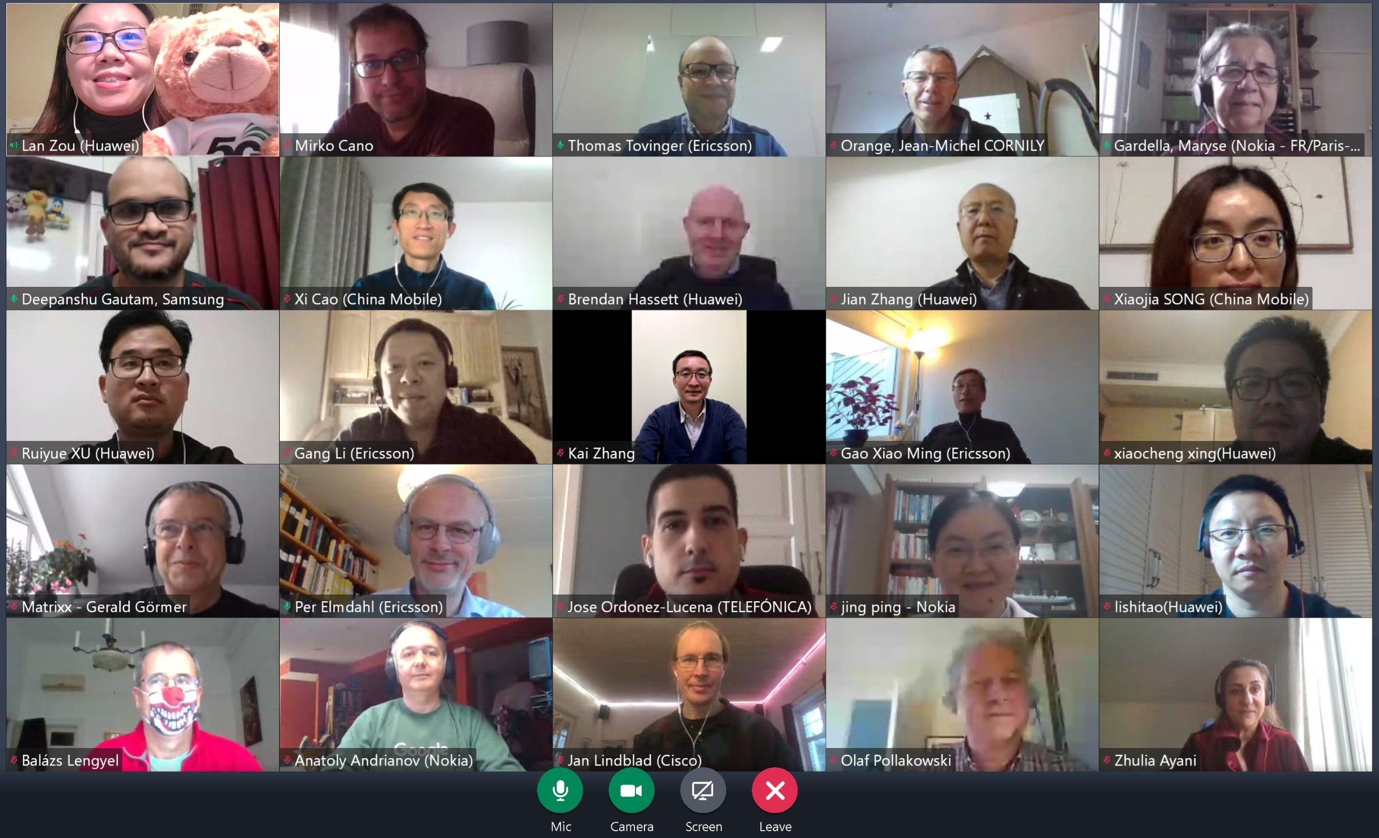
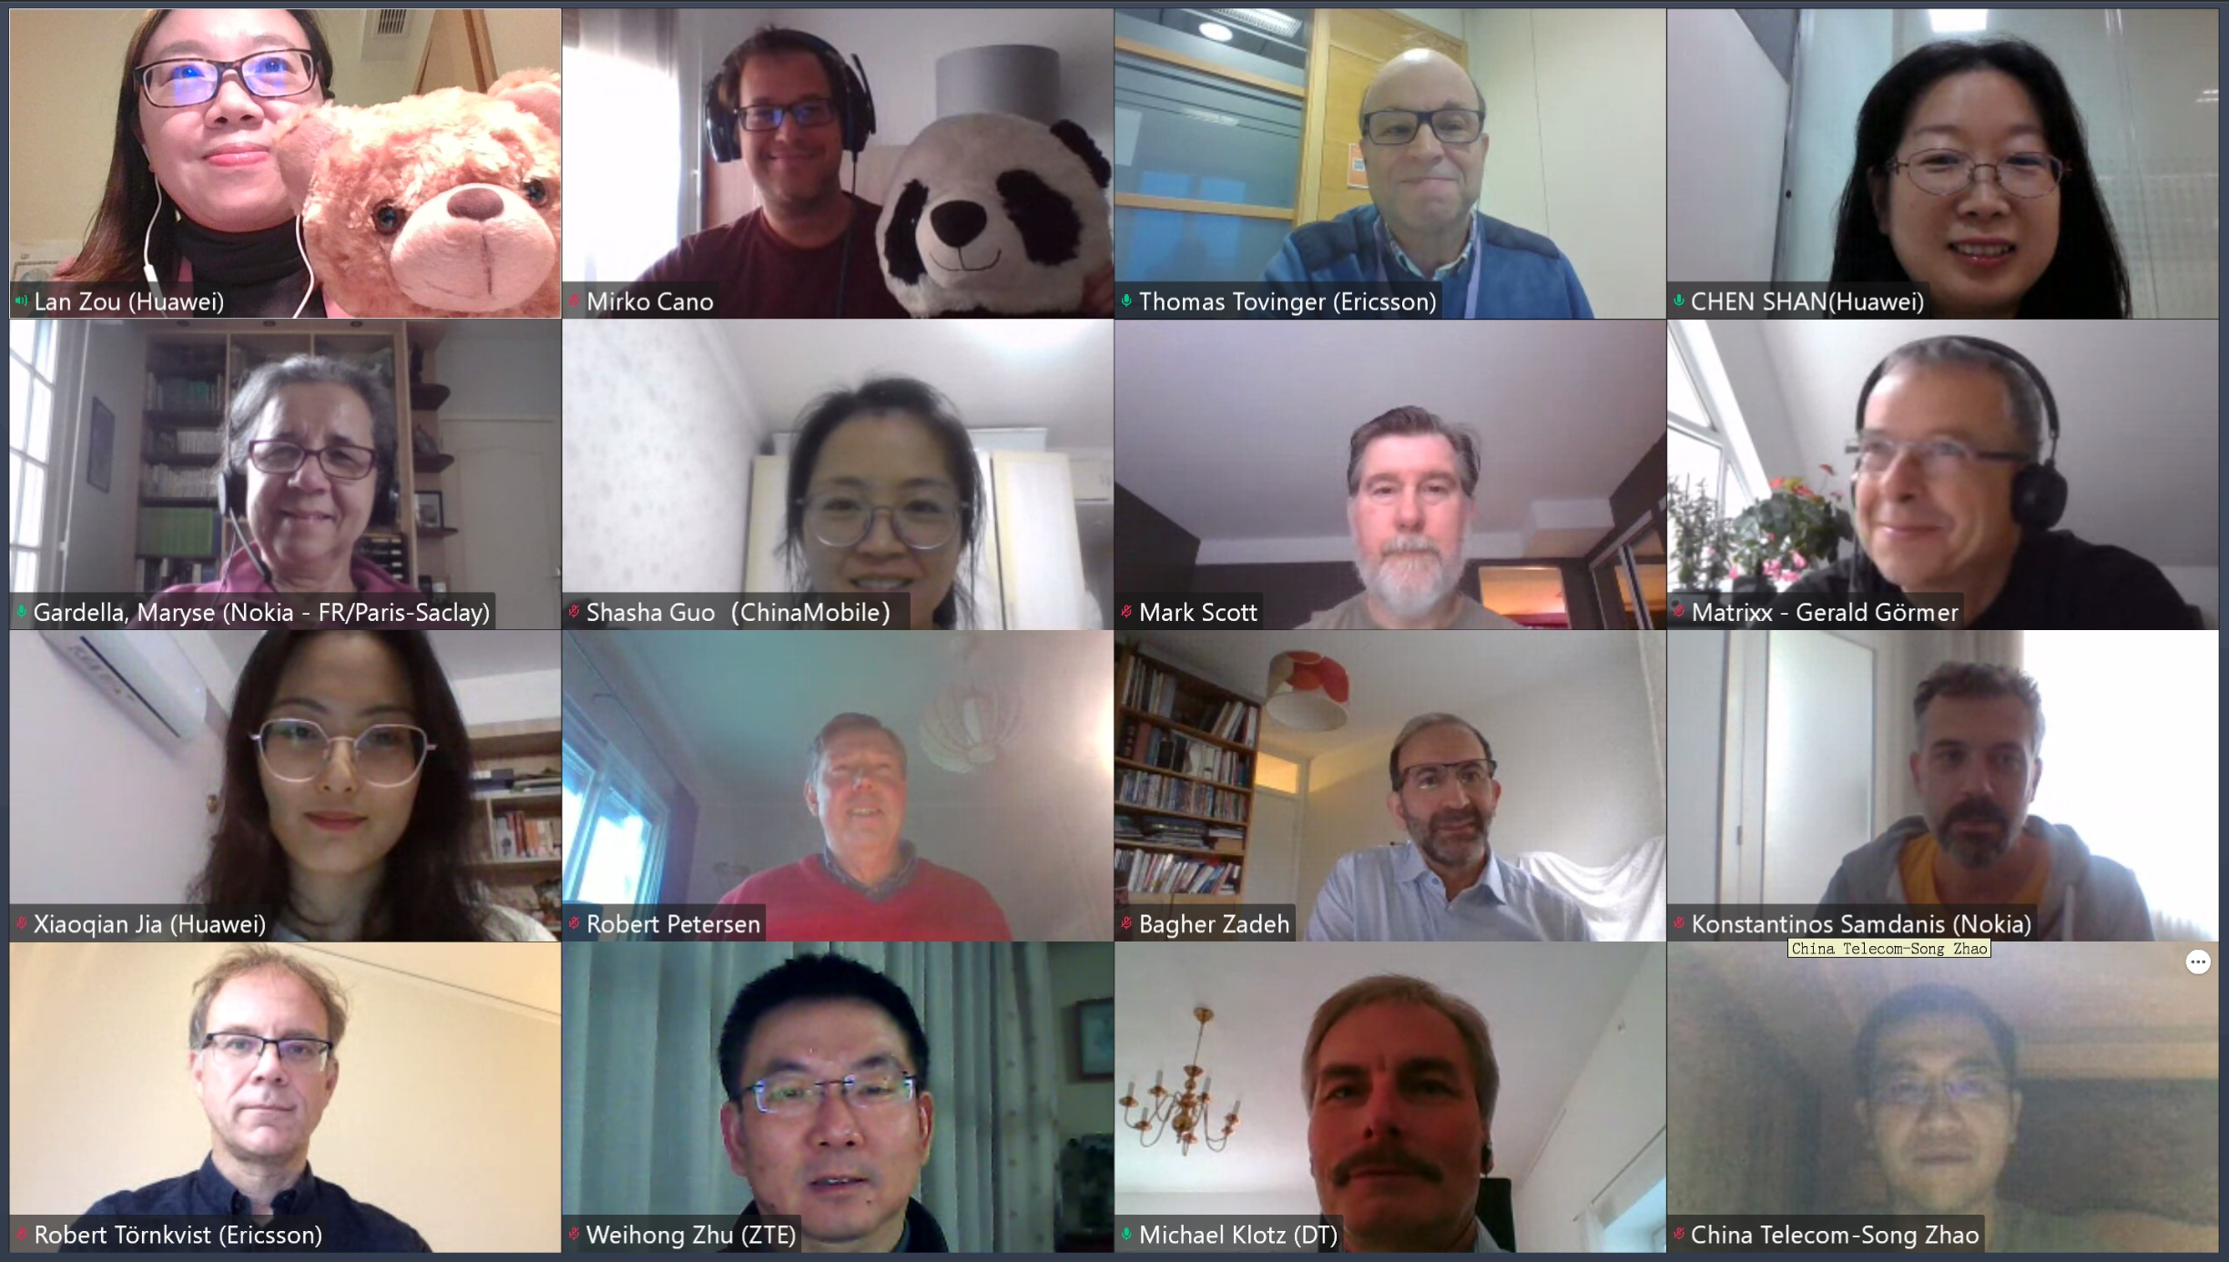
Thank you!

