Slide 1
One Last Thing…
3GPP TSG SA4#135
Goa (India), 9-13 February 2026
3GPP SA WG4 Chair

Slide 2
3GPP Excellence awards
Since 2012, 3GPP recognises individual’s contribution to a 3GPP Working group during the year.
Nominations are submitted by the WG chairs – for consideration at the December TSG Plenary meetings.
As soon as the 3GPP TSG leadership have deliberated and decided on a maximum of four awards for the year; the traditional totems are manufactured and sent to the Working Group Chair, for their presentation during the next WG meeting.

Slide 3
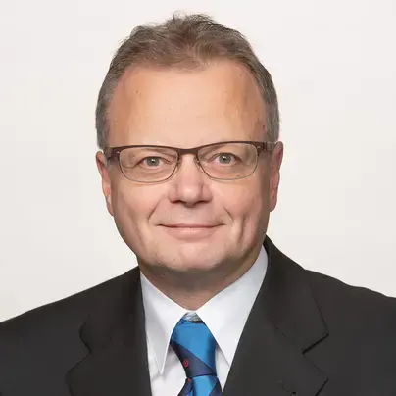
SA4 past recognitions
In 2016
Kari Järvinen (Nokia)
“Your contribution to the success of 3GPP goes well beyond 2016, but this year's Award is a recognition of your work on the codec selection for MCPTT and your diplomacy and leadership to complete the enTV work despite the challenges encountered.
On behalf of SA4, I would like to thank Kari Järvinen for his major contribution to the group's success.”
Frédéric Gabin, Chair 3GPP SA Working Group 4

Slide 4
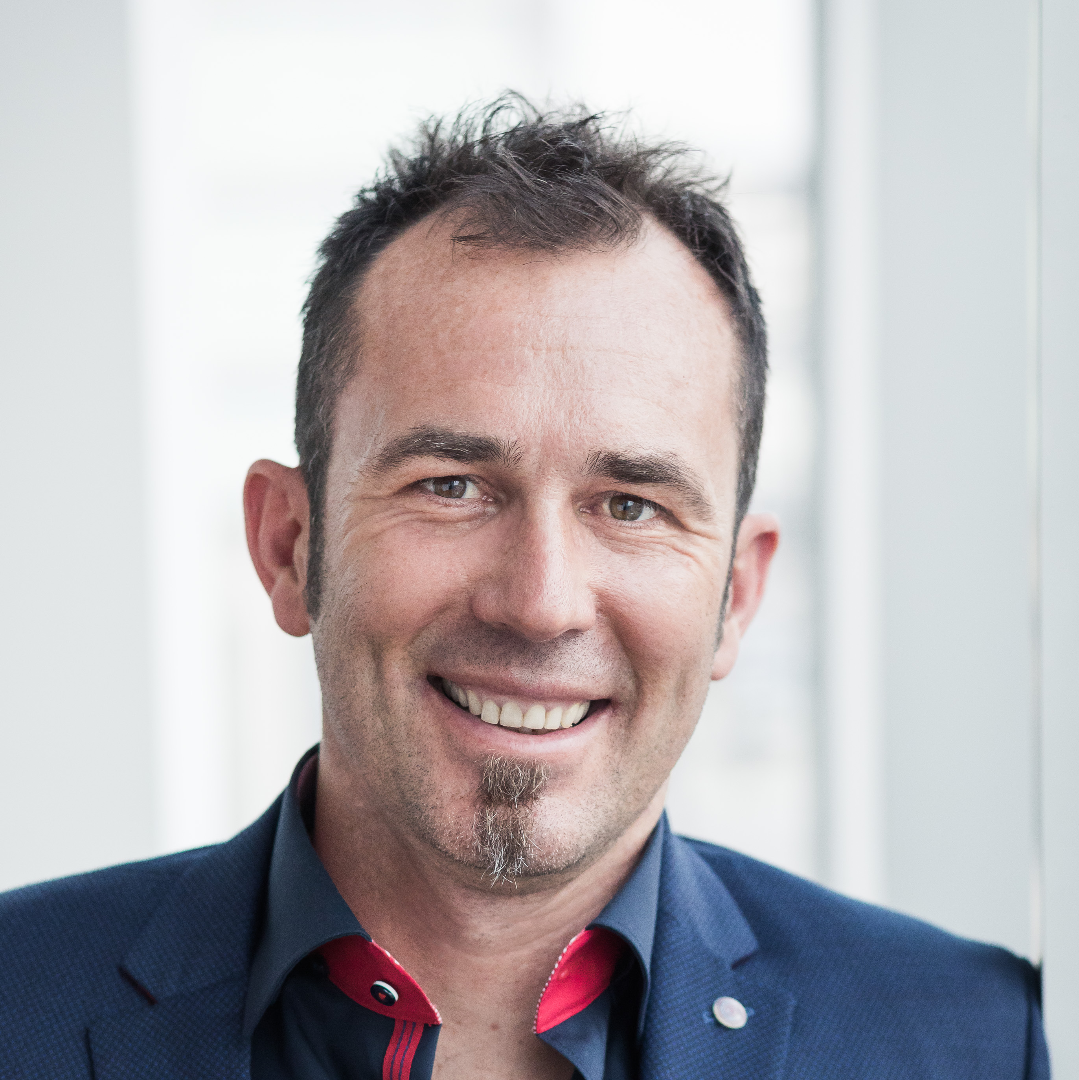
SA4 past recognitions
In 2017
Thomas Stockhammer (Qualcomm)
“It is a pleasure that you receive this award for the excellent contribution and leadership you demonstrated in achieving Rel-14 Enhanced Television Services over 3GPP eMBMS.
You have provided technical inputs, given support for the work to progress and – at the same time – made sure the 3GPP status and progress was understood by broadcasters.”
Frédéric Gabin, Chair 3GPP SA Working Group 4

Slide 5
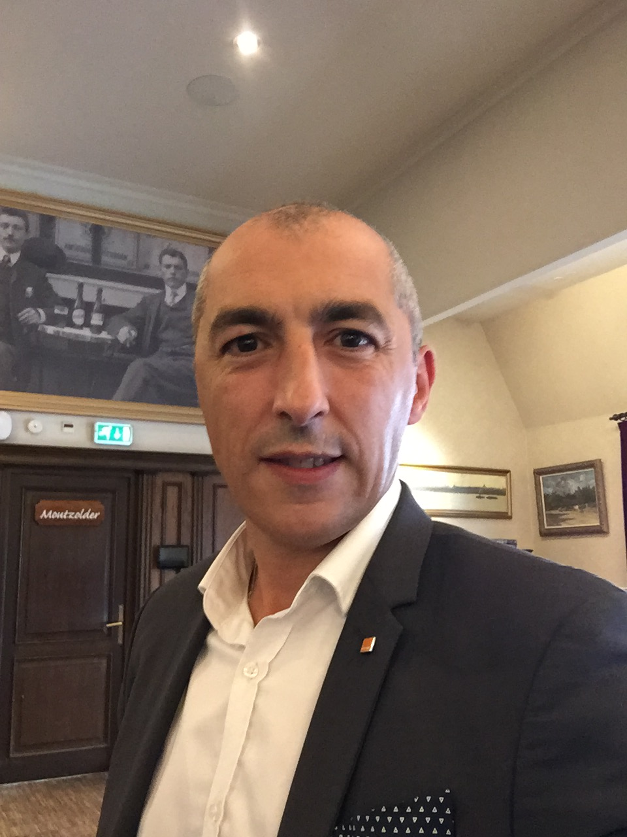
SA4 past recognitions
In 2018
Gilles Teniou (then Orange)
“On behalf of the whole group, I wish to thank you Gilles for chairing both the video and audio debates regarding the Virtual Reality Profiles for Streaming Media Work Item (VRstream) and for having built a consensus proposal for the finalization of TS 26.118 - 3GPP Virtual reality profiles for streaming applications.”
Frédéric Gabin, Chair 3GPP SA Working Group 4

Slide 6
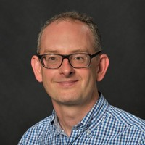
SA4 past recognitions
In 2022
Richard Bradbury (BBC)
“Congratulations Richard and thanks for your key contribution to the 5G Media streaming and especially the AF Event Exposure specification work, completed in Rel-17 in 2022".
Frédéric Gabin, Chair of SA Working Group 4

Slide 7
In 2025
3124 delegates attended a WG meeting.
The 3GPP Excellence award becomes an even more important recognition.
The completion of Release 19 features strengthening the attractivity of 5G Advanced was obviously key selection criteria in the nomination process.

Slide 8
And guess what…

Slide 9
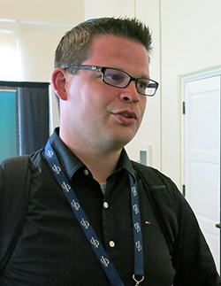
SA4 got another Excellence award!!
And the winner is…
Thank you, Jan, for your outstanding leadership in driving ATIAS_Ph2 to completion. Your contributions shaped the test methods that now underpin how immersive audio performance is evaluated across the industry. Your work has strengthened the foundation for reliable, interoperable immersive experiences in future 3GPP devices and services. Congratulations!
Jan Reimes
HEAD Acoustics

Slide 10
Have a good meeting !

