Slide 1

3GPP TSG SA WG4 (SA4)
meeting #129-e
SA4#129-e, electronic meeting,
19-23 August 2024
Hosted by MCC
Presentation to SA4 opening plenary SA4 Chair
Tdoc S4-241575

Slide 2
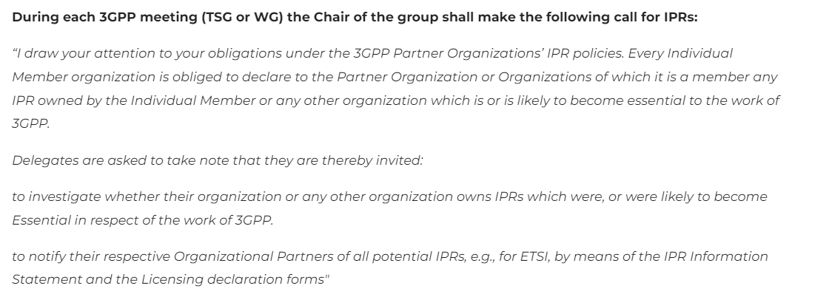
A.I.3 - Call for IPRs

Slide 3
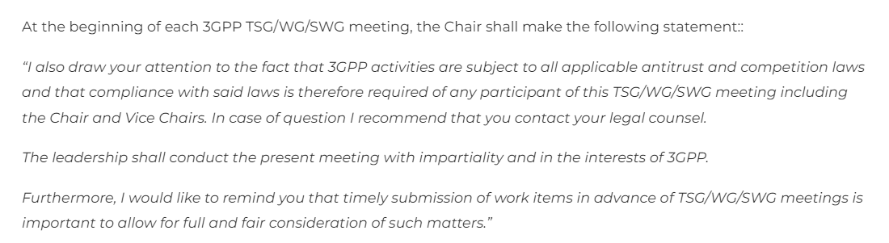
A.I.3 - Statement regarding competition law

Slide 4
A.I. 6 - Issues for immediate attention
SA4 leadership and subgroups
Work Item handling at SA4 (to be agreed at SA4#129-e) (NEW)
SWG Ad Hoc Telcos
SA4 Calendar 2024/2025/2026
Rel-19 planning
TS/TR Rapporteurs
http://www.3gpp.org/DynaReport/TSG-WG--S4.htm?Itemid=461

Slide 5
SA4 leadership and subgroups
SA4 officials:
Chair: Frédéric Gabin (Dolby France SAS , ETSI)
Vice Chairs:
Gilles Teniou (Tencent, CCSA)
Jaeyeon Song (Samsung Electronics Co., Ltd, TTA)
Secretary: Andrijana Brekalo (MCC Support)
Sub Working Groups and their Chairs
Audio SWG | Multicast-Broadcast-Streaming (MBS) SWG | Real Time Communications (RTC) SWG | Video SWG
Tomas Toftgård (Ericsson LM, ETSI) & Stéphane Ragot (Orange, ETSI) | Frédéric Gabin (Dolby France SAS, ETSI) | Saba Ahsan (Nokia corporation, ETSI) | Gilles Teniou (Tencent, CCSA)

Slide 6
Work Item handling at SA4 (to be agreed at SA4#129-e)
The following handling guidelines apply to SA4 in addition to regular 3GPP Working Procedures
A new WID (Study or Normative) should only be considered for agreement if it is submitted on time, with at least 4 supporting companies, with an agreeable SWG allocation and if it fits with the overall SA4 workplan (i.e. within the agreed guideline of a maximum of 16 concurrent items);
It is encouraged that new WID are accompanied with a work plan. For studies, the work plan should also include indication of potential normative work
New WID submitted for information or discussion are welcome at any SA4 meeting;
Whether an SA4 meeting will discuss and agree new WID or not will be indicated in the proposed meeting agenda (shared at least 3 weeks before the meeting);
Meetings during which new WID can be agreed will include a dedicated A.I. and corresponding SA4 plenary session to discuss WID and planning. It is recommended to favor F2F ordinary meetings for such sessions;
Exceptions to the above handling guidelines are always possible due to e.g. pressing circumstances and assuming large SA4 consensus;

Slide 7
SWG Ad Hoc Telcos
To WI/SI rapporteurs, when preparing post SA4#129-e WI/SI work plans, please beware of the following guidelines:
Available weeks:
Note 1: according to a decision by 3GPP SA#90-e, meetings are not allowed during certain weeks. E.g. in this case, we should avoid:
- 2 weeks before and after SA#105 plenary Sep 10 – 13, 2024
- Golden week, Oct 1 – 7, 2024
- All Saints, Nov 1, 2024
- the week before SA4#130, Nov 18 – 22, 2024
Also, for some SWGs we should be aware of collisions with IBC 2024, Sep 13 – 16, 2024; AES convention Oct 8-10, 2024; and MPEG#148, Nov 4 – 8, 2024.
Note 2: it is expected that not all weeks will be filled with SA4 AH Telcos.
Here is the proposed list of available weeks for SA4 AH meetings:
Sep 23 – 27, 2024
Oct 8-11, 2024 (Golden week ends on Oct 7, AES convention Oct 8-10)
Oct 14 – 18, 2024 (Proposed MBS Ad hoc e-meeting Oct 16-18, 2024)
Oct 21 – 25, 2024
Oct 28 – 31, 2024 (All Saints, Nov 1, 2024)
Nov 4-8, 2024 (MPEG#148, Nov 4 – 8, 2024)
Reminder on preferred day of the week per SWG:
Monday – Audio SWG
Tuesday – Video SWG
Wednesday – RTC SWG
Thursday – MBS SWG
Friday – Audio SWG

Slide 8
SA4 calendar - 2024
Meetings in 2024 | Dates | Venue and Host
SA4#130 | F2F: 18-22 November 2024 | Host: ATIS, Venue: Orlando, Florida, USA

Slide 9
SA4 calendar – 2025 (revised and agreed at SA4#128)
Meetings in 2025 | Dates | Venue and Host
SA4#131 | F2F: 17-21 Feb. 2025 | Host: EBU, Venue: Geneva, Switzerland
SA4#131e-bis | E-meeting: 11-17 April 2025 | Host: MCC, Electronic meeting
SA4#132 | F2F: 19-23 May 2025 | Host: TBD, Venue: Japan
SA4#133e | E-meeting: 21-25 Jul. 2025 | Host: MCC, Electronic meeting
SA4#134 | F2F: 17-21 Nov. 2025 | Host: TBD, Venue: North-America

Slide 10
SA4 calendar – 2026 (agreed at SA4#128)
Meetings in 2025 | Dates | Venue and Host
SA4#135 | F2F: 9-13 Feb. 2026 | Host: TBD, Venue: TBD
SA4#135e-bis* | E-meeting: 13-17 Apr. 2026 Note: dates TBC depending on MPEG#154 exact dates. | Host: MCC, Electronic meeting
SA4#136 | F2F: 11-15 May 2026 | Host (TBC): Interdigital, Venue: Montreal
SA4#137e | E-meeting: 24-28 Aug. 2026 | Host: MCC, Electronic meeting
SA4#137e-bis* | E-meeting: 12-16 Oct. 2026 Note: dates TBC depending on MPEG#156 exact dates. | Host: MCC, Electronic meeting
SA4#138 | F2F: 16-20 Nov. 2026 | Host: TBD, Venue: TBD
* Only one of April or October meeting is expected to be needed.
Note: In case hosting offers are received from individual companies or other organizations, these offers would need to be worked into the overall plan. I.e., these offers would NOT entail additional F2F meetings.

Slide 11
Rel-19 planning

