Slide 1

SA4#126 Social
November 16, 2023

Slide 2
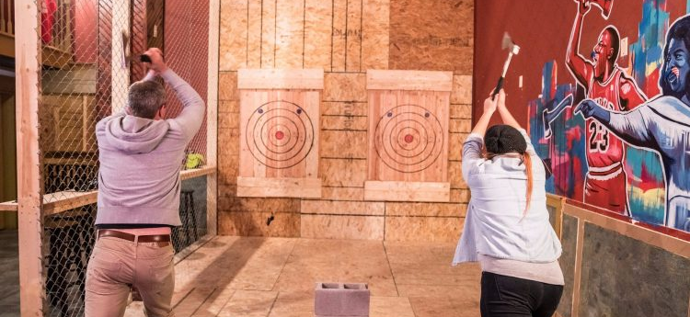
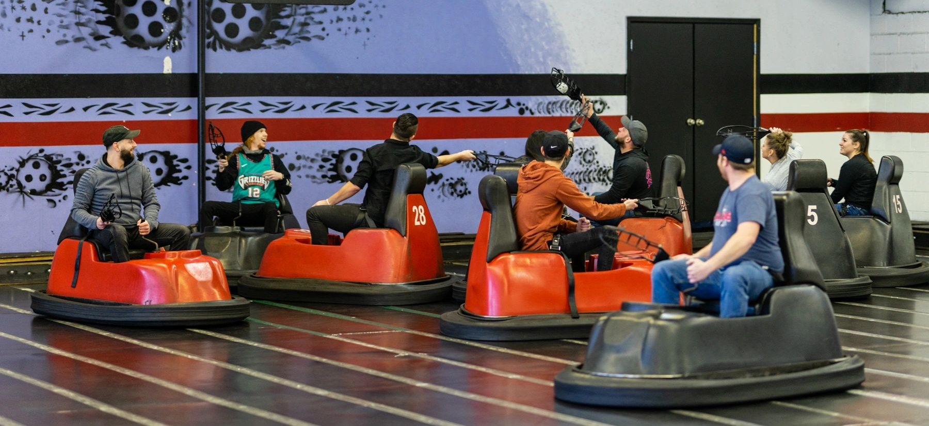
History
to continue the good spirit of social gatherings, here is a proposal for another self-funded social event at SA4#126. Everyone is invited!
This time we had three options
Thanks to Chris and the Chicago Lumberjack Association for making great suggestions – but we go safe

Slide 3
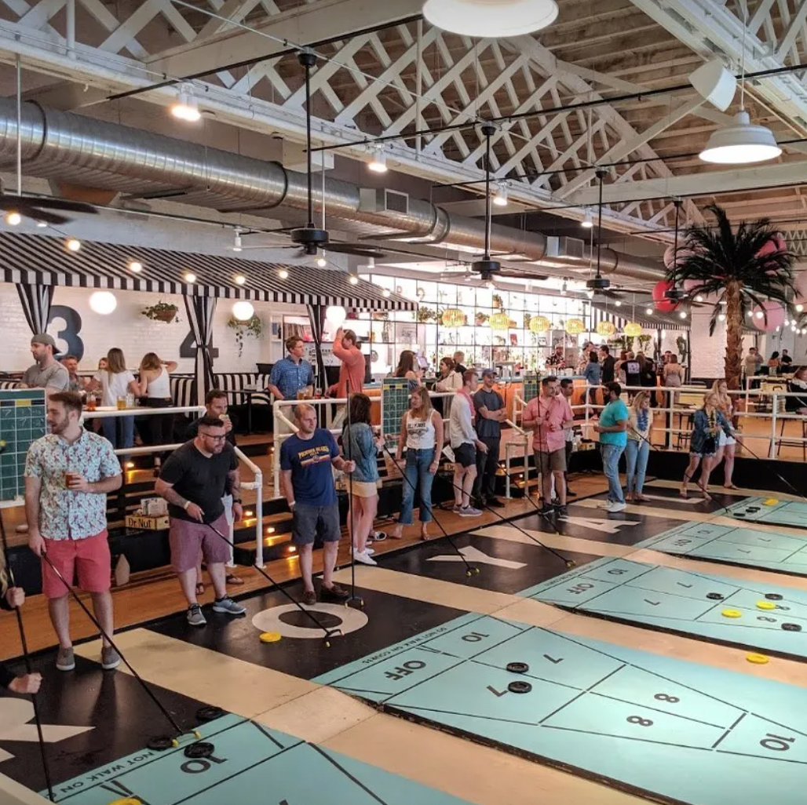
We go on a Shuffleboard
We again checked Chicago for options and found something very uniting: Cabana Party and Shuffle boarding. This place Royal Palms Chicago offers to host us.
You will get 2 hours of free drinks of beer, wine, and sodas as well as there will be playing of shuffle board.
The total cost including playing, drinks, gratuity (20%) and all kind of tax (sales 10%, amusement 10%) sums up to be 75 USD per person.
Food is NOT included, but can be picked up at food trucks.
If you're interested in placing a catering order, check out the food truck calendar and menus here! You're also welcome to order a la carte upon arrival. We recommend placing a pre-order for parties with 20+ guests.
Just a NOTE: Everyone can play Shuffleboard.

Slide 4
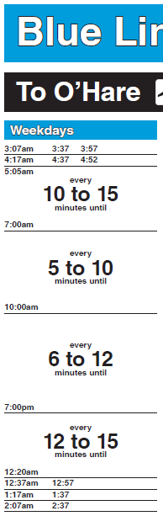
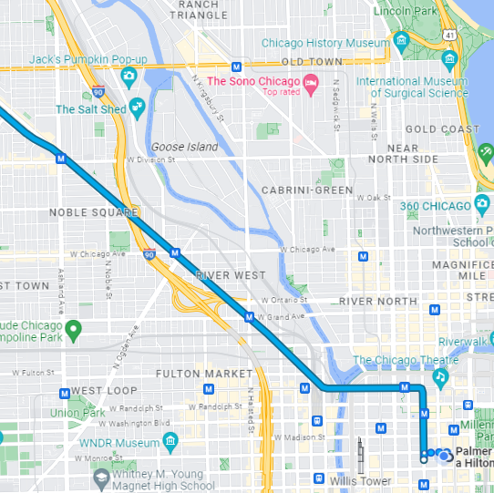
Logistics
Date and Schedule:
November 16, 2023
Party and Shuffling: 20:00 - 22:30
Directions from Meeting hotel
(23min on tram, 4 + 12 + 7)
Suggest to leave from hotel at 19:20
Commute:
Schedule blue line - Monroe
Go to O'Hare, get off at Damen (6 Stops)
Ticket is USD 5 each way
Uber or Taxi about the same time

Slide 5
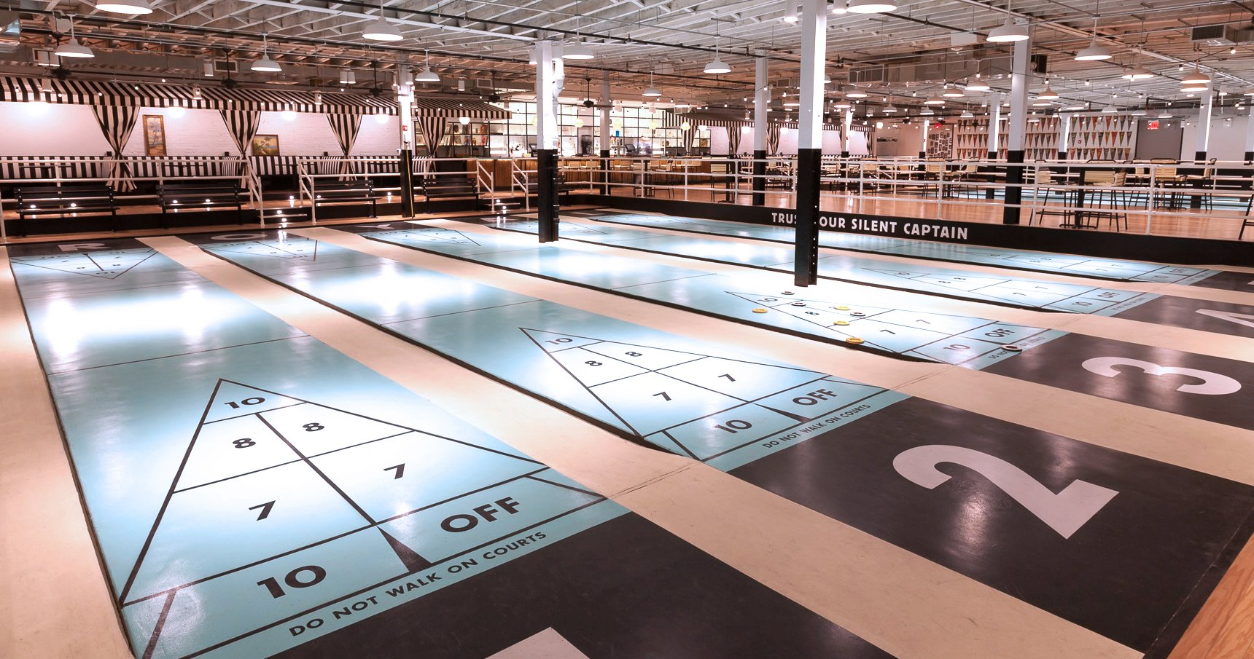
What is Shuffleboard?

Slide 6
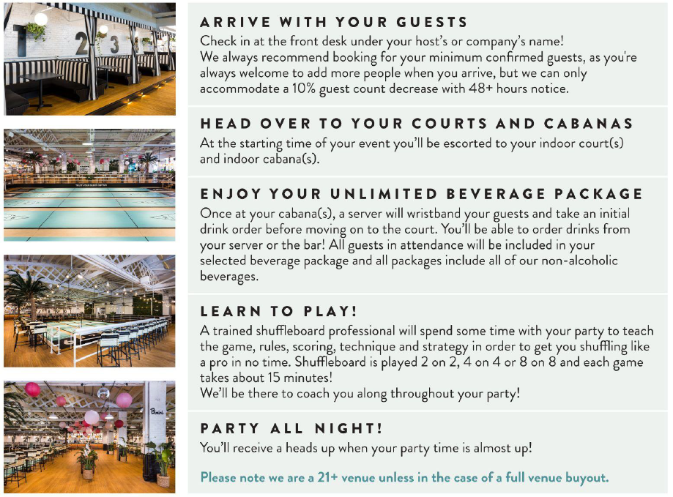
Arrangement
Event starts at 20:00

Slide 7
Signups (43-4 = 39)
Bold = paid (26)
Yellow Option 1 (14)
Green Option 2 (10)
Blue Option 3 (4)
Reservation: 28+
Mary-Luc | stephane Onno
Imed Bouazizi | Chris Steck
Elmira | Wang Bin (传增 黄)?
Jan Reimes | Jaeyeon Song
Iraj | Andre Schevciw
Emmanuel Thomas | Liangping Ma
Gilles | Gazi Illahi
Thomas Stockhammer | Serhan Gül
Stefan D | Ahmed Hamza
Gerhard Tech | Saba Ahsan
Gaëlle Martin-Cocher | Srinivas Gudumasu
Nikolai Leung | Thorsten Lohmar
Razvan-Andrei Stoica | Markus Multrus
Frédéric Gabin | Antoine Burckard (ETSI)
Milan Jelinek | Rufael Mekuria
Eleni Fotopoulou (2) | Waqar Zia
Andrei Stoica | Dimitri Podborski
Eddy Hall | Simon Gunkel
Walt Husak | Nien Wu
Andrijana | Huang Chuanzeng (传增 黄)?
Yongjing Zhang | Tomas Toftgård
https://forms.gle/k7WhMKx3TuK2xUqu6

Slide 8
Questions
Puuhh
Have fun
Maybe not next time
Others?

