Slide 1
SA4#121 Social Bowling
Self-funded Social Event

Slide 2
Invitation
as this is the first time we meet again since almost 3 years, we are sure there are many stories to be told.
Hence, we organize a small self-funded social gathering on Nov 17, 2022. We checked for SUPing on Garonne, but may get a bit too chilly. Mountain hiking at 6am was also no option, and who would do wine tasting in France. Hence, we are back to BOWLING. At 8pm we have made initial arrangements at https://bowlingcenter31.fr/ to have a mix of food, bowling, fun and drinks. Bowling and food per person is 45-50 Euros, drinks would be paid individually.
In order to make final arrangements, can you please let us know if you participate by November 9, 2022. We can arrange for up to 60 people, so it would be a first come first serve. After November 9, 2022, we may share with selected 3GPP colleagues outside SA4 if there is still room.
To simplify payments, people can paypal Thomas 50 Euros. However, if this is not possible, we can also arrange cash during SA4#121.
If you have questions, reach out to us.
The SA4 social event team (Thomas, Fred and Gilles)

Slide 3
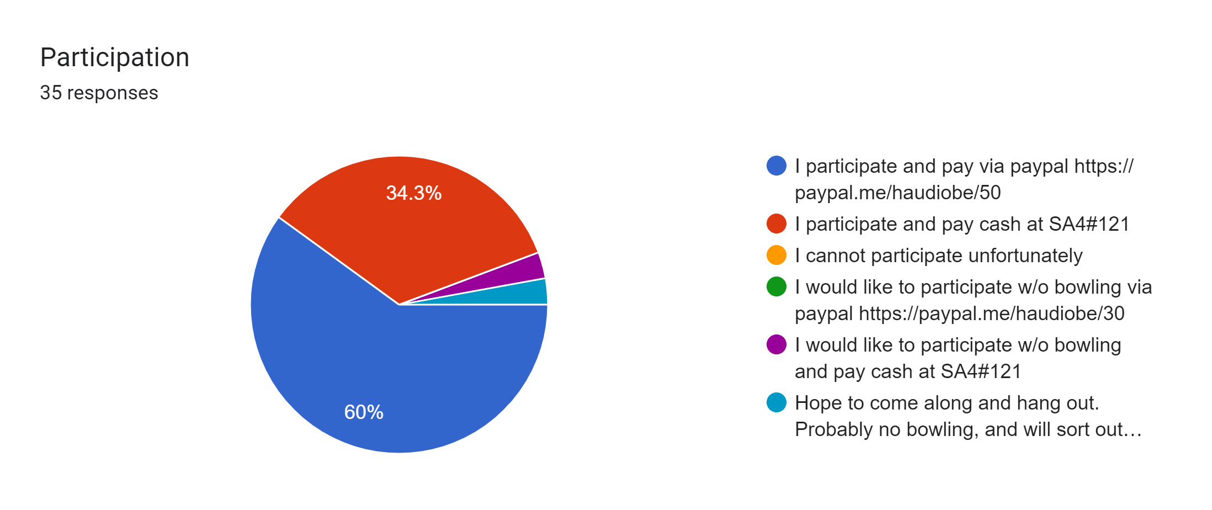
Responses

Slide 4

Drinks are kindly sponsored
Dolby will kindly pay for Thursday Emmy presentation drinks.
THANK YOU
And we still have ability to add several people, please register today to finalize the count or let me (Thomas) know
http://www.tinyurrl.com/sa4-121

