Slide 1
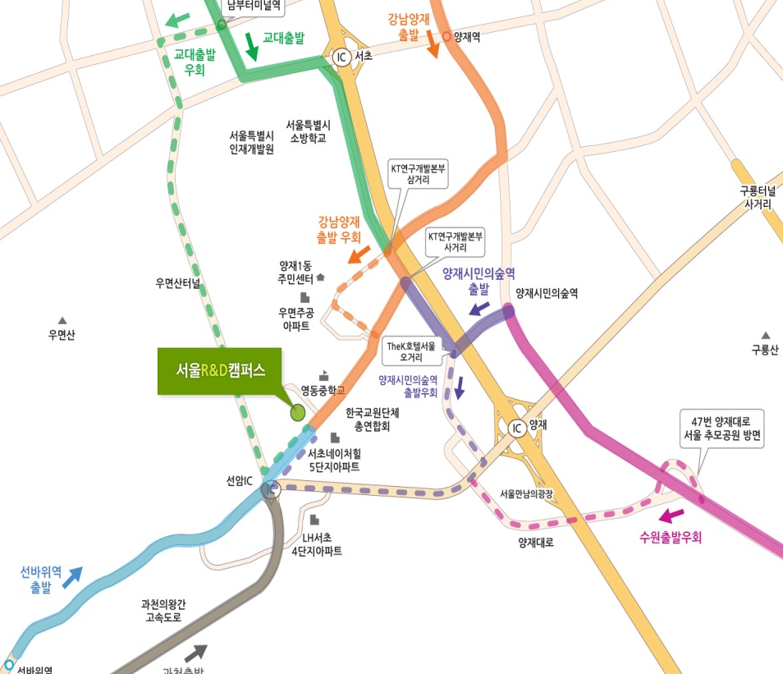
[01]
How to get to Seoul R&D Campus
Gyodae
□ Car
- 33, Seongchon-gil, Seocho-gu, Seoul
□ BUS(National hill 3, 4 /Umyeon Elementary School)
- Maeul Bus(Village bus): 서초 18, 18-1, 2
- City Bus : 19, 3412
- Blue Bus : 541, 542
□ Subway
- Seonbawi (Line no.4)
- Yangjae (Shinbundang/ Line no.3)
- Yangjae Citizen’s Forest (Shinbundang)
※ It takes about 20~30 minutes on foot from
Yangjae Citizen’s Forest station.
Yangjae
Suwon
Seonbawi
Yangjae Citizen’s Forest
Gwacheon
Detour Route

Slide 2
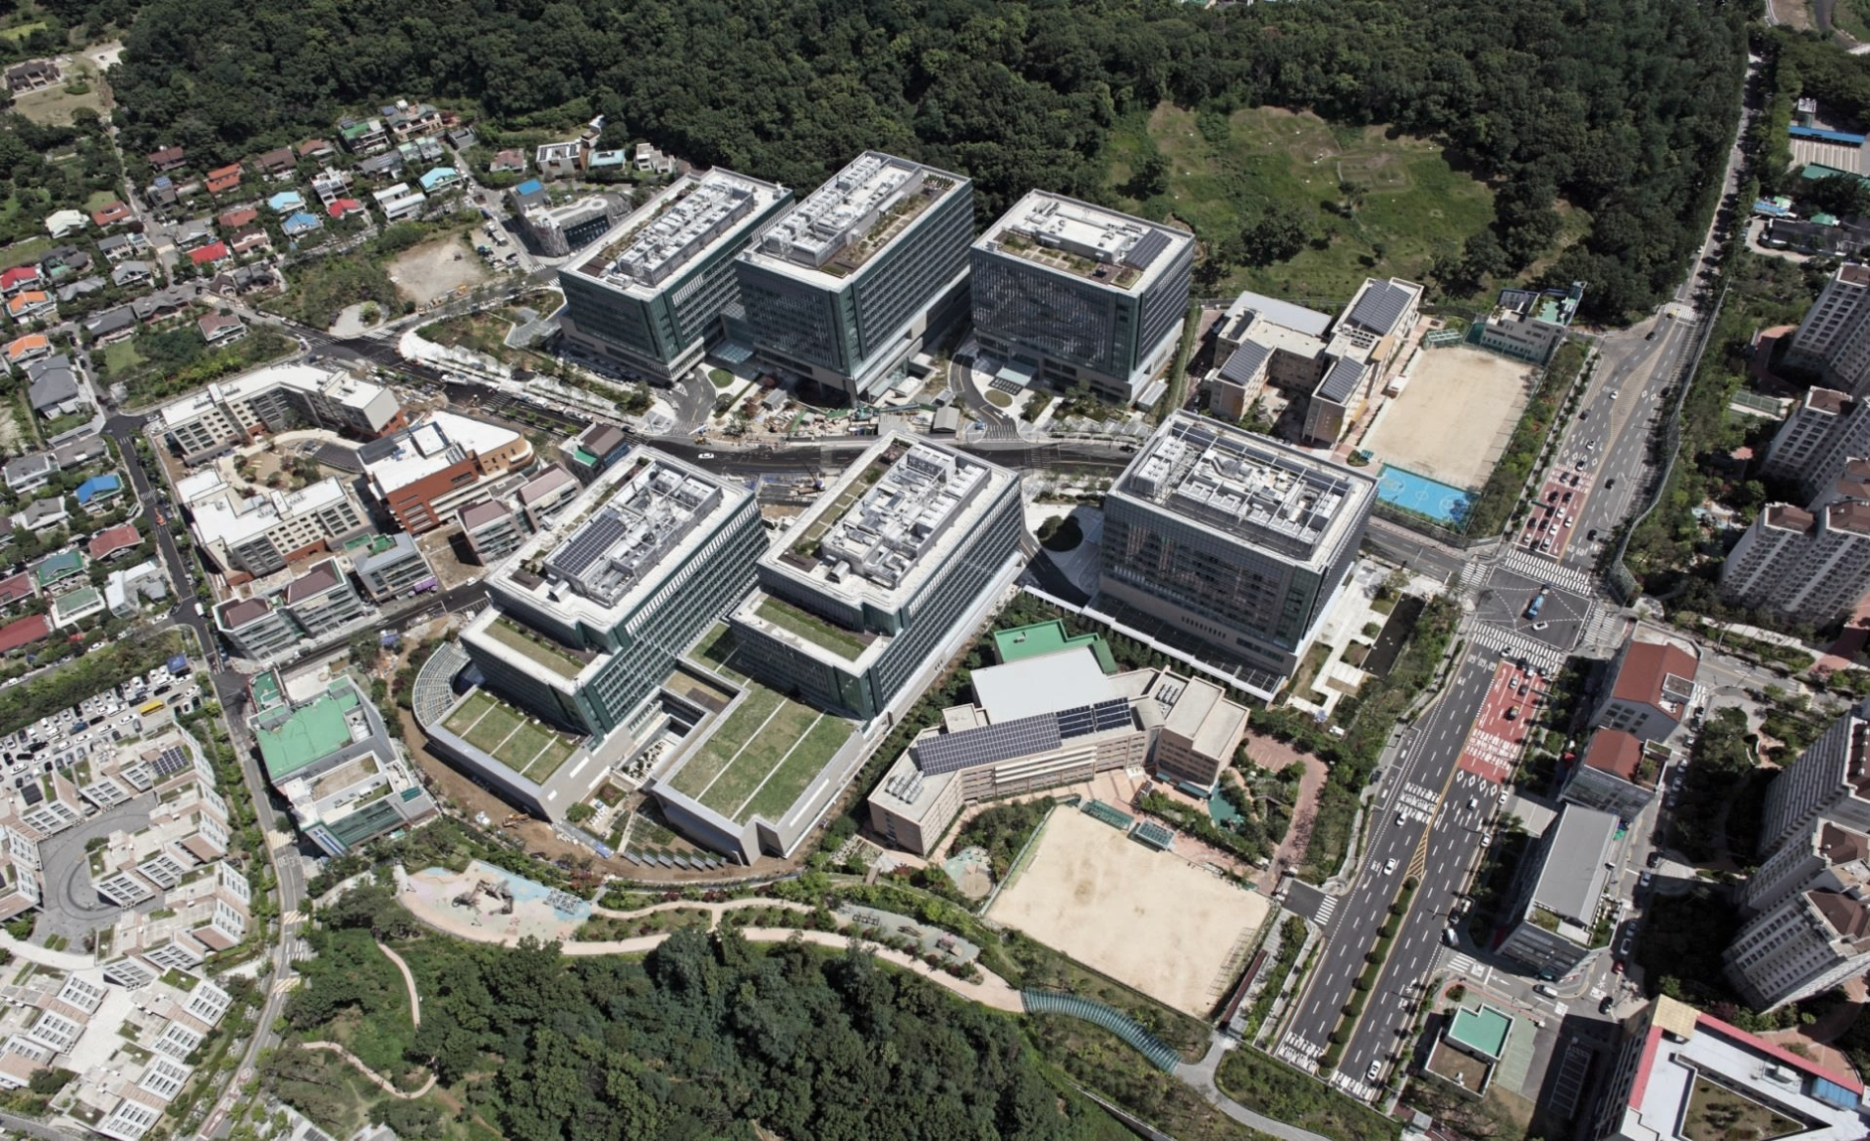
[02]
Introduction for R&D campus Seoul
Meeting Place
(E107)
Seongchon Maeul
D
E
F
Yeongdong Middle School
Umyeon Village
Daycare Center
A
B
C
Guest Parking
(A tower)
Umyeon Elementary School
Taebong-ro

Slide 3
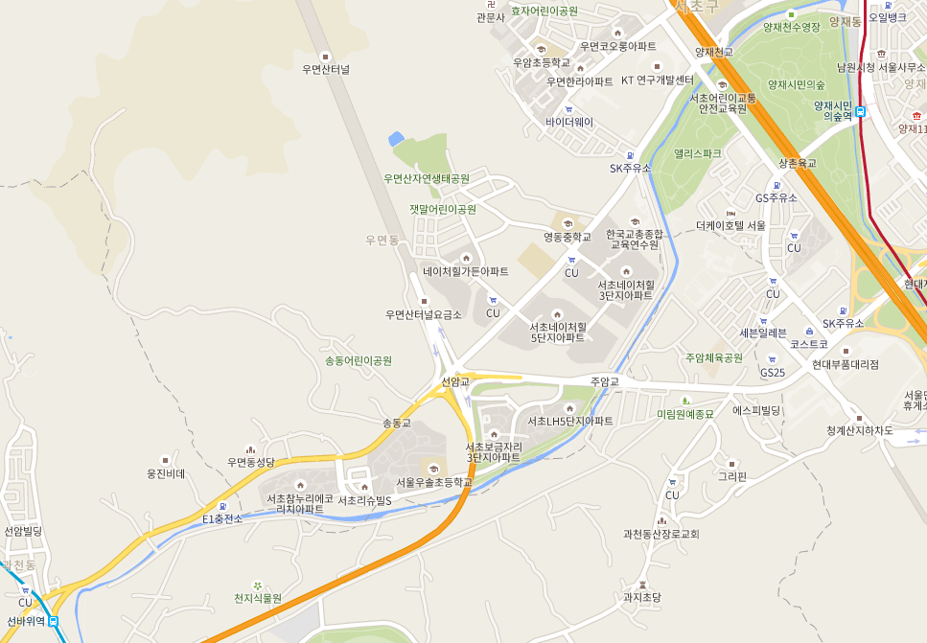
[02]
Introduction for R&D campus Seoul
Samsung Electronics Service Center
Motor Service Center
Yangjae citizen's forest station
Dong office
Downtown area
Umyeon Ecological Park
Park
Cafeteria
Yangjaecheon(Stream)
Seoul R&D Campus
Soule R&D campus
Subway station
Culture Art Park
Cafeteria
Yangjaecheon
Cafeteria
Samsung Electronics Service Center
- Family physician
- Orthopedics
- Otolaryngology
- Pediatrics
- Dentist
Seonbawi Station

