Slide 1
Process and agenda for SA3#103-e
SA3 Chair

Slide 2
Outline
Process
General
Email rules
Drafting
Decision making
Discussion monitoring
Week 1
Scope
Deadlines
Confcall agenda (if any)
Week 2
Scope
Deadlines
Confcall agenda (if any)
Chairman election
Candidates
Voting tool introduction
Deadlines

Slide 3
General
Process document:
https://www.3gpp.org/ftp/TSG_SA/WG3_Security/TSGS3_103e/Docs/S3-211989.zip
Agenda:
https://www.3gpp.org/ftp/TSG_SA/WG3_Security/TSGS3_103e/Docs/S3-211350.zip
Conference call:
To be scheduled daily depending on needs 13:00-15:00 UTC
Conference calls topics are collected in this document
GoToMeeting in combination with TOHRU for hand raising with meeting ID ”3GPP-SA3#103e”

Slide 4
Email rules (1/2)
Final status:
"[SA3#103-e][AI#] Final status" as subject line (only by rapporteurs)
Comment thread:
"[SA3#103-e][AI#<,group name if applicable>][S3-21wxyz] <exact Tdoc title>" as subject line
Preliminary decision:
"[SA3#103-e][AI#] Preliminary decisions" as subject line (only by the leadership)
Direct requests to the SA3 leadership:
"[SA3#103-e][admin] … " as subject line

Slide 5
Drafting
Drafts folder:
https://www.3gpp.org/ftp/tsg_sa/WG3_Security/TSGS3_103e/Inbox/Drafts
Filename convention for revisions:
"draft_S3-21wxyz-r#"
Merges:
Authors are to explicitly announce the merge and close the discussion on their merged documents’ threads
Discussion and drafting is to be continued on the baseline document thread
Mirrors:
Focus the discussion on the changes in the main CR (cat-F) thread not the mirrors (cat-A)

Slide 6
Decision making
Positions:
Positions (especially support/objection/objection withdrawal) are to be explicitly stated on the target contribution thread preferably at the beginning of the email. Below is an example of the scenarios to avoid:
Company X sends email stating objection to the contribution
Later, on the same thread Company Y sends email stating support of Company X (Company Y here should in addition state explicitly their objection to the contribution)
Objections are to be raised before the provided deadlines to allow time for discussion and compromise
Automatic decisions:
Unchallenged documents are automatically approved by the last challenge deadline or, in case of preliminary decisions, the following day’s challenge deadline
Challenged documents are to be noted by the last challenge deadline unless all objections have been withdrawn
Objections to a cat-F CR applies automatically to all the mirrors, i.e., cat-A if any. Objections on any mirrors (ex. revised into cat-F) must be explicitly withdrawn.

Slide 7
Discussion Monitoring
The SA3 leadership will monitor the email discussions to keep a track record of disagreements and for the note taking. The agenda items will be split among the leadership members as shown in the table below.
MCC will continuously provide feedback on the documents directly to the authors, over the admin channel or in the corresponding email thread. So please pay attention to such feedback.
Who | Agenda items
VC (MQ) | 4.1, 4.2, 4.3, 4.4, 4.5, 4.6, 4.7, 4.8, 4.12, 4.14, 4.15, 4.21, 5.2, 5.4, 5.5, 5.6, 5.9, 5.14, 5.16, 5.19, 5.21, 5.22, 5.23
VC (RR) | 3, 4.9, 4.10, 4.11, 4.13, 4.16, 4.17, 4.18, 4.19, 4.20, 4.22, 5.1, 5.3, 5.7, 5.8, 5.10, 5.11, 5.12, 5.13, 5.15, 5.17, 5.18, 5.20, 5.24

Slide 8
Candidates
https://www.3gpp.org/news-events/elections/2182

Slide 9
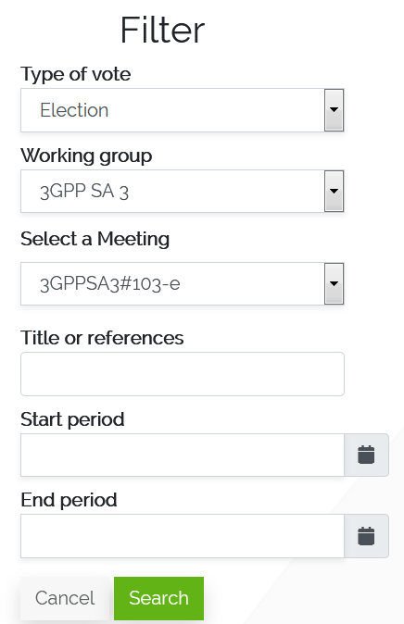
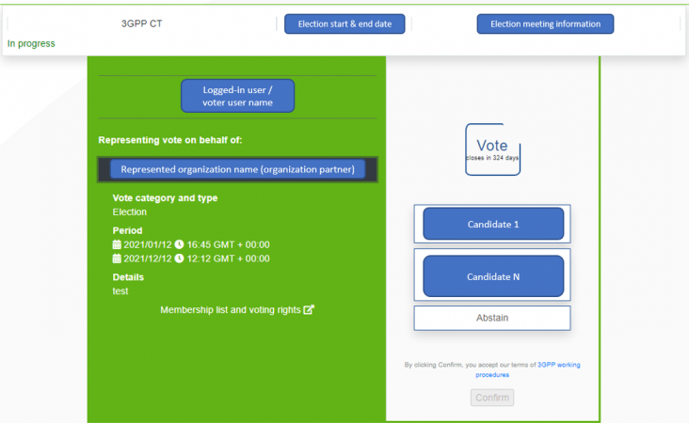
Voting tool introduction
1. Access Voting tool with logged in account
3. Enter election details pages
2. Find 3GPP SA3#103-e meeting through filter
Please be careful. It is not 3GPPSA3#103.
4. Cast a vote and confirm

Slide 10
Deadlines
Monday 10 May 2021 | Tuesday 11 May 2021 | Wednesday 12 May 2021 | Thursday 13 May 2021 | Friday 14 May 2021
Candidature submission deadline 11:00 UTC
Monday 17 May 2021 | Tuesday 18 May 2021 | Wednesday 19 May 2021 | Thursday 20 May 2021 | Friday 21 May 2021
Registration deadline 13:00 UTC | 1st ballot start 13:00 UTC | 1st ballot end 13:00 UTC | 2nd ballot start 13:00 UTC | 2nd ballot end 12:00 UTC

Slide 11
Week 1 - Scope
Admin
Agenda items 1 & 2
Rel-17 study items:
Study items: 5.3, 5.7 to 5.19, 5.21, 5.22
The remaining study items will be covered in Week 2
Notes
If needed, we will allow discussion on SA2 LSes and related documents to continue during Week 2 as well
Email approval for Week 1 output will take place during Week 2. The deadlines are shown in slide 12

Slide 12
Week 1- Deadlines
Time (UTC)\Day | Monday 17 May 2021 | Tuesday 18 May 2021 | Wednesday 19 May 2021 | Thursday 20 May 2021 | Friday 21 May 2021
8:00-9:00 | Start of e-meeting at 8:00 ☺
9:00-10:00
10:00-11:00 |  | W1 - 1st challenge deadline at 11:00 | W1 - 2nd challenge deadline at 11:00 | W1 - 3rd challenge deadline at 11:00 | W1 - Last challenge deadline at 11:00
11:00-12:00 |  |  |  |  | W1 - Rapporteurs to announce final status at 12:00
12:00-13:00 | Registration deadline at 13:00 | 1st ballot starts at 13:00 | 1st ballot ends at 13:00 | 2nd ballot starts at 13:00 | 2nd ballot ends at 12:00
13:00-14:00 | Conf call W1/D1 | Conf call W1/D2 | Conf call W1/D3 | Conf call W1/D4 | Conf call W1/D5
14:00-15:00 |  |  |  |  | End of Week 1 of e-meeting at 15:00 ☹
15:00-16:00 |  |  | W1 - Objections latest at 16:00 | Portal opens W1 - Last revision at 17:00
Chair candidature presentation

Slide 13
Week 1 - Conference call agenda
The timeslot limits are not strict except the conference call start and ending times.
Time (UTC)\Day | Monday 17 May 2021 | Tuesday 18 May 2021 | Wednesday 19 May 2021 | Thursday 20 May 2021 | Friday 21 May 2021
13:00 - 13:30 | Chair candidature presentation (5 min for each) 1, 2 & incoming LSes and Editorials | 5.12 FS_eNPN_SEC | 1st ballot results (10 min) Reserved | Reserved | 2nd ballot results (10 min)
13:30 - 14:00 | 1, 2 & incoming LSes and Editorials | 5.16 FS_eNA_Sec | Reserved | Reserved
14:00 - 14:30 | 5.11 FS_5MBS_SEC | 5.14 FS_UC3S | 5.9 FS_5G_ProSe_Sec | Wrap-up
14:30 - 15:00 | 5.10 FS_IIoT_SEC | 5.8 FS_eEDGE_SEC | 5.17 FS_AMFREAL_SEC | Wrap-up
Free for use.
To be scheduled based solely on requests. SA3 leadership can assist with chairing if needed. No support for preliminary decisions.
Free for use.
Will be scheduled based partly on requests. SA3 leadership will chair. Important discussion and decisions will be scheduled in the orange slots, to the extent possible.

Slide 14
Week 2 - Scope
Admin
Agenda items: 3, 6 & 7
New proposals
Agenda items: 4.21 & 5.23
All normative items
Work items: 4.1 to 4.20
Rel-17 study items:
Study items: 5.1, 5.2, 5.4 to 5.6, 5.20
Other areas
4.22 and 5.24
Notes
Email approval for Week 2 output will take place after the meeting. The deadlines will be provided during Week 2.

Slide 15
Week 2- Deadlines
W1O = Week 1 Output
Time (UTC)\Day | Monday 24 May 2021 | Tuesday 25 May 2021 | Wednesday 26 May 2021 | Thursday 27 May 2021 | Friday 28 May 2021
8:00-9:00 | Start of e-meeting at 8:00 ☺
9:00-10:00
10:00-11:00 |  | W1O – available at 11:00 W2 - 1st challenge deadline at 11:00 | W1O– last comm. at 11:00 W2 - 2nd challenge deadline at 11:00 | W2 - 3rd challenge deadline at 11:00 | W2 - Last challenge deadline at 11:00
11:00-12:00 |  |  |  |  | W2 - Rapporteurs to announce final status at 12:00
12:00-13:00
13:00-14:00 | Conf call W2/D1 | Conf call W2/D2 | Conf call W2/D3 | Conf call W2/D4
14:00-15:00 |  |  |  |  | End of e-meeting at 15:00 ☹
15:00-16:00 | Portal closes |  | W2 - Objections latest at 16:00 | W1O – last rev. at 17:00 Portal opens W2 - Last revision at 17:00

Slide 16
Week 2 - Conference call agenda
The timeslot limits are not strict except the conference call start and ending times.
Time (UTC)\Day | Monday 24 May 2021 | Tuesday 25 May 2021 | Wednesday 26 May 2021 | Thursday 27 May 2021
13:00 - 13:30 | 3 & 4.22 | 4.21 & 5.23 | Reserved | Reserved
13:30 - 14:00 | 3 & 4.22 | 4.22, 3 (remaining LSs) | Reserved | Reserved
14:00 - 14:30 |  | 5.5 |  | Wrap-up & admin
14:30 - 15:00 |  | 4.16 & 5.20 eSBA sec |  | Wrap-up & admin
Free for use.
To be scheduled based solely on requests. SA3 leadership can assist with chairing if needed. No support for preliminary decisions.
Free for use.
Will be scheduled based partly on requests. SA3 leadership will chair. Important discussion and decisions will be scheduled in the orange slots, to the extent possible.

