Slide 1
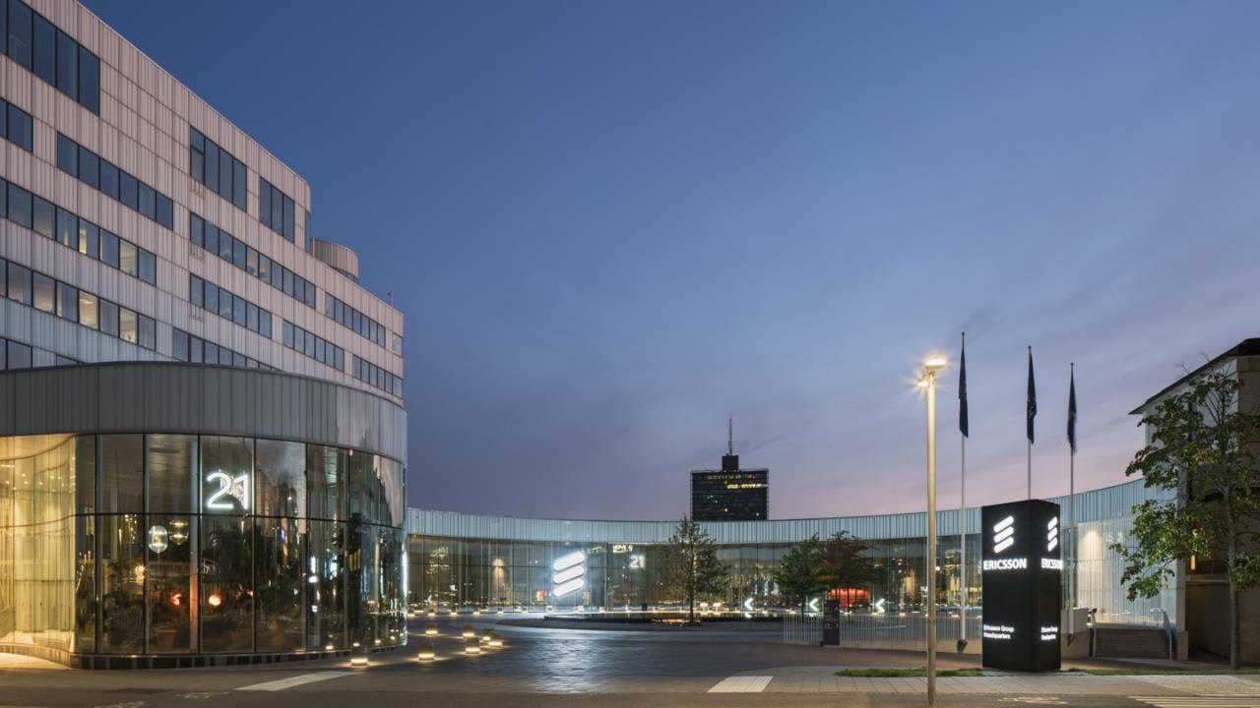
SA3#100bis-e eNPN merger discussion
Image: Ericsson headquarters, Kista, Sweden
2020-10-12

Slide 2
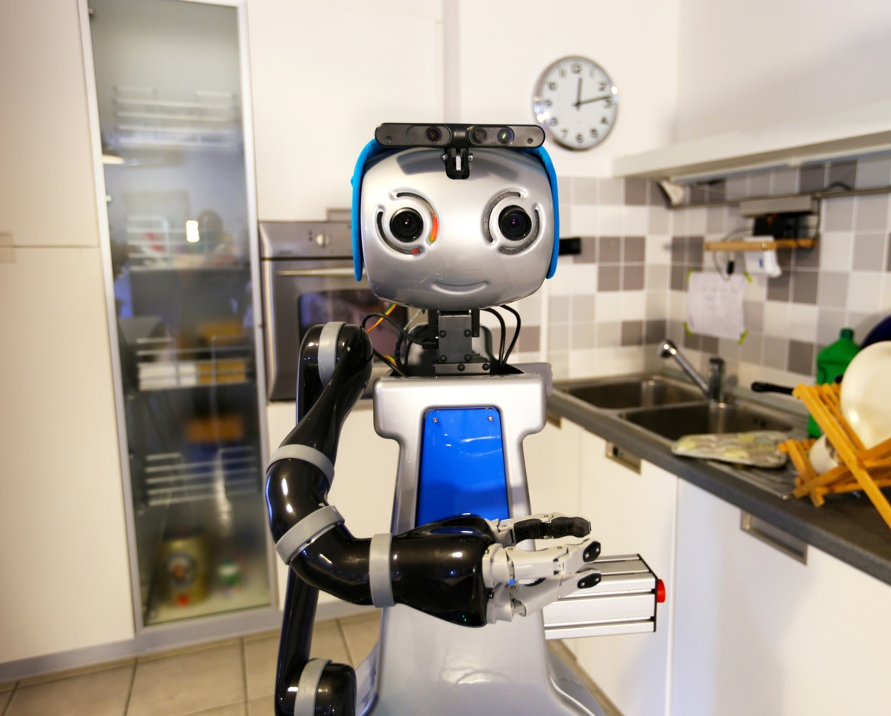
Agenda
Initial access – 15 minutes
Provisioning – 15 minutes
SID revision – 15 minutes
LSes - 15 minutes

Slide 3
Initial Access
S3-202585 | Securing initial access for UE onboarding between UE and SNPN Nokia to provide proposal on how to fit 2550 aspects in | Ericsson, Huawei, Hisilicon, Qualcomm Incorporated, Lenovo, Motorola Mobility, InterDigital
S3-202522 | Key issue for UE onboarding for provisioning | Intel Corporation (UK) Ltd
S3-202327 | New key issue on UE onboarding for SNPN | ZTE Corporation

Slide 4
Provisioning
S3-202333 | Clarification on Key Issue #2 Nokia to provide proposal on how to fit 2550 aspects in | Huawei, Hisilicon, Ericsson
S3-202550 | Update of key issue on provisioning of credentials | Nokia, Nokia Shanghai Bell
S3-202588 | Discussion on provisioning server | Ericsson, Huawei, Hisilicon, InterDigital, Lenovo, Motorola Mobility, China Mobile
S3-202586 | Definition of Provisioning Server | Ericsson, Huawei, Hisilicon, InterDigital, Lenovo, Motorola Mobility, China Mobile
S3-202513 | Add Provisioning Server Term | Intel Corporation (UK) Ltd
S3-202332 | New Key Issue on Provisioning of PNI-NPN credentials Vf to provide comments Nokia to provide comments too. | Huawei, Hisilicon, Ericsson
S3-202535 | Key issue on remote provisioning of non-3GPP credentials for PNI-NPN | China Mobile

Slide 5
SID revision
S3-202638 | eNPN SID: discussion | THALES, Orange, Idemia
S3-202654 | eNPN scope | THALES, Orange, Idemia
S3-202663 | Scope of TR 33.857 | Philips International B.V.
S3-202655 | eNPN security assumptions | THALES, Orange, Idemia
S3-202658 | Proposed TR Assumptions on credentials | Ericsson
S3-202657 | eNPN SID revision | THALES, Orange, Idemia

Slide 6
LSes
S3-202360 | LS on architectures for access to SNPNs using credentials owned by an entity separate from the SNPN | S2-2004385
S3-202631 | [DRAFT] Reply-LS on AAA based solutions for credentials owned by an entity separate from the SNPN | Ericsson
S3-202652 | Reply LS on architectures for access to SNPNs using credentials owned by an entity separate from the SNPN | Qualcomm Incorporated
S3-202326 | Reply LS on architectures for access to SNPNs using credentials owned by an entity separate from the SNPN | ZTE Corporation
S3-202363 | LS on security issue for on-boarding and remote provisioning | S2-2005949
S3-202336 | Reply LS on security issue for on-boarding and remote provisioning | Huawei, Hisilicon
S3-202328 | Reply LS on on-boarding and remote provisioning | ZTE Corporation
S3-202633 | [DRAFT] reply LS on security issues for on-boarding and remote provisioning | Ericsson

Slide 7
Thank you for participating!

