Slide 1
ISAC Open Issues
Sherry Shen (Moderator)

Slide 2
Open Issues related to work scope
Whether WT#1 (study overall architecture enhancement) is needed?
What is non-3GPP sensing? Whether the support for non-3GPP sensing is in scope?
What does “ISAC service authorization and control” mean?
Whether mobility and service continuity for periodic and triggered ISAC service is in scope of the R19 study?
Whether TR only or TR+TS work is developed in Rel-19?
Whether reusing existing solutions is assumed?

Slide 3

Open Issues 1
Whether WT#1 (study overall architecture enhancement) is needed?
Yes: The overall architecture is the basis for developing solutions
No: Architecture enhancement is the result of the overall study
Way forward:
merge WT#1 into WT#2 as the headline, TU number has to be reserved for overall architecture enhancement, e.g. spread over other WTs

Slide 4
Open Issues 2
What is non-3GPP sensing? Whether the support for non-3GPP sensing is in scope?
The following cases may be considered as non-3GPP sensing:
UE mounted with non-3GPP sensors
sensing measurement at UE/gNB based on implementation
WLAN sensing at UE (not in SA1 requirement)
Yes: SA1 requirement; already supported on UE / Vehicle
No: low priority
Way forward:
Remove WT#3 and add the following NOTE:
The architecture is developed focusing on the support of 3GPP sensing, which can also be applied to non-3GPP sensing.

Slide 5
Open Issues 3
What does “ISAC service authorization and control” mean? Whether WT-2.1 (ISAC service authorization and control) and WT-2.6 (Policy control) should be combined?
Option 1: Whether a UE/3rd party AF is authorized to use ISAC service considering subscription or privacy of the object and the environment?
Option 2: Configuration parameters (operator policies) are configured or provisioned to UE/ gNB for the authorization of using ISAC services, e.g. PLMN, location area, frequency, …
Way forward:
For Option 1, authorization based on subscription is in SA2 scope, and authorization due to privacy is the SA3 work.
Both options are considered in scope, but as separate WTs:
  For WT#2.1, keep the wording as simple as the existing wording to capture Option 1
  WT#2.6 can be reworded to capture Option 2.

Slide 6
Open Issues 4
Whether mobility and service continuity for periodic and triggered ISAC service is in scope of the R19 study?
Yes: SA1 requirement (The 5G system shall support continuity for 5G wireless sensing service (e.g., for sensing a moving object).)
No: low priority
Way forward:
To agree on the definition of service continuity first: Study whether and how to enable uninterruptedly providing the sensing service when the tracked target is moving (HW)
How about to "to down prioritize the design of the feature for supporting a continuous sensing session at 3GPP defined layer for a object moves between sensing areas of different sensors“ (QC)
Related to whether only gNB based sensing is supported?
Discussion will be continued offline
Notes:
is

Slide 7
Open Issues 5
Whether TR only or TR+TS work is developed in Rel-19?
TR only: Only RAN1 study is planned for R19 (see slide 12)
TR+TS: Complete solutions within a release; phased approach (system architecture in R19, enhancement/extensions in R20)
Way forward:
Keep 2 options open until Dec. plenary meeting based on RAN status
For SID for the TR+TS in R19, down scoping is expected

Slide 8
Open Issues 6
Whether reusing/enhancing/referring to existing functionalities is assumed?
Yes: minimum system impact, beneficial for reducing TU
No: solutions should not be restricted
Way forward:
no NOTE is needed in the SID to restrict solutions

Slide 9
Appendix for info

Slide 10
SA1 requirements mapped to SA2 functionalities
Configuration & authorization
  Configuration parameters are configured or provisioned to UE or gNB for the authorization of using ISAC services, e.g. PLMN, location area, frequency, …
Discovery and selection of sensing devices/entities
  One or multiple UEs/gNBs are discovered and selected to perform sensing
Service invocation & exposure
  Sensing result can be requested and exposed to 3rd party App or UE
  Sensing result may include the final result or the processed sensing data per request of service consumer
Sensing data (3GPP/non-3GPP) processing & collection
  UE based calculation and 5GC NF based calculation: new NF or existing NF
  Collection from gNB and/or UE
Service continuity
  Transmitter/receiver mobility
  Object mobility
Subject to regulation and operator’s policies, the 5G network shall be able to configure and/or authorize or revoke authorization of sensing transmitter(s) and sensing receiver(s) for 5G wireless sensing service.
The 5G network shall be able to provide a mechanism for an MNO to configure UEs supporting V2X applications to support 5G Wireless sensing service when not served by RAN.
Subject to regulation and operator policy, the 5G network shall be able to activate, configure, and deactivate 5G wireless sensing based on parameters such as location and network conditions (e.g., network load).
The 5G network shall enable UEs without 5G coverage to use unlicensed spectrum to provide 5G wireless sensing service.
Subject to regulation, the 5G network shall enable UEs supporting V2X application to perform 5G Wireless sensing when not served by RAN using the allowed ITS spectrum and unlicensed spectrum.
NOTE 2: Such configuration and authorization can also include the selection of multiple sensing transmitters/receivers for 5G wireless sensing services.
Subject to operator’s policy, the 5G network shall be able to provide secure means to report sensing result to a trusted third-party requesting information about a target object when specific requested conditions are met.
Subject to operator’s policy, the 5G network shall provide secure means for a trusted third-party to request 5G wireless sensing service based on specific parameters (e.g., refresh rate, period of time, sensing KPIs, geographical location) and to receive the corresponding sensing results.
Subject to operator’s policy and regulation, the 5G system shall be able to provide secure means for a trusted third-party to receive sensing results with contextual information.
Subject to user’s consent, regulation and operator’s policy, the 5G network may provide secure means to expose to a trusted third-party the combined sensing result derived from the joint processing of the 3GPP sensing data and non-3GPP sensing data.
Subject to operator’s policy, the 5G network may provide secure means for the operator to expose information towards trusted third-party on whether a given sensing service is available and the estimated quality of the given service for a certain geographic area and time.
Based on operator’s policies, operator’s control and regulation, the 5G system shall be able to collect 3GPP sensing data from sensing receivers for processing.
Subject to user consent, regulation, and operator’s policy, the 5G system shall be able to collect non-3GPP sensing data from authorized non-3GPP sensors and securely provide it to 5G network.
Subject to user consent, regulation, and operator’s policy, the 5G system should support the joint processing of the 3GPP sensing data and non-3GPP sensing data to derive a combined sensing result.
The 5G system shall support continuity for 5G wireless sensing service (e.g., for sensing a moving object).
(Source: TS 22.137v1.0.0)

Slide 11
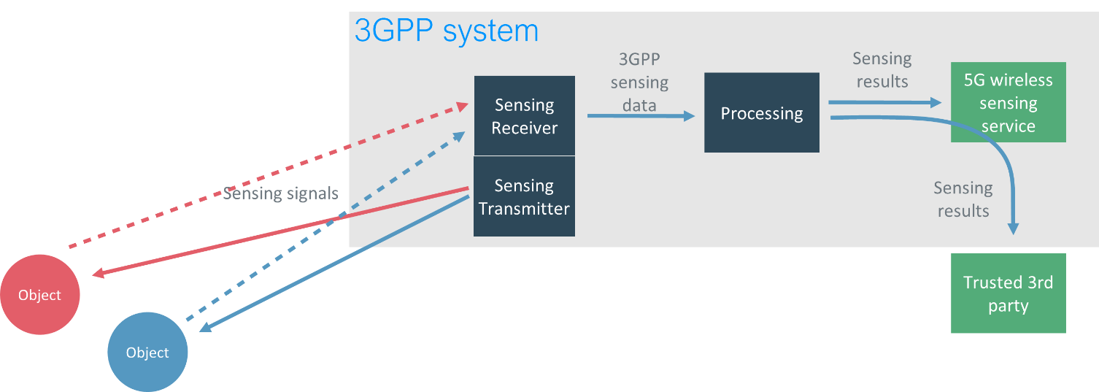
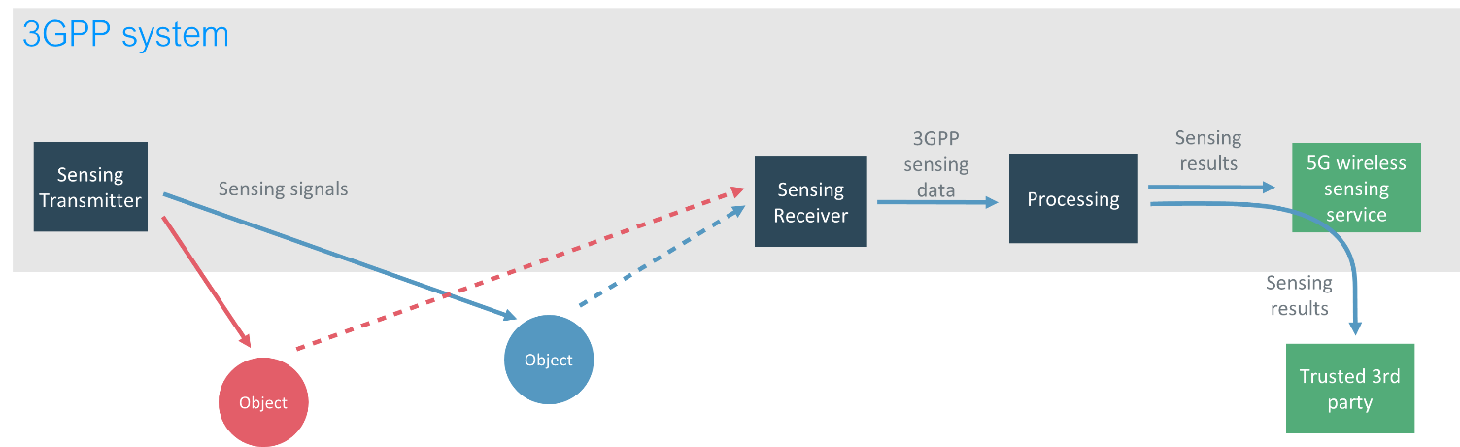
SA1 defined sensing operations
Monostatic sensing
Figure 4.2-1: Example of sensing with co-located sensing receiver and sensing transmitter
Bistatic sensing
Figure 4.2-2: Example of sensing with separated sensing receiver and sensing transmitter
Source: TS 22.137

Slide 12
RAN status up to RAN#101
Regarding ISAC, the following way forward seems agreeable:
  If not already done in SID, a RAN-led study objective to select a small number of ISAC use cases from TR22.837, and to identify appropriate corresponding information needed for point 2 below, i.e. scenarios, frequency ranges and sensing modes.
  A RAN1-led study objective to define channel modelling details for sensing using 38.901 (if applicable to the selected use cases) as a starting point, and taking into account relevant measurements, including:
    modelling of sensing targets, including, for example (if needed by the selected use cases), radar cross-section (RCS), mobility and clutter/scattering patterns;
    spatial consistency.
  This objective to start after completion of the first (RAN-led) objective if not already done in SID.

