Slide 1
PINs Terminology
Discussion for CC
Adrian Buckley, FS_PIN Rapporteur
3GPP TSG-SA WG1 Meeting #92e S1-204430
Electronic Meeting, 11-20 November, 2020 (revision of S1-204xxx)

Slide 2
What is a PIN
We already have PINs today
  Wearables network
  Home automation network
Capabilities within the PIN
  It is managed (something[s] keep policy what is connected to it, what device in the PIN can do what, encryption keys etc)
  Demarcation point (gateway) between the PIN and Public operators network. Smartphone or Watch in wearables, gateway or voice assistant in home automation.
Characteristics devices
  Small, battery constrained, physical size constrained
  Continuous power
  Will use licensed and unlicensed bands
  Lot of the communications can stay within the PIN.

Slide 3
Some PIN questions
Do I always need a gateway to the 3GPP network?
  No I can use my smartphone to play stored video over my headset / earbuds in a cave.
  Home automation events can stay within the home network
Do I always need eSIM /UICC
  No earbuds, headsets and rings are examples of devices that have physical limitations.
  Home automation events typically stay within the home network.
Can a PIN consist of just UEs?
  Yes a smartwatch (eSIM) and a smartphone (UICC) is a good example.
Can a PIN just be 3GPP devices?
  Yes we have a UE, IoT device and a “thing”.
Licensed spectrum
  The operator must have control, the PIN Element has to comply to requirements to provide this control.

Slide 4
Suggested definitions
Personal IoT Network: A Personal IoT Network (PIN) is one or more PIN elements that communicate with each other.
PIN Element: A PIN Element (PE) is the basic component making up a PIN-User’s Personal IoT Network. A PIN Element is handled as a single entity in PIN but physically it may be either a single device or a group of devices. The PIN Element may be an IoT Device, TE, MT, ME, “thing” (See TS22.101) or even a complete UE.
Configuration PIN Capability: A Configuration PIN Capability (CPC) is a capability in the PIN that manages the PIN.
Gateway Capability: A Gateway PIN Capability (GPC) is a gateway that provides access to and from the public operators network (fixed/mobile/cable) and a PIN.

Slide 5



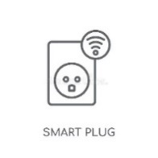
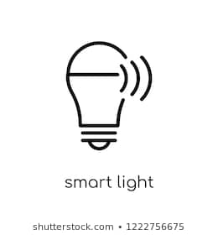
Pictorial view
Personal IoT network
Direct Network
Connection
PIN element
Direct Network
Connection
CPC
5GS
Direct Device
Connection
PE
GPC
PIN element
PIN element

Slide 6
Pictorial view-v2
Personal IoT network
Direct Network
Connection
PIN element
InDirect Network
Connection
CPC
5G CN
Direct Device
Connection
Direct Device
Connection
PE
GPC
PIN element
PIN element

Slide 7
Issues with FS_RESIDENT terms
Evolved Residential Gateway: a gateway between public operator network (fixed/mobile/cable) and a customer premises network within a residence, office or shop
Premises Radio Access Station: a base station installed at a customer premises network primarily for use within the residence, office or shop.
Wearables (a PIN) can be used on a train, bus, in a car. They don’t need a public operator network to work – I can play music from my smartphone in a cave if I like.

Slide 8
Proposal
Use terms in slide 4 “Suggested Definitions”
Rapporteur updates the terms in usecases in the TR between now and next SA1 meeting and provides a contribution for all to see.

