Slide 1
WF on the measurement interval and observation time for frequency/time correction for 2.5kHz and 0.37kHz
3GPP TSG-RAN WG4 #95e
25th May. - 5th June. 2020
R4-2008869
ZTE,

Slide 2
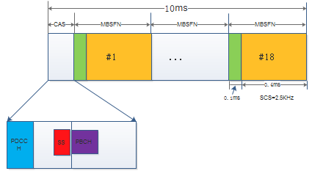
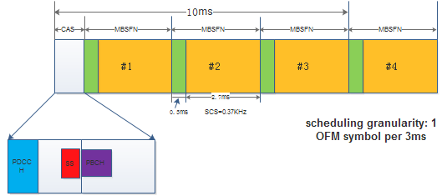
Background
  In Rel-16 LTEbased 5G terrestrial broadcast, two numerologies 2.5KHz and 0.37KHz was introduced for mobility up to 250km/h and and rooftop reception, the basic diagram is shown as following:
  Similar as Rel-14 FeMBMS, EVM related issues for new introduced numerologies 2.5khz and 0.37khz should be specified. In the existing R16 TS 36.104 spec and R16 TS 36.101 spec, there are no such kind of requirement defined yet, therefore we proposed to further discuss and resolve it.
Figure 1. SCS 2.5kHz with CP 100us for mobility up to 250km/h
Figure 2. SCS 0.37kHz with CP 300us for rooftop reception

Slide 3
Measurement interval and observation period for EVM measurement
Agreement:
For 2.5KHz SCS:
Observation period for single EVM measurement: 1ms
measurement interval for EVM averaging among different subframes: 10ms;
For 0.37KHz SCS:
Observation period for single EVM measurement: 3ms
measurement interval for EVM averaging among different subframes: 10ms;

Slide 4
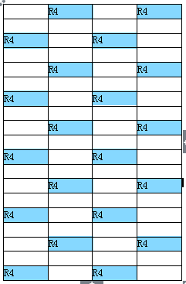
Observation period for freq/timing error estimation
Agreement: for 2.5KHz SCS:
Observation period for freq/timing error estimation: 1ms
Note: 1st symbol and 2nd symbol are used for freq/timing estimation.
Figure 1. RS pattern of Df=2 and Dt=2 for the support of mobility up to 250km/h

Slide 5
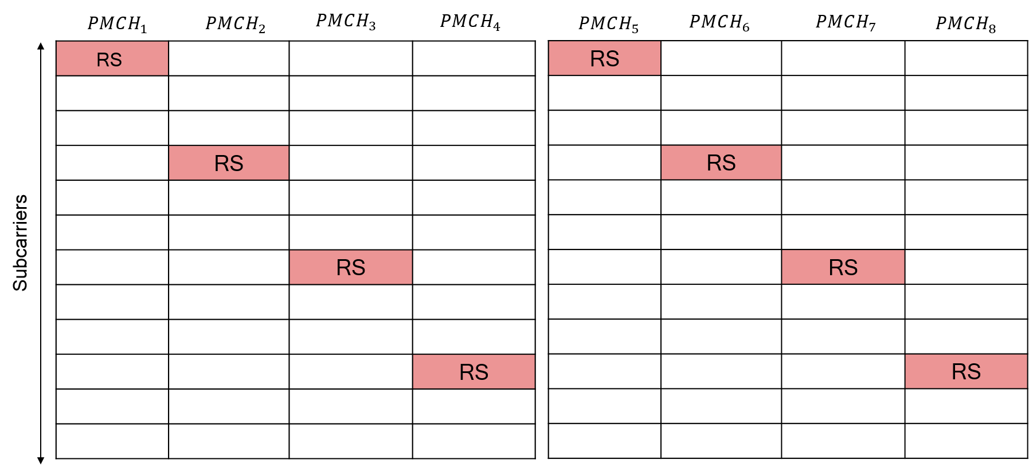
Observation period for freq/timing error estimation
Agreement: for 0.37KHz SCS:
Observation period for freq/timing error estimation for MBSFN RS type 1: 6ms
Note: 1st symbol and 2nd symbol are used for freq/timing estimation.
Figure 1. RS patter for Df=3 and Dt=4 for rooftop reception

Slide 6
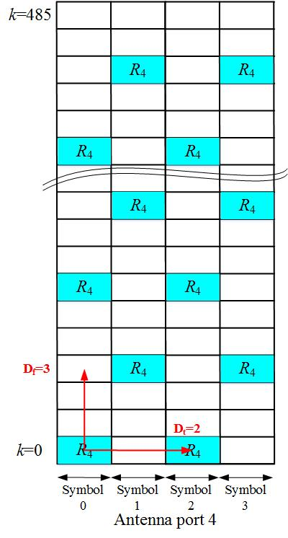
Observation period for freq/timing error estimation
Agreement: for 0.37KHz SCS:
Observation period for freq/timing error estimation for MBSFN RS type 2 : 6ms
Note: 1st symbol and 2nd symbol are used for freq/timing estimation.
Figure 1. RS patter for Df=3 and Dt=4 for rooftop reception

Slide 7
EVM window ratio and FFT size
Agreement: for 2.5KHz and 0.37KHz SCS:
EVM window ratio should reuse the value of 15KHz with normal CP;
FFT size should only have factors of 2 and/or 3 basd on RAN1 agreement to limit UE complexity.

Slide 8
References:
  [1]R4-2007396,Impacts on BS RF requirement of new introduced numerology, ZTE Corporation [2]R4-2007397,CR to 36.104: Introduction of LTE based 5G terrestrial broadcast numerologies
  [3]R4-2007398,CR to 36.101: Introduction of LTE based 5G terrestrial broadcast numerologies

