Slide 1
RAN4#105 meeting schedule
3GPP TSG-RAN WG4 Meeting #105
Toulouse, France, November 14th – November 18th , 2022
Agenda Item: 2
R4-22xxxxx
RAN4 Chair: Xizeng Dai
Vice Chair: Haijie Qiu, Andrey Chervyakov,

Slide 2
Monday
Venue Time | RAN4 Main (Ground floor) | RAN4 RRM (RAN1 Brk 2, 1st floor) | RAN4 BSRF_Demod_Test (RAN4 Brk 1, Ground floor)
9:00-9:30 | 1. Opening of the meeting 2. Approval of the agenda 3. Letters / reports from other groups / meetings
9:40-10:30
11:00-13:00
14:00-16:00
16:30-18:20
18:20 – 19:20 (evening ad hoc)

Slide 3
Tuesday
Venue Time | RAN4 Main (Ground floor) | RAN4 RRM (RAN1 Brk 2, 1st floor) | RAN4 BSRF_Demod_Test (RAN4 Brk 1, Ground floor)
8:00-10:30
11:00-13:00
14:00-16:00
16:30-18:20
18:20 – 19:20 (evening ad hoc)

Slide 4
Wednesday
Venue Time | RAN4 Main (Ground floor) | RAN4 RRM (RAN1 Brk 2, 1st floor) | RAN4 BSRF_Demod_Test (RAN4 Brk 1, Ground floor)
8:00-10:30
11:00-13:00
14:00-16:00
16:30-18:20
18:20 – 19:20 (evening ad hoc)

Slide 5
Thursday
Venue Time | RAN4 Main (Ground floor) | RAN4 RRM (RAN1 Brk 2, 1st floor) | RAN4 BSRF_Demod_Test (RAN4 Brk 1, Ground floor)
8:00-10:30
11:00-13:00
14:00-16:00
16:30-18:20
18:20 – 19:20 (evening ad hoc)

Slide 6
Friday
Venue Time | RAN4 Main (Ground floor) | RAN4 RRM (RAN1 Brk 2, 1st floor) | RAN4 BSRF_Demod_Test (RAN4 Brk 1, Ground floor)
8:00-10:30
11:00-13:00
14:00-16:00
16:00-17:00 | 13 Future meetings 14 Any other business Social event for resuming

Slide 7
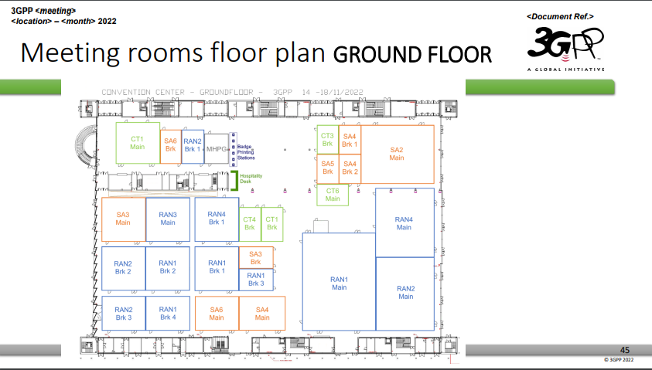
Annex

Slide 8
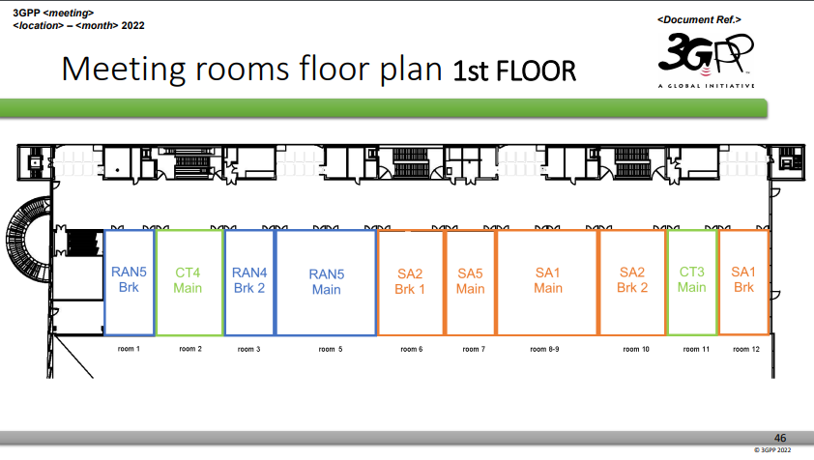
Annex

Slide 9
Thanks!
Wish a successful RAN4 meeting

