Slide 1

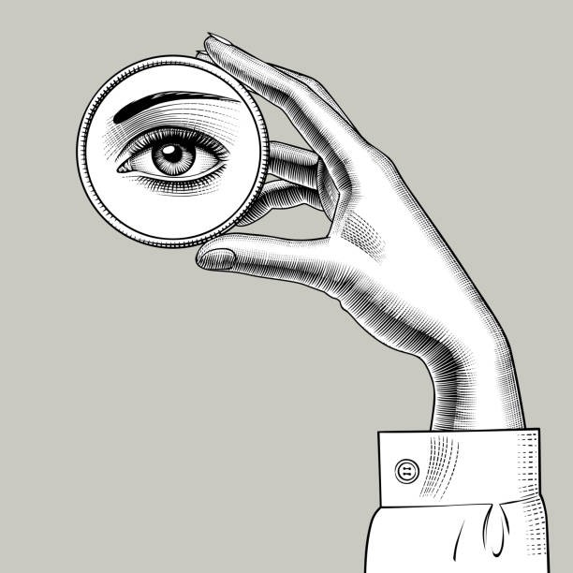
The “Agree with yourself” AWARD
presented to
PHILIPPE GODIN
Agreeing with yourself can be very difficult at times, but not for him. He made an observation, then asked a question to others about it, received no answer, and eventually agreed with his own observation (“Yes. The example is correct.”). All in the same document (R3-211126).
The RAN3 Chairman

