Slide 1


Play @ Club DaDa Thursday 20th Nov. 19:30 S4-25XXXX: FS_AMBISONICS
R2 band
&

Slide 2
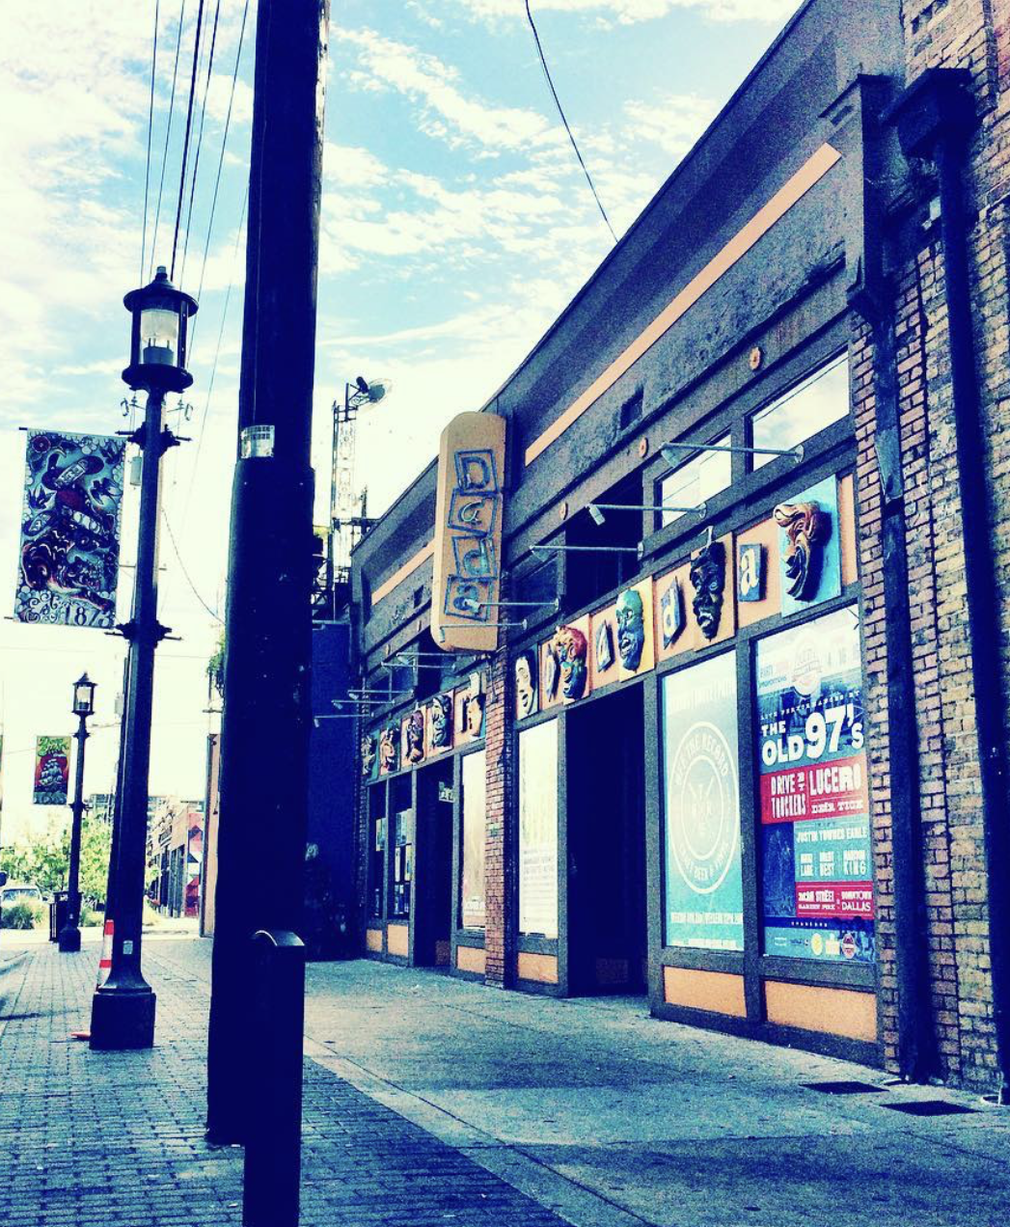
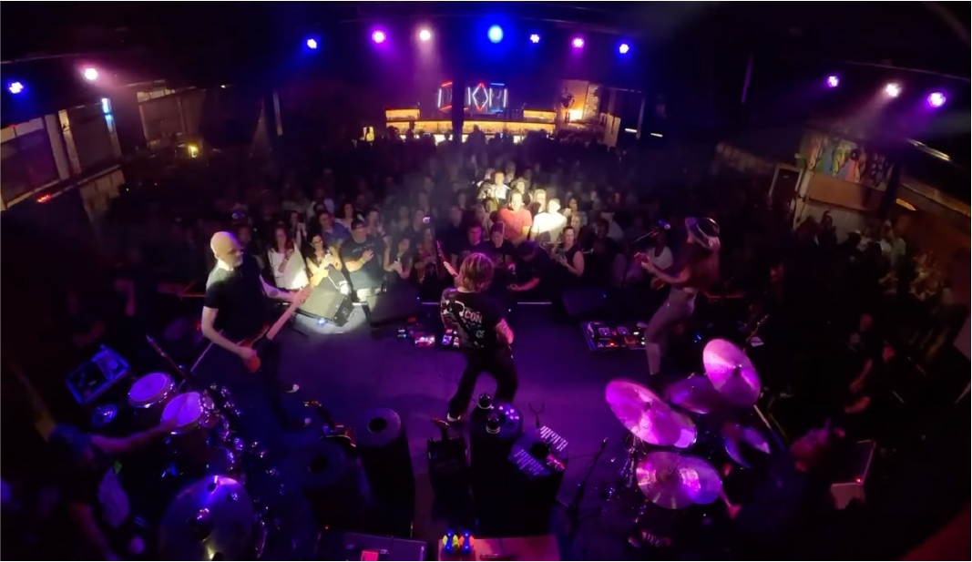
LOCATION: 2720 ELM STREET, DALLAS TX 75226
www.dadadallas.com

Slide 3

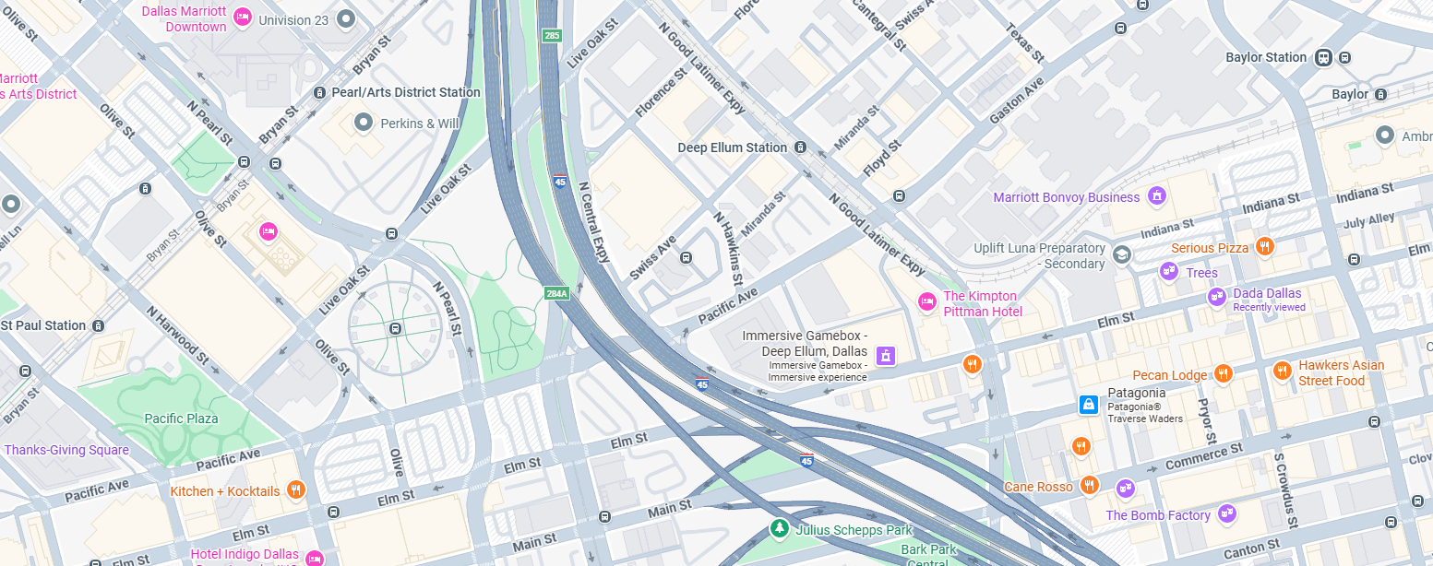

DART Green Line
~700m

Slide 4
20th Nov. Schedule at Club DaDa
18:30 Doors open
19:30 – 20:45 The Ambisonics
20:45 – 21:00 Interlude
21:00 – 22:15 RAN2 Band
22:15 – 22:30 Safety margin time
22:30 Curfew for all music
22:45 Venue closes
Venue capacity is strictly 350, so we need to allocate “tickets”.
These are colourfull wristbands.
Admittance will be strictly controlled, i.e. no wristband, no entrance.
Admission and drinks will be free, thanks to the event sponsors.
There is no food at Club DaDa!
Please grab something quick on the way, people should be able to bring in nibbles.

