Slide 1
Agreement for SRS Tx hopping
SRS hop
0
1
3
4
DCI
PUSCH

Slide 2
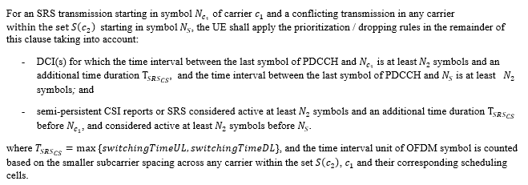
SRS Carrier switching
SRS Transmission starting at symbol 0
0
1
3
4
Up to the UE what to do for the whole hop
DCI
PUSCH

Slide 3
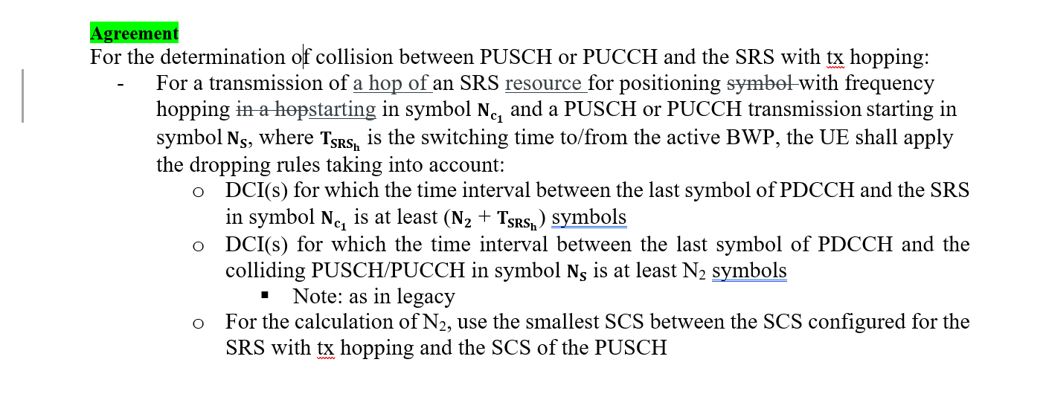
Suggested change to align timeline and UE behavior of SRS Tx hopping and SRS carrier switching

