Slide 1

3GPP Conference
Live WEA Test
Delegate Presentation
Dallas-Arlington
November 2025

Slide 2

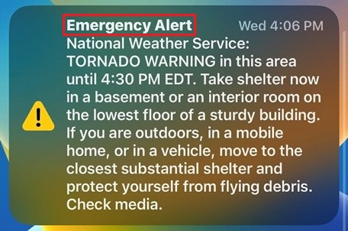



PURPOSE
Evaluate how international mobile devices respond to the US Public Warning System, Wireless Emergency Alert (PWS/WEA), in a controlled environment, generating critical insights into alert delivery performance across diverse technologies, networks, and device types.
This information will assist the planning efforts of Alerting Authorities expecting the presence of international devices (e.g., major tourist areas, US-hosted international events).

Slide 3
OBJECTIVES
Utilize the 3GPP delegates’ device expertise to ensure high-quality, reliable data collection, adding credibility and precision to the data beyond general public surveys.
1
Encourage voluntary delegate participation in the survey to collect all performance data across diverse technologies, networks, and device types.
2
Generate PWS/WEA delivery insights from the data collected and share this data with all Alerting Authorities.
3

Slide 4
Live Test Information
The City of Dallas Office of Emergency Management (OEM) is a DHS FEMA Integrated Public Alert and Warning System (IPAWS) designated Alerting Authority that will perform the live WEA test with the following information:
Date
Time
Alert Code
Test Alert Message
Alert Duration
Nov 20th, Thursday
2:30 CT
Imminent Threat
TEST. City of Dallas, Wireless Emergency Alert proficiency TEST. No action required.
Three (3) hours

Slide 5
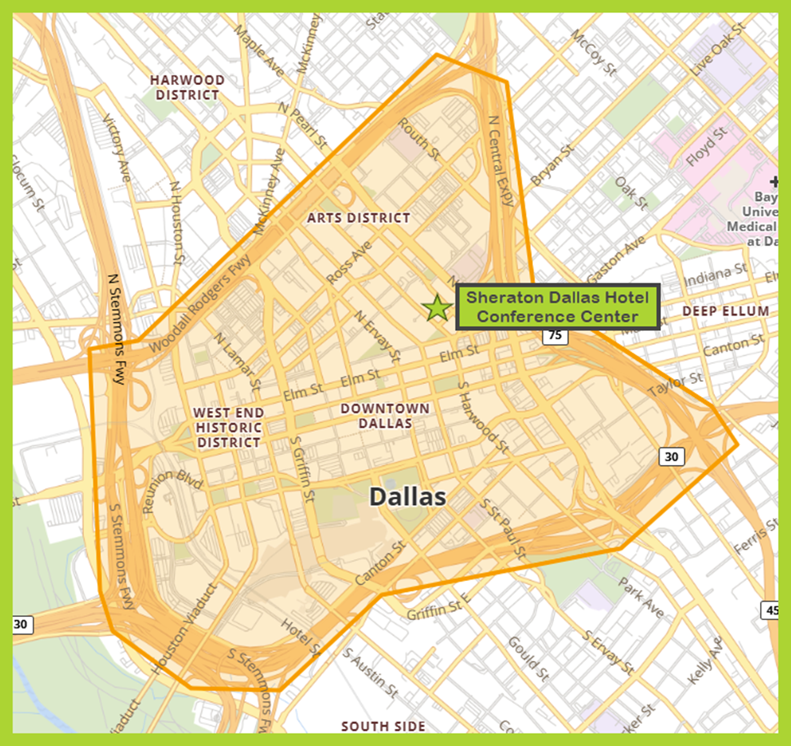
Defined Alert Test Area

Slide 6
What to Expect
Delegates will receive the live test alert on their mobile devices if they have opted in via their WEA user settings and are scanning the cellular broadcast.
The test alert message will INCLUDE the word "TEST," and does not require protective action.
The alert will produce a loud attention signal and vibration cadence in addition to displaying the alert text.
Complete the live test survey.
Delegates may receive real scenario emergency or other test alerts at any time during the week.
The test alert language that delegates can identify as the targeted test for survey is: TEST. City of Dallas, Wireless Emergency Alert proficiency TEST. No action required.
Notes:
Should we have them stay on their current OS version?

Slide 7
Before the Live Test
WG Chairs are asked to please remind the delegates a few minutes before the test to:
Check device user settings and enable emergency alerts to receive the scheduled live PWS/WEA test message.
Ensure that device has cellular connectivity (cellular only or dual connectivity with WiFi) and is not in WiFi only mode.
Notes:
Should we have them stay on their current OS version?

Slide 8
iOS Opt-in Instructions
1. Go to SETTINGS
2. Select NOTIFICATIONS
3. Scroll all the way down
4. Stop at GOVERNMENT ALERTS section
5. Select EMERGENCY ALERTS
6. Turn on: EMERGENCY ALERTS, others are optional
Note: Some iOS have a wider Alerts selection
Turn on: EXTREME THREATS and SEVERE THREATS

Slide 9
Android Opt-in Instructions
1. Go to SETTINGS
2. Select NOTIFICATIONS
4. Scroll down and select WIRELESS EMERGENCY ALERTS.
Note: Some Androids will have this item under ADVANCED SETTINGS.
5. Turn on: EXTREME THREATS and SEVERE THREATS, others are optional

Slide 10
Survey Data
Please note that ALL data is beneficial toward creating expectations for the Alerting Authorities and allowing them to plan accordingly for the safety of our international guests.
Examples for iOS and Android are given in the subsequent slides, but data for all OS providers, device models, and from all countries is relevant and greatly appreciated.
Survey responses are beneficial whether or not the alert is presented on your device, including all information fields available.
The data will be shared with the 3GPP membership for the benefit of all members.
Access to the survey will be provided during the Mega Meeting week before the test.

