Slide 1
Discussion on PC2 and PC1.5 CA_n41C with single UL carrier handling in RAN5
3GPP TSG-RAN5 Meeting #94-e R5-220269r1
Electronic Meeting, Feb 21 – Mar 4, 2022
CMCC, Huawei, Hisilicon

Slide 2
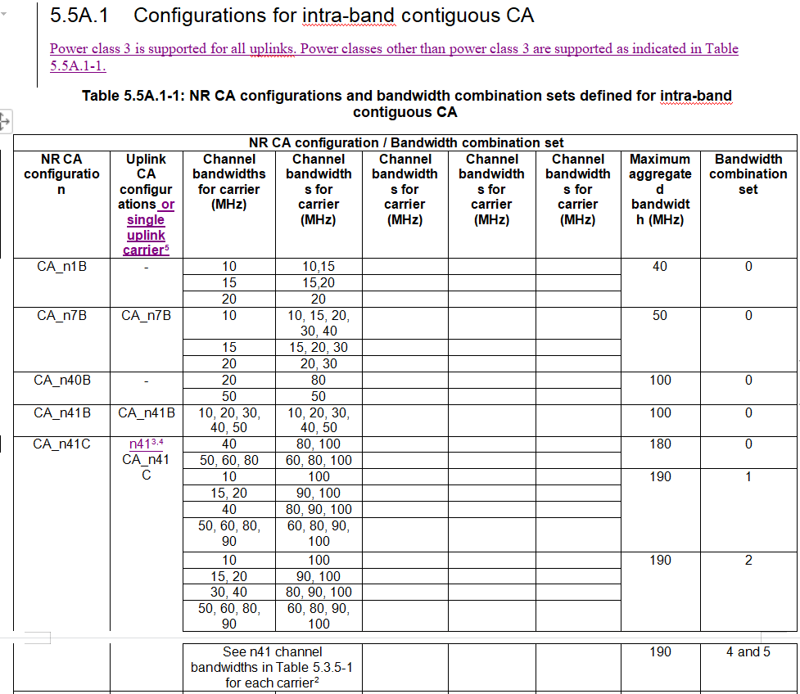
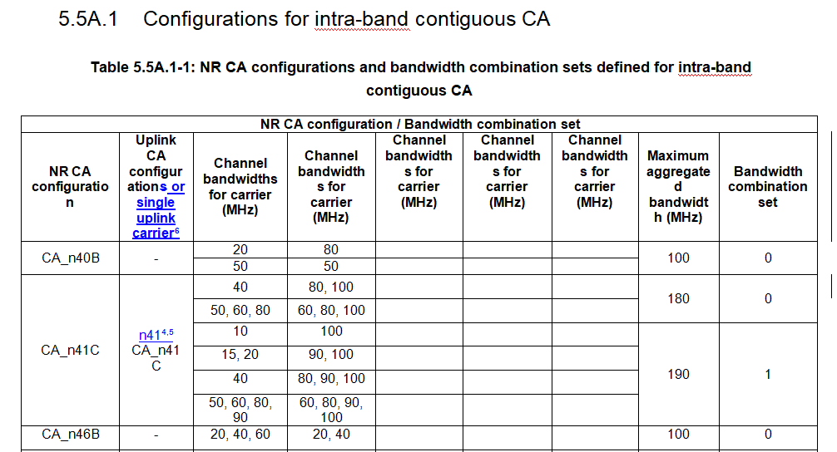
General sections in TS 38.521-1
Observation 1: There are new changes for Section 5.5A.1 of TS 38.101-1 agreed in R4-2118320 for PC2 and PC1.5 CA_n41C with single UL carrier.
TS 38.521-1
R4-2118320
Proposal 1: The corresponding changes are needed in Section 5.5A.1 in TS 38.521-1 for PC2 and PC1.5 CA_n41C with single UL carrier.

Slide 3
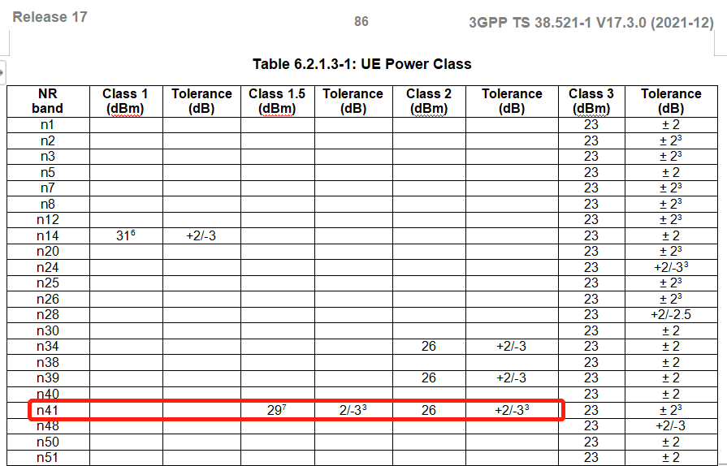
Tx test cases in TS 38.521-1
Observation 2: The MOP TC 6.2.1 has already covered PC2 and PC1.5 for single carrier n41.
Proposal 2: The Tx testing for CA configurations with single UL carrier shall be captured in single carrier TCs (e.g. 6.2.1) rather CA TCs (e.g. 6.2A.1). There is no need to change Tx TCs for PC2 and PC1.5 CA_n41C with single UL carrier since all the Tx test cases have already been completed for single carrier n41. PC1.5 CA_n41C shall not be regarded as completed before PC1.5 n41 to be confirmed as completed.

Slide 4
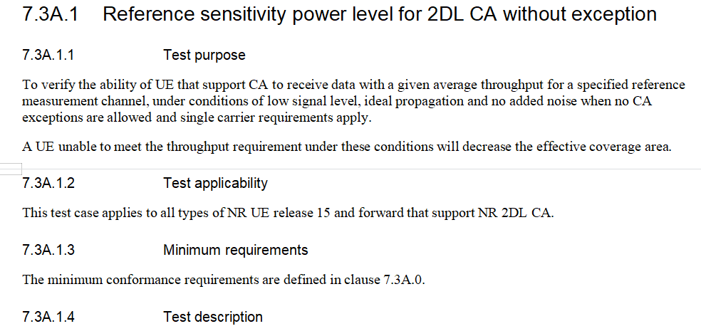
Rx test cases in TS 38.521-1
Observation 3: The UL configuration and requirements for CA_n41C with single UL carrier have already been well captured in TS 38.521-1. Comparing with PC3 CA_n41C, no additional Rx requirements are defined for PC2 or PC1.5 CA_n41C with single UL carrier in TS 38.101-1.
TS 38.521-1
Proposal 3: All the necessary Rx testing for CA_n41C with single UL carrier have already been well covered by the Rx TCs for the corresponding 2DL CA without exception TCs. There is no need to change Rx TCs for PC2 or PC1.5 CA_n41C with single UL carrier since all the intra-band contiguous 2DL CA for CA_n41C without UL CA configuration Rx test cases have already been completed in TS 38.521-1.

Slide 5
Thank you!

