Slide 1
WF on DC_(n)71AA single UL
3GPP TSG-RAN WG4 Meeting #99-e
Electronic Meeting, 19th -27th May 2021
R4-210xxxx
Skyworks, [MediaTek], […]

Slide 2
Background: 98-bis WF[1] agreements Non-Contiguous NR-CA / EN-DC
38.101-3 Rel-17.1.0
WF[1] and CR [2]
WF[1] and CRs [2,3] are a first step start towards simplification, but there’s room for further improvements,
For example, ΔR_{IBNC} test points for NC EN-DC could be further reduced to one pair of entries per band and per uplink (UL) aggressor channel bandwidth (CBW).

Slide 3
Background: Further Simplification Opportunity #1
38.101-3 Rel-17.1.0
Opportunity #1
38.101-3 Rel-17.1.0
Opportunity #1
Opportunity #1: using the example of DC_2A_n2A , reduction from 25 to 8 ΔR_{IBNC} test points, ie (x3 reduction) by keeping only 1 pair per UL- CBW
Opportunity #1: using the example of DC_(n)5AA: reduction from 7 pairs to 4 pairs of MSD test points, by keeping only 1 worst-case MSD test point / CBW
Observation: (from P1 [4])
For NC EN-DC/NR-CA:
It may not be necessary to capture all pairs of ΔR_{IBNC} test points. It is sufficient to specify only 1 pair of test points per UL CBW:
  Test Point 1) Specify the Wgap range for which the worst case (highest) ΔR_{IBNC} is reached. This corresponds to the collision of the lowest victim’s CBW which experiences the greatest overlap with the lowest IMD order;
  Test Point 2): Specify the Wgap range for which the best case (lowest) ΔR_{IBNC} is reached,
For contiguous EN-DC/NR-CA:
It is sufficient to specify only 1 test point per UL CBW, the one that leads to the worst-case (highest) MSD:
  For each distinct Uplink Aggressor CBW, only specify the worst-case (highest) MSD test point. This corresponds to the collision of the lowest victim’s CBW which experiences the greatest overlap with the lowest IMD order;

Slide 4
Background: Opp. #1 “Lowest victim CBW that leads to the highest MSD”
Test point B)
Test point C)
Test point A)
Test point B) E-UTRA 10MHz CBW should be the RAN4 candidate
Illustration of adopting the smallest victim’s CBW that leads to the highest MSD using the DC_(n)71AA BCS2 test point candidates
For BCS 2 DC_(n)71AA, there are three E-UTRA Rx CBW candidates: 5,10,15 MHz CBW.
E-UTRA 5MHz: Test Point A) does not lead to worst case MSD (refer to bar graph)
        Note: the “*” refers to the measured 3.3dB and 5.5dB MSD levels using “small RB allocations” as agreed in WF [1].
E-UTRA 15MHz: Test Point C) leads to the greatest overlap with the lowest IM order but this test point does not lead to the worst case/highest MSD,
E-UTRA 15MHz: Test Point B) corresponds to the minimum victim’s CBW that has the greatest overlap with the lowest IM order and leads to the worst-case/highest MSD. It is sufficient to only adopt this test point.

Slide 5
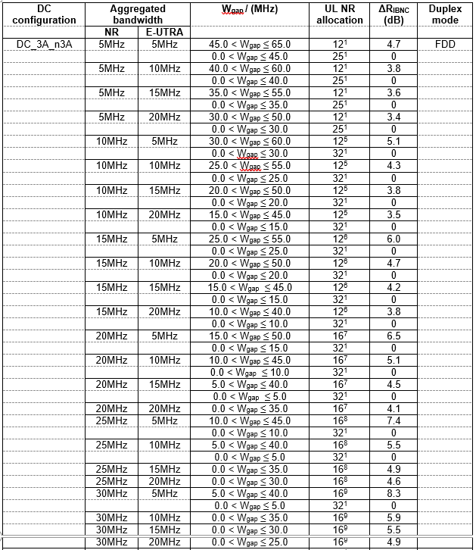
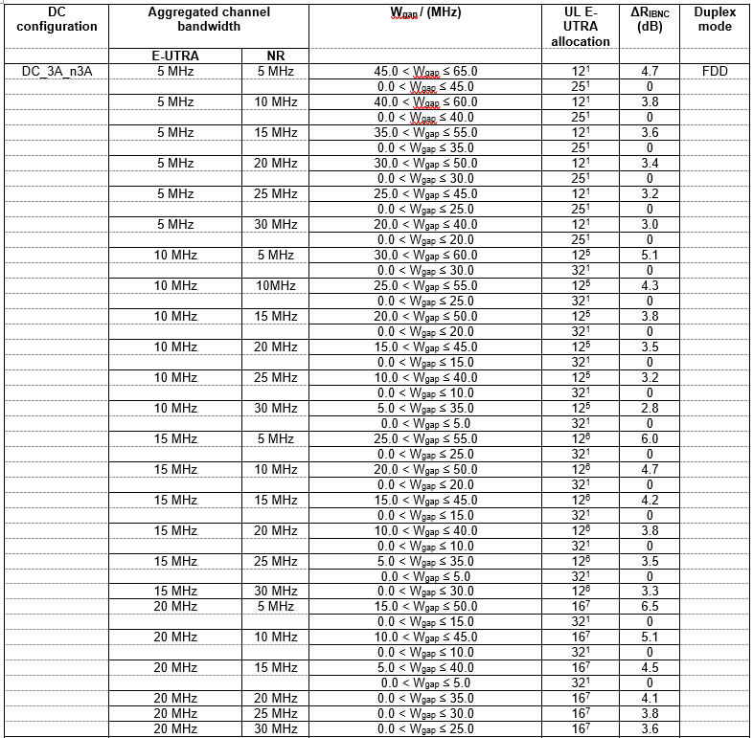
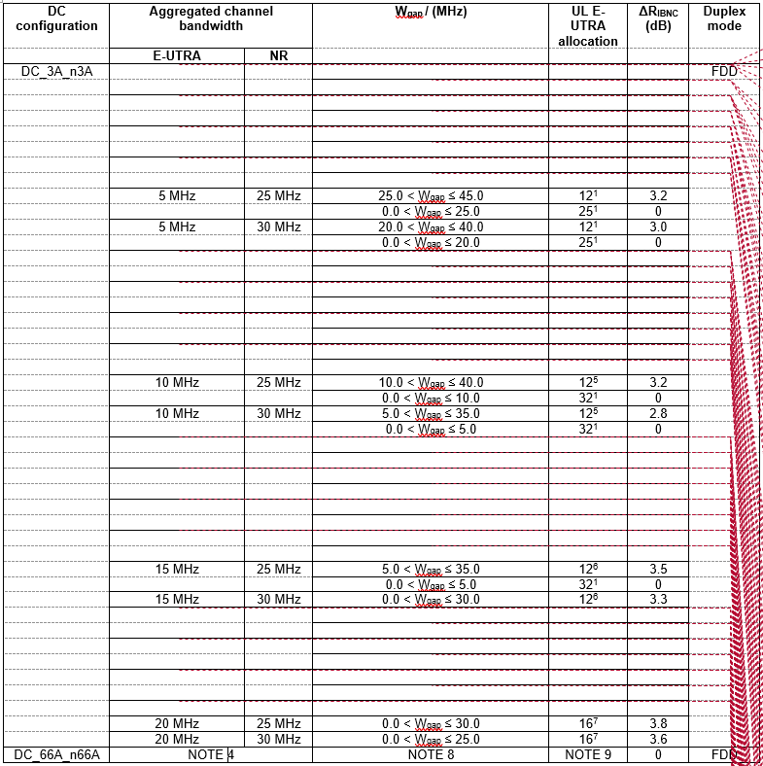
Background: Further Simplification Opportunity #2
Table 7.3B.3.2-2
Table 7.3B.3.2-1
Table 7.3B.3.2-1 optimization
Opportunity #2: using the example of DC_3A_n3A , reduction from 44 to 13 ΔR_{IBNC} test points,
by avoiding duplication of mirrored ΔR_{IBNC} test points.
Observation: (from P2 [4])
It may not be necessary to capture ΔR_{IBNC} for all mirror cases of swapping NR/LTE as Aggressor/Victim. Keeping ΔR_{IBNC} only for the LTE anchor point should be sufficient since there is little difference in REFSENS levels between LTE and NR for a given CBW.

Slide 6
WF on intra-band single UL MSD test points
Agreement:
For the selection of single UL REFSENS test points for future REL-17 combinations or for REL-17 new BCS requests of a legacy combination, adopt WF [1] agreement with the following clarification:
Intra-Band Non-Contiguous:
For each distinct Uplink Aggressor CBW, specify only 1 pair of test points:
  Test Point 1) Specify the Wgap range for which the worst case (highest) ΔR_{IBNC} is reached. This corresponds to the collision of the lowest victim’s CBW which experiences the greatest overlap with the lowest IMD order leading to the highest MSD/ ΔR_{IBNC} ;
  Test Point 2) Specify the Wgap range for which the best case (lowest) ΔR_{IBNC} is reached.
Handling of EN-DC mirror cases:
  2.1) For all mirror cases of table 7.3B.3.2-2 (NR=aggressor), do not specify the NR ΔR_{IBNC} test points in table 7.3B.3.2-1 (LTE = aggressor). A mirror case is a case where the CBW permutations are identical, the only change is a swap of Aggressor / Victim (LTE ←→NR).
  2.2) ΔR_{IBNC} test points may be specified in table 7.3B.3.2-1 (LTE = aggressor) only if the mirror ΔR_{IBNC} test points are not specified in table 7.3B.3.2-2 (NR=aggressor).
Intra-Band Contiguous:
For each distinct Uplink Aggressor CBW, only specify the worst-case (highest) MSD test point. This corresponds to the collision of the lowest victim’s CBW which experiences the greatest overlap with the lowest IMD order leading to highest MSD ;
Test points for which MSD is less than 0.5 dB do not need to be specified;
Only specify single UL REFSENS test points where NR is the aggressor and LTE is the victim.

Slide 7
WF on DC_(n)71AA Single UL MSD Test Points
Agreement:
Based on the proposed guidelines and the MSD proposals in [4,5,6], adopt the following single uplink MSD test points for DC_(n)71AA in CR [7].
EN-DC configuration / channel allocations /MSD
EN-DC configuration | E-UTRA/NR band | F_{C} (UL) (MHz) | UL Channel bandwidth (MHz) | UL allocation (LCRB) | F_{C} (DL) (MHz) | MSD (dB)
DC_(n)71AA^{X} | 71 | N/A | 10 | N/A | 642.0 | [21.3]
 | n71 | 673.0 | 20 | [5 (RB_{start} = 0)] | 627.0 | 0
DC_(n)71AA^{X} | 71 | N/A | 15 | N/A | 639.5 | [5.5]
 | n71 | 670.5 | 15 | [5 (RBstart = 0)] | 624.5 | 0
DC_(n)71AA^{XX} | 71 | 680.5 | 5 | N/A | 639.5 | [6.5]
 | n71 | 670.5 | 15¹ | [5 (RBstart = 2)] | 627.0 | 0
DC_(n)71AA^{XXX} | 71 | 680.5 | 5 | N/A | 634.5 | [6.0]
 | n71 | 670.5 | 15 | [5 (RBstart = 0) | 624.5 | 0
NOTE 1: In accordance to BCS1, the NR uplink bandwidth is specified as in this table, but the corresponding NR downlink bandwidth is 5 MHz larger. NOTE X: Applicable only to BCS 2. NOTE XX: Applicable only to BCS 1. NOTE XXX: Applicable to BCS 0,1,2. For BCS2, the E-UTRA uplink carrier frequency is N/A.

Slide 8
REFERENCES
[1] R4-2105338, WF on single UL intra-band ENDC REFSENS Exceptions, 3GPP TSG-RAN WG4 #98bis-e, Electronic Meeting, Apr. 12-Apr. 20, 2021, Skyworks Solutions Inc., T-Mobile USA, CHHTL.
[2] R4-2111520, CR for 38.101-1-h10: Corrections to intra-band non-contiguous CA REFSENS, 3GPP TSG-RAN WG4 #99-e, Electronic Meeting, 19th-27th May 2021, Skyworks Solutions Inc., T-Mobile USA
[3] R4-2111522, CR for 38.101-3-g70: Corrections to intra-band non-contiguous EN-DC REFSENS, 3GPP TSG-RAN WG4 #99-e, Electronic Meeting, 19th-27th May 2021, Skyworks Solutions Inc., T-Mobile USA
[4] R4-2107626, Intra-Band Single Uplink REFSENS Simplification, 3GPP TSG-RAN WG4 #99-e, Electronic Meeting, 19th-27th May 2021, Skyworks Solutions Inc.
[5] R4-2109630, MSD for DC_(n)71AA BCS2, 3GPP TSG-RAN WG4 #99-e, Electronic Meeting, 19th-27th May 2021, MediaTek Inc.
[6] R4-2107642, Qualcomm’s MSD proposal presented in Rd1Sum [99e][116] NR_Baskets_P1, 3GPP TSG-RAN WG4 #99-e, Electronic Meeting, 19th-27th May 2021, Skyworks Solutions Inc.
[7] R4-2111488, Draft CR for 38.101-3: Introduction of DC_(n)71AA_BCS2, 3GPP TSG-RAN WG4 #99-e, Electronic Meeting, 19th-27th May 2021, T-Mobile USA, Skyworks Solutions Inc.

Slide 9
Thanks!

