Slide 1
WF on architecture and device type for DC_8A-20A_n28A
3GPP TSG-RAN WG4#99-e R4-2107804
Electronic Meeting, May 19 – 27, 2021
Huawei, HiSilicon, [Qualcomm Incorporated]

Slide 2
Background
DC_8-20_n28 was requested in RANP#90 and start discussion in RAN4#98-e meeting. Based on the approved WF [1], companies are encouraged to provide analysis/discussion for the combination DC_8A-20A_n28A.
In this meeting, companies [2] [3] provided some analysis on this topic.
Some assumptions are made to further study the MSD level due to IMD3 of band 20 and n28 Tx.

Slide 3
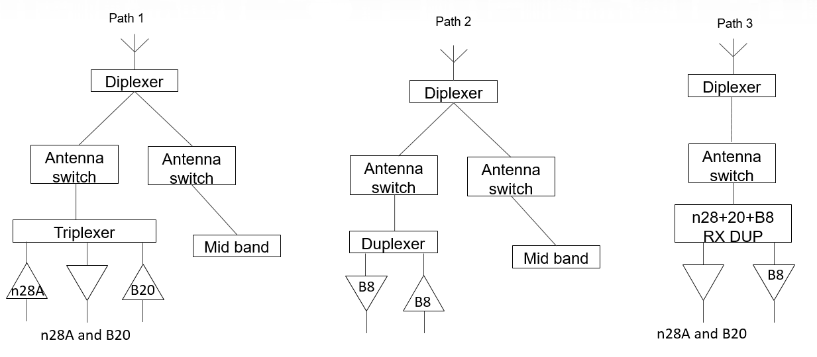
Assumptions on MSD calculation
FE architecture:
General linearity parameters:
Attenuation and isolation values:
Component | IP3(dBm)
Antenna switch | 68
Diplexer | 86
Triplexer/Duplexer | 74
PA forward mixing | 30
PA reverse mixing | 28
LNA | -6
Attenuation and Isolation Parameter | Value (dB) | Comment
Antenna ISO | 10
PA gain | 25
PCB isolation Paout-Pain | 60 | PCB isolation (PA forward mixing)
n28 Tx attenuation at Band 8 Rx | 27
B20 Tx attenuation at B8 RX | 43
The Triplexer isolation between band 20 Tx and band n28A Tx | 50

Slide 4
WF
Proposal 1: Companies are encouraged to provide MSD estimation in next meeting based on the assumptions.
Proposal 2: It’s FFS whether the 3 LB antenna approach is not feasible in a smartphone due to the correlation issue.

Slide 5
References
# | TDoc | Title | Source
1 | R4-2105337 | Way forward on analysis and framework of LB-LB-LB combinations | MediaTek, Vodafone
2 | R4-2111478 | LB_LB_MB MSD and LB_LB_LB Feasibility | Qualcomm Incorporated
3 | R4-2110243 | TP for TR 37.717-21-11: DC_8A-20A_n28A | Huawei, HiSilicon

