Slide 1
Way Forward on NR TxD & Power Class
3GPP TSG-RAN WG4 Meeting # #99-e
Electronic Meeting, 19th – 27th May., 2021
R4-210xxxx
vivo

Slide 2
LS related - Applicable power class for capability signaling in different releases
Proposals:
Option 1: Applies for all Power Classes for both Rel-15 and Rel-16
Option 2: Applies for only PC2 for Rel-15, and for all power classes in Rel-16;
Option 3: Others
Agreement(GTW): Option 1

Slide 3
LS related - Relation with full power capability
Clarify the relationship between transparent TxD capability signalling and full Tx power capability
Proposals
Option 1: No dependency
Option 2: A UE can support only one of the two capabilities
Agreements:
[Option 1]

Slide 4
LS related - Relation with SRS antenna switching
Clarify the relationship between transparent TxD capability signalling and SRS antenna switching
Proposals
Option 1: No dependency
Option 2: A UE that supports 1T2R antenna switching SRS should have at least one full power PA
In another word, transparent TxD UE capable UE with an architecture of 23+23 for PC2, are not allowed to be 1T2R antenna switching capable
Option 3: Others
Agreements:
[Option 1]

Slide 5
LS related - Relation with Non-codebook based transmission
Clarify the relationship between transparent TxD capability signalling and non-codebook based transmission
Proposals
Option 1: No dependency
Option 2: Non-codebook based UEs required full power PAs per Tx chain for power efficient operation.
Option 3: Others
Agreements:
FFS

Slide 6
LS related - Relation with other multi-antenna features
Clarify the relationship between transparent TxD capability signalling and other multi-antenna features
Proposals
Option 1: No dependency
Option 2: A TxD capable UE can indicate support for a feature only if UE behavior and performance for the feature is unaffected by TxD capability.
Option 3: Others
Agreements:
FFS

Slide 7
Remaining Issues - MPR
Proposals
Following offset range based on 1TX was proposed.
Agreements
Edge MPR for QPSK/16QAM (D1): [0.5~1.5]dB
Outer MPR for QPSK/16QAM (D2): [0.5~1.5]dB
Edge DFT-S MPR for 64QAM (D3): [0.5~1.5]dB
Outer/Inner DFT-S MPR for 64QAM (D4): [0.5~1.5]dB
CP-OFDM MPR for 64QAM (D5): [0.5~1.5]dB
Inner (other than High order) (D6): [0~0.5]dB
256QAM proposals marked in the table;
Pi/2 BPSK currently leave unchanged
Modulation |  | MPR (dB)
 |  | Edge RB allocations | Outer RB allocations | Inner RB allocations
DFT-s-OFDM | Pi/2 BPSK | ≤ 3.5 | ≤ 0.5 | 0
 | QPSK | ≤ 3.5+D1 | ≤ 1+D2 | 0+D6
 | 16 QAM | ≤ 3.5+D1 | ≤ 2+D2 | ≤ 1+D6
 | 64 QAM | ≤ 3.5+D3 | ≤ 2.5+D4
 | 256 QAM | ≤ 4.5 + [1]
CP-OFDM | QPSK | ≤ 3.5+D1 | ≤ 3+D2 | ≤ 1.5+D6
 | 16 QAM | ≤ 3.5+D1 | ≤ 3+D2 | ≤ 2+D6
 | 64 QAM | ≤ 3.5+D5
 | 256 QAM | ≤ 6.5 + [2]

Slide 8
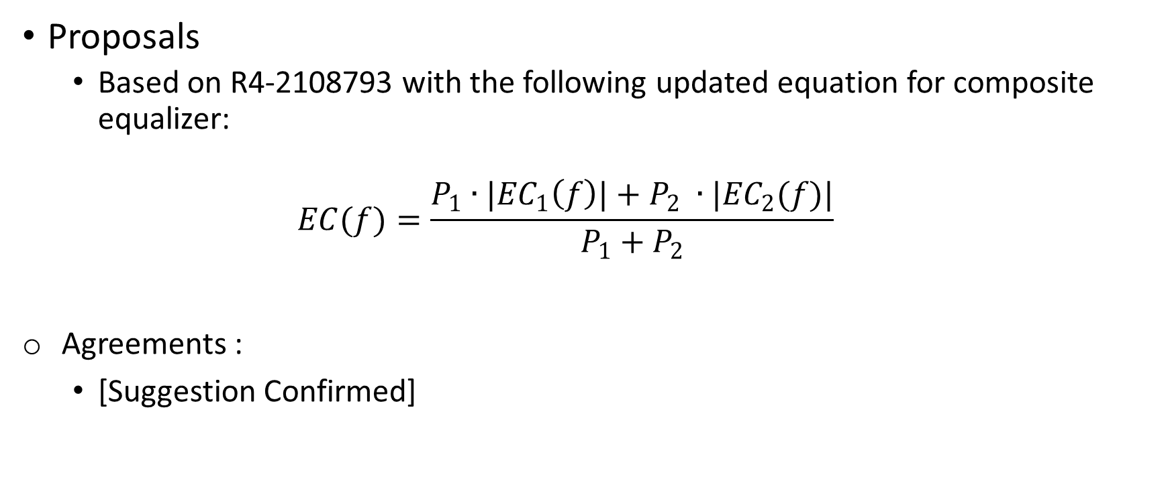
Remaining Issues - TxD EVM spectrum flatness
Proposals
Based on R4-2108793 with the following updated equation for composite equalizer:
$$EC(f)=\frac{P_{1}{ ∙|EC}_{1}\left(f\right)|+{P_{2} ∙|EC}_{2}(f)|}{P_{1}+P_{2}}$$
Agreements :
[Suggestion Confirmed]

Slide 9
Remaining Issues - Testing related issues
Proposals
Option 1: Leave these discussions to RAN5 and not pursue them before agreement of RAN4 CR.
Option 2: Continue discussion in RAN4.
Agreements :
[Option 1]

Slide 10
Remaining Issues - TxD antenna and channel models
Proposals
Option 1: No more discussion on these issues.
Option 2: Further discuss the relevant antenna and channel models and their impact as part of, and prior to, concluding on conformance testing methodologies and reference receivers for TxD with conducted measurements.
Agreements :
[Option 1]

Slide 11
Power class related- The Pcmax for NR for Rel-15 EN-DC
Proposals
Option 1: The Pcmax for NR is modified to use the lower possible power class to decide the lower bound of the configured power. (Huawei)
Option 2: The Pcmax for NR is modified according to the declared NR power capability for NSA so that the PHR becomes correct. (Ericsson)
Option 3:Do not consider further refinements of Pcmax for NR.
Option 4: Others
Agreements :
FFS

Slide 12
Power class related- Fallback to 1-port Tx for SA in Rel-15
Proposals
Option 1: Confirm ue-PowerClass should always be supported for 1-port transmission fall back mode for SA in Rel-15.
UE do not support TxD capability would equip a full power chain
For UE support TxD capability, when falls back to 1-port transmission, it is also reasonable to suppose it would use TxD to achieve ue-PowerClass in standalone mode
Option 2: Others
Agreements :
Option 1
[Rel-15 CR would be introduced to clarify the understanding]

