Slide 1
Way Forward on SRS antenna switching requirements for TxD
3GPP TSG-RAN WG4 Meeting # #99-e
Electronic Meeting, 19th – 27th May., 2021
R4-210xxxx
OPPO

Slide 2
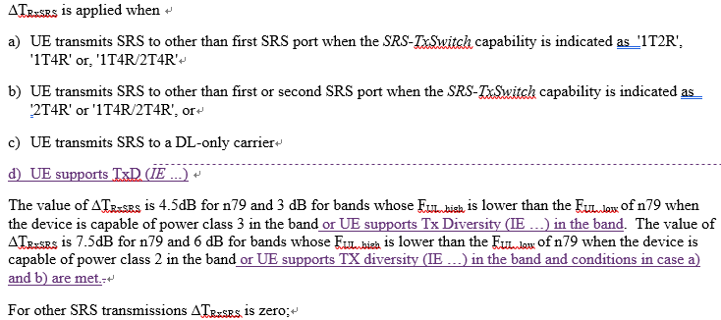
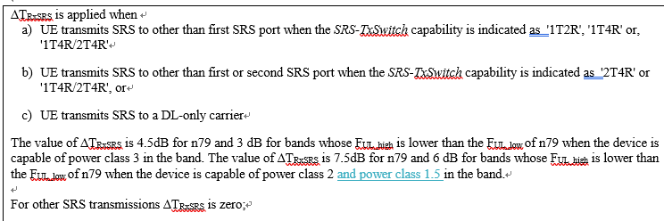
Background 1
SRS IL changes for TxD were proposed in #99e as below
Option 1:Based on [1], The ∆TRxSRS needs to be increased by 3 dB overall except for the PC2 case which accommodates the use of PA with 3 dB lower power for SRS antenna switching.
Option 2: Based on [2], Add PC1.5 to the ∆TRxSRS specification and no need to specify TxD
Option 1
Option 2

Slide 3
Agreements
In GTW, the following are agreed
SRS antenna switching which was targeted for DL CSI would not use UL antenna virtualization, i.e. UL TxD
SRS antenna switching functionality cannot be excluded for UE supporting TxD.
And Chair guidance:
Leave discussion on concrete value for loss and how to combine Option 1 and 2 to further email discussion.

Slide 4
WF
Introduce PC1.5 to spec
Explicit introduce TxD for SRS antenna switching IL, but how to harmonize with the current SRS conditions are FFS, and the exact IL values are FFS
At least following PC2 UE architectures with TxD but without antenna virtualization for all antenna ports are to be analyzed in #100e
23PA+23PA
26PA+23PA
26PA+26PA
At least 1T2R, 1T4R, 2T4R and 1T4R/2T4R srs-TxSwitch are to be analyzed in #100e
CRs are to be introduced in #100e

Slide 5
Reference
[1] R4-2108793, SRS switching and spectral flatness with TX diversity, QC
[2] R4-2110816, R16 SRS IL update, OPPO

