Slide 1
Way forward on PMI reporting requirements for Tx ports larger than 8 and up to 32
3GPP TSG-RAN4 Meeting #95e
Electronic Meeting May 25 – June 5 , 2020
Agenda item: 6.18.1.2
R4-2008846
Document for: Approval
Ericsson, Samsung

Slide 2
Timeline of previous agreements
#92
  WF: R4-1910017
#92bis
  WF: R4-1912834
  simulation assumptions: R4-1912811
#93
  WF: R4-1915858
  Simulation assumptions: R4-1915859
#94e
  WF: R4-2002393
  Simulation assumptions: R4-2002394
#94e-Bis
  WF: R4-2005549
  Simulation assumptions: R4-2005550

Slide 3
PMI tests SP Type I page 1
Wideband PMI requirements
  32Tx ports
Subband PMI requirements
  16Tx ports

Slide 4
16Tx ports SP Type I page 2
Duplex mode:
  FDD 10MHz/15kHz BW/SCS
  TDD 40MHz/30kHz BW/SCS
Number of Rx antennas:
  2Rx, and 4Rx
Subband size
  FDD: 8
  TDD: 16

Slide 5
NZP-CSI-RS configuration SP Type I page 3
16Tx ports:
  (k0, k1, k2, k3) = (2, 4, 6, 8), l0 = (5)
32Tx ports:
  (k0, k1, k2, k3) = (2, 4, 6, 8), (l0, l1) = (5, 12)

Slide 6
Result collection SP Type I page 4
Further alignment needed given current divergency amonst companies’ results.
Set gamma (gain) values based on simulation results in RAN4#96-e
Detailed simulation assumptions found in tdoc R4-2008847

Slide 7
Type II test setup
Test setup:
  Option 1: Only use SU-MIMO test setup, i.e., one tested UE
  Option 2: MU-MIMO based test setup, i.e., one tested UE + one co-scheduled UE (generated by TE)
  Proponents for each option need to provide technical analysis for how the test set-up can guarantee UE PMI reporting requirements with type II codebook for its intended purpose.
The baseline receiver assumption is UE without interference cancellation capability with/without co-scheduled UE.
Under the baseline UE receiver assumption, the PMI calculation processing will not change with and without co-scheduled UE.
TE vendors are encouraged to provide feedback for the test feasibility of MU-MIMO test setup.

Slide 8
Parameters for SU-MIMO Type II page 1
Codebook construction
  Option 1: 16Tx ports (N1,N2) = (4,2), (O1, O2) = (4,4)
  Option 2: 32Tx ports (N1,N2) = (4,4), (O1, O2) = (4,4)
L (numberOfBeams)
  2
N_{psk} (phaseAlphabetSize)
  Option 1: 4
  Option 2: 8
SubbandAmplitude
  Option 1: False
  Option 2: True
PMI-FormatIndicator
  Option 1: Wideband
  Option 2: Subband
Propagation condition
  TDLA30-5
MIMO correlation
  Option 1: XP High
  Option 2: XP Medium

Slide 9
Parameters for SU-MIMOType II page 2
MCS and rank
  As baseline, use MCS 20, rank 2
Beam steering model
  Option 1: Reusing beam steering approach with dual-cluster beams as specified in B.2.3B.4A of TS 36.101
  Option 2: Use Equation 1 as beam steering model for Type II codebook performance requirements.
Test metric
  TP ratio between following PMI and rand PMI

Slide 10
Parameters for MU-MIMO Type II page 1
Test metric
  Option 1: TP ratio between following PMI and random PMI
  Option 2: TP ratio between following Type II codebook and following SP Type I codebook
  Other options are not precluded
codebook construction
  Option 1: 32Tx ports (N1, N2) = (4,4), (O1, O2) = (4,4)
  Other options are not precluded
Npsk (phaseAlphabetSize)
  Option 1: 8
  Other options are not precluded

Slide 11
Parameters for MU-MIMO Type II page 2
subbandAmplitude
  Option 1: True
  Other options are not precluded
MIMO correlation
  Option 1: XP Medium
  Other options are not precluded

Slide 12
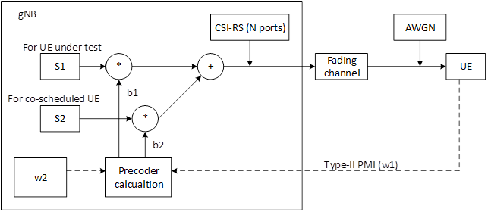
MU-MIMO based test setup design
FFS regarding co-scheduled UE channel assumptions (H(f,t,p))

Slide 13
For Information: Beam steering model for L number of beams

