Slide 1
Status and WF on BS antenna parameters in response to ITU-R LS
[138] FS_6425_10500_MHz
3GPP TSG-RAN WG4 Meeting #95-e R4-200xxxx
Electronic meeting, May 25 – June 5, 2020
Moderator(Ericsson)

Slide 2
Background
ITU-R WP5D sent LS to 3GPP asking for IMT parameters in a given list of frequency ranges.
RAN4 started discussion on those parameters in RAN4#94-e-bis.
Follow up discussion happened in the 1st round of RAN4#-95e.
Misalignments have been noticed on some definition, what objectives should be targeted when setting those parameters.
During the 1st round , it was proposed to focus on few key parameters and a compromise was proposed on values for array configuration and elements spacing. But this was not accepted, some companies preferred to stick with their initial proposals.
This WF is identifying the observed misalignments and list the different proposals for array configuration and elements spacing for further discussion and possible agreement.

Slide 3
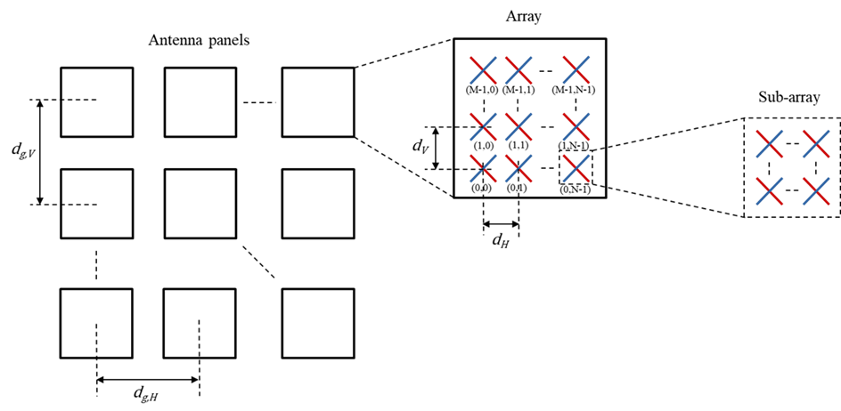
Sub-arrays - vertical element spacing
Antenna model should consider sub-arrays
Definition of vertical element spacing d_{v}:
  Without sub-array: distance between 2 elements.
  For 2x1 sub-array, elements are grouped 2 by 2, the vertical element spacing becomes twice the distance in between individual element, as shown below:

Slide 4
Objective
First priority when selecting the antenna parameters communicated to ITU-R :
  Option 1: Parameters optimized to give certain bemforming properties.
  Option 2: Parameters representative of deployed or future products.

Slide 5
General questions
Should we present different sets of parameters:
  For each scenario (e.g rural, ..)
      Yes / No
  For a subset of scenario (e.g. All macro based scenarios: macro urban and macro sub-urban)
      Yes / No
  For different frequency ranges (e.g. <2.5GHz, 2.5-5GHz, >6GHz)
      Yes / No
  For the same scenario, should we consider parameters for antenna with sub-arrays and antenna without sub-array?
      Yes / No

Slide 6
Antenna Array configuration < 5GHz
 |  |  |  | Rural | Macro Suburban | Macro Urban | Micro Urban | Indoor
Antenna array configuration | Initial proposals | Nokia |  | 8 x 8 | 8 x 8 | 8 x 8 | 8 x 8 | 8 x 8
 |  | CATT |  | 8 x 8 | 8 x 8 | 8 x 8 | 8 x 8
 |  | Ericsson |  | 4 x 8 | 4 x 8 | 8 x 8 | 8 x 8
 |  | ZTE |  |  | 4 x 8 | 8 x 8 | 8 x 8
 |  | Huawei | <2.5GHz | 4 x 8 | 4 x 8 | 4 x 8 | 4 x 8 | 4 x 8
 |  |  | >2.5GHz | 8 x 8 | 8 x 8 | 8 x 8 | 8 x 8 | 8 x 8
 | Proposed compromise |  |  | 4 x 8 | 4 x 8 | 8 x 8 | 8 x 8 | 8 x 8
 | Comments received |  |  | TBD | 8 x 8 | 8 x 8 | 8 x 8 | 8 x 8
 | Potential agreement |  |  | ? | ? | 8 x 8 | 8 x 8 | 8 x 8

Slide 7
Radiated elements separation <5GHz
 |  |  | Rural | Macro Suburban | Macro Urban | Micro Urban | Indoor
Radiating Element spacing | Initial proposals | Nokia | H: 0.5 λ V: 0.7 λ | H: 0.5 λ V: 0.7 λ | H: 0.5 λ V: 0.7 λ | H: 0.5 λ V: 0.7 λ | H: 0.5 λ V: 0.7 λ
 |  | CATT | H: 0.5 λ V: 0.9 λ | H: 0.5 λ V: 0.9 λ | H: 0.5 λ V: 0.9 λ | H: 0.5 λ V: 0.9 λ
 |  | Ericsson | H: 0.5 λ V: 1.4 λ | H: 0.5 λ V: 0.9 λ | H: 0.5 λ V: 0.5 λ | H: 0.5 λ V: 0.5 λ
 |  | ZTE |  | H: 0.5 λ V: 0.7 λ | H: 0.5 λ V: 0.7 λ | H: 0.5 λ V: 0.7 λ
 |  | Huawei | H: 0.5 λ V: 0.9 λ | H: 0.5 λ V: 0.9 λ | H: 0.5 λ V: 0.9 λ | H: 0.5 λ V: 0.9 λ | H: 0.5 λ V: 0.9 λ
 | Proposed compromise |  | H: 0.5 λ V: 0.9 λ | H: 0.5 λ V: 0.9 λ | H: 0.5 λ V: 0.7 λ | H: 0.5 λ V: 0.5 λ | H: 0.5 λ V: 0.5 λ
 | Comments received |  | TBD |  | H: 0.5 λ V: 0.9 λ
 | potential agreement |  | ? | H: 0.5 λ V: 0.9 λ | ? | H: 0.5 λ V: 0.5 λ | H: 0.5 λ V: 0.5 λ

Slide 8
Antenna Array configuration >6GHz
 |  |  | Macro Suburban | Macro Urban | Micro Urban | Indoor
Antenna array configuration | Initial proposals | Nokia | 8 x 8 | 8 x 8 | 8 x 8 | 8 x 8
 |  | CATT | 8 x 8 | 8 x 8 | 8 x 8
 |  | Ericsson | 4 x 8 | 8 x 8 | 8 x 8
 |  | ZTE | 8 x 12 8 x 16 | 8 x 12 8 x 16 | 8 x 12 8 x 16 | 8 x 12 8 x 16
 |  | Huawei | 8 x 16 | 8 x 16
 | Proposed compromise |  | 4 x 8 | 8 x 8 | 8 x 8 | 8 x 8
 | Comments received |  | 8 x 16 | 8 x 16 | 8 x 8 | 8 x 8
 | Potential agreement |  | ? | ? | 8 x 8 | 8 x 8

Slide 9
Radiated elements separation >6GHz
 |  |  | Macro Suburban | Macro Urban | Micro Urban | Indoor
Radiating Element spacing | Initial proposals | Nokia | H: 0.5 λ V: 0.7 λ | H: 0.5 λ V: 0.7 λ | H: 0.5 λ V: 0.7 λ | H: 0.5 λ V: 0.7 λ
 |  | CATT | H: 0.5 λ V: 0.7 λ | H: 0.5 λ V: 0.7 λ | H: 0.5 λ V: 0.7 λ
 |  | Ericsson | H: 0.5 λ V: 0.9 λ | H: 0.5 λ V: 0.5 λ | H: 0.5 λ V: 0.5 λ
 |  | ZTE | H: 0.5 λ V: 0.7 λ | H: 0.5 λ V: 0.7 λ | H: 0.5 λ V: 0.7 λ
 |  | Huawei | H: 0.5 λ V: 0.5 λ | H: 0.5 λ V: 0.5 λ
 | Proposed compromise |  | H: 0.5 λ V: 0.9 λ | H: 0.5 λ V: 0.7 λ | H: 0.5 λ V: 0.5 λ | H: 0.5 λ V: 0.5 λ
 | Comments received |  | H: 0.5 λ V: 0.5 λ | H: 0.5 λ V: 0.5 λ
 |  |  | H: 0.5 λ V: 0.5 λ | H: 0.5 λ V: 0.5 λ
 | potential agreement |  | ? | ? | H: 0.5 λ V: 0.5 λ | H: 0.5 λ V: 0.5 λ

Slide 10
Reference
[1] R4-2006110, Nokia, Nokia Shanghai Bell
[2] R4-2006111, Nokia, Nokia Shanghai Bell
[3] R4-2006288, CATT
[4] R4-2006289, CATT
[5] R4-2006924, Ericsson
[6] R4-2007309, Huawei
[7] R4-2007310, Huawei
[8] R4-2007393, ZTE
[9] R4-2008111, Ericsson
[10] R4-2008328, 1st Round Summary, Ericsson

