Slide 1
WF on 100MHz CBW in NR-U
3GPP TSG-RAN WG4 Meeting #95-e R4-200XXXX
e-Meeting, May.25th – June.5th 2020
Huawei, HiSilicon

Slide 2
Background and WF goal
It is agreed to support 100MHz CBW for NRU, but the system parameters and RF requirements are still not specified.
This WF clarify the following parameters for 100MHz CBW for NRU in band n46
  Channel raster
  Intra-carrier guard band
  SEM

Slide 3
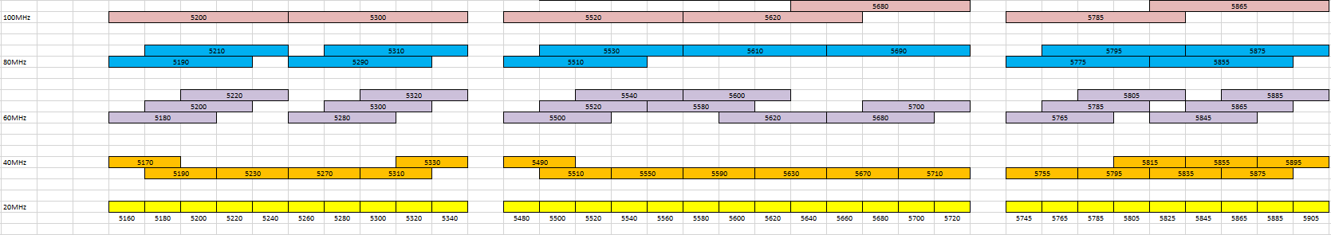
WF on channel raster for 100MHz CBW in NRU
Tabel.1 channel raster for 100MHz CBW in NRU
Channel raster for 100MHz CBW in NRU:
  Option 1: All values in Table.1 are supported
  Option 2: FFS on red values
  Note: At least for type A multi-channel access(multi-LBT sub-band access), there should be no restriction since there is no coexistence issue
Channel frequency (MHz) | N_{REF} | Reference frequency (MHz)
5200 | 746668 | 5200.02
5300 | 753332 | 5299.98
5520 | 768000 | 5520
5540 | 769332 | 5539.98
5560 | 770668 | 5560.02
5580 | 772000 | 5580
5620 | 774668 | 5620.02
5640 | 776000 | 5640
5660 | 777332 | 5659.98
5680 | 778668 | 5680.02
5785 | 785668 | 5785.02
5865 | 791000 | 5865

Slide 4
WF on intra-carrier guard band for 100MHz CBW in NRU
The intra-carrier guard band for 100MHz CBW in NRU should be
SCS | 100MHz Channels
30KHz | 50-6-50-5-50-6-50-6-50 | Max. 273
Alt-1: 60KHz | 24-4-24-3-24-4-24-4-24 | Max. 135
Alt-2: 60KHz | 23-5-23-5-23-5-23-5-23 | Max. 135

Slide 5
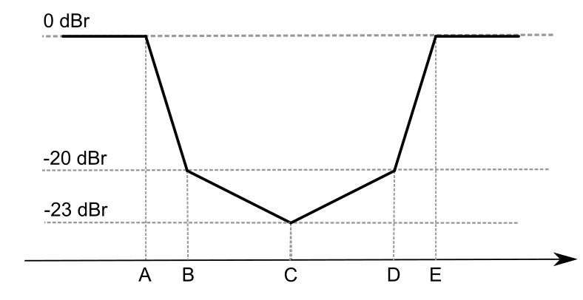
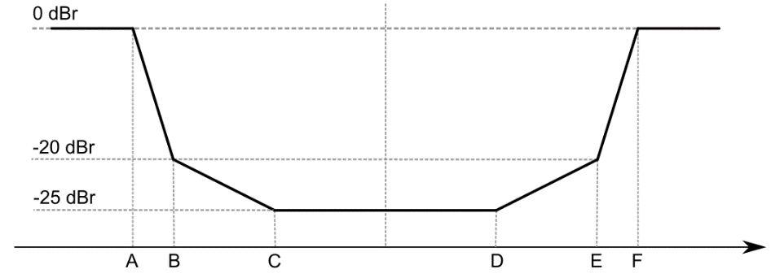
WF on SEM for 100MHz CBW in NRU
Use same SEM as which has already agreed in NRU
  SEM with single punctured sub-band
    emission mask of the puncture center is limited at -23dBr
  SEM with 2 punctured sub-bands
    The center floored at –25dBr
SEM with 3 punctured sub-bands
  Option 1:The center floored at –25dBr
  Option 2:The center floored at –28dBr
Figure 1. SEM for 100MHz CBW with single punctured sub-band
Figure 2. SEM for 100MHz CBW with 2 punctured sub-bands

Slide 6
References
[1] R4-2007417 Discussion on 100MHz for NR-U ZTE
[2] R4-2007323 Further considerations on 100MHz CBW in NR-U Huawei
[3] R4-2006141 NR-U Punctured Channel SEM for 100 MHz Bandwidth CableLabs
[4] R4-1915979 WF on NR-U spectral emission mask

