Slide 1
WF for 5G broadcast demod requirement
Qualcomm

Slide 2
PMCH demod test scoope
Define following test
0.37 kHz SCS new numerology for rooftop reception
MBSFN RS type 1 and type 2
Corresponding test applicability for UE with both Tx and Rx functionalities needs to be specified, e.g., UE can report supported MBSFN type 1 or 2, and UE is not mandated to support both
For receiver only type UEs, the applicability rule related to RS types is FFS
Applicability rule FFS
2.5 kHz SCS new numerology for mobility with 250km/h
Doppler spread corresponding to 250km/h is 162Hz

Slide 3
CAS demod test scope
Define PBCH in CAS detection test
Companies are encouraged to bring simulation results for PDCCH in CAS in next meeting for further discussion.

Slide 4
PMCH rooftop scenario propagation condition
Design propagation channel based on the following assumptions:
Majority of the received signal power by UE needs to be concentrated on echoes/channel taps within CP window.
EI windows length to be considered for long numerology test is 800us, by taking RS pattern and implementation margin into consideration.
Echoes/channel taps outside EI window are week and should have negligible impact on system performance.
Use the following propagation condition (in table below) as starting point, necessary adjustment can be made by appending echo/tap and adjustment of echo/tap location and power based on the agreed assumptions and modulation order/code rate

Slide 5
Propagation condition table for rooftop scenario
Delay (us) | 0 | 130 | 220 | 240 | 400 | 520 | 650 | 800
Relative power (dB) | -11 | -10 | -4.5 | -3.5 | 0 | -13 | -20 | -25

Slide 6
PMCH mobility scenario propagation condition
Use the following channel as starting point
Extended Delay Spread
Maximum Doppler frequency [x]Hz
Relative Delay [ns] | Relative Mean Power [dB]
-310 | -3.6
-280 | -1.5
-160 | -1.4
0 | 0
60 | -0.6
780 | -7.0
49650 | -10
49680 | -11.5
49800 | -11.4
49960 | -13.6
50020 | -10.6
50740 | -17.0
109650 | -20
109680 | -21.5
109800 | -21.4
109960 | -23.6
110020 | -20.6
110740 | -27.0

Slide 7
Propagation condition for CAS
Rooftop scenario: no mobility, AWGN is considered in this scenario
Mobility scenario: EVA with 250km/h speed is considered in this scenario

Slide 8
Simulation assumptions for PMCH rooftop scenario
Rooftop scenario agreed assumption is captured in the following table
MCS options
For RS type Td=4 and Td=2: MCS 18,21,22,24
Other options are not precluded if UE can’t achieve 1% BLER PMCH with necessary implementation margin with current options
Test number | Cell | Bandwidth(MHz) | Modulation order | Propagation condition | Antenna configuration | Test metric | MBSFN RS type | Number of MBSFN subframes per 40ms
1 | Dedicated | 10 | TBD | TBD | 1x1 | 1% PMCH BLER | 1 | 13
2 | Dedicated | 10 | TBD | TBD | 1x1 | 1% PMCH BLER | 2 | 13

Slide 9
Simulation assumptions for PMCH mobility scenario
Mobility scenario agreed assumption is captured in the following table
MCS options
Use MCS 12 as a starting point, but other options are not precluded if UE can’t achieve 1% BLER PMCH with necessary implementation margin with MCS 12.
Test number | Cell | Bandwidth(MHz) | Modulation order | Propagation condition | Antenna configuration | Test metric | Number of MBSFN subframes per 40 ms
1 | Dedicated | 10 | TBD | TBD | 1x2 low | 1% PMCH BLER | 39

Slide 10
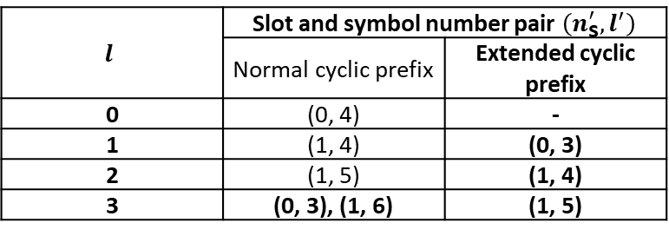
Simulation assumptions for CAS scenario
CAS PBCH scenario agreed assumption is captured in the following tables
Test number | PBCH repetition pattern | PBCH Bandwidth | Transmission bandwidth | Reference channel | Propagation condition | Antenna configuration | Test metric
1 | Table 6.6.4.1-1 in TS 36.211 | 1.4MHz | 10MHz | Table 2.2.3-2 | [AWGN] | 1x1 low | 1% Pm-bch
2 | Table 6.6.4.1-1 in TS 36.211 | 1.4MHz | 10MHz | Table 2.2.3-2 | [EVA162Hz] | 1x2 low | 1% Pm-bch
$$l$$ | Slot and symbol number pair $\left(n_{\text{s}}^{′},l^{′}\right)$
 | Normal cyclic prefix | Extended cyclic prefix
0 | (0, 4) | -
1 | (1, 4) | (0, 3)
2 | (1, 5) | (1, 4)
3 | (0, 3), (1, 6) | (1, 5)
Parameter | Value
Number of transmitter antennas | 1
Channel bandwidth | 1.4MHz
Modulation | QPSK
Target coding rate | 40/4416
Payload (without CRC) | 24

