Slide 1
3GPP TSG-RAN WG4 Meeting #94-e Electronic Meeting, 24 Feb.- 6 Mar.,2020
draft R4-2002452
WF on IAB EMC core requirements
ZTE, …

Slide 2
Background
Based on [1] current EMC emission requirement is discussed in three parts:
Radiated emssion
conducted emission
harmonic and flicker
For radiated emission and harmonic and flicker, some agreements has been captured in slide 3 while for conducted emission the issue is captured in slide 4.
Based on [2] current EMC immunity requirement is dicussed in two parts:
Radiated immunity
Other immunity
So far no agreement on immunity requirement can achive, the issue is captured in slide 4.

Slide 3
Agreements
We will not define 2 sets of EMC requirement for DU and MT, but to define requirements per each enclosure and each port.
For IAB EMC radiated emission requirement,
1, DU and MT in different enclosure:
Radiated emission requirement for IAB with different enclosure, the requirements are the same and they are applied per enclosure.
2, DU and MT in one enclosure:
For TDM IAB-node with only one enclosure, reuse current radiated emission requirement of BS in TS 38.113.
For FDM and SDM IAB-node with only one enclosure, radiated emission should be tested in 3 cases based on declaration.
Further analysis is needed to avoid redundancy
3, Similar principle of BS EMC spec for the type 1-O and 2-O BS will be applied to the type 1-O and 2-O TDM IAB-node for radiated emission requirement.
-- the OTA radiated spurious emission definiton for IAB is still under discussion in RF session.
Reuse base station requirement for harmonic current emission and voltage fluctuation and flicker to an IAB-node.

Slide 4
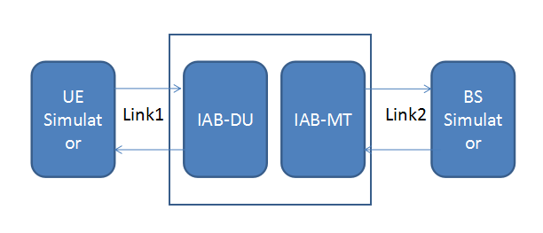
Issues
Conducted Emission requirement:
Whether to have different requirements for in-door and out-door use:
Option 1: Define different requirement based on the use environment, the use case can be declared
Opiton 2: Define only one set of requiremnt based on BS regulatory requiremnt
Ohter options not precluded
Radiated Immunity requirement
Testability issue as one link or two links
Option 1: Test one link each time. This is easy to do so but not the real case of IAB.
Option 2: Test both links. Need to consider different requirements for BS and UE and corresponding links.
Other options not precluded
Other immunity requirement except for radiated immunity requirement
How to define the test level
Option 1: Based on regulatory requirement of BS
Option 2: Define different test level in case of different enclosure for DU and MT based on use environment
Other options not precluded

Slide 5
Wayforward
To capture agreeable contents to the IAB TR 38.xxx
To provide further analysis to the issues listed in slide 4.

Slide 6
Reference
[1] R4-2001253 further discussion on IAB EMC emission requirement, ZTE
[2] R4-2001254 further discussion on IAB EMC immunity requirement, ZTE

